Slide 1
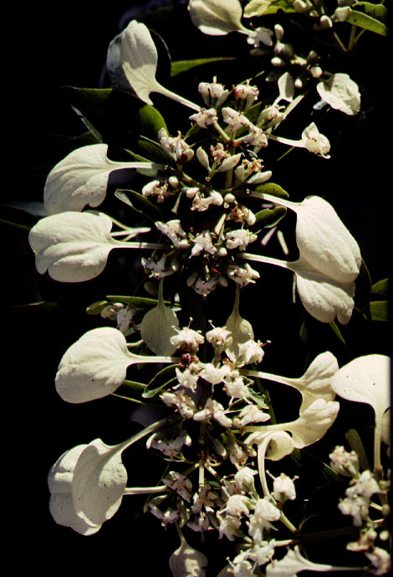
RU BIACEAE

Slide 2
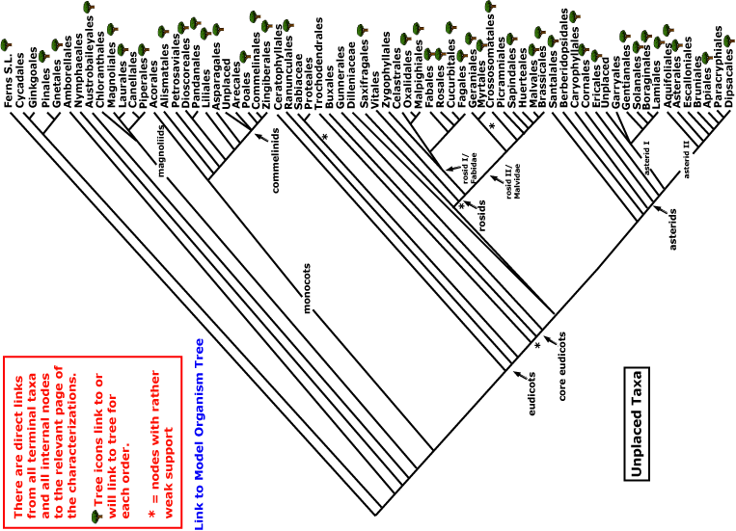
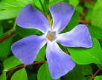
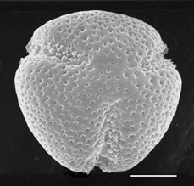
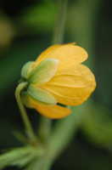
RUBIACEAE
magnoliids
rosids
Current Angiosperm Phylogeny Group Tree for Flowering Plants
2016
monocots
asterids
core eudicots
eudicots

Slide 3
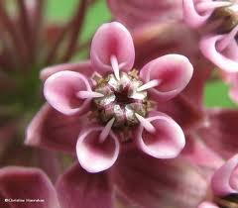
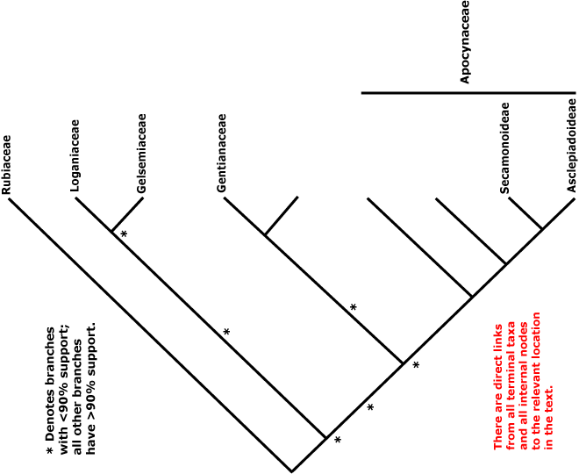
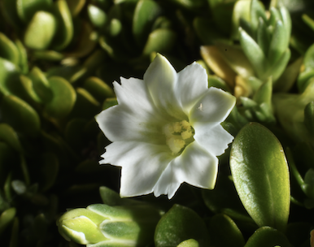
GENTIANALES
Asterids with
opposite leaves
radial symmetry
contorted petals

Slide 4
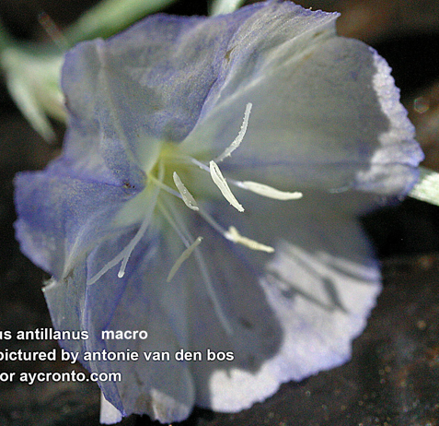
general Asterid Characters
fused corolla
stamens adnate to corolla
stamens equal to or fewer
than perianth lobes
gynoecium 2-carpellate
ALL GOOD!! — Core Asterid

Slide 5
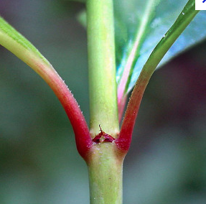
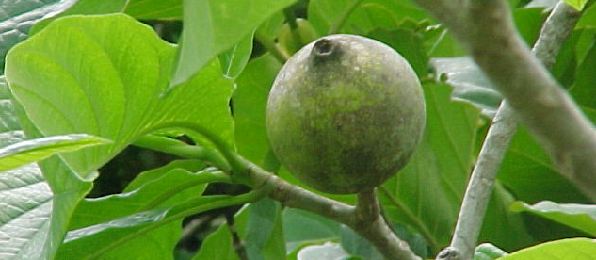
KEY CHARACTERS FOR THE RUBIACEAE
opposite leaves (order)
stipules connate in pairs
colleters (order)
inferior ovary

Slide 6
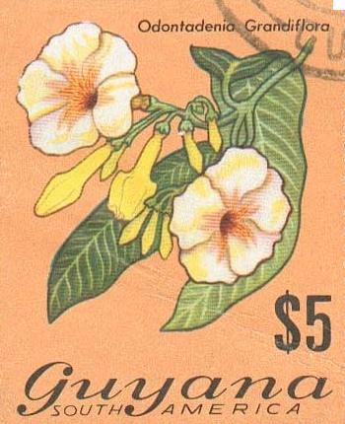
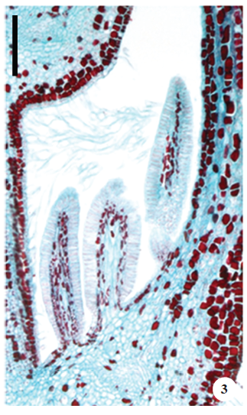
Colleter: an often obviously mucilaginous secretory hair, not vascularised, commonly found in groups or tufts near or at the adaxial base of the leaf and on the calyx (APG)
Glandular trichomes with a multicellular stalk and a usually multicellular head are sometimes classified as colletters, a term derived from the Greek colla, glue…Esau 1953
Colleters in Odontadenia (Apocynaceae)
Martins 2012
Notes:
Martins, F.M., 2012. Leaf and calycine colleters in Odontadenia lutea (Apocynaceae-Apocynoideae-Odontadenieae): their structure and histochemistry. Brazilian Journal of Botany, 35(1), pp.59-69.

Slide 7
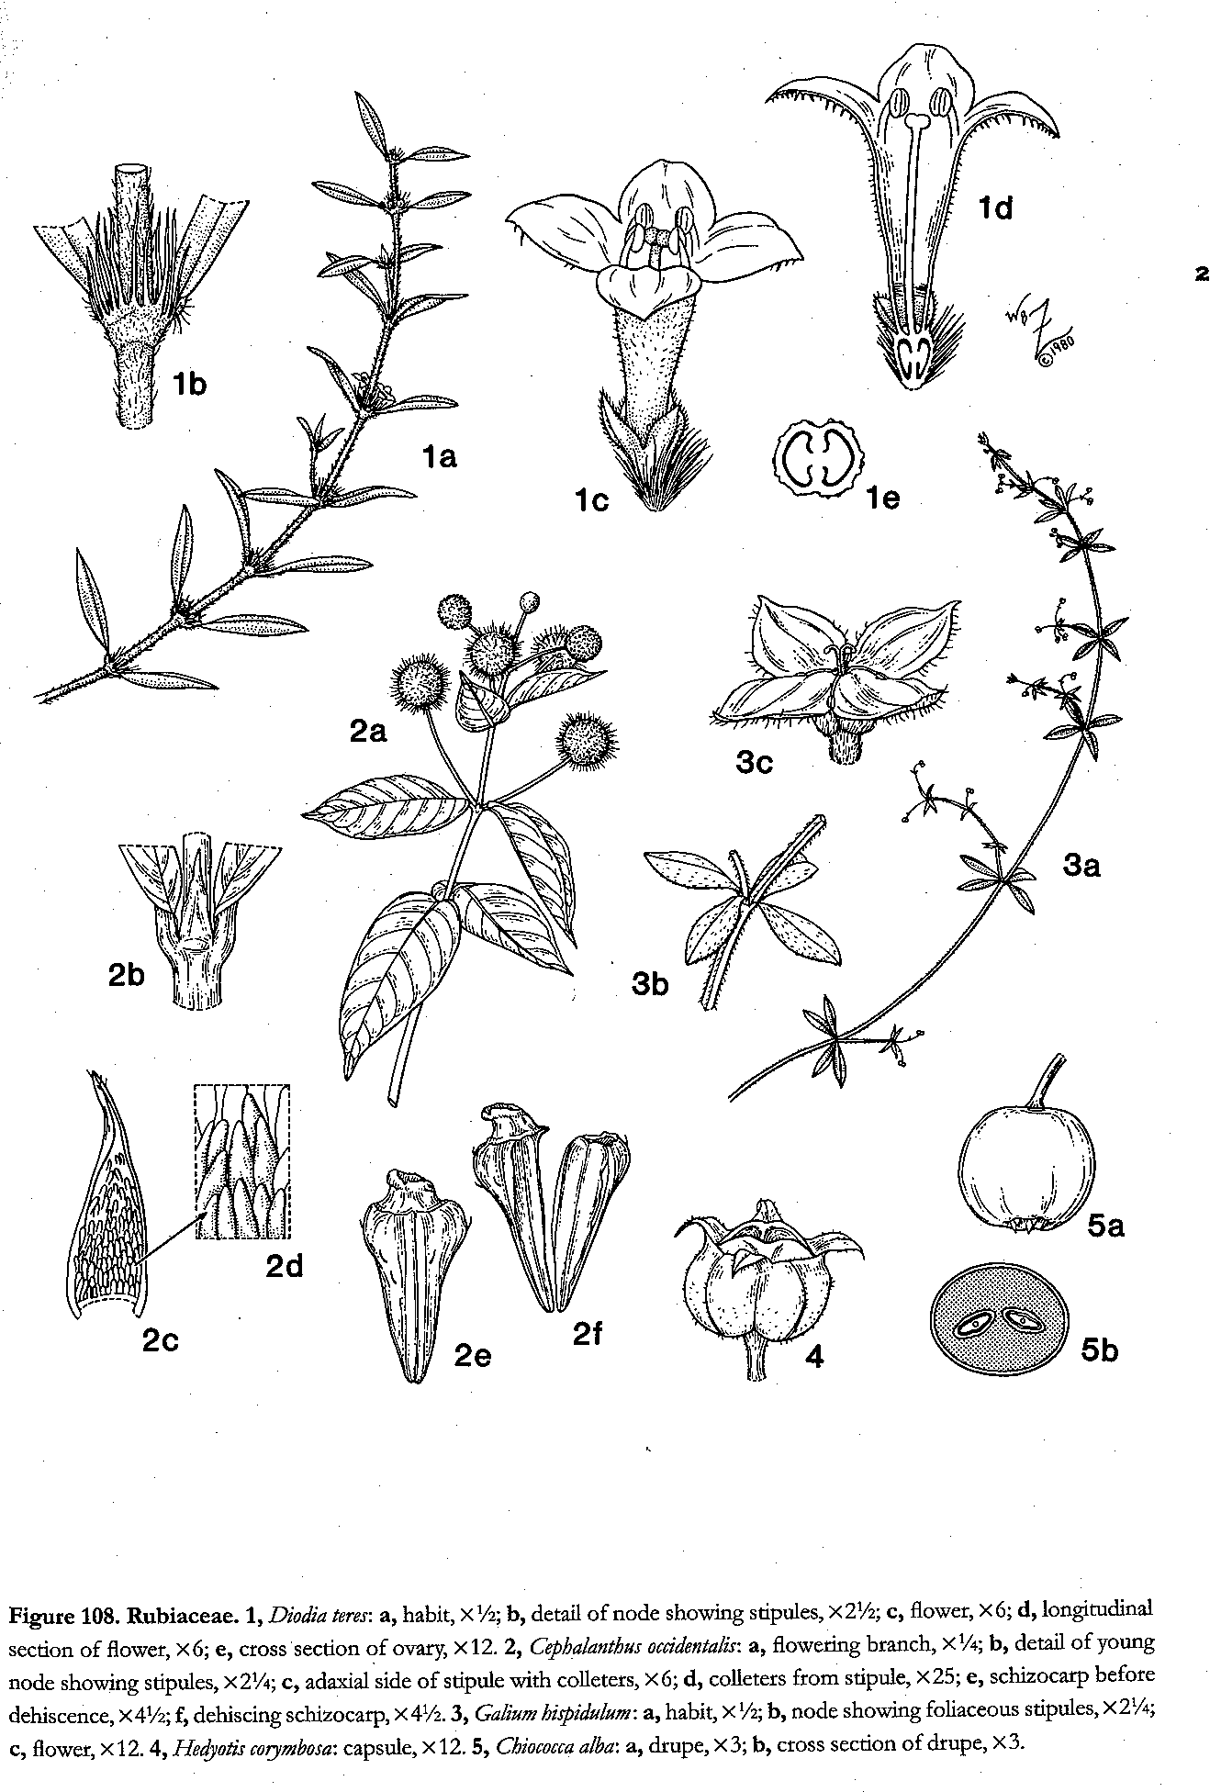

Slide 9
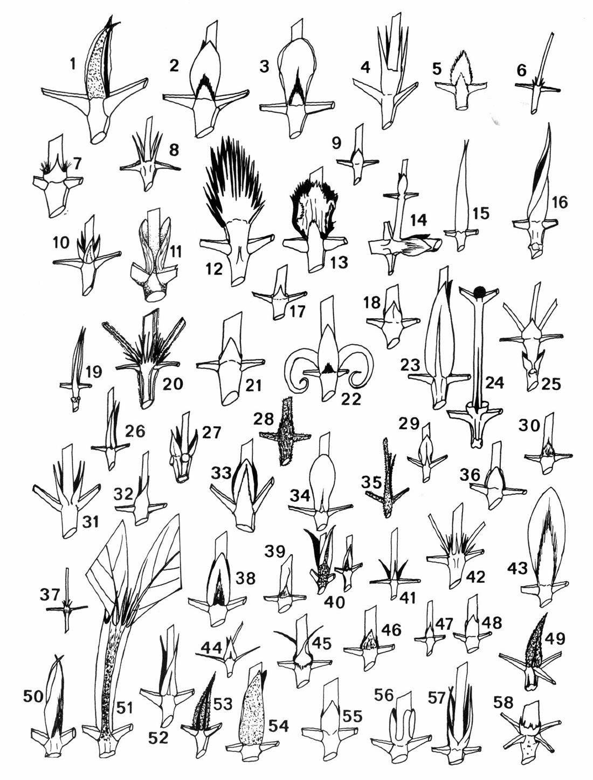
Gentry’s stipules of the
Rubiaceae

Slide 10
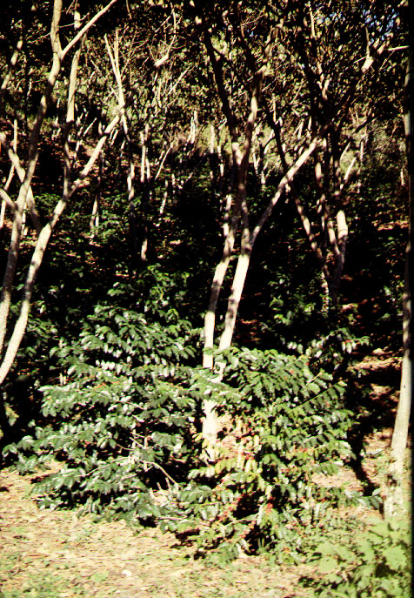
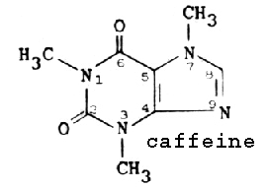
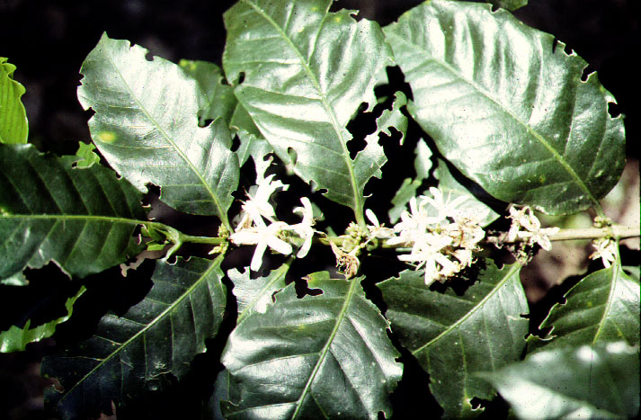
Coffea - shadegrown selfer

Slide 11
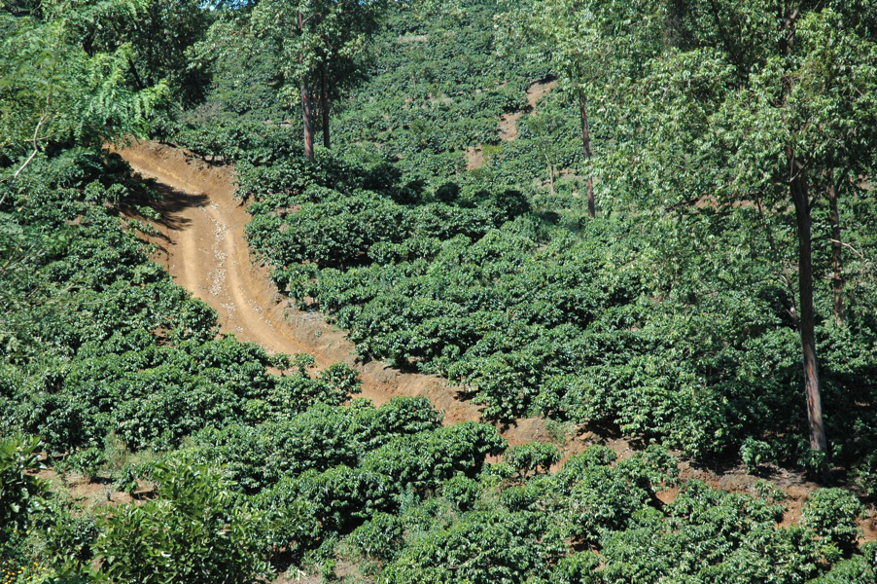

Slide 12
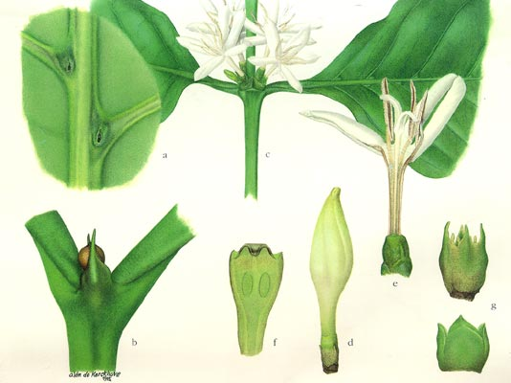
coffee close-up

Slide 13
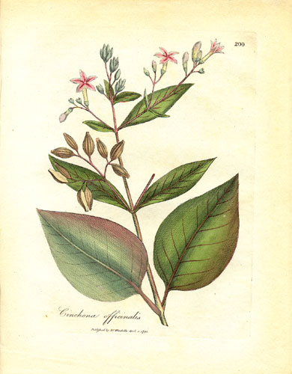
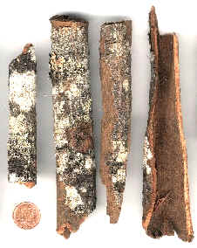
Cinchona officinalis - quinine

Slide 14
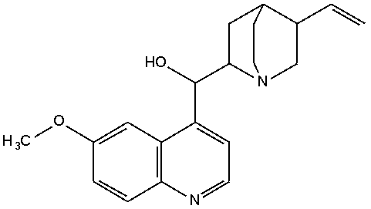
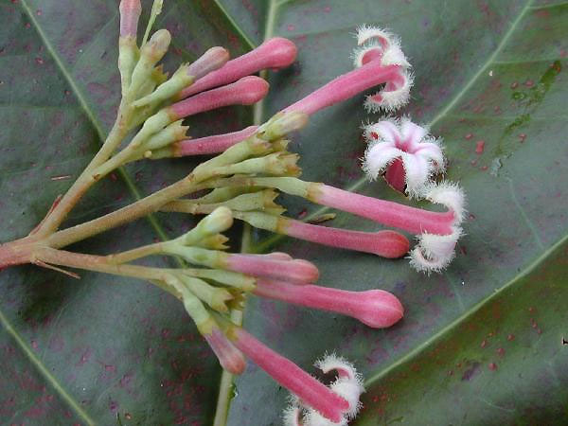
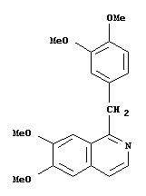
quinine, a quinoline alkaloid..
from Cinchona
contrast papaverine, an isoquinoline alkaloid…
Notes:
Quinine is a powerful antipyretic, i.e., it effectively lowers body temperature. During malaria, the victim goes through 3- or 4-day bouts of extreme chills and then burning fever that can reach 107 degrees F, brought about by the episodes of reproduction in and synchronous rupture of red blood cells by the malaria pathogens. Most human fatalities result when body temperature is too extreme, and quinine thereby permits the victim to pass through critical stages of lethal body temperature. The alkaloids also help to slow down the infection and reproduction of the protozoan.
http://www.botgard.ucla.edu/html/botanytextbooks/economicbotany/Cinchona/
Wikipedia: The name of the genus is due to Linnaeus, who named the tree in 1742 after a Countess of Chinchon, the wife of a viceroy of Peru, who, in 1638, was introduced by natives to the medicinal properties of the bark. Stories of the medicinal properties of this bark, however, are perhaps noted in journals as far back as the 1560s-1570s (see the Ortiz link below).

Slide 15
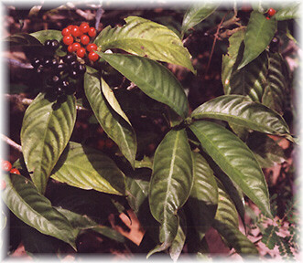
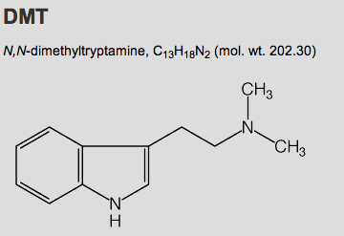
Psychotria viridis: Chacruna: source of DMT in ayahuasca brews.

Slide 16
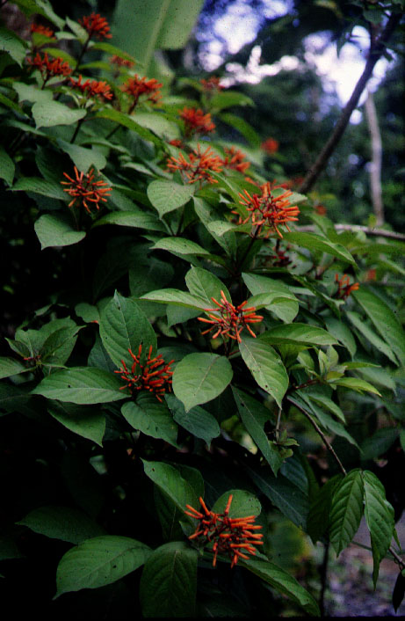
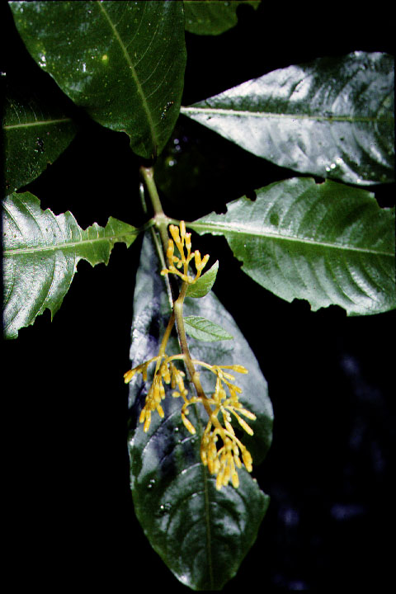
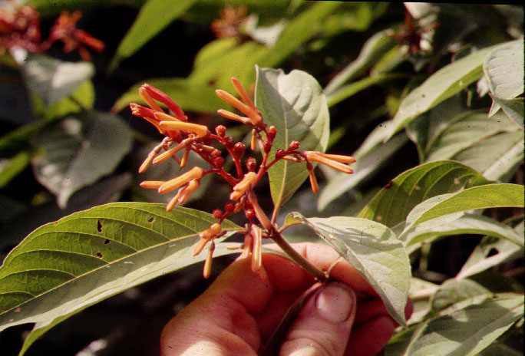
Hamelia:
colored peduncles

Slide 17
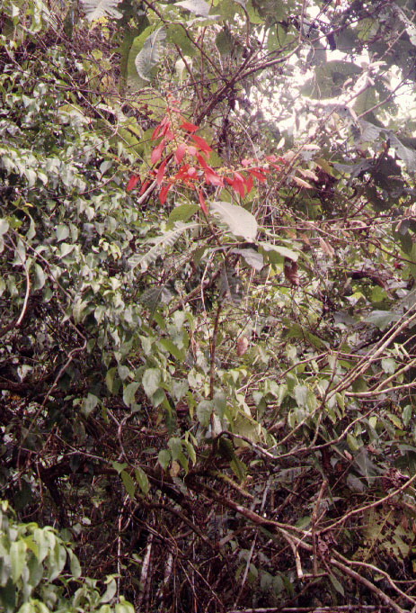
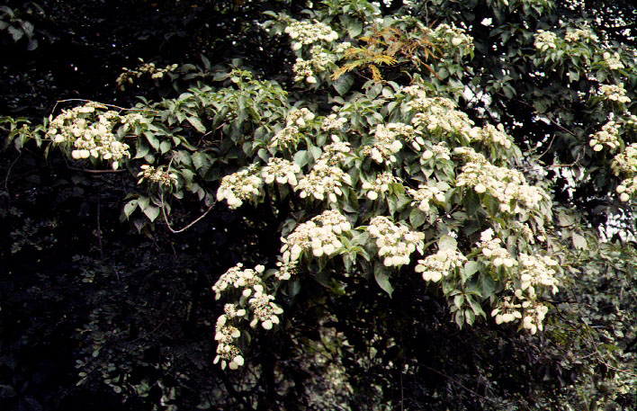
showy bracts:
Warcsewiczia
Calycophyllum

Slide 18
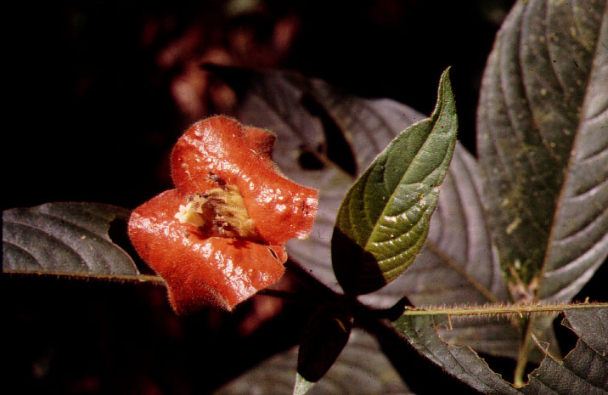
hotlips…Psychotria

Slide 19
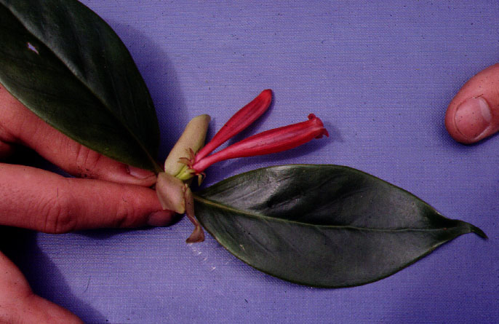
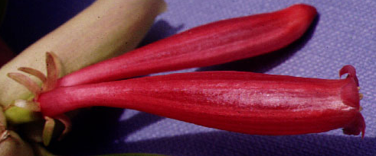
Hillia - zygomorphic epiphyte

Slide 20
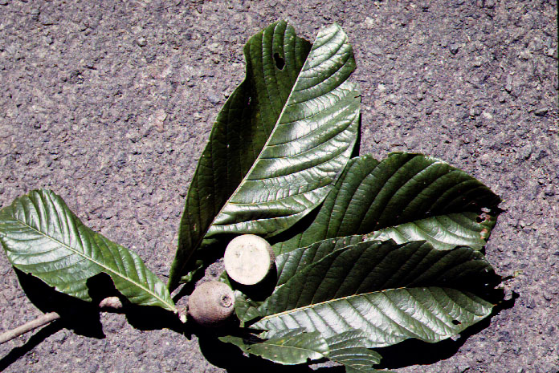
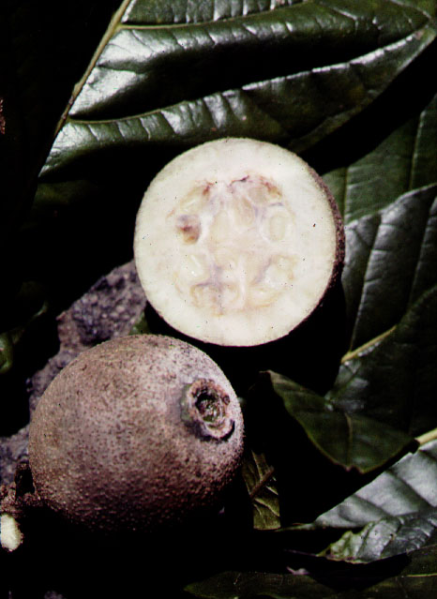
Genipa - big fruits with flat seeds

Slide 21
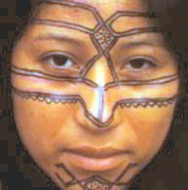
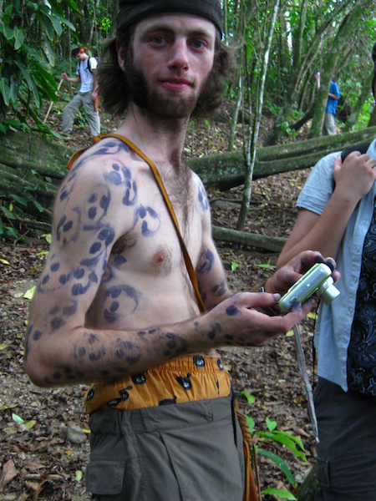
Genipa – body dye

Slide 22
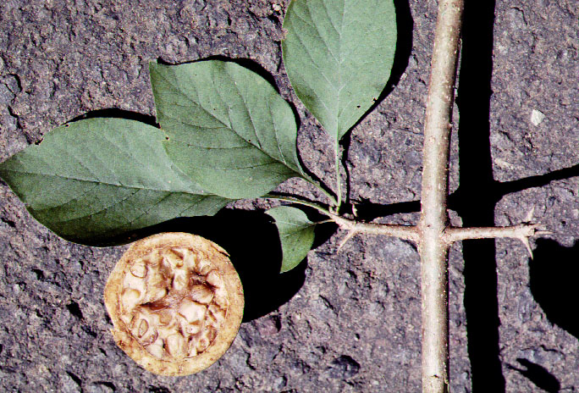
Randia - spines, many seeds

Slide 23
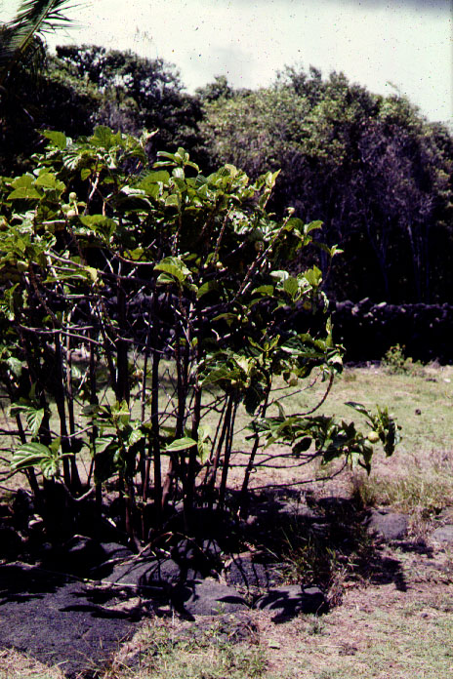
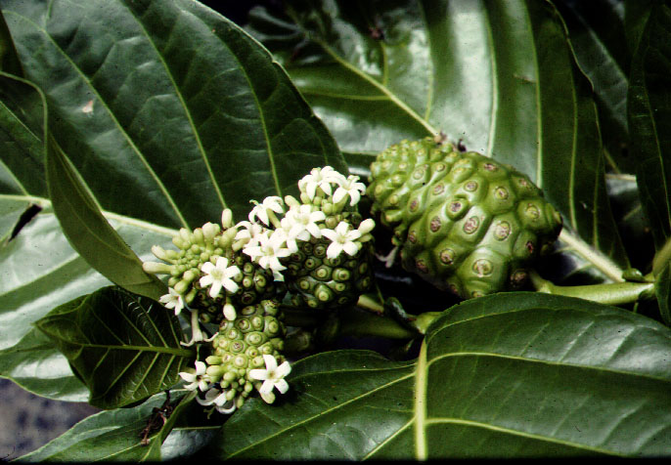
Morinda
…early Hawaiian
arrival
Notes:
the fruits were eaten as a famine food, and in some Pacific islands, are even a staple food of choice (Raratonga, Samoa, Fiji), where they were eaten raw or cooked. Elsewhere, the fruit is eaten raw with salt (Indochina, Australian Aborigines); or cooked as a curry. The fruits may also be fed to pig livestock. The young leaves can also be eaten as a vegetable and contain protein (4-6%). Seeds may be roasted and eaten.Other uses: The bark of the Great Morinda produces a reddish purple and brown dye used in making batik and the tree was widely grown for this purpose in Java. In Hawaii, a yellowish dye was also extracted from the roots and also used to dye cloth. The tree was also purposely planted to provide support for pepper vines and shade tree for coffee bushes. Also as a wind-break in Surinam.Traditional medicinal uses: Various parts are used to contain fever and as a tonic (Chinese, Japan, Hawaii); leaves, flowers, fruit, bark to treat eye problems, skin wounds and abscesses, gum and throat problems, respiratory ailments, constipation, fever (Pacific Islands, Hawaii); to treat stomach pains and after delivery (Marshall Islands). Heated leaves applied to the chest relieve coughs, nausea, colic (Malaysia); juice of the leaves is taken for arthritis (Philippines). The fruit is taken for lumbago, asthma and dysentery (Indochina); pounded unripe fruit is mixed with salt and applied to cuts and broken bones; ripe fruit is used to draw out pus from an infected boil (Hawaii); juices of over-ripe fruits are taken to regulate menstrual flow, ease urinary problems (Malay); fruits used to make a shampoo (Malay, Hawaii) and to treat head lice (Hawaii). Other exotic diseases treated with the plant include diabetes (widespread) and venereal diseases.Role in the habitat: Like other mangrove and shore plants, the Great Morinda helps to stabilise the shore and provide shade under which other less hardy plants can establish themselves. Their fruits appear to attract the Weaver Ants (Oecophylla smaragdina), which also often make their remarkable nests out of the living leaves of the plant. In residence, these ants may protect the plant from insect predators.

Slide 24
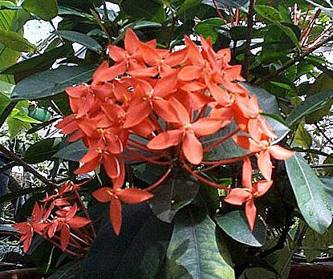
Ixora coccinea - common ornamental

Slide 25
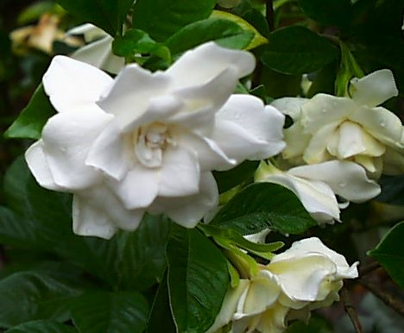
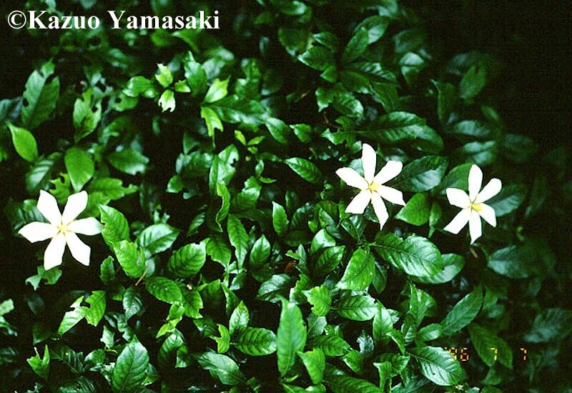
Gardenia

Slide 26
KEY CHARACTERS FOR THE RUBIACEAE
opposite leaves (order)
stipules
colleters (order)
inferior ovary

Slide 27
RU BIACEAE
Set aside

Slide 28
Notes:
Rubiaceae family for 241, begun Nov. 30, 2004

