Slide 1
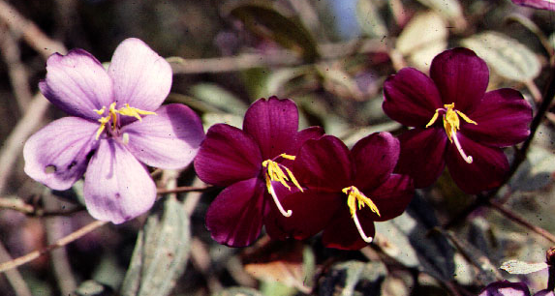
MELASTOMATACEAE

Slide 2
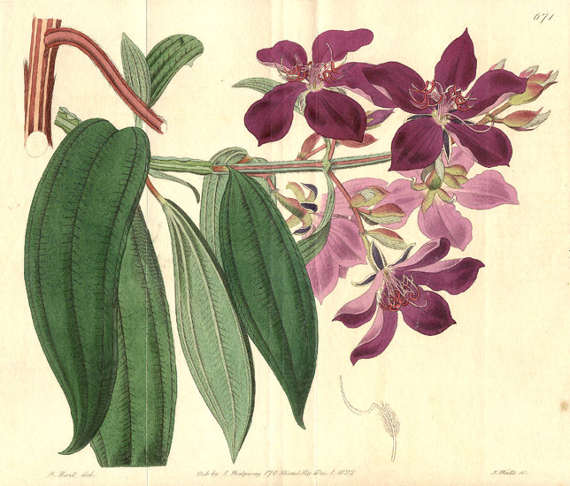

Slide 3
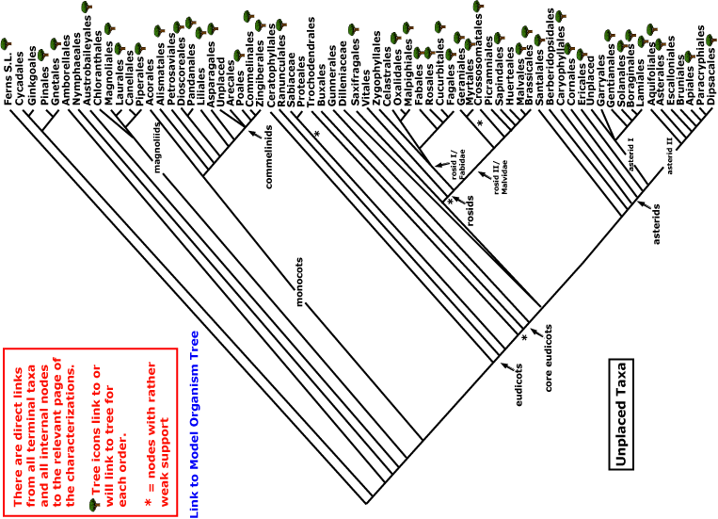
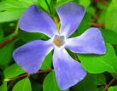
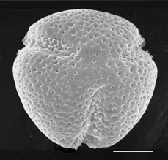
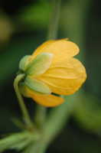
MELASTOMATACEAE
magnoliids
rosids
Current Angiosperm Phylogeny Group Tree for Flowering Plants
2018
monocots
asterids
core eudicots
eudicots

Slide 4
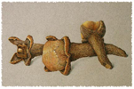
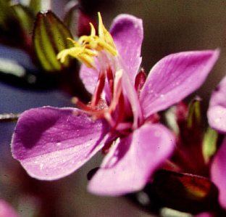
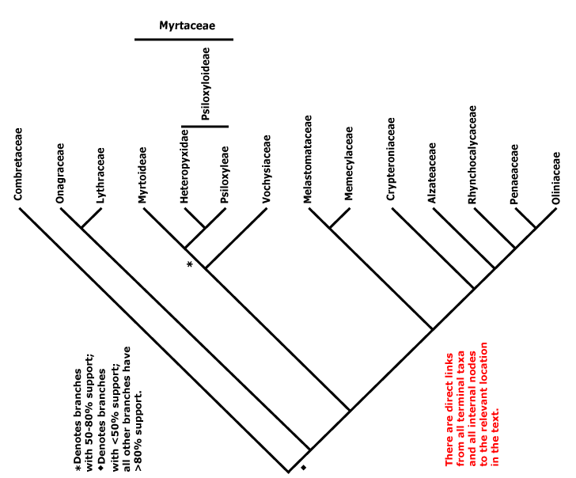
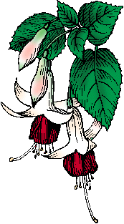
evening
primrose
fireweed
cloves
Fuchsia
MYRTALES

Slide 5
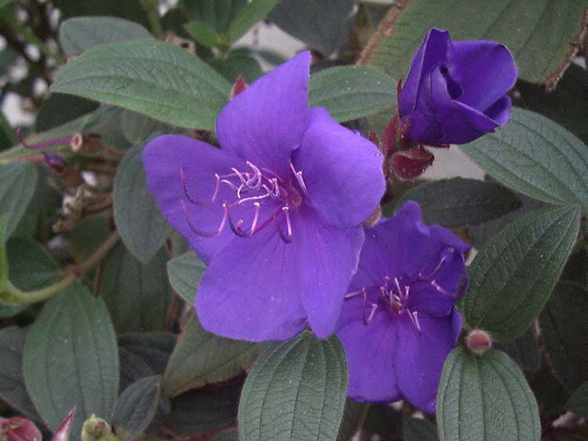
Tibouchina - the best-known ornamental

Slide 6
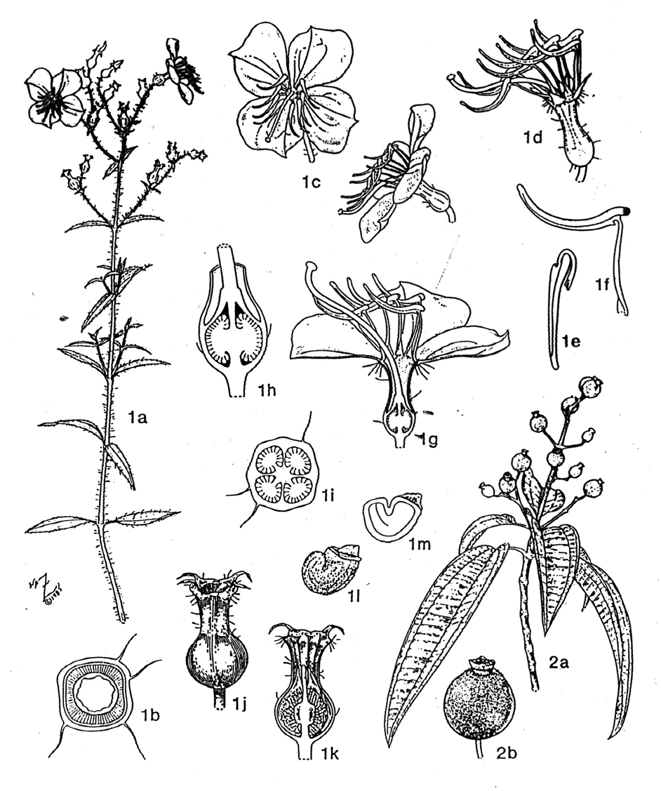
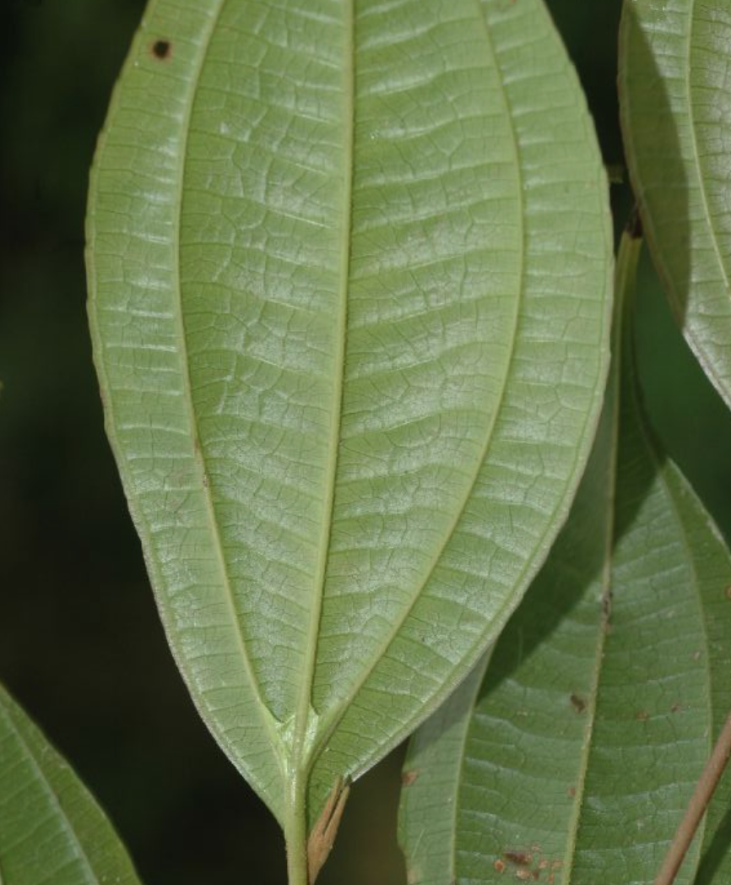
MELASTOMATACEAE
opposite leaves
arcuate basal secondaries
ladder tertiaries
staminodes or stamen appendages
stamens 2x petals
hypanthium and/or inferior ovary
Rhexia
2. Tetrazygia

Slide 7
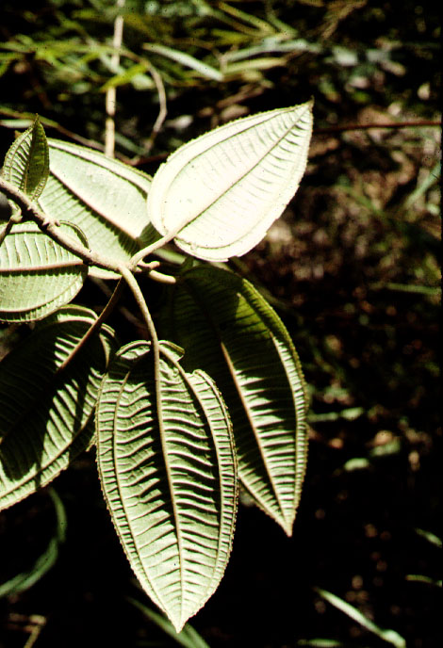
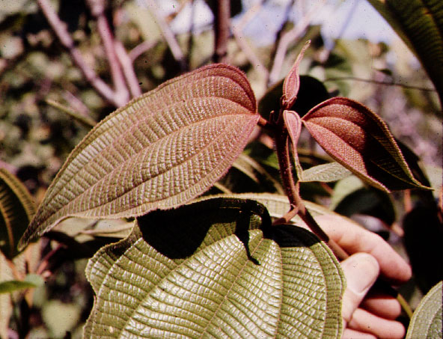
MELASTOMATACEAE:
arcuate basal secondaries, -- including a marginal vein
perpendicular tertiaries

Slide 8
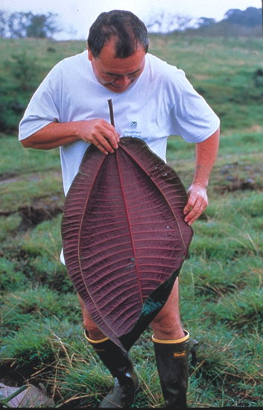
Miconia calvescens, introduced to Hawaii

Slide 9
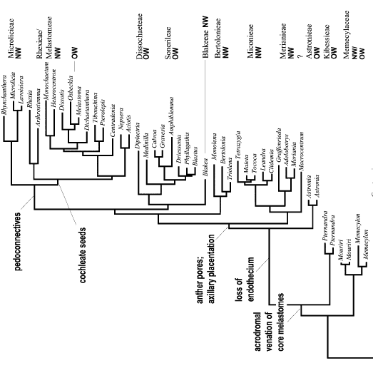
Notes:
American Journal of Botany 88(3): 486–498. 2001.
MOLECULAR PHYLOGENETICS OF MELASTOMATACEAE
AND MEMECYLACEAE: IMPLICATIONS FOR
CHARACTER EVOLUTION1
G. CLAUSING2,4 AND S. S. RENNER3,4

Slide 10
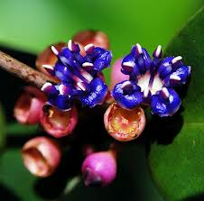
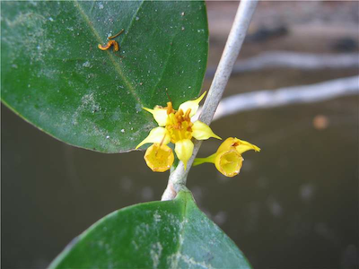
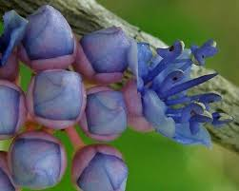
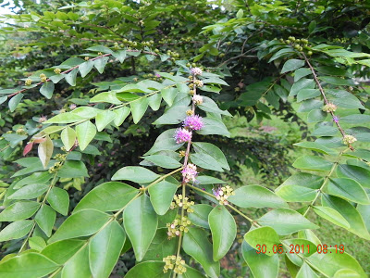
Mouriri and Memecylon
Mouriri
Memecylon

Slide 11
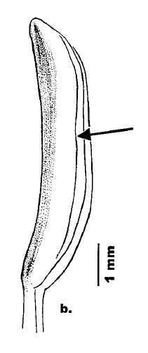
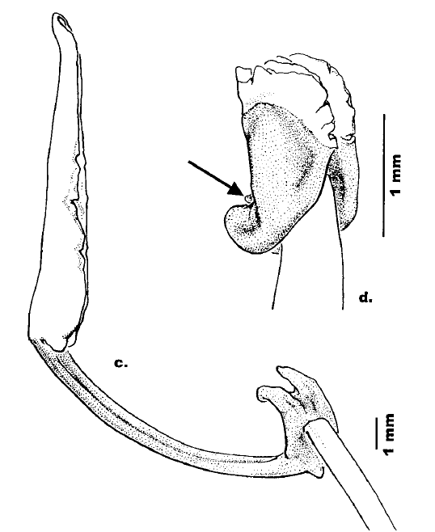
Origin of poricidal stamens and appendages in melastomes
Memecylon
Beccarianthus
Melastoma
Pollen sacs white, connective tissue and appendages shaded
Notes:
American Journal of Botany 88(3): 486–498. 2001.
MOLECULAR PHYLOGENETICS OF MELASTOMATACEAE
AND MEMECYLACEAE: IMPLICATIONS FOR
CHARACTER EVOLUTION1
G. CLAUSING2,4 AND S. S. RENNER3,4

Slide 12
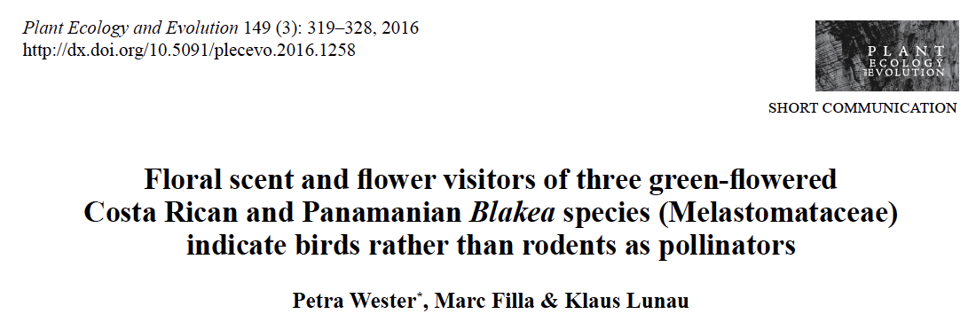
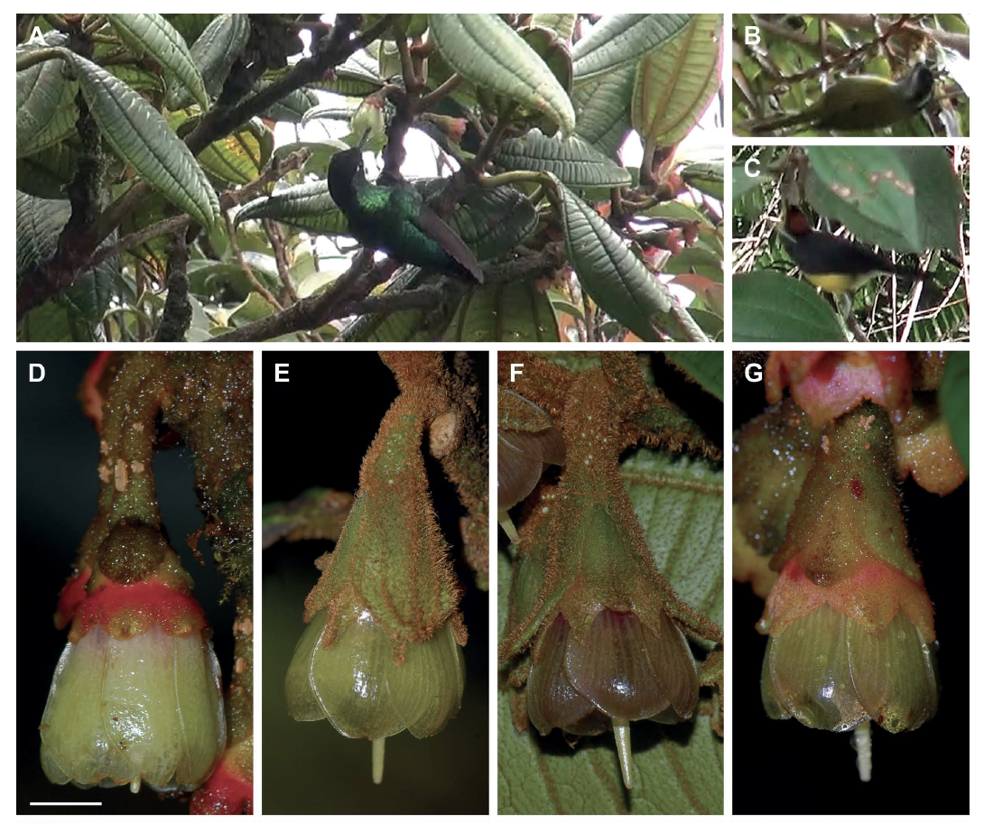

Slide 13
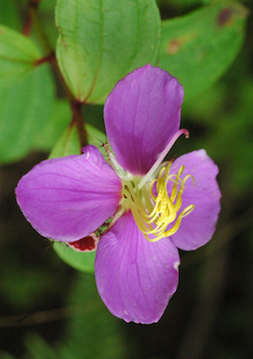
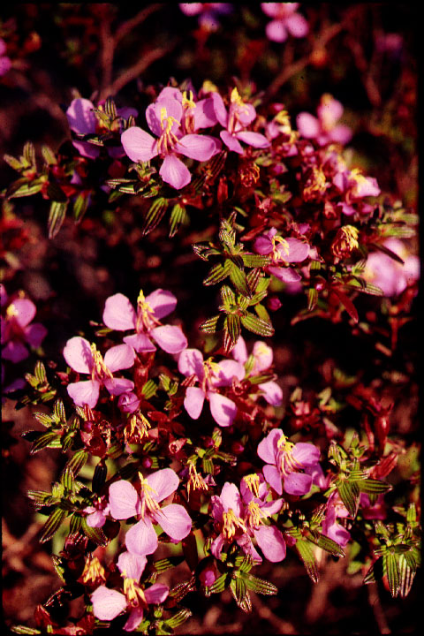
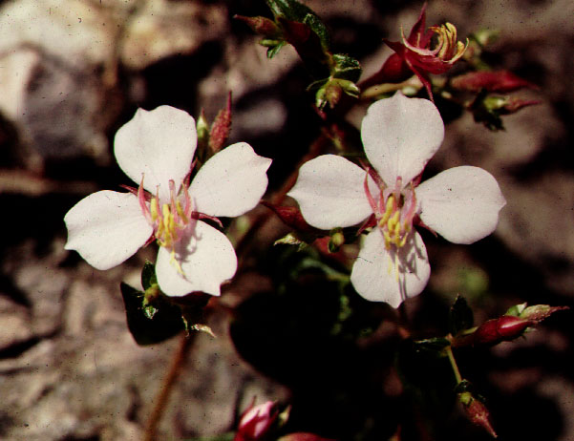
Monochaetum

Slide 14
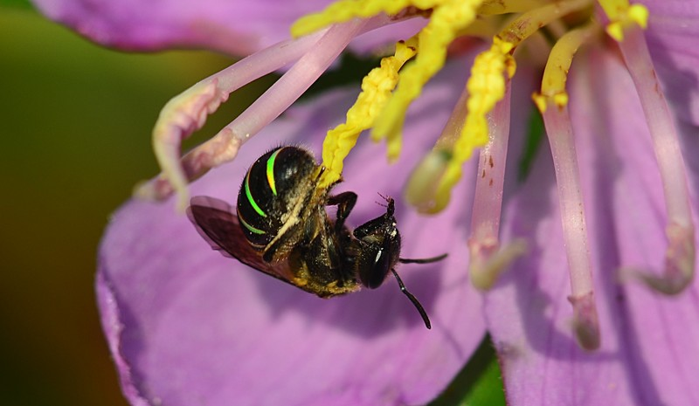
Buzz pollination of Melastomataceae
buzz pollination

Slide 15
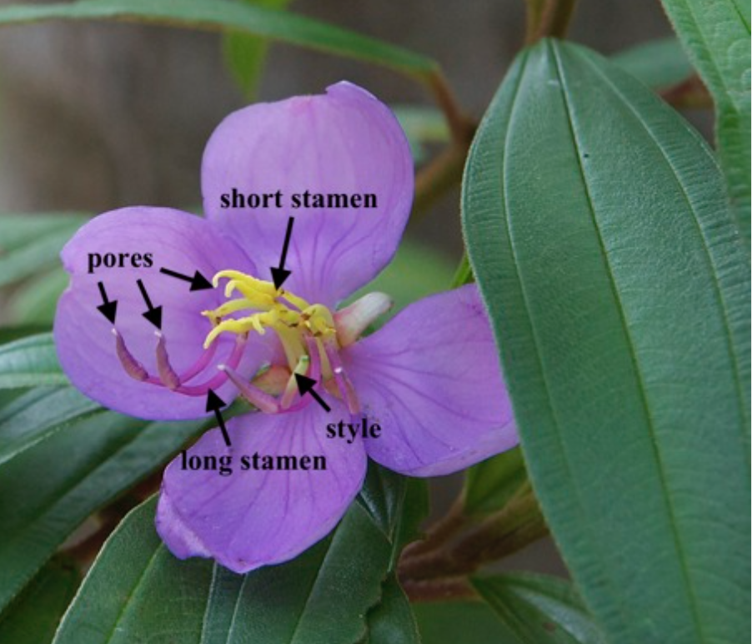
carpenter bees visiting Melastoma

Slide 16
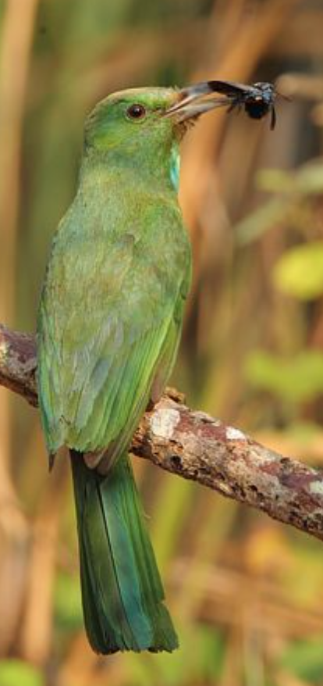
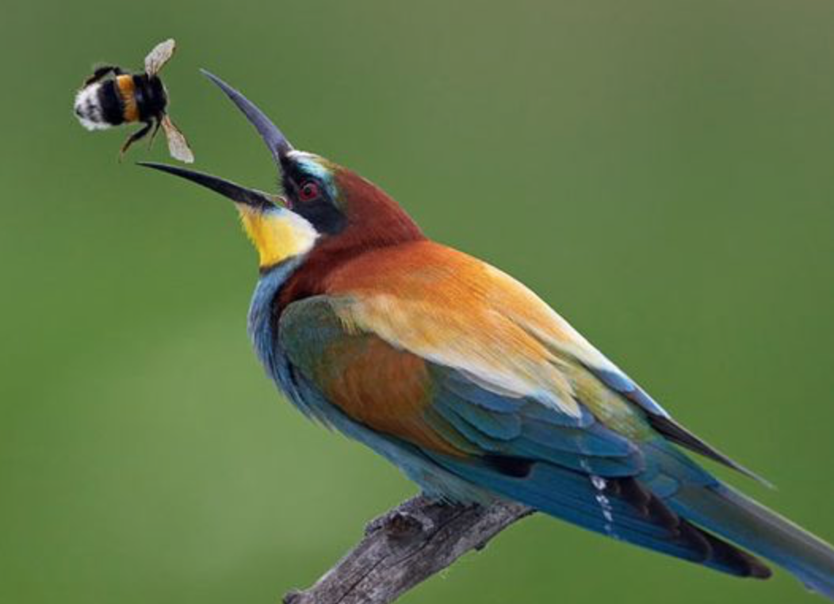
Bee eaters preying on a carpenter bee
Nyctyornis athertoni

Slide 17
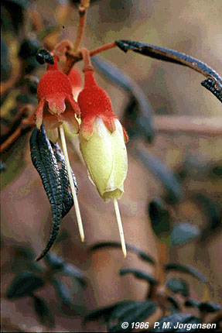
Brachyotum
Notes:
Brachyotum ledifolium Brachyotum ledifolium (Desr.) Triana (Melastomataceae)
Brachyotum ledifolium (Desr.) Triana (Melastomataceae), a typical shrub of the elfin forest; hummingbird pollinated. Collected by P. M. Jørgensen, Pichincha province, Ecuador.

Slide 18
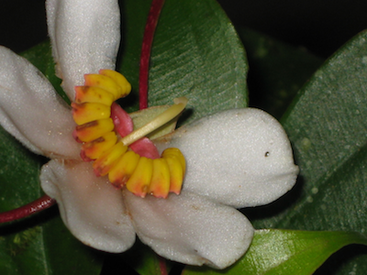
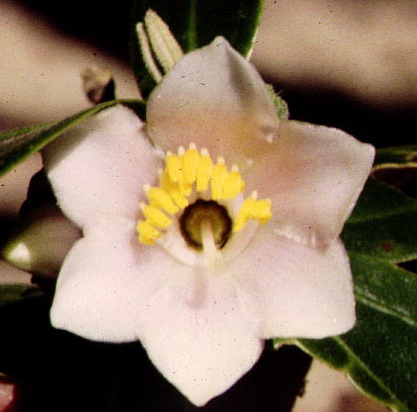
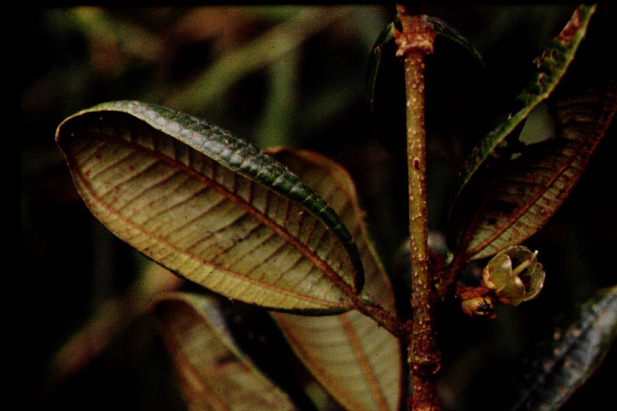
Blakea
Notes:
Lumer, Cecile. 1980. Rodent pollination of Blakea (Melastomataceae) in a Costa Rican cloud forest. Brittonia 32: 512-517.

Slide 19
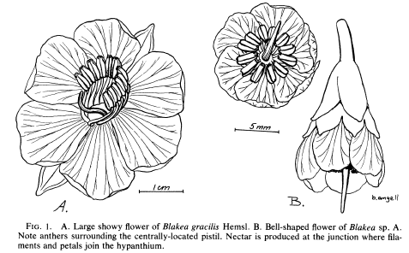
Cecile Lumer, 1980.
Blakea sp. A inhabits areas of extreme environmental conditions in the Mon- teverde Cloud Forest Reserve. It grows as a hemi-epiphyte in the upper canopy of most of the cloud forest, on fallen logs in cut-over areas on the continental divide and is quite common in the elfin forest. In these areas it is subject to an extremely harsh environment of strong winds and wind-driven rain. The floral morphology of Blakea sp. A was somewhat of a puzzle. The presence of nectar, well hidden rather than showy flowers, and lack of scent indicated a pollinator other than bees. Furthermore, the green flowers and purple anthers pointed to the possibility of nocturnal pollination (Percival, 1965; Faegri & van derPijl, 1971).
Notes:
Lumer, C., 1980. Rodent pollination of Blakea (Melastomataceae) in a Costa Rican cloud forest. Brittonia, 32(4), pp.512-517.

Slide 20
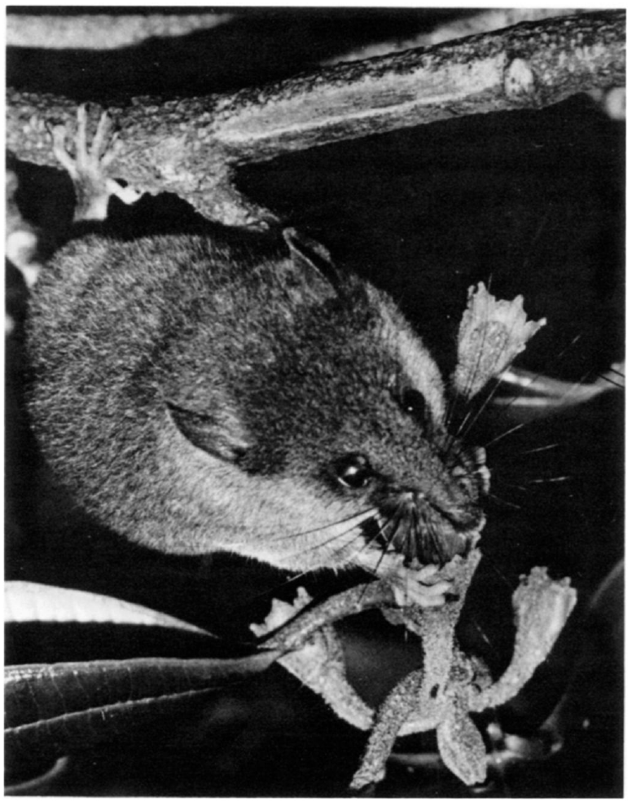

Slide 21
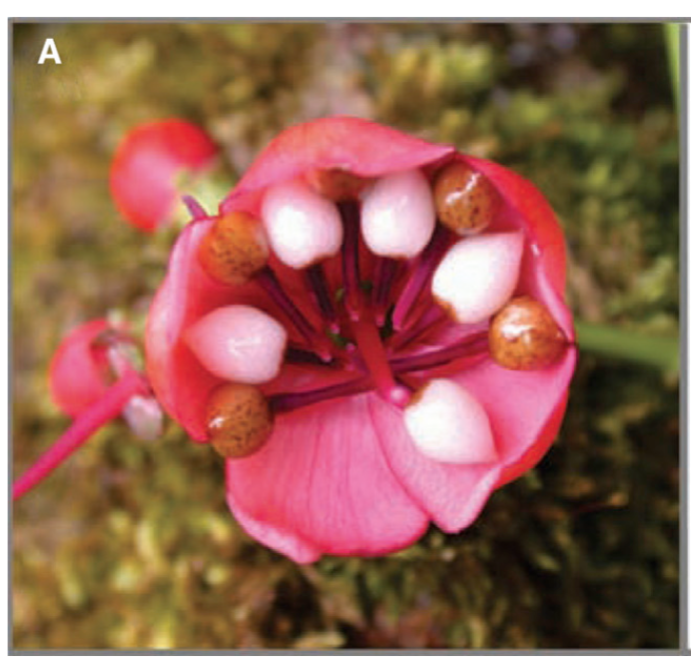
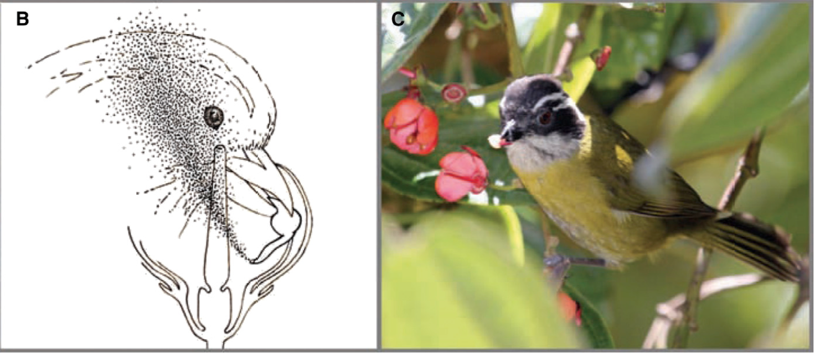
Axinaea pollinated by a tanager
five mature anthers with large white food body appendages
birds pluck and squeeze the food body causing a puff of pollen to exit the anthers from the apical pore
sooty-capped bush tanager) holding a food body and anther sac
Notes:
VIDEO AT https://www.cell.com/current-biology/fulltext/S0960-9822(14)00634-4
dellinger2014.pdf
Edwards_j2014.pdf
Figure 1. Co-evolution of a flower and its pollinator.
(A) Flower of Axinaea costaricensis, showing five mature anthers with large white food body appendages. The tubular magenta anther sacs
extend from the base of each food body. (B) A schematic showing how birds pluck and squeeze the food body causing a puff of pollen to
exit the anthers from the apical pore. The pollen can then be transferred to stigmas by wind or by birds when visiting other flowers.
(C) Chlorospingus pileatus (sooty-capped bush tanager) holding a food body and anther sac from A. costaricensis. The food bodies primarily
provide sugars and vitamin C. Credits: (A) Photo cropped from image by Juan Franscisco Morales (http://melas-centroamerica.com/
axinaea-costaricensis/); (B) drawing by Ann Kremers; (C) photo by Florian Etl.

Slide 22
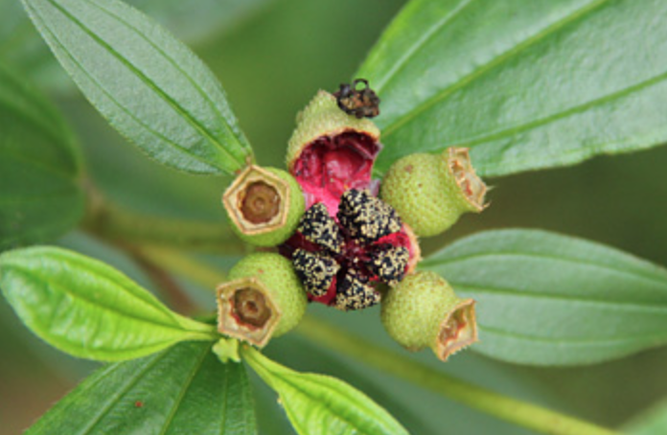
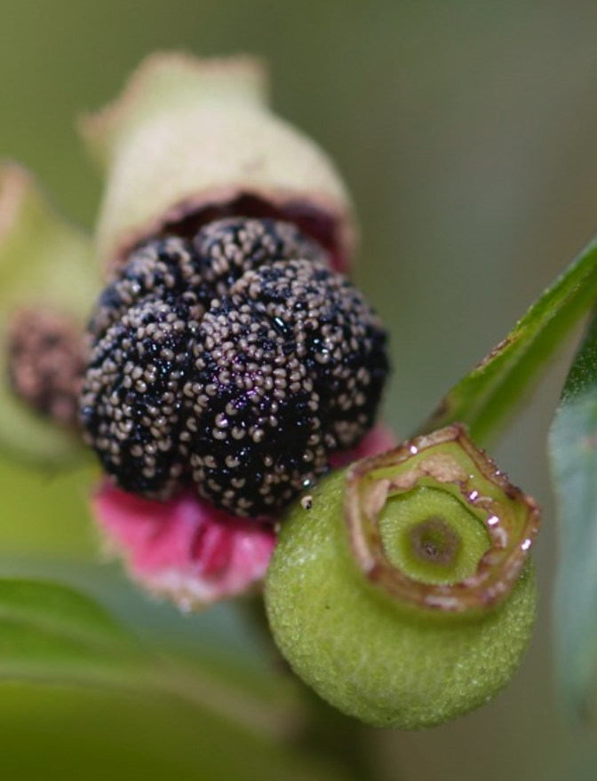
Melastoma fruits dehisce, presents white seeds on black placentae, the latter edible for humans, but staining the tongue black.
Hence the black mouth family, Melastomataceae
fruits are the favorites of birds like the flowerpeckers and doves which also disperse the seeds. Squirrels and monkeys are also fond of the fruits.
Notes:
(Meyer 2001).

Slide 23
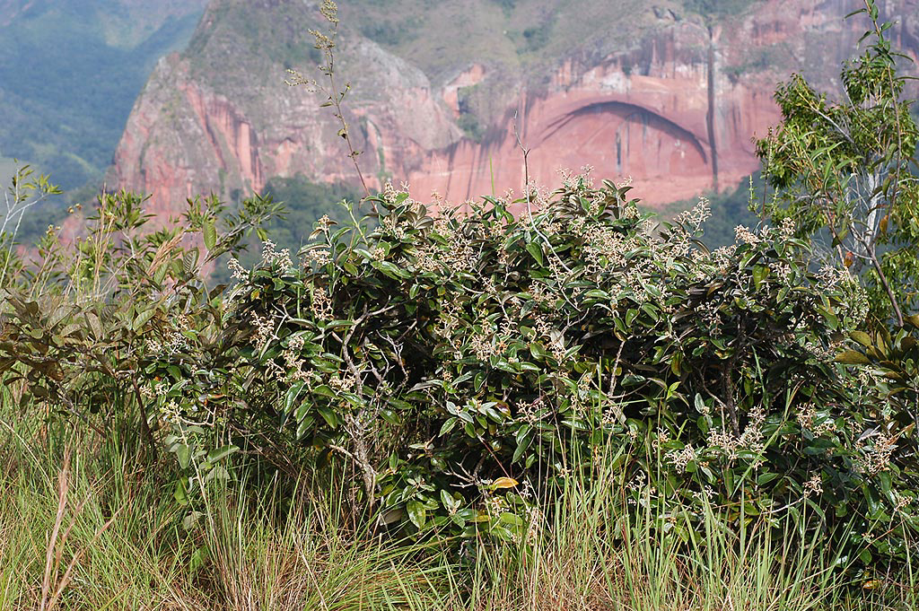
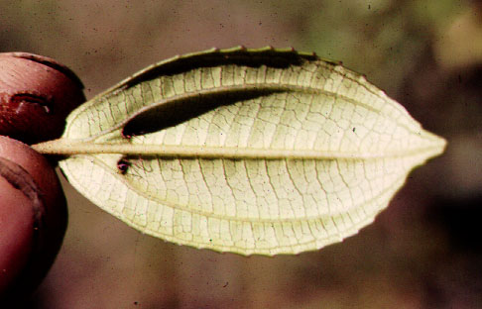
Miconia 1000 species

Slide 24
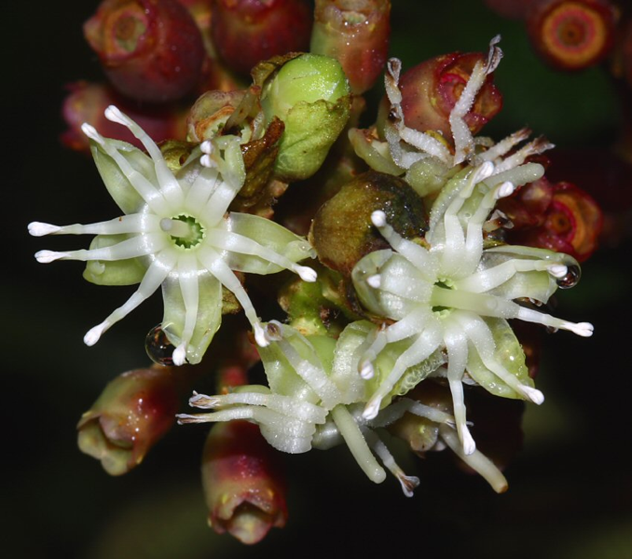
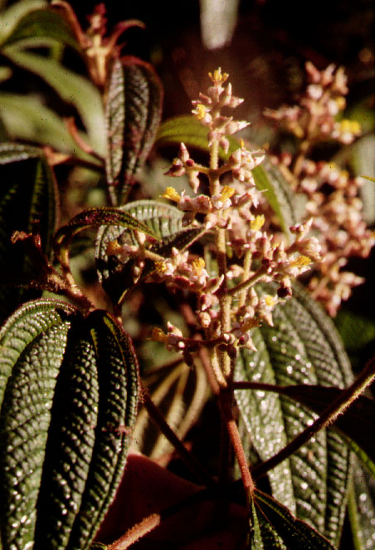
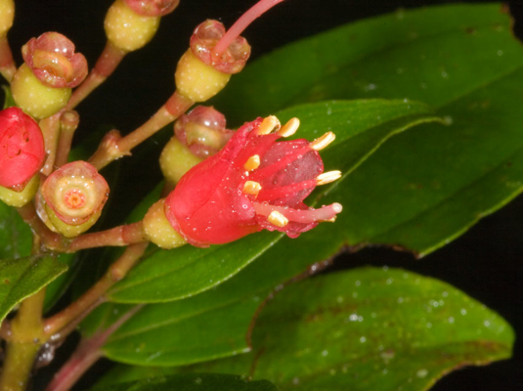
Miconia

Slide 25
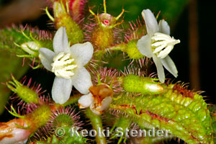
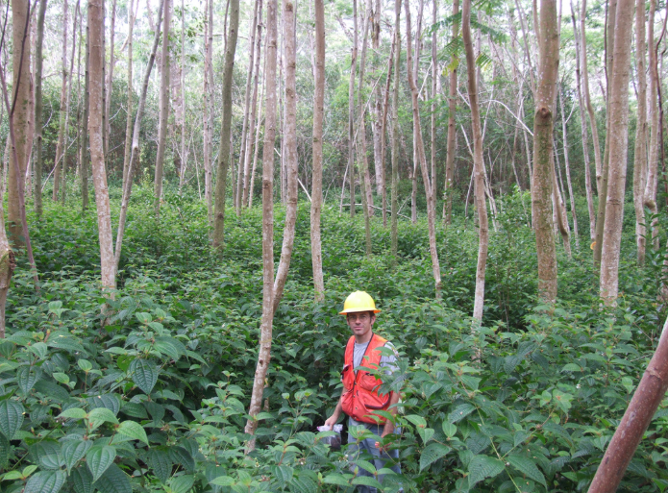
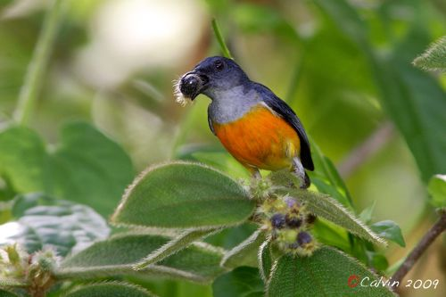
Clidemia hirta, Koster’s Curse
Coster's curse growing densely under a young albizia plantation, Hawaii Island, Hawaii
Notes:
Clidemia hirta, commonly called soapbush or Koster's Curse, is a perennial shrub. It is an invasive plant species in many tropical regions of the world, creating serious damage.
Originally from the American Neotropics (Mexico to Paraguay as well as the Caribbean),[1][2] it has been introduced to Australia, Southern Asia and East Africa.
It was introduced to Hawaiʻi in the 1940s; by 1978 it had spread to over 90,000 acres (360 km2) of land on Oʻahu. In 1972 Koster's Curse was first spotted on the Big Island. In Sri Lanka it is quite invasive in wet zone and upcountry forests, especially invading gaps in the forest, preventing other native species from emerging.[3]
"Koster's curse" is a commonly used name in places where the plant grows as a noxious weed, such as Hawai'i. Koster was the man who between 1880 and 1886 accidentally introduced seeds of C. hirta to Fiji in coffee nursery stock, where its problematic nature was first noticed around 1920 (

Slide 26
MELASTOMATACEAE
opposite leaves
2 pairs of basal secondaries
ladder tertiaries
staminodes or stamen appendages
stamens 2x petals
Hypanthium and/or inferior ovary
Rhexia
2. Tetrazygia

