Slide 1
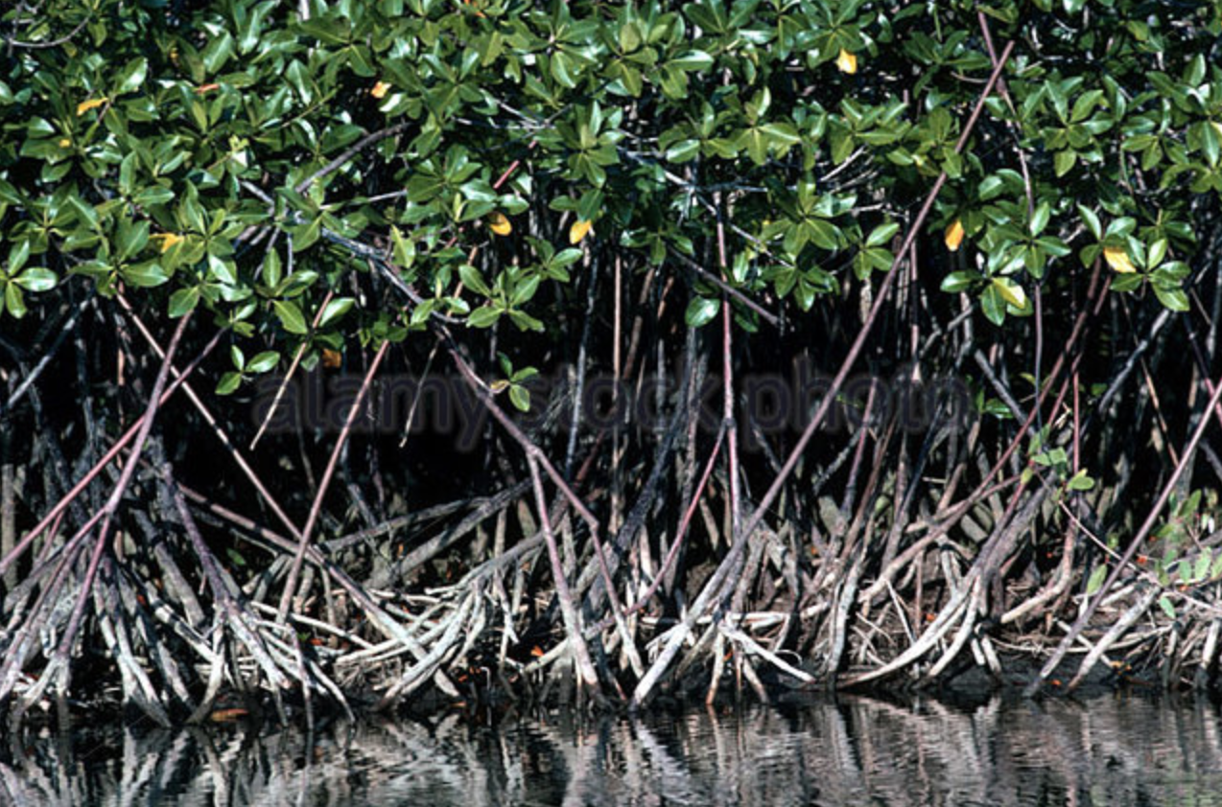
mangroves

Slide 2
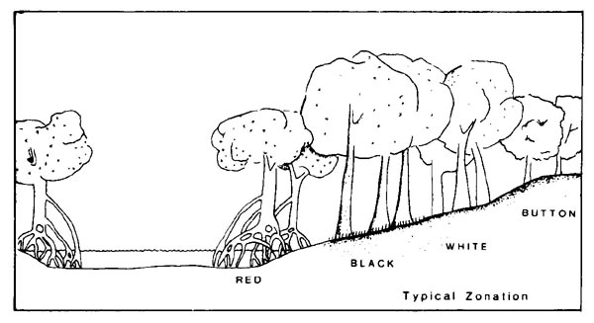
Neotropical mangrove niche differentiation
Conocarpus erectus)e
Combretaceae
Laguncularia racemosa
Combretaceae
Rhizophora mangle
Rhizophoraceae
Avicennia nitida
Acanthaceae

Slide 3
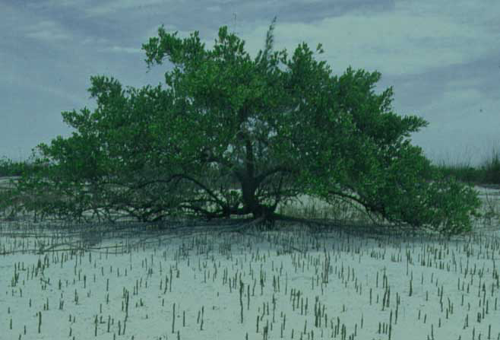
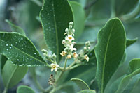
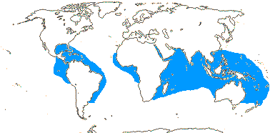
Avicennia - the black mangrove
Notes:
Photographer: A. Gentry
Copyright: MBG
Voucher: GENTRY 33978

Slide 4
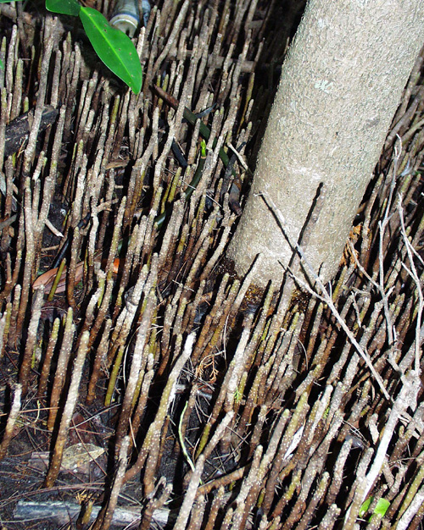
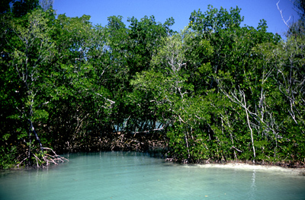
black mangrove roots grow up to the air, because they grow in salt water

Slide 5
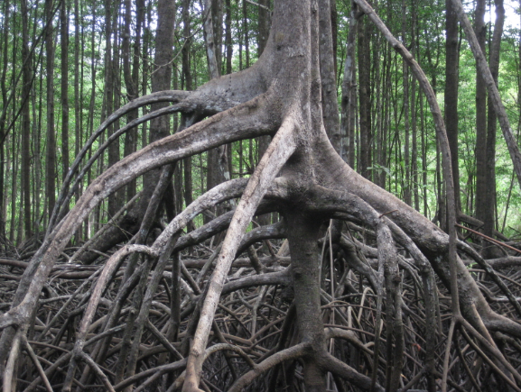
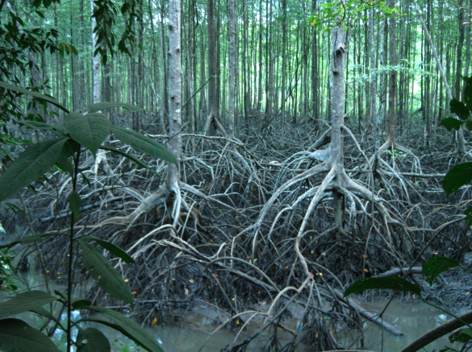
RED: Rhizophora mangle
Rhizophoraceae, Malpighiales

Slide 6
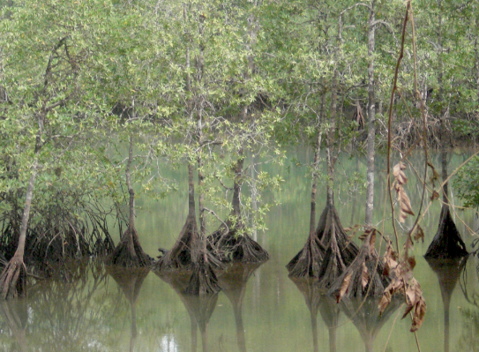
Pelliciera, the Tea Mangrove of Central America

Slide 7
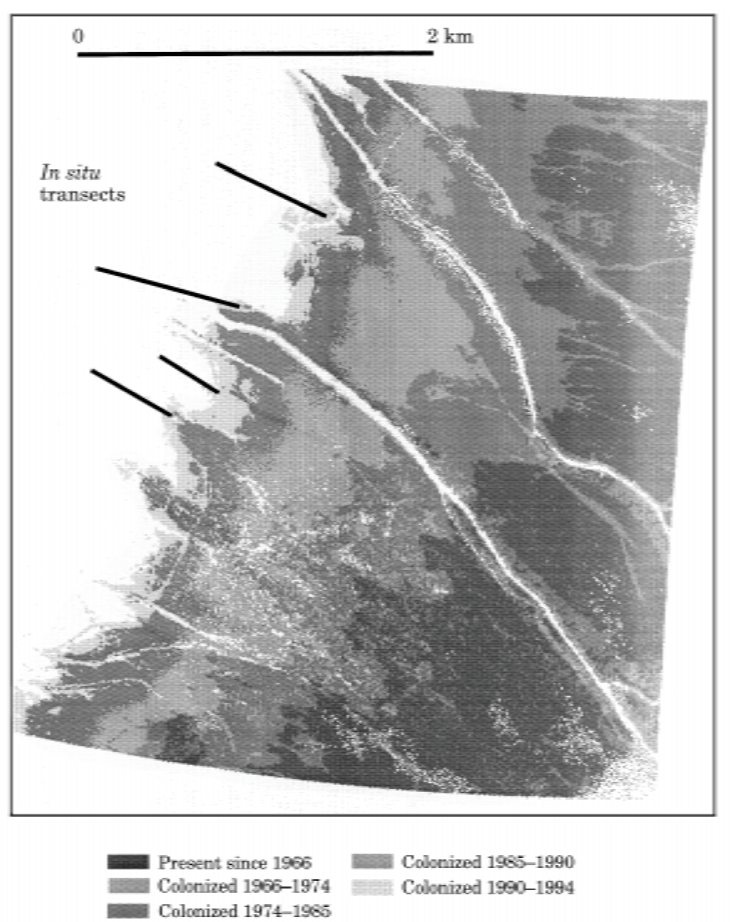
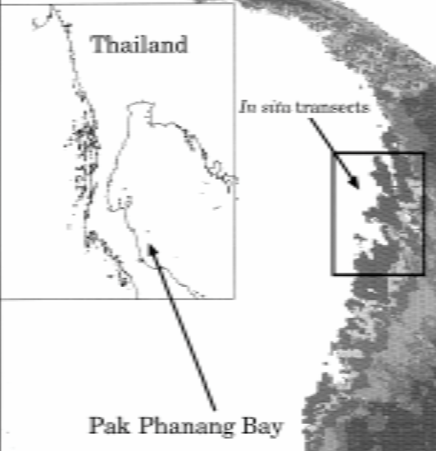
Colonization of marine muds by red mangrove in Thailand
Panapitukkul et al. 1998

Slide 8
Neotropical mangrove niche differentiation
Conocarpus erectus)e
Combretaceae
Laguncularia racemosa
Combretaceae
Rhizophora mangle
Rhizophoraceae
Avicennia nitida
Acanthaceae

Slide 9
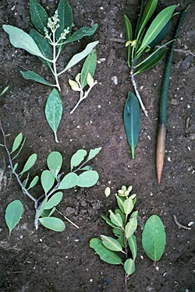
Mangroves are
convergent.
RED: Rhizophora
mangle
Rhizophoraceae
BLACK: Avicennia, Acanthaceae
Celastraceae
SWEET: Maytenus phyllanthoides
Combretaceae
WHITE: Laguncularia
racemosa
Notes:
Four species of mangroves. Clockwise from top left: Avicennia germinans, Rhizophora mangle, Laguncularia racemosa, Maytenus phyllanthoides. The long thin fruit of the Rhizophora is the viviparous propagule which contains a pre-germinated seed. The green stalk to the top is the stem and the brown tip is the root. The whole fruit floats vertically in the water like a tall skinny buoy and drifts until its root strikes mud, then takes root and grows.
Maytenus phyllanthoides occurs widely in coastal and near- coastal Mexico––along the Gulf and Pacific coasts––as well as saline sites in some inland areas (e.g., Coahuila, Nuevo León, Puebla, Hidalgo, Querétaro). It extends eastward to Cuba, the Bahamas, and Florida, where it occurs in 10 peninsular and Keys counties (Wunderlin & Hansen 2008). A closely similar form occurs in five counties of southernmost Texas (Turner et al. 2003)––along the Gulf Coast in both areas.
Mangrove Species
Black Mangrove—Avicennia germinans
Red Mangrove—Rhizophora mangle
White Mangrove—Laguncularia racemosa
Sweet Mangrove—Maytenus phyllanthoides

Slide 10
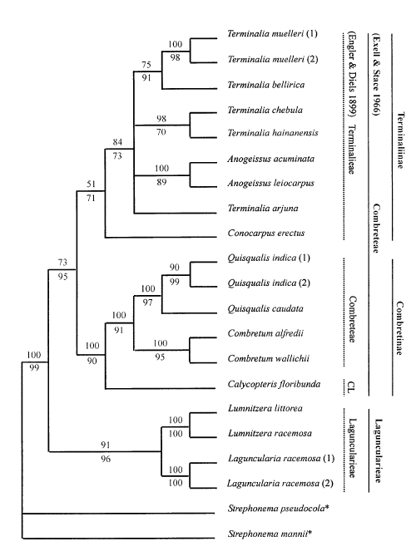
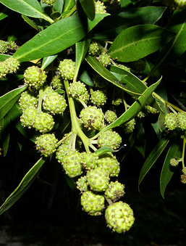
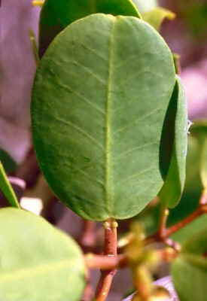
white and button mangroves are independently derived from within the Combretaceae, Myrtales
Notes:
phylogen from tan2002.pdf

Slide 11
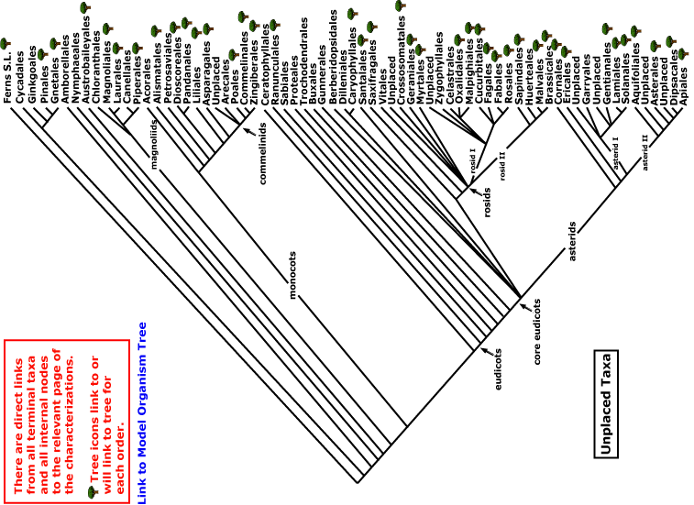
BUTTON
& WHITE RED BLACK
Current Angiosperm Phylogeny Group Tree for Flowering
independent origins
of mangroves

