Slide 1
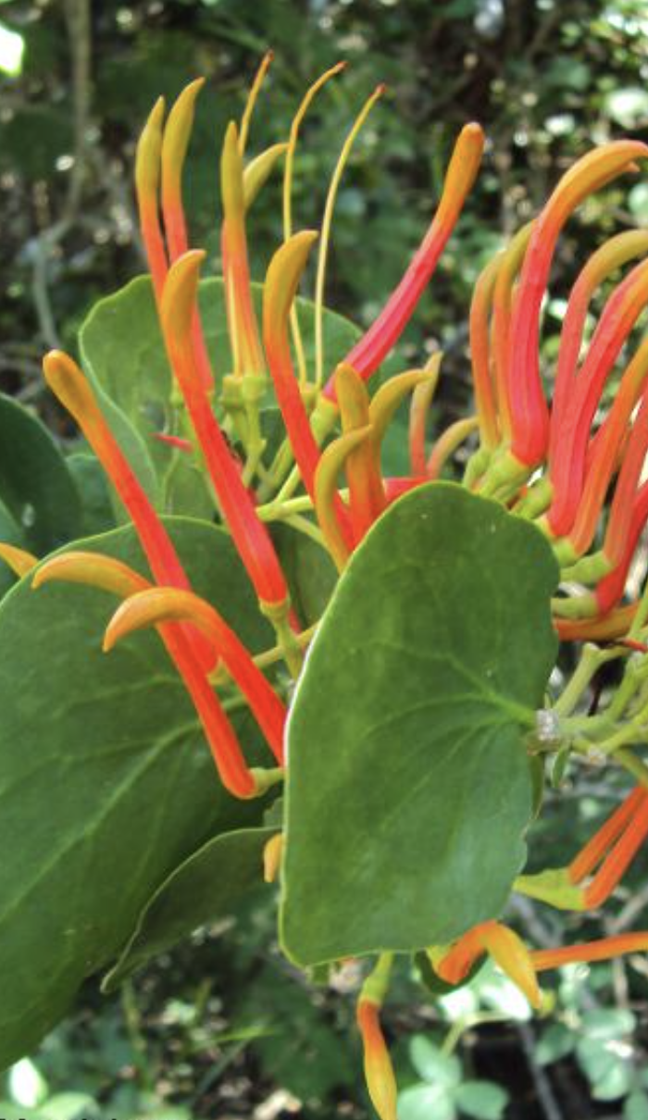
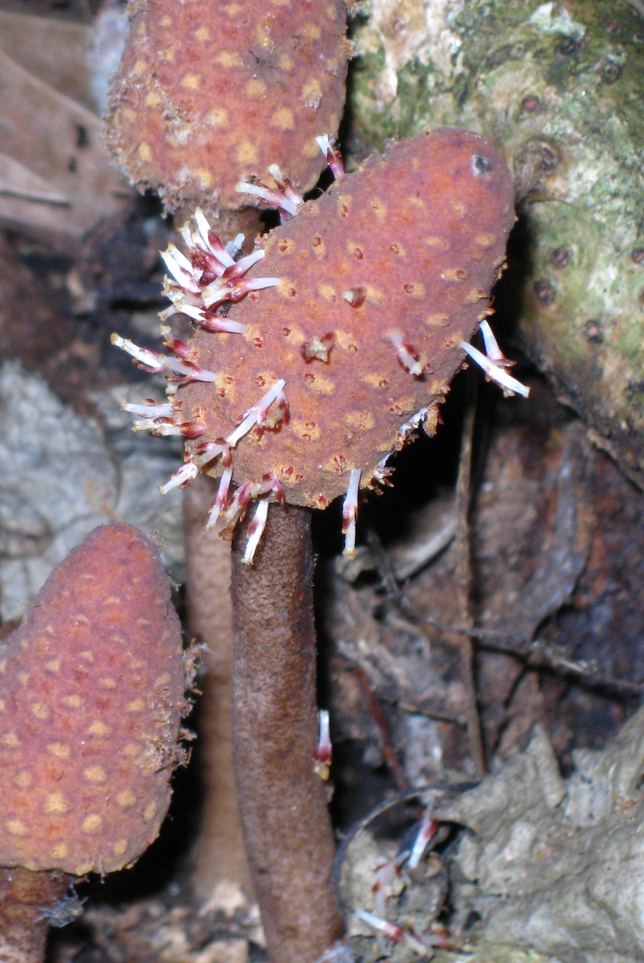
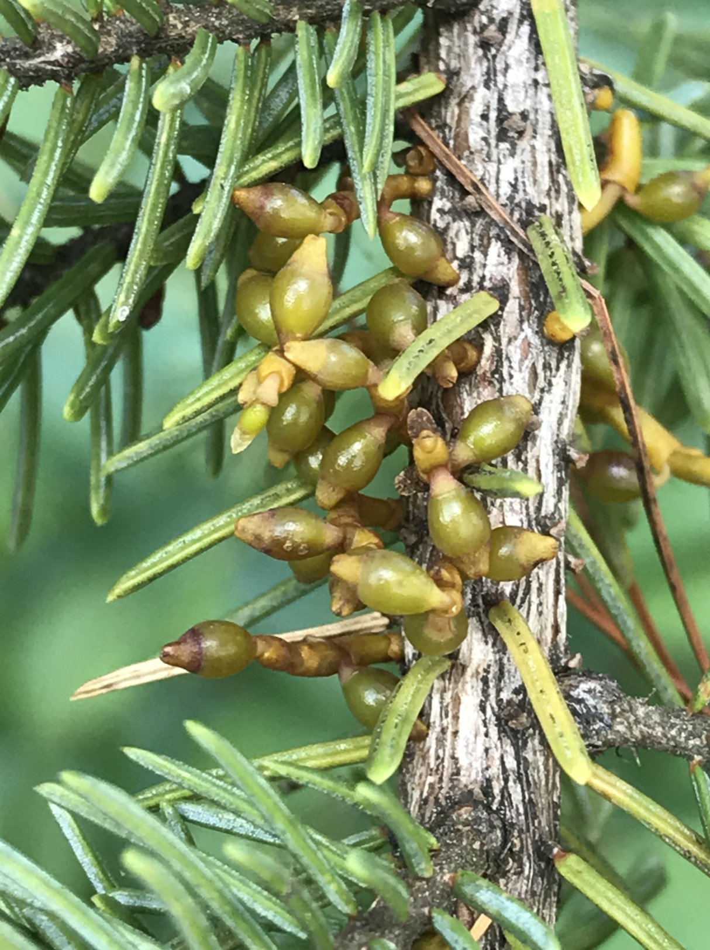
LORANTHACEAE
(and Loranthaceae and Viscaceae).
Notes:
http://www.parasiticplants.siu.edu/Santalales.IPWC/Sants.IPWC.html

Slide 2
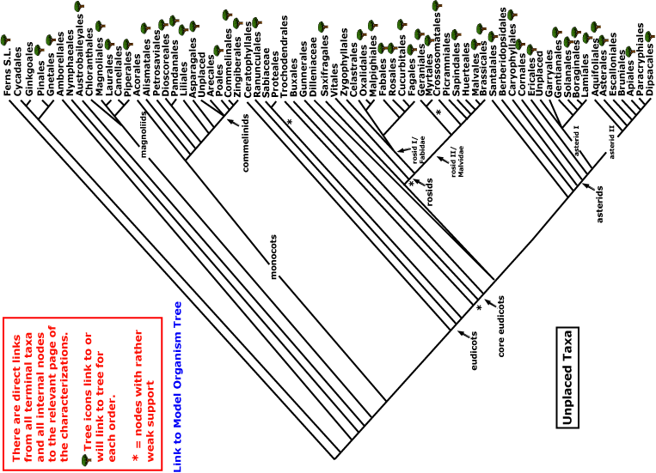
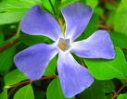
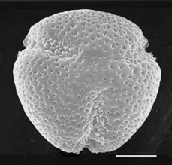
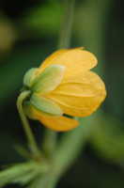
LORANTHACEAE
magnoliids
rosids
Current Angiosperm Phylogeny Group Tree for Flowering Plants
2018
monocots
asterids
core eudicots
eudicots

Slide 3
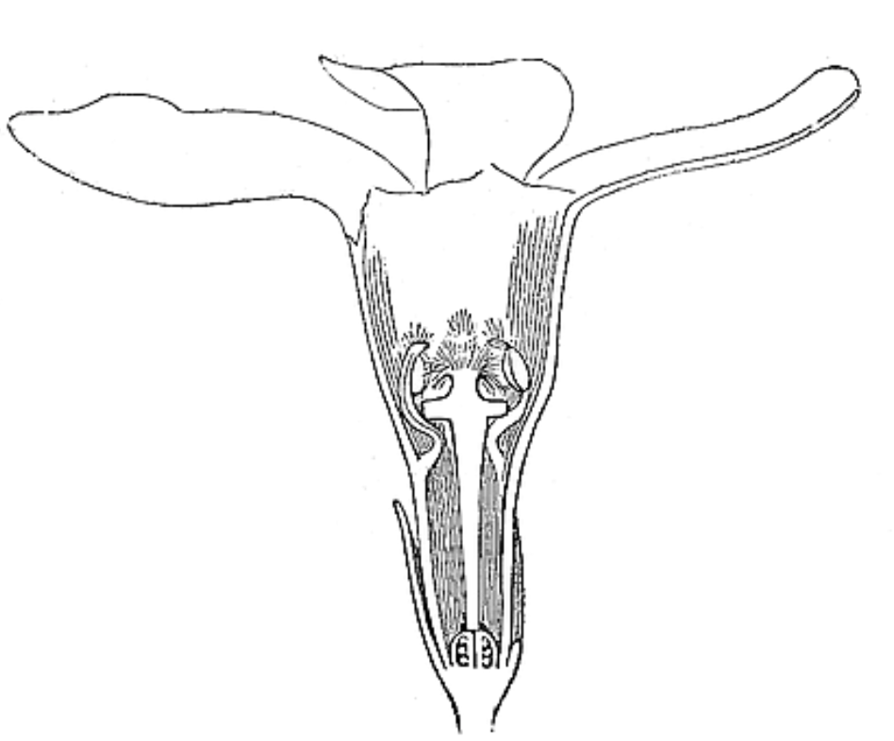
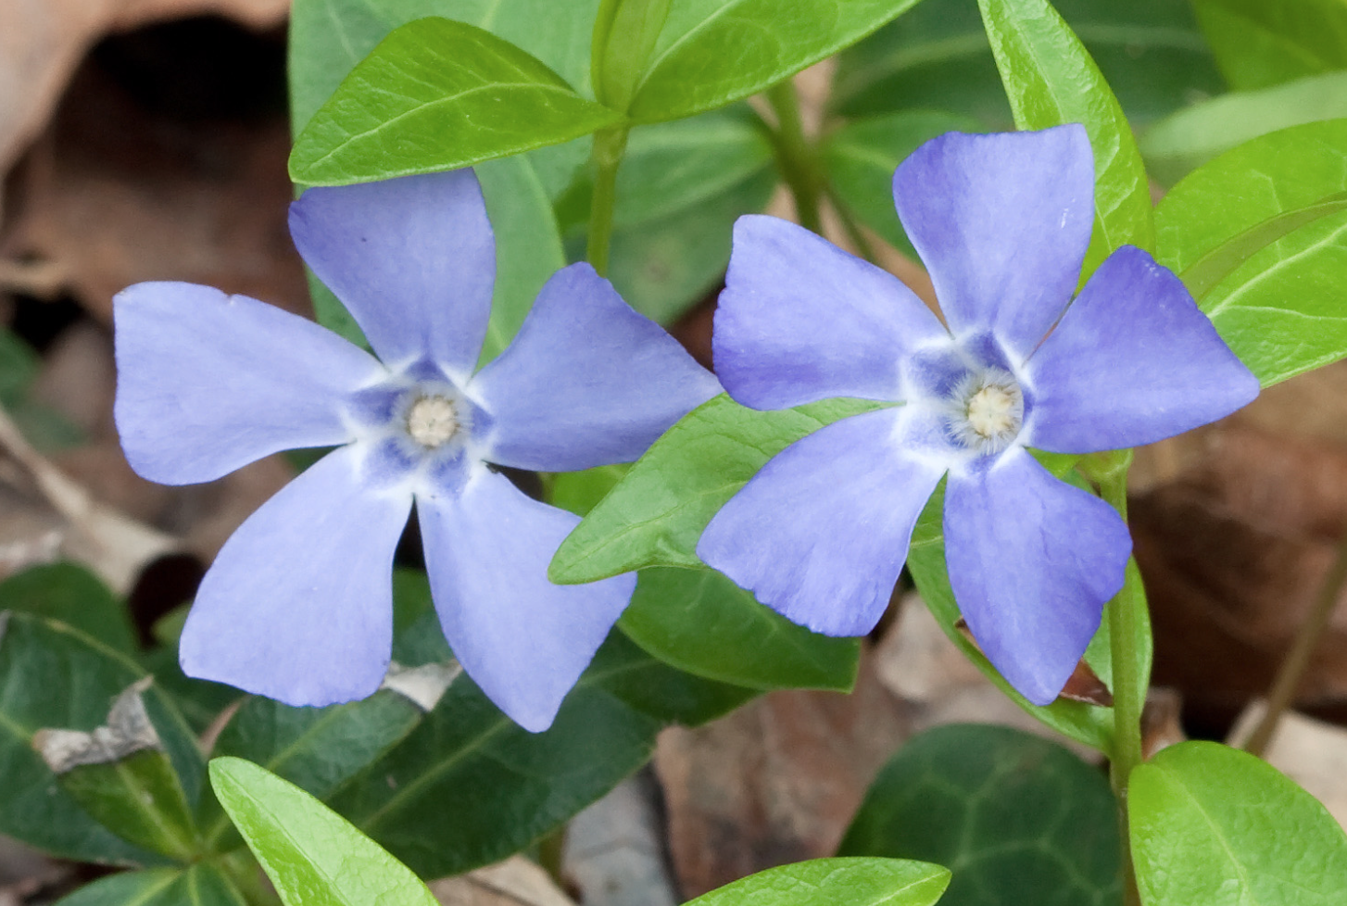
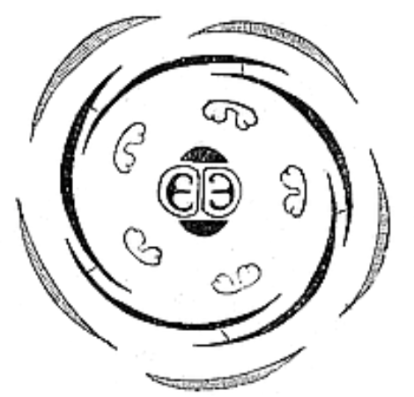
Asterids and Asterid wannabes
ASTERID SYNAPOMORPHIES
1. Connate corolla
2. Stamens adnate to the corolla
3. Stamen number at most = petal/sepal number
4. Carpels 2

Slide 4
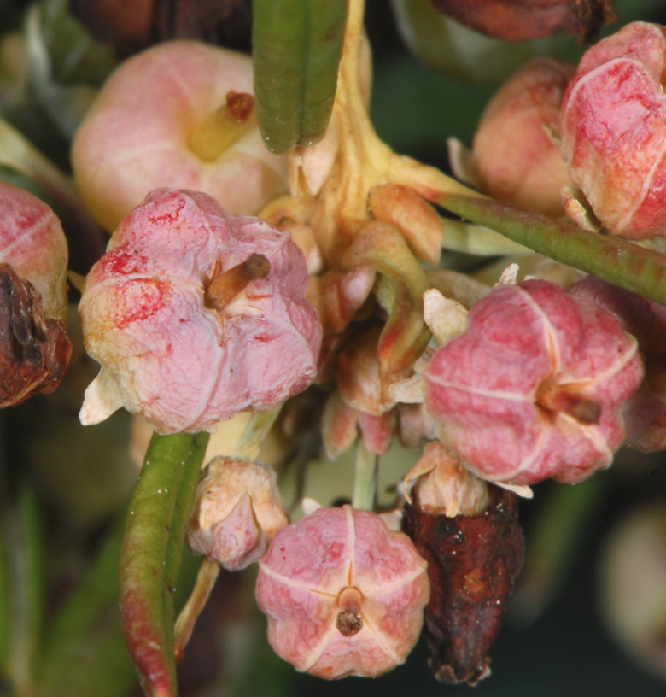
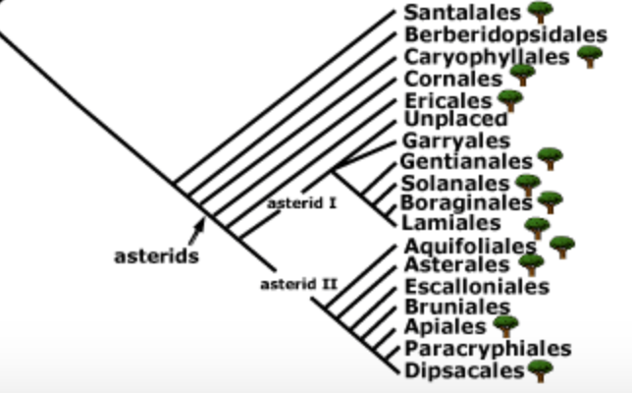
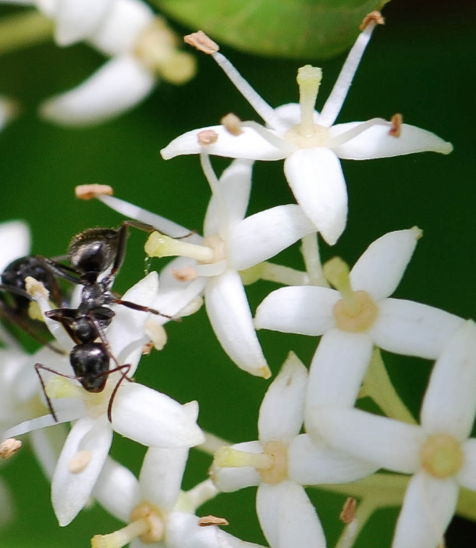
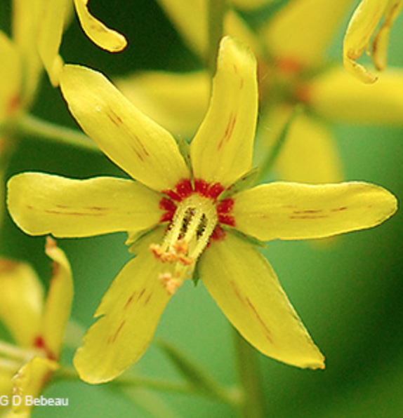
Asterids and Asterid wannabes
ASTERID WANNABE FAILURES
1. Corolla unfused
2. Stamens not adnate to the corolla
3. Stamens teice the petals/sepals
4. Too many carpels (five)

Slide 5
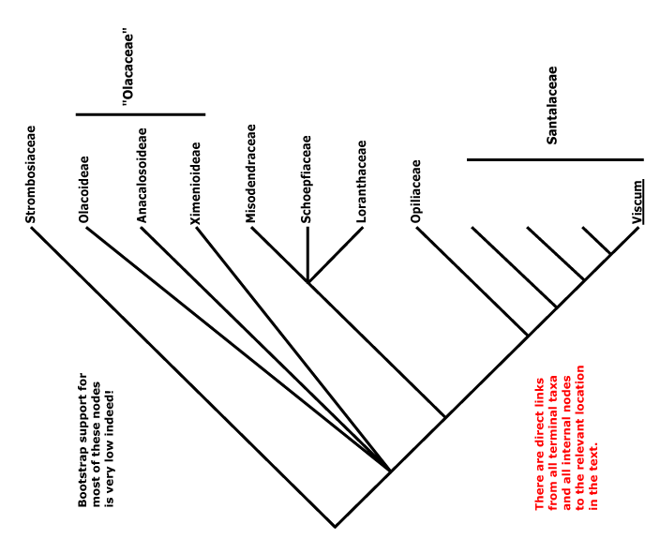
Loranthaceae and Santalaceae are distinct families in the Santalales
Notes:
Su, H.J., Hu, J.M., Anderson, F.E., Der, J.P. and Nickrent, D.L., 2015. Phylogenetic relationships of Santalales with insights into the origins of holoparasitic Balanophoraceae. Taxon, 64(3), pp.491-506.

Slide 6
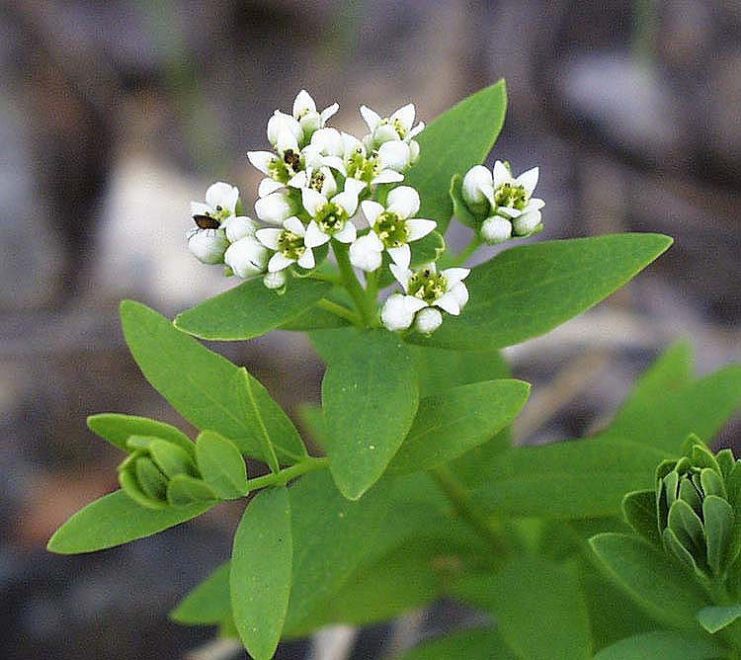
The bastard toadflax (Comandra umbellata) of the Santalaceae is in Vermont.
Notes:
Comandra has broad host preference.

Slide 7
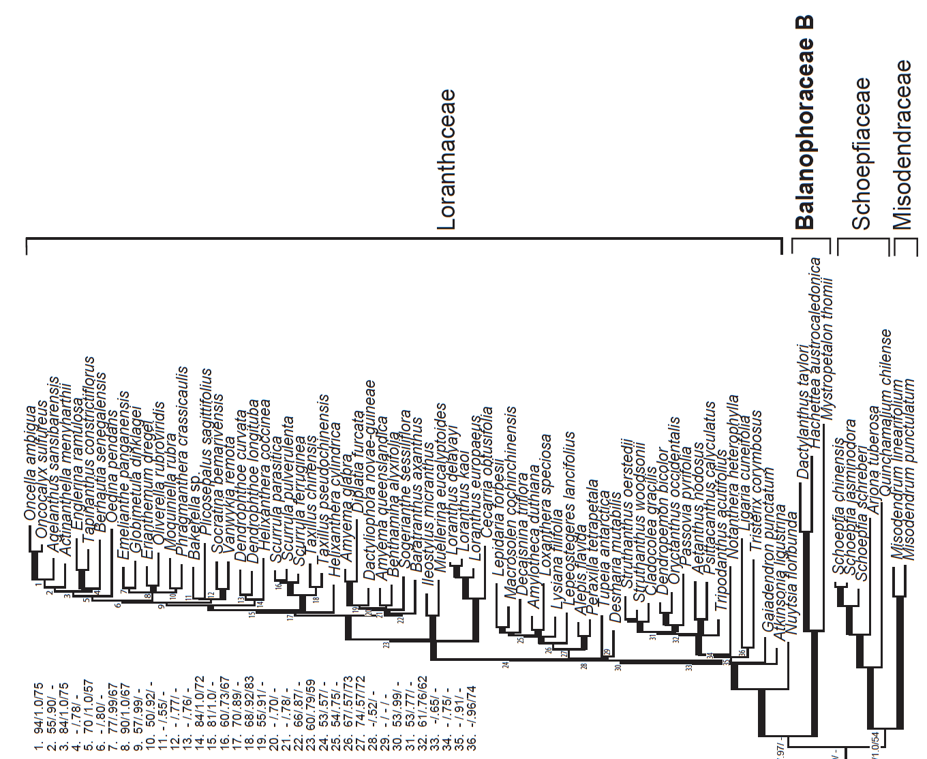
Su et al., 2015

Slide 8
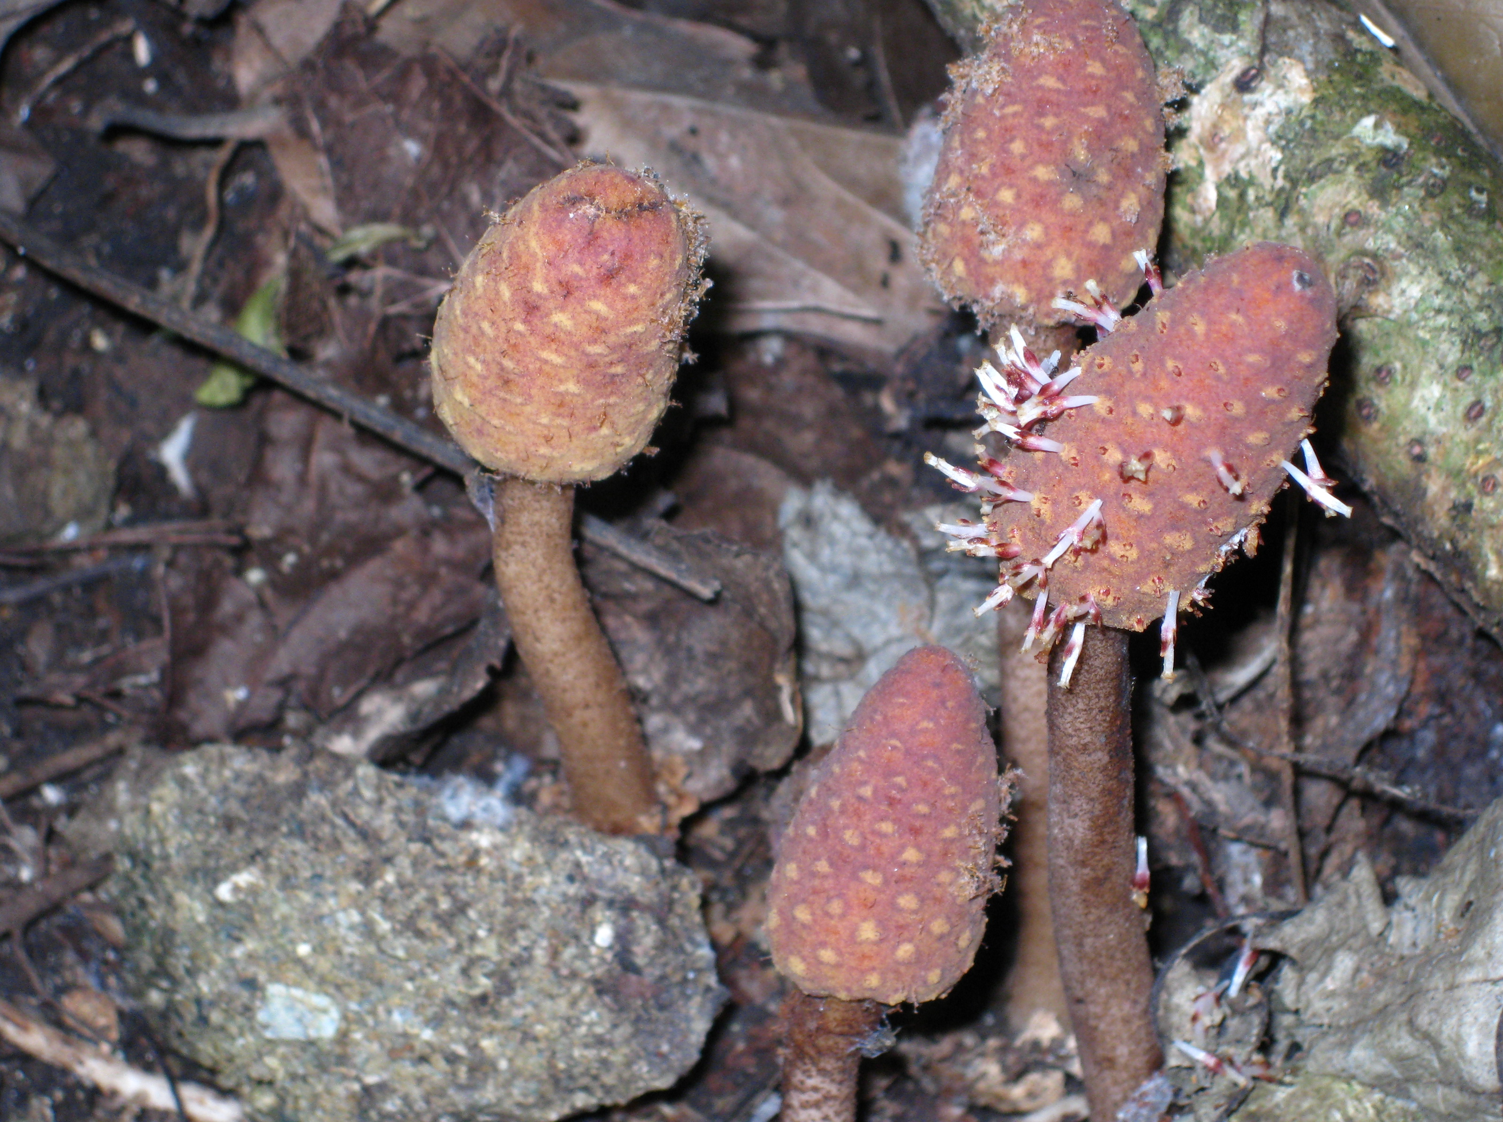
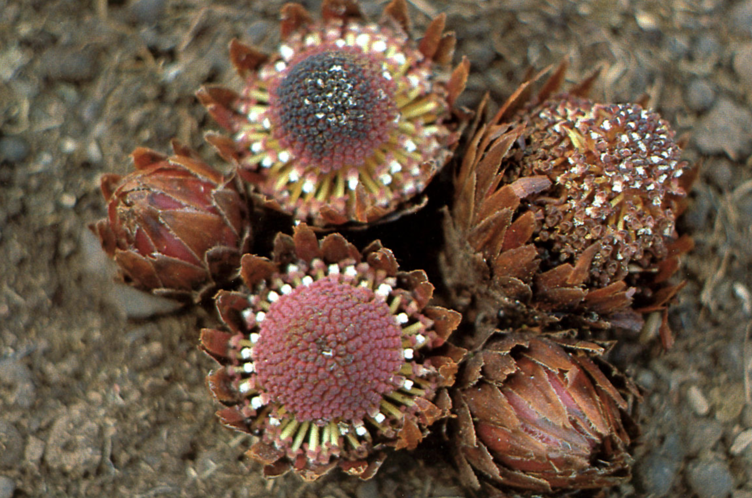
Balanophoraceae
Helosis
Langsdorffia

Slide 9
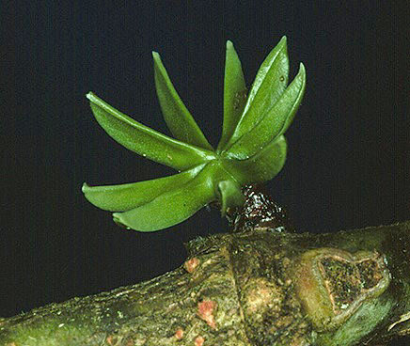
Key Characters for the Loranthaceae
Parasites
Opposite leaves
Stamens equal and opposite perianth parts
Perianth connate
And some more characters:
Disk
Inferior ovary
Red or orange flower color
Extra cotyledons

Slide 10
Su et al., 2015

Slide 11
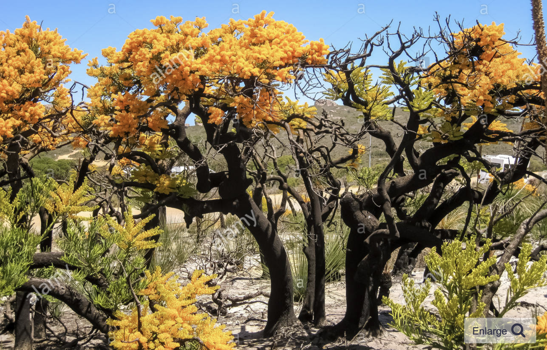
Nuytsia, Australian tree-parasite ancentral in the family

Slide 12
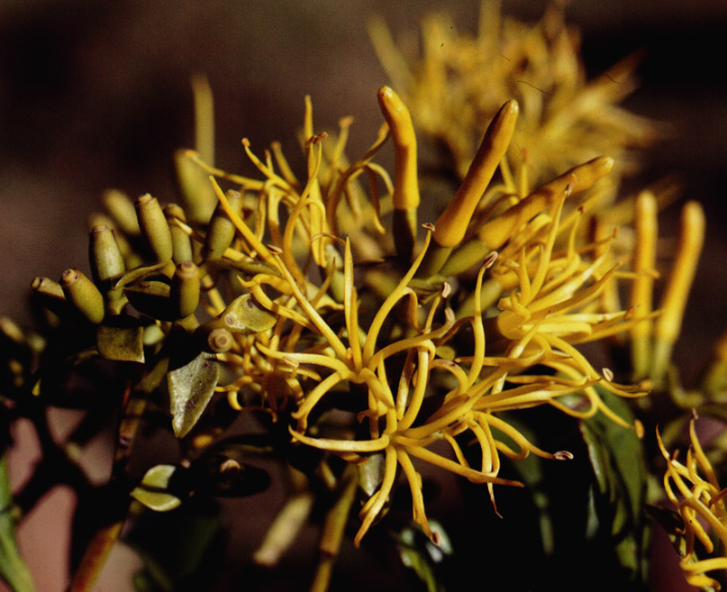
Gaiadendron - a small tree that is parasitic on roots of Ericaceae

Slide 13
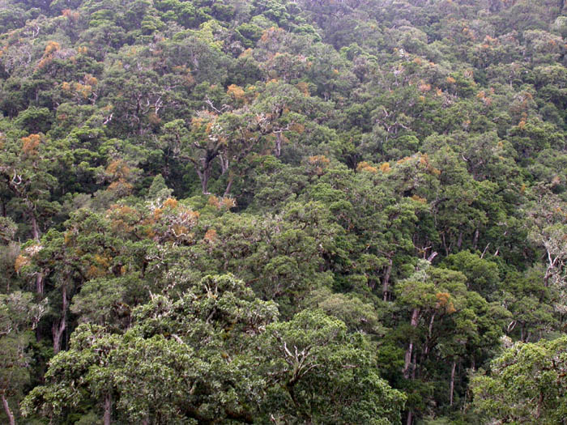
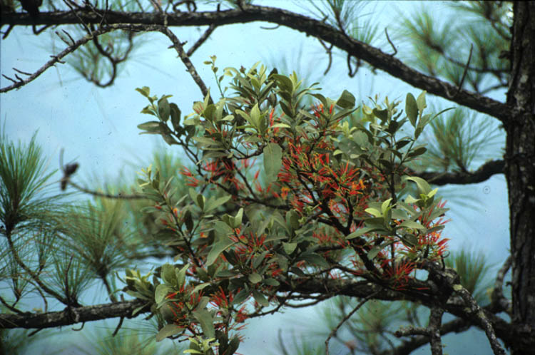
Psittacanthus – its place in the forest

Slide 14
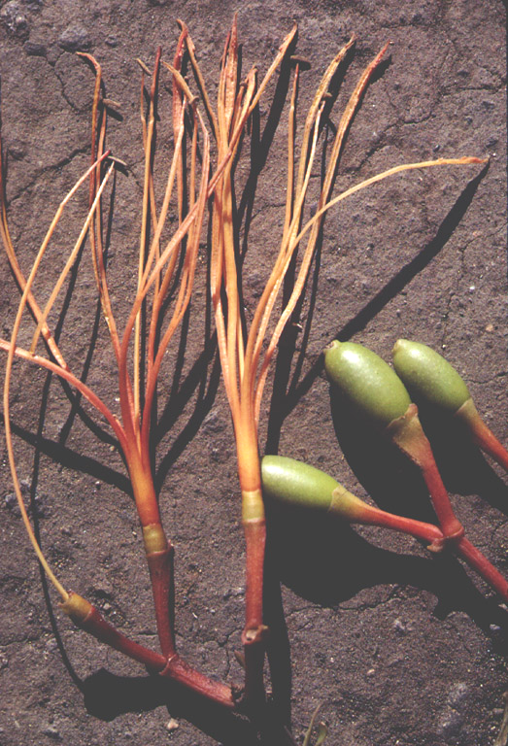
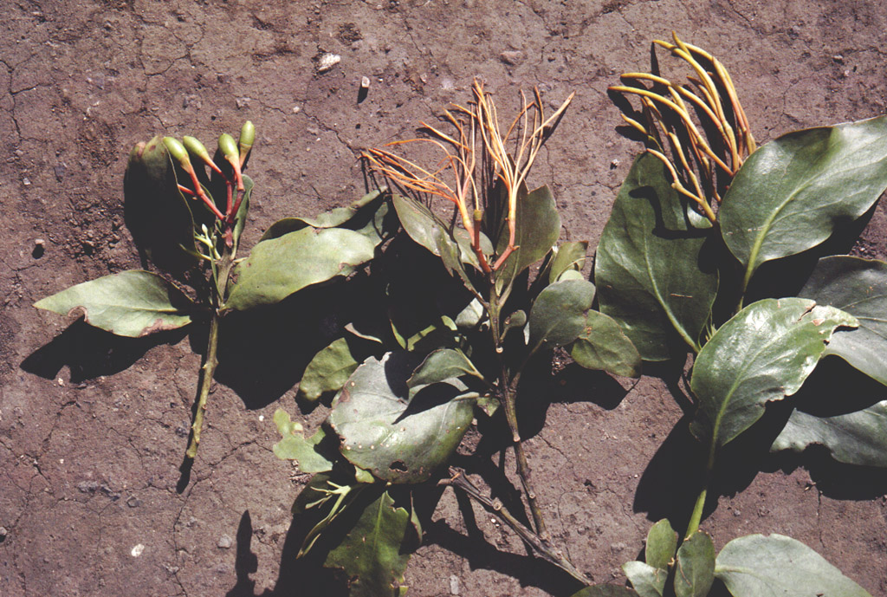
Psittacanthus - parasite on montane-forest oaks in Costa Rica

Slide 15
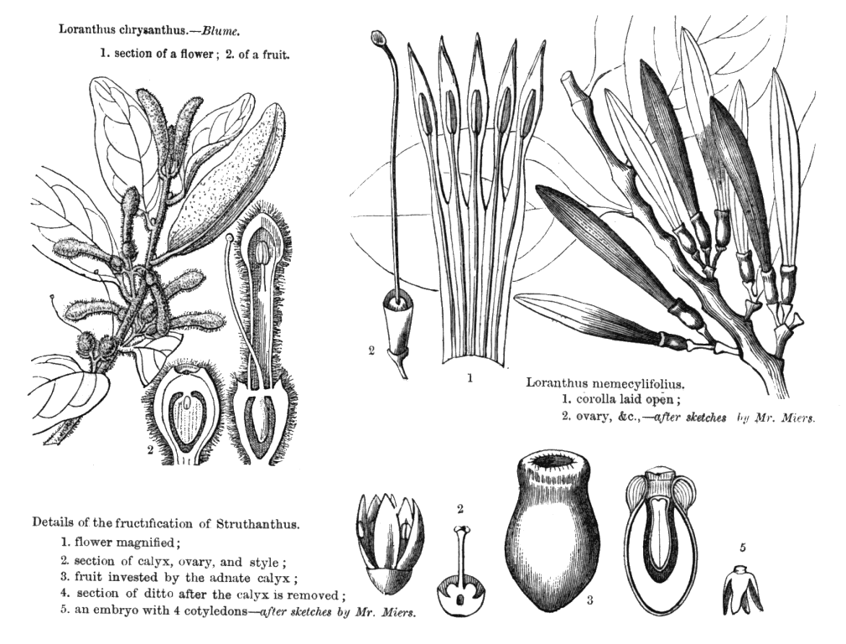
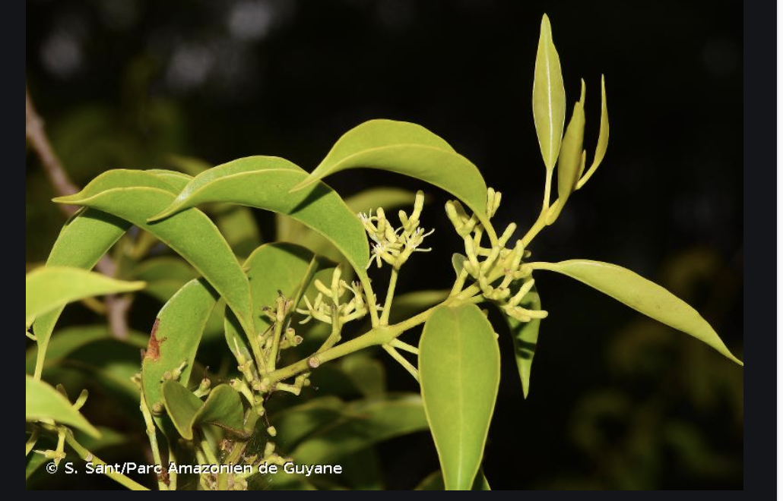
Struthanthus

Slide 16
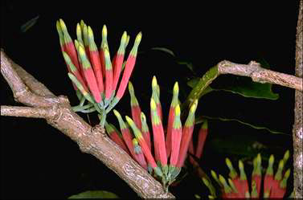
Amylotheca dictyophleba
[DLN 3012]
Notes:
Photographer: Ollerenshaw

Slide 17
http://biodiversity.uno.edu/delta/angio/images/loran789.gif

Slide 18
Su et al., 2015

Slide 19
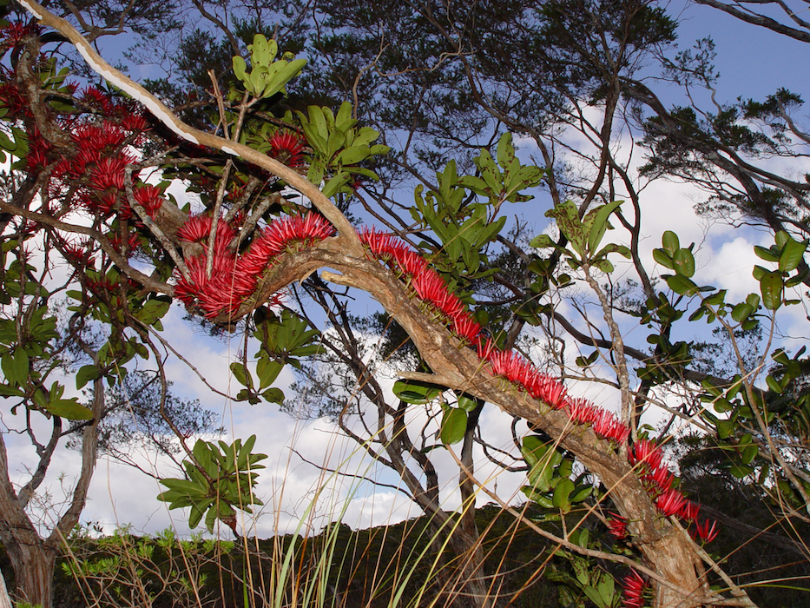
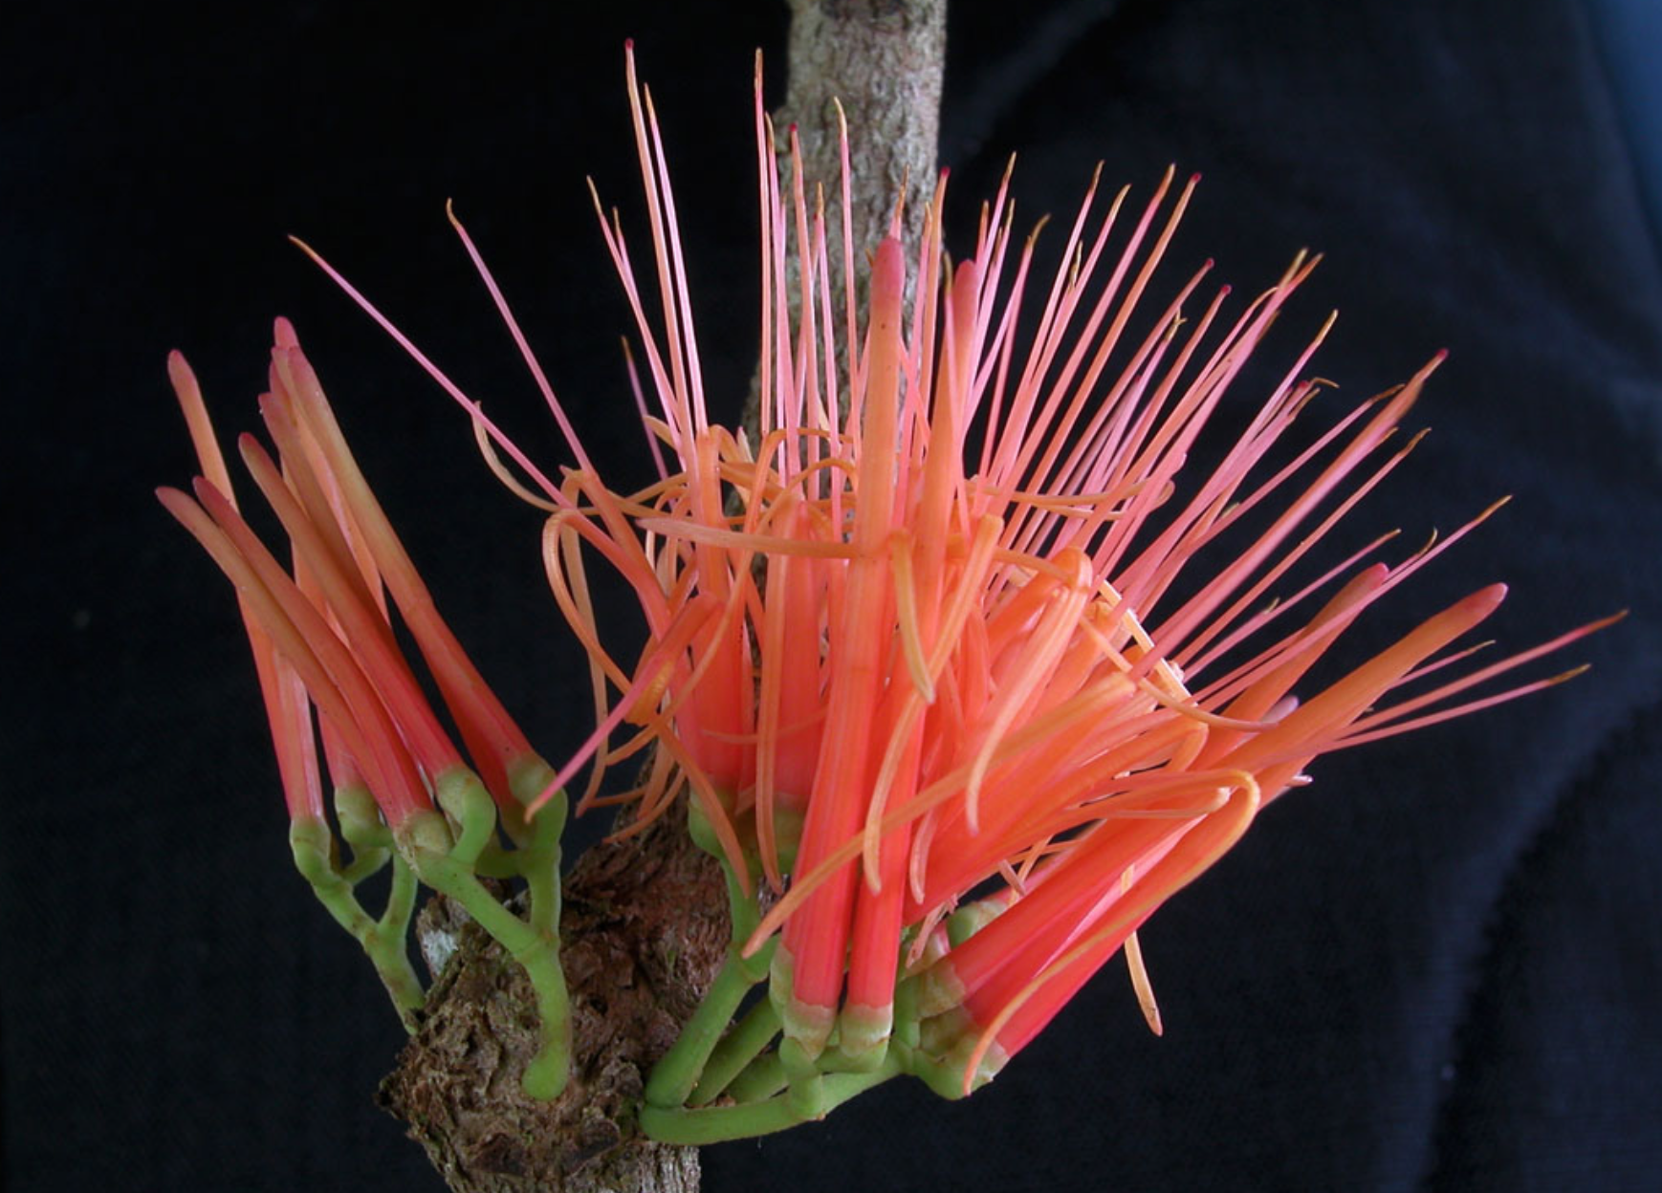
Amyema, Australia

Slide 20
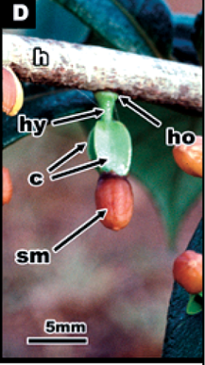
Psittacanthus schiedeanus seedling showing the numerous cotyledons.
Photo by D. L. Nickrent. [DLN 3012]
Struthanthus sp. Seedling
wilson2006.pdf
Notes:
Cotyldeons (c); elongate hypocotyl (hy), discoidal
holdfast (ho), and seed mass (sm)

Slide 21
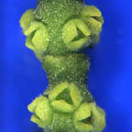
Mistletoes elsewhere in the Santalaceae are in the tribe Visceae
Arceuthobium, Phoradendron, Dendrophthora, Korthasella
Key characters:
Monoecious stem parasites with brittle, jointed stems, tiny flowers, and two fused cotyledons

Slide 22
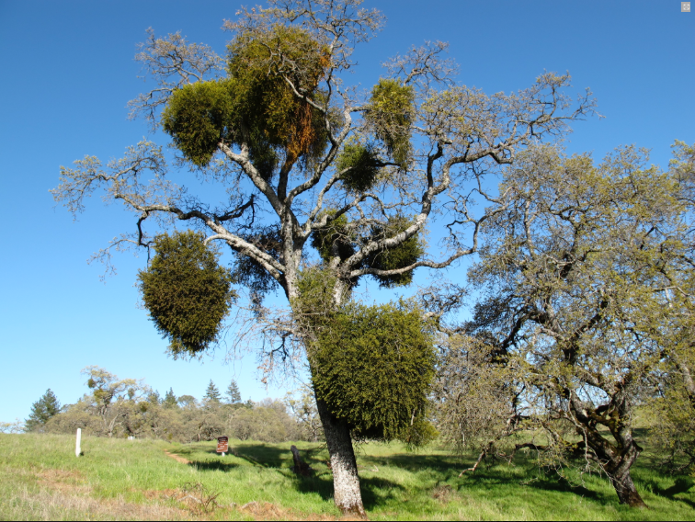
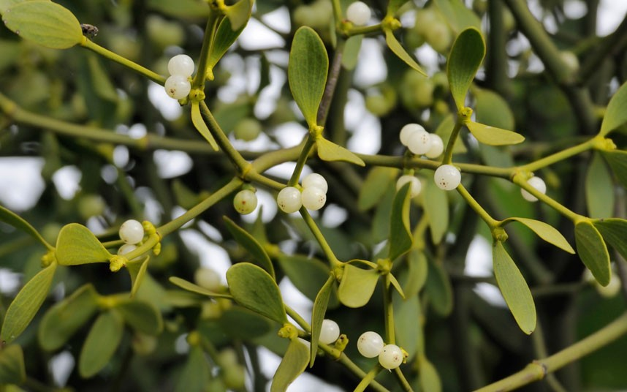
Phoradendron - the mistletoe genus familiar to most people in North America (in Europe it’s Viscum album)

Slide 23
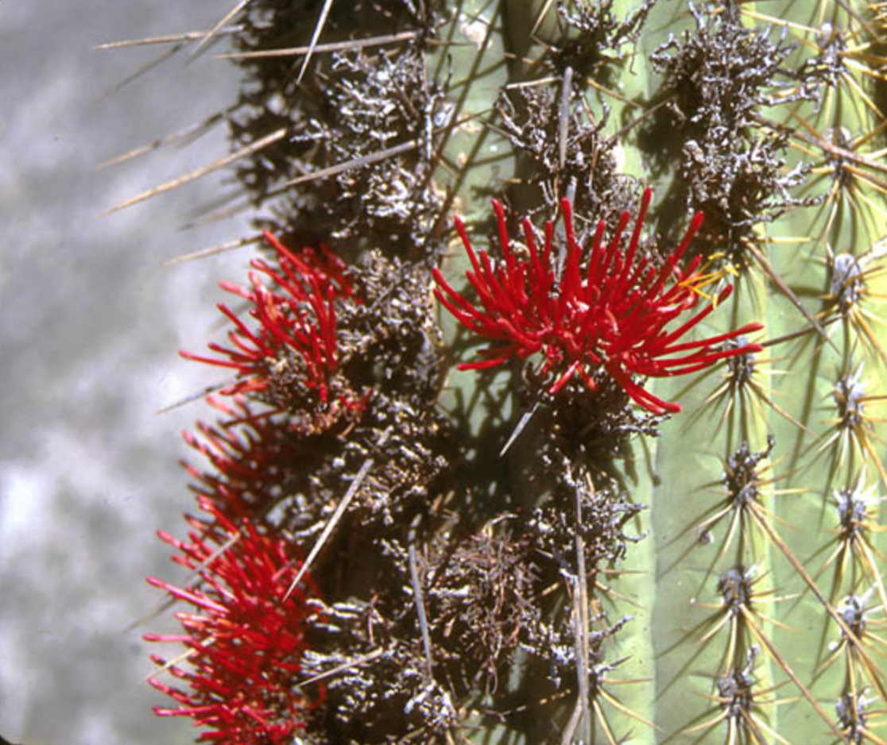
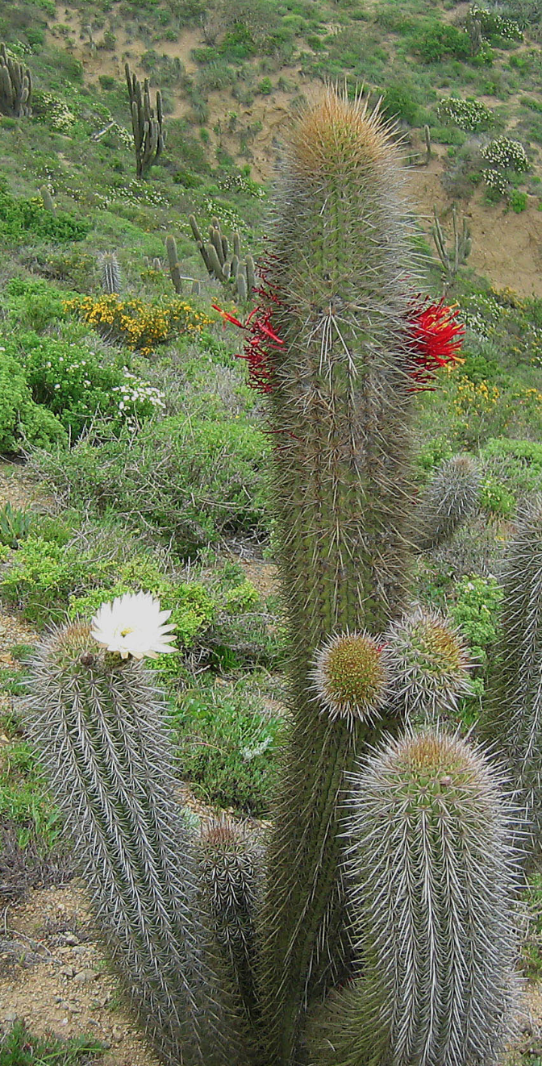
Tristerix aphyllus on Echinopsis chilensis, Chile
Notes:
Excellent detailed portfolio of a cactaceae loranth with cellular haustorium pix.
http://parasiticplants.siu.edu/Loranthaceae/TristerixAphyllus.html
Also refs to articles

Slide 24
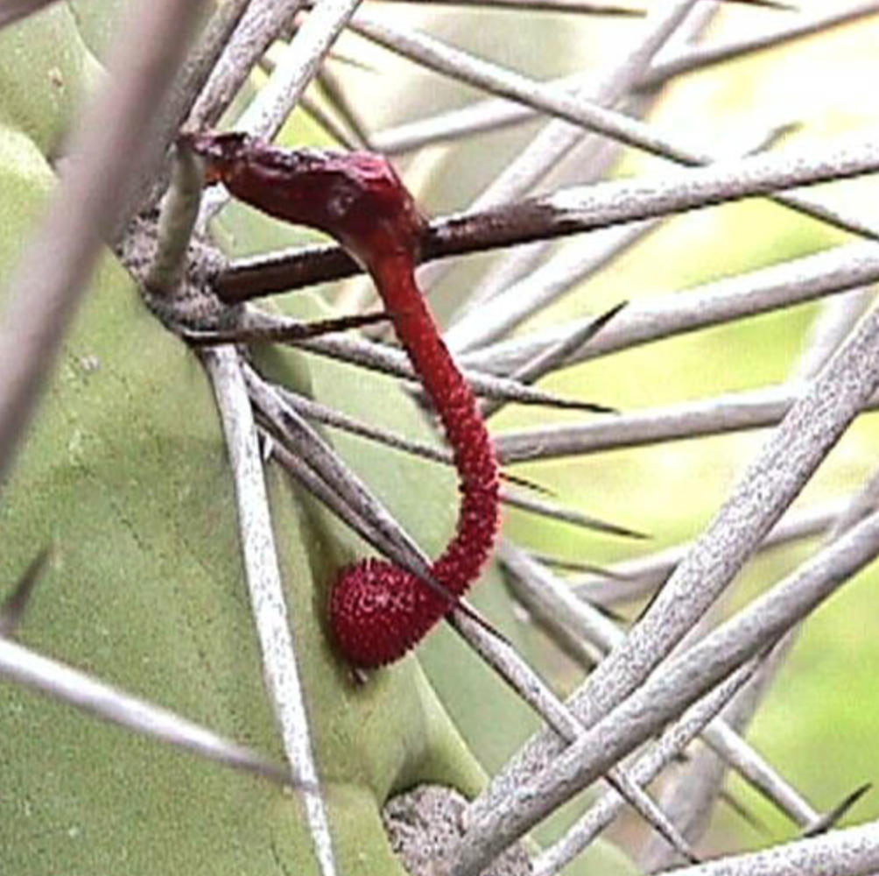
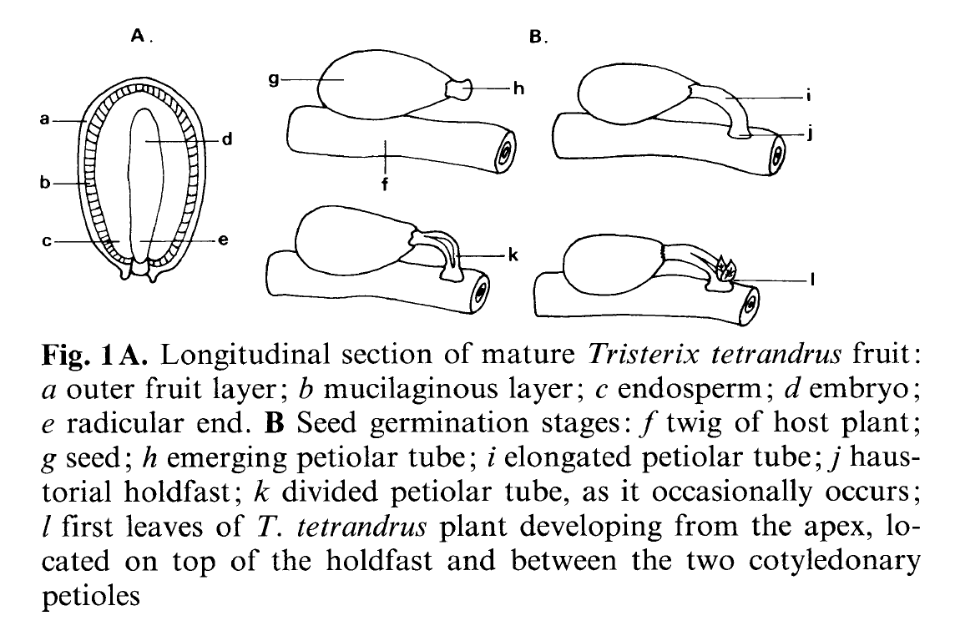
Tristerix aphyllus germinating.
Notes:
Hoffmann, A.J., Fuentes, E.R., Cortés, I., Liberona, F. and Costa, V., 1986. Tristerix tetrandrus (Loranthaceae) and its host-plants in the Chilean matorral: patterns and mechanisms. Oecologia, 69(2), pp.202-206. hoffmann1986.pdf

Slide 25
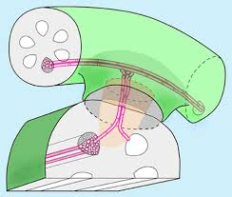
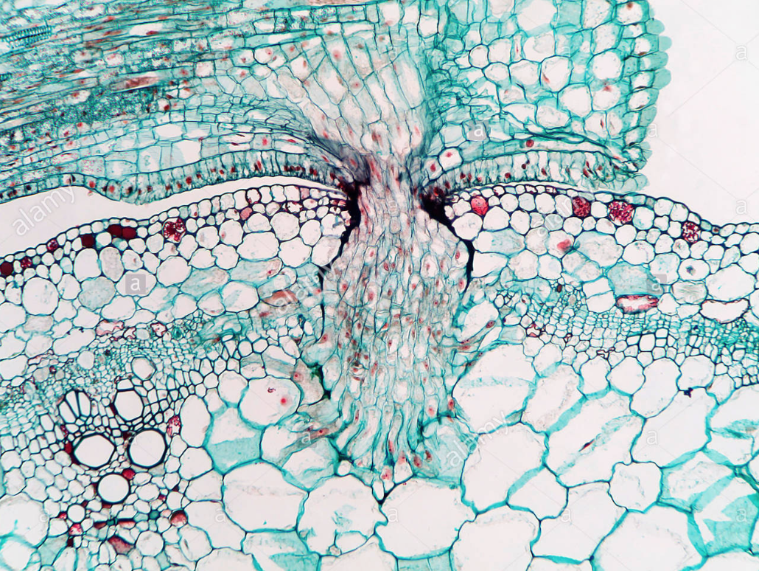
Notes:
http://www.alamy.com/stock-photo/haustorium.html

Slide 26
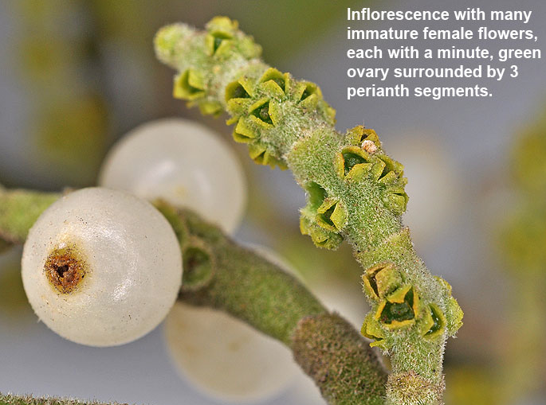
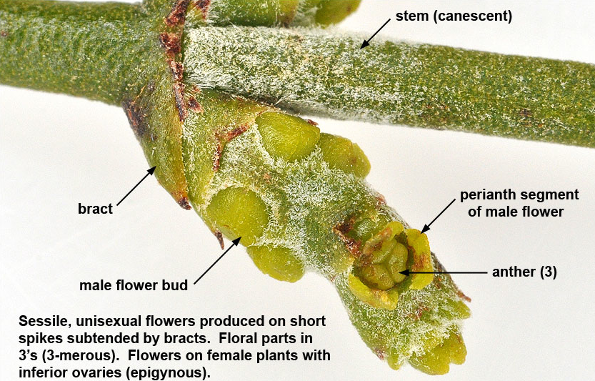

Slide 27
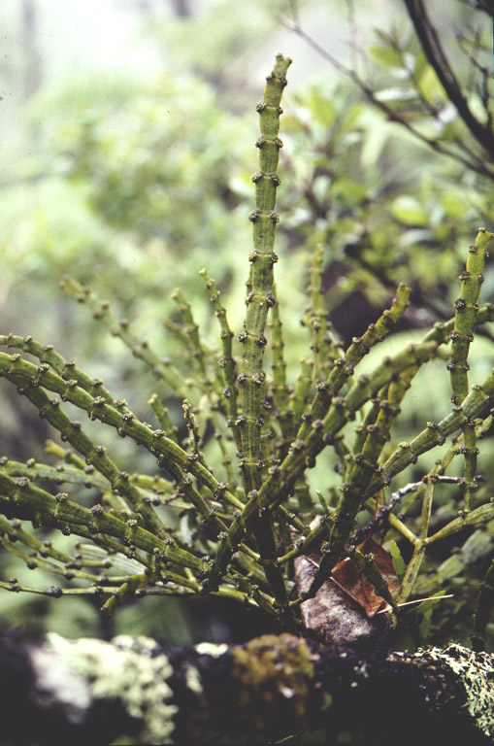
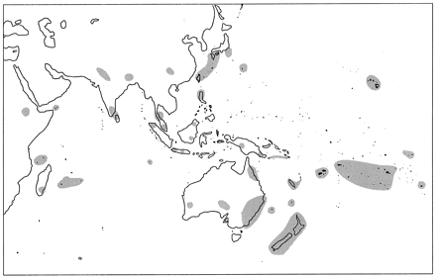
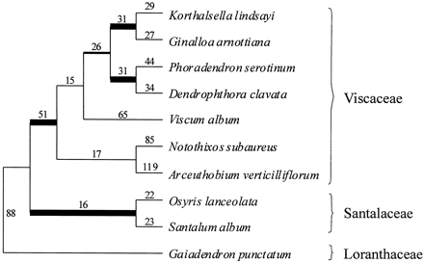
Korthalsella- a mistletoe with flat stems and no leaves from Hawaii.
Genus distribution
Mia Molvray, Paul J. Kores and Mark W. Chase, 1999

Slide 28
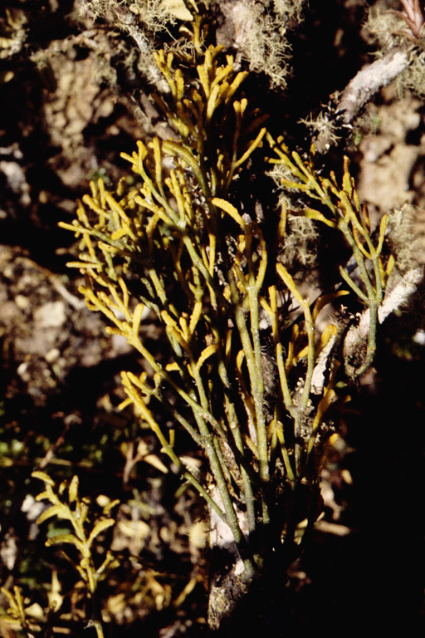
Dendrophthora - an extremely reduced mistletoe from high montane Costa rica

Slide 29
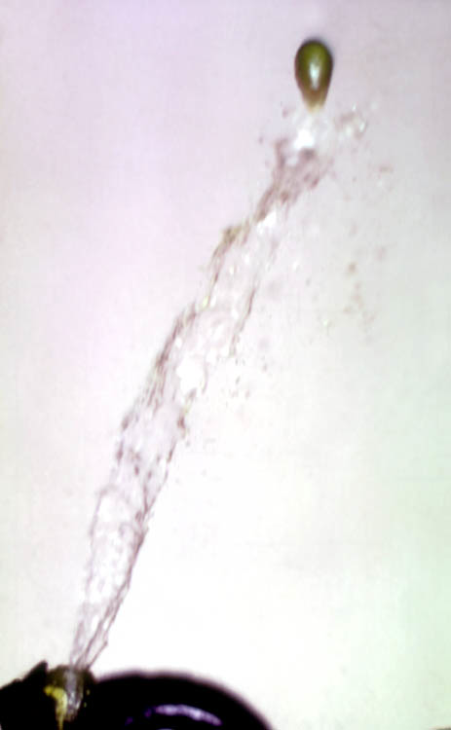
Arceuthobium - the native mistletoe of the Northeast
Explosive fruit dehiscence
Notes:
http://www.parasiticplants.siu.edu/Viscaceae/cycle.html

Slide 30
Key Characters for the Loranthaceae
Parasites
Opposite leaves
Stamens equal and opposite perianth parts
Perianth connate
And some more characters:
Disk
Inferior ovary
Red or orange flower color
Extra cotyledons

Slide 31
EXTRA IMAGES
Notes:
http://biodiversity.uno.edu/delta/angio/images/loran171.gif

Slide 32
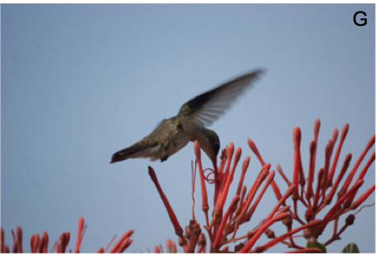
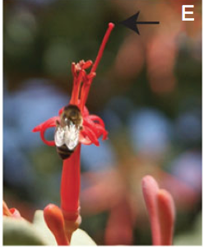
Loranthaceae — a Look into Pollination Syndromes of Psittacanthus auriculatus
Butterfly Pollination
Max (Buck) Buchholz
Hummingbird Pollination
Bee Pollination

Slide 33
Background on Loranathaceae — Seed Dispersal/Germination and Pollination
Germination
Birds eat drupes
Viscin on seeds
Haustorium penetrates
Pollination
Hummingbirds go for nectar at base of corolla tube
Corolla tube splits and anthers become prominent
Birds break open connate corolla and pollen explodes off anther

Slide 35
Aims of Perez-Crespo Study
Analyze floral visitors of P. auriculatus
Determine which pollinators are most frequent (or most successful)
Investigate floral biology of P. auriculatus
What breeding system is most effective (selfing, animal pollinators?)
Nectar secretion
Pollination syndromes

Slide 36
Flower Growth and Floral Biology of P. auriculatus
Two day phase
Connate corolla eventually splits
12 H male, overlap, 36 H female, style starts shorter than stamen

Slide 39
Pollination by Different Methods, and Different Species
Hummingbirds are most frequent visitors
Hummingbirds contacted anthers and stigma
Butterflies and bees did not
Natural selfing able to occur due to protandry (stigma passes anthers during growth on day 1 of flowering)

Slide 42
Implications?
Stigma begins to bend outwards
Helps facilitate pollen transfer to head of hummingbirds (theory)
Natural cross pollination seems to be most effective
Produces the most fruits
Why? Crossing may require more than one pollen donor (this wasn’t done in the manual crossing)
Nectar
First produced at stage of maximum pollen
Theory of re-absorption

Slide 43
References
http://onlinelibrary.wiley.com/doi/10.1111/plb.12365/abstract
http://www.amjbot.org/content/93/5/787/F4.expansion
https://peerj.com/articles/2491/
http://www.floristtaxonomy.com/category/loranthaceae/page/31
Dave Barrington’s Slides ☺

