Slide 1
Investigating the timing of deglaciation and the efficiency of subglacial erosion in central-western Greenland with cosmogenic ¹⁰Be and ²⁶Al

Slide 2
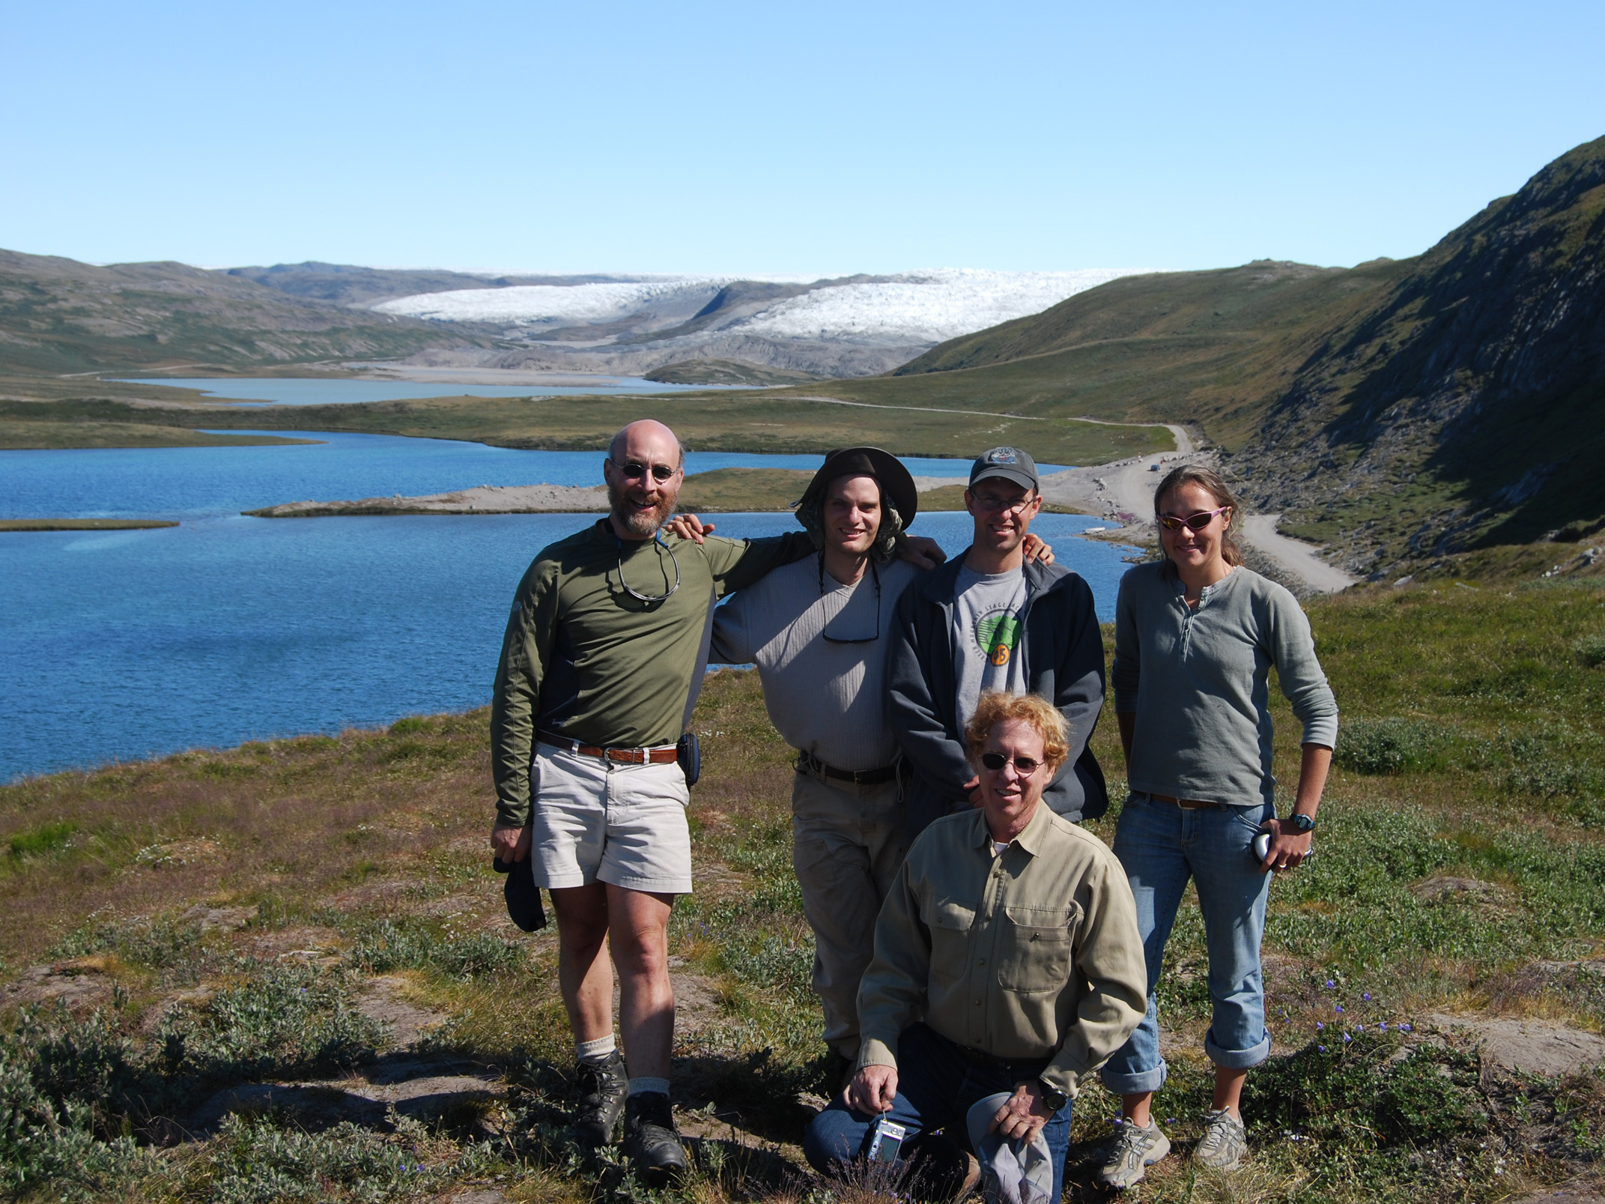
Joseph Graly
University of Vermont ’10
University of Wyoming
Tom Neumann
NASA Cryospheric Branch
Paul Bierman
University of Vermont
Bob Finkel
Lawrence Livermore National Laboratory

Slide 3
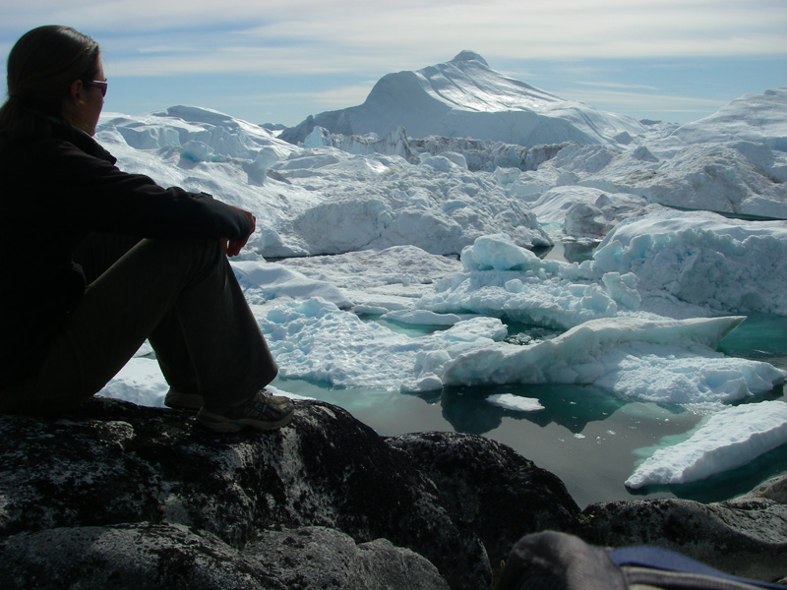
Thesis Road Map:
Optimizing sample preparation for ¹⁰Be analysis by accelerator mass spectrometry
Paired bedrock and boulder ¹⁰Be concentrations resulting from early Holocene ice retreat near Jakobshavn Isfjord, western Greenland
Constraining landscape history with ¹⁰Be and ²⁶Al in paired bedrock and boulder samples, Upernavik, central-western Greenland

Slide 4
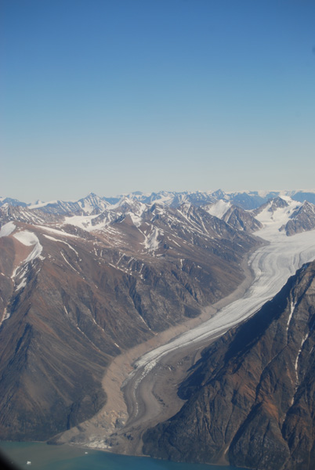
Background & Rationale

Slide 5
Why Greenland?
Background
&
Rationale
Greenland Ice Sheet holds ~7 m global sea level equivalent
Highly susceptible to warming climate
Goal: to investigate how the ice sheet behaved during past warming episodes in order to understand how it might behave in the future

Slide 6
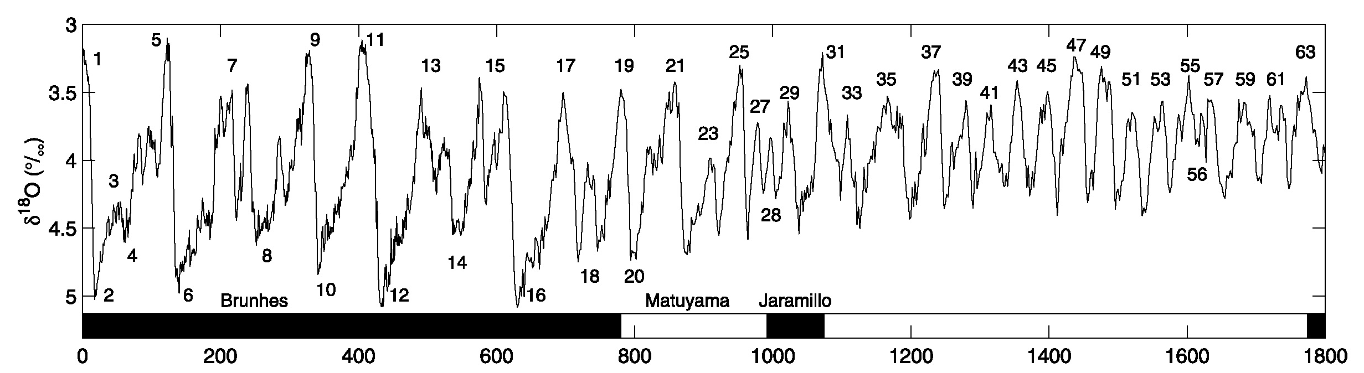
Climate Basics
Climate is not static over time!
Holocene Period
(Lisiecki and Raymo, 2005)
Warmer
Colder
X-axis: thousands of years ago (“ka”)
Last “Ice Age”
Warm periods: “Interglacial”
Cold periods: “Glacial”

Slide 7
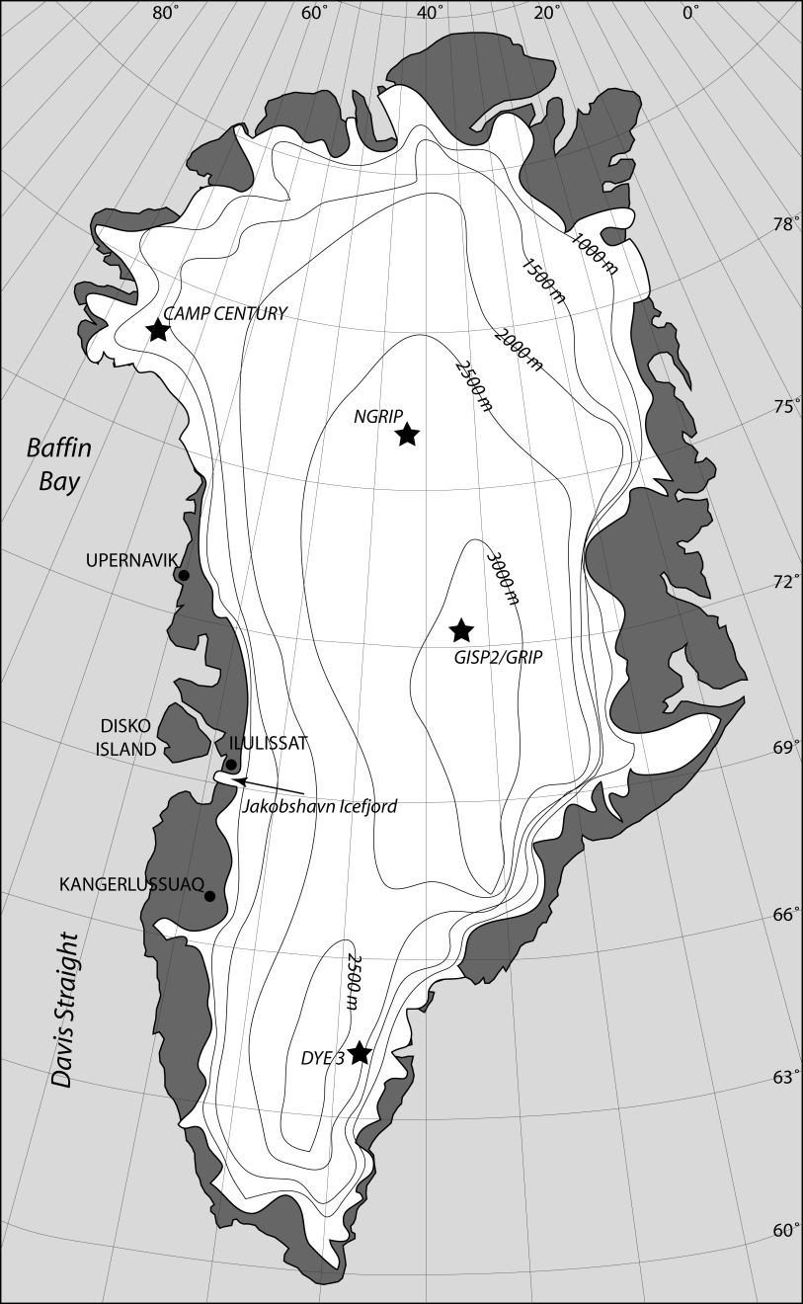
Variability of the Greenland Ice Sheet
Interglacial period
ice extent
Glacial period
ice extent
Cuffey and Marshall (2000)
Letréguilly et al. (1991)
Otto-Bliesner et al. (2006)
Overpeck et al. (2006)
Bennike et al. (2002)
Funder and Hansen (1996)
Winkelman et al (2010)

Slide 8
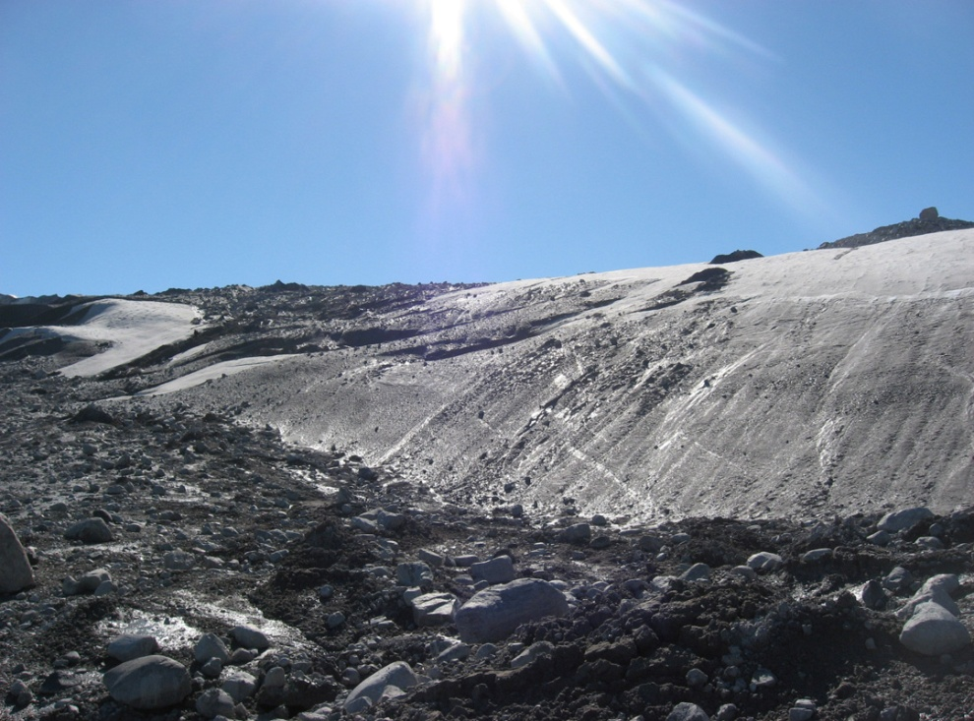
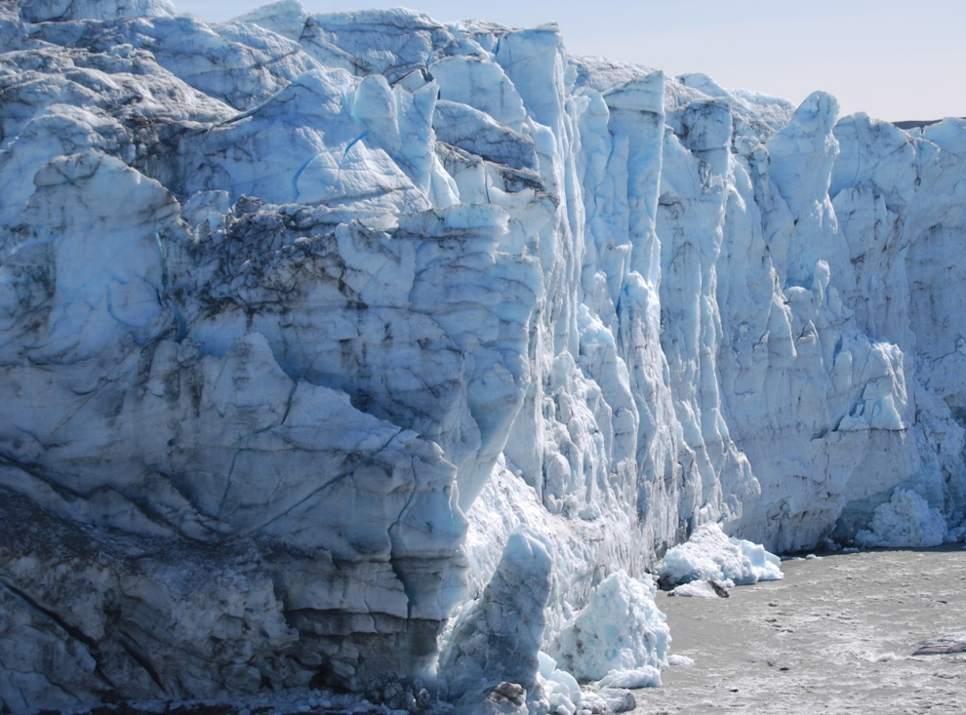
Ice Can Lose Mass in Multiple Ways
Background
&
Rationale
Melting
Sublimation
Calving

Slide 9
Research Goals
Background
&
Rationale
At two different sites in western Greenland:
Make inferences about the efficiency of subglacial erosion
How effectively does ice erode bedrock surfaces?
Does this control the landscape we see today?
Determine the chronology of ice retreat after the last glacial period
When did ice retreat begin?
How long did ice retreat last?
How rapid were ice retreat rates?
Compare ice behavior between two sites

Slide 10
Tools, Study Design, & Methodology

Slide 11
Tools: in situ cosmogenic ¹⁰Be and ²⁶Al
Tools,
Study Design,
&
Methodology
“In situ”: produced within the mineral structure (quartz)
“Cosmogenic”: from cosmic rays
“¹⁰Be”: rare, radioactive isotope of beryllium
“²⁶Al”: rare, radioactive isotope of aluminum

Slide 12
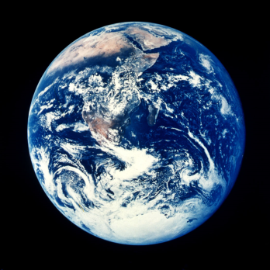
Formation of in situ cosmogenic ¹⁰Be
Background
&
Rationale
Tools,
Study Design,
&
Methodology
Earth is bombarded by high-energy cosmic rays
…causing the formation of ¹⁰Be in quartz
n
p⁺
¹⁰Be is produced only on the surface of a rock
n
p⁺
¹⁶O
¹⁰Be
¹⁰Be is produced at about 6 atoms per year per gram of quartz
(8 protons,
8 neutrons)
(4 protons,
6 neutrons)
n
p⁺
p⁺
n
¹⁰Be is radioactive and has a half-life of 1.38 million years

Slide 13
“Cosmogenic Dating”
Background
&
Rationale
Tools,
Study Design,
&
Methodology
Glacial period: Bedrock is shielded
Ice
Interglacial period: Bedrock is exposed
Assumption: Zero inheritance (i.e. no ¹⁰Be leftover from previous periods of exposure)

Slide 14
Sampling Scheme & Methodology
Background
&
Rationale
Tools,
Study Design,
&
Methodology
Collect bedrock and boulder samples in a transect parallel to direction of ice flow
Analyze ¹⁰Be concentrations
Isolate quartz, remove impurities
Isolate pure Be from quartz
Measure ¹⁰Be/⁹Be ratios by accelerator mass spectrometry (AMS)
Calculate exposure ages
Analyze ²⁶Al contents (only certain samples)
Make inferences about ice behavior

Slide 15
Sampling Scheme
Tools,
Study Design,
&
Methodology
“Dipstick” Sampling:
Sea Level
West
East
(Ocean)
(Interior Greenland)

Slide 16
Cosmogenic Inheritance
Tools,
Study Design,
&
Methodology
More prevalent in bedrock than in boulders
Outcrop is exposed (earlier interglacial?)
Outcrop is covered by ice
Ice is non-erosive, doesn’t remove ¹⁰Be
Outcrop is exposed again
Boulder: 10 ka
Bedrock: 30 ka

Slide 17
Study Sites
Tools,
Study Design,
&
Methodology
Ilulissat:
Latitude: 69°N
Continuous land surface
Jakobshavn Isfjord
Upernavik:
Latitude: 73°N
Fjord-dissected terrain
No major outlet glaciers

Slide 18
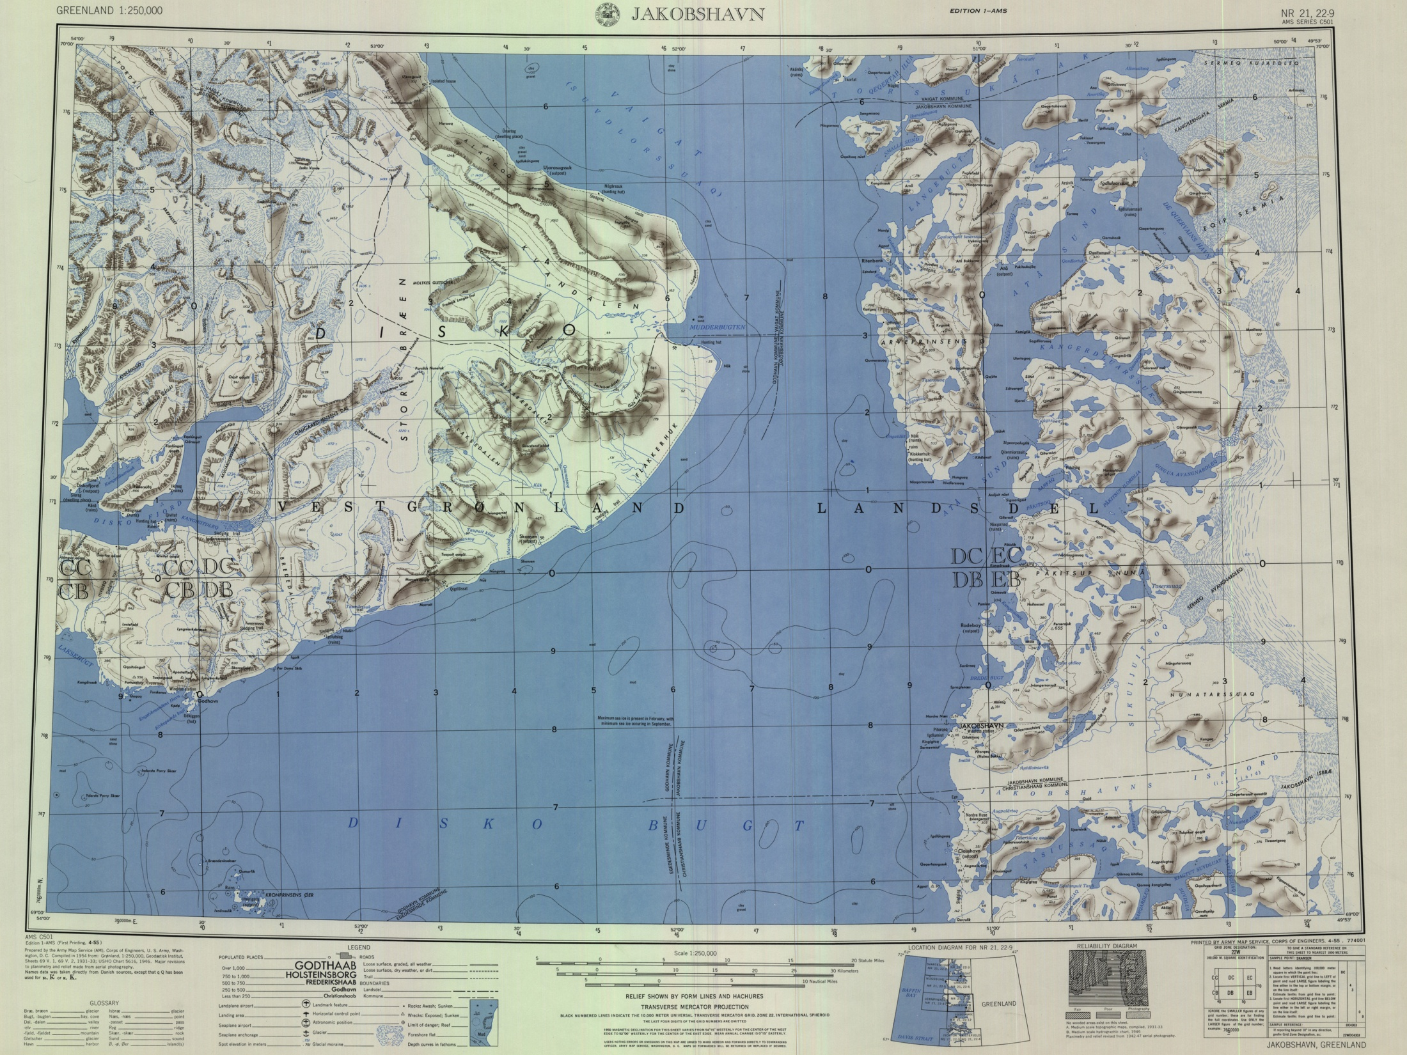

Slide 19
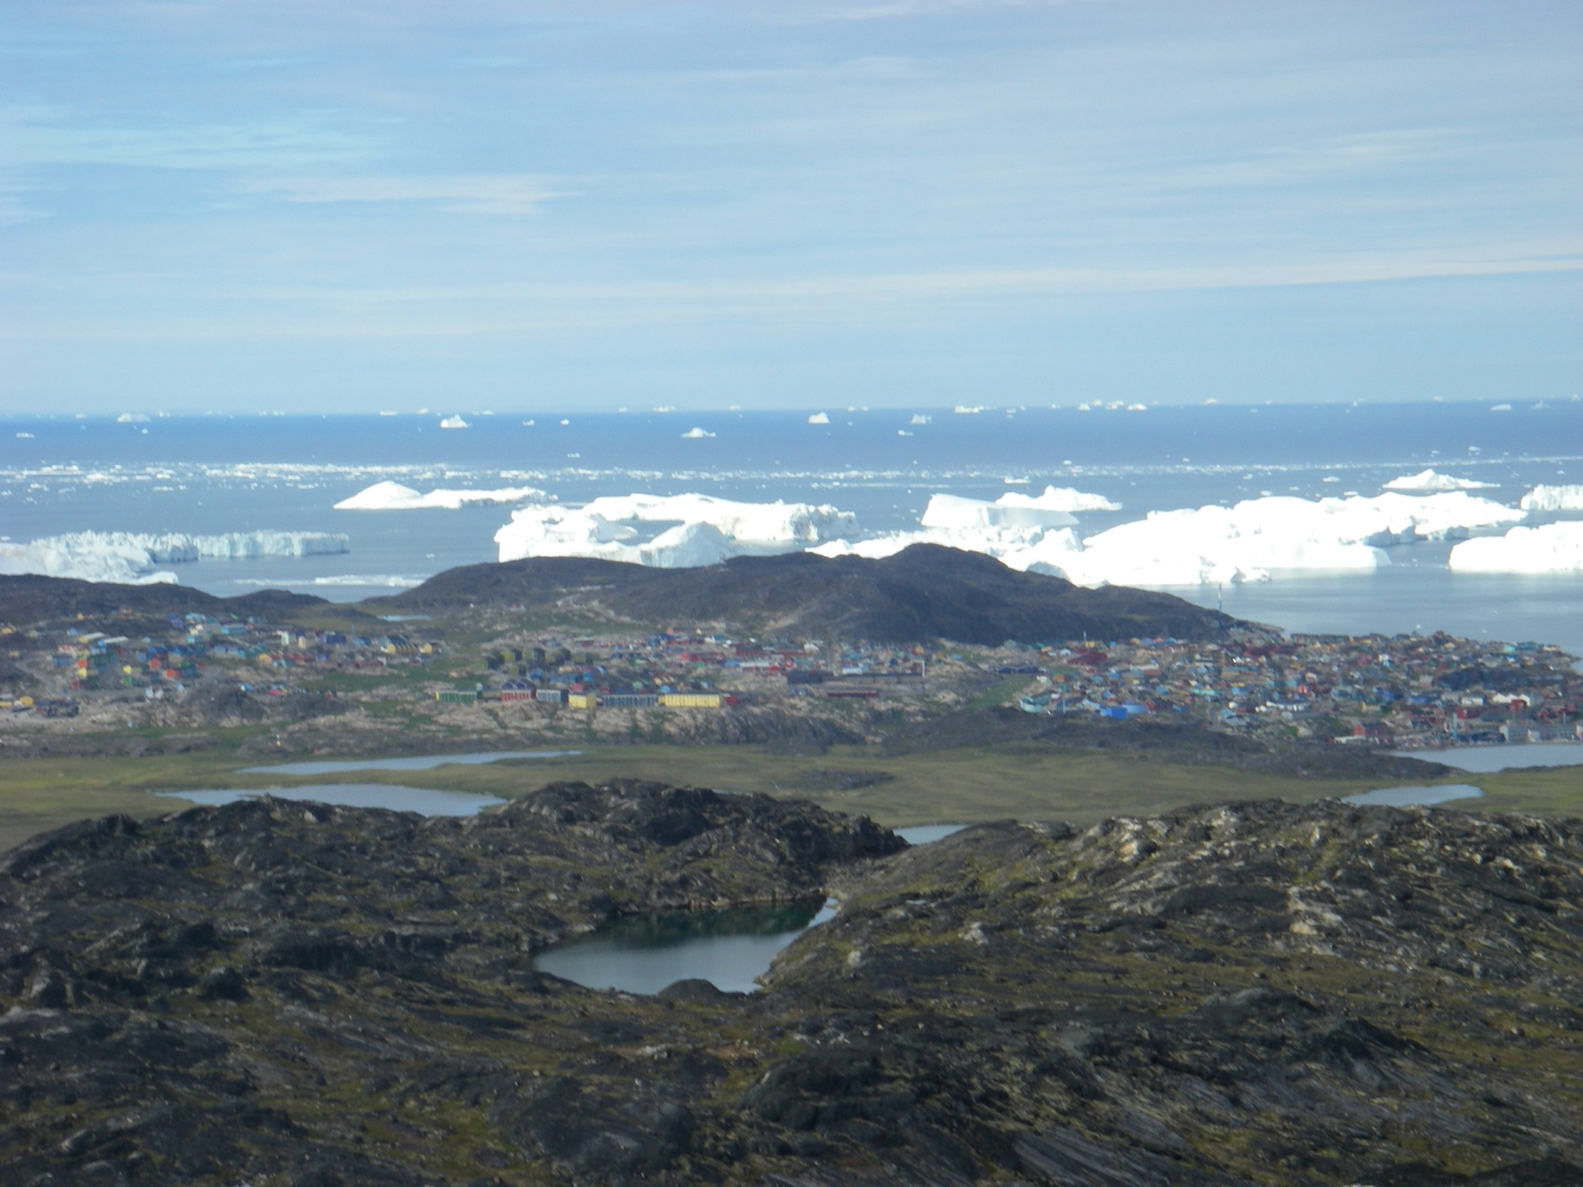
Site #1: Ilulissat, 69°N

Slide 20
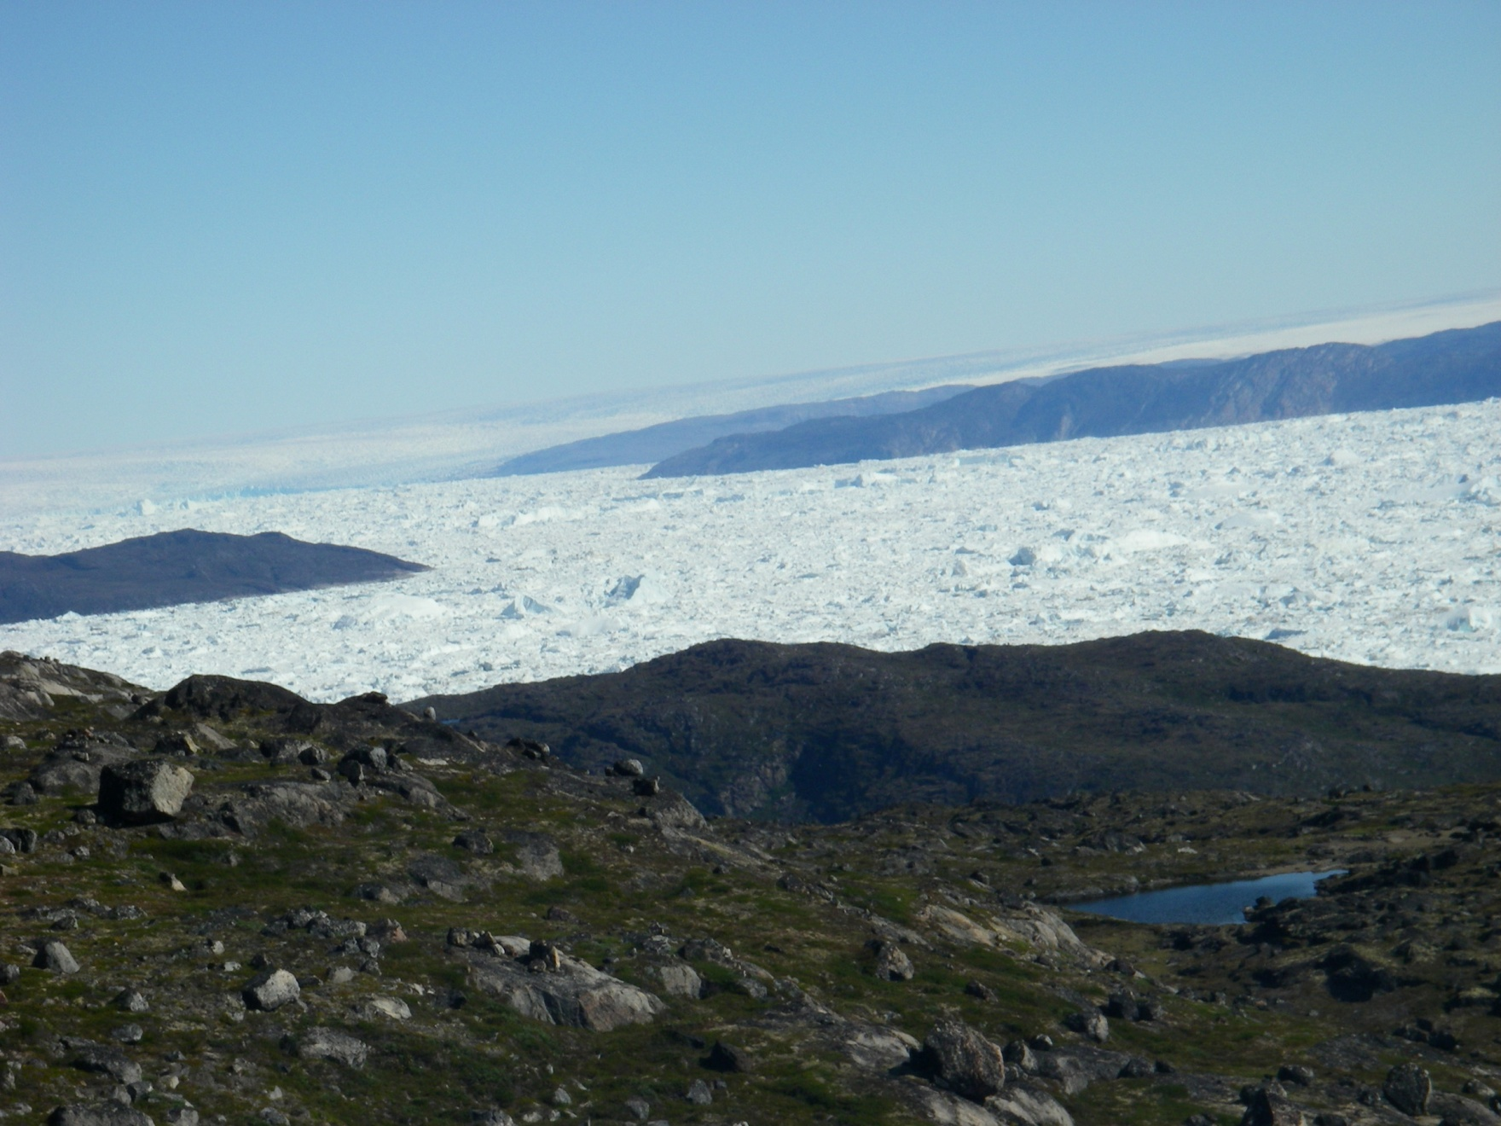
Site #1: Ilulissat, 69°N

Slide 21
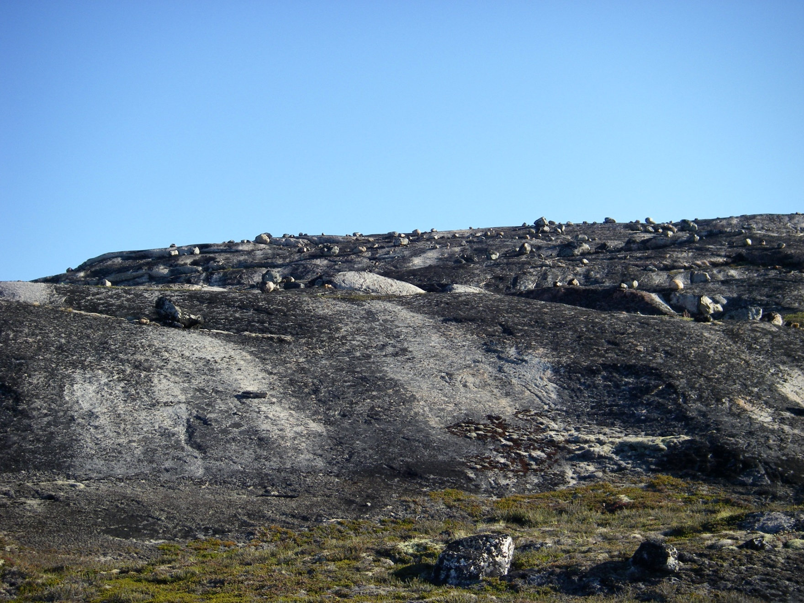
Site #1: Ilulissat, 69°N

Slide 22
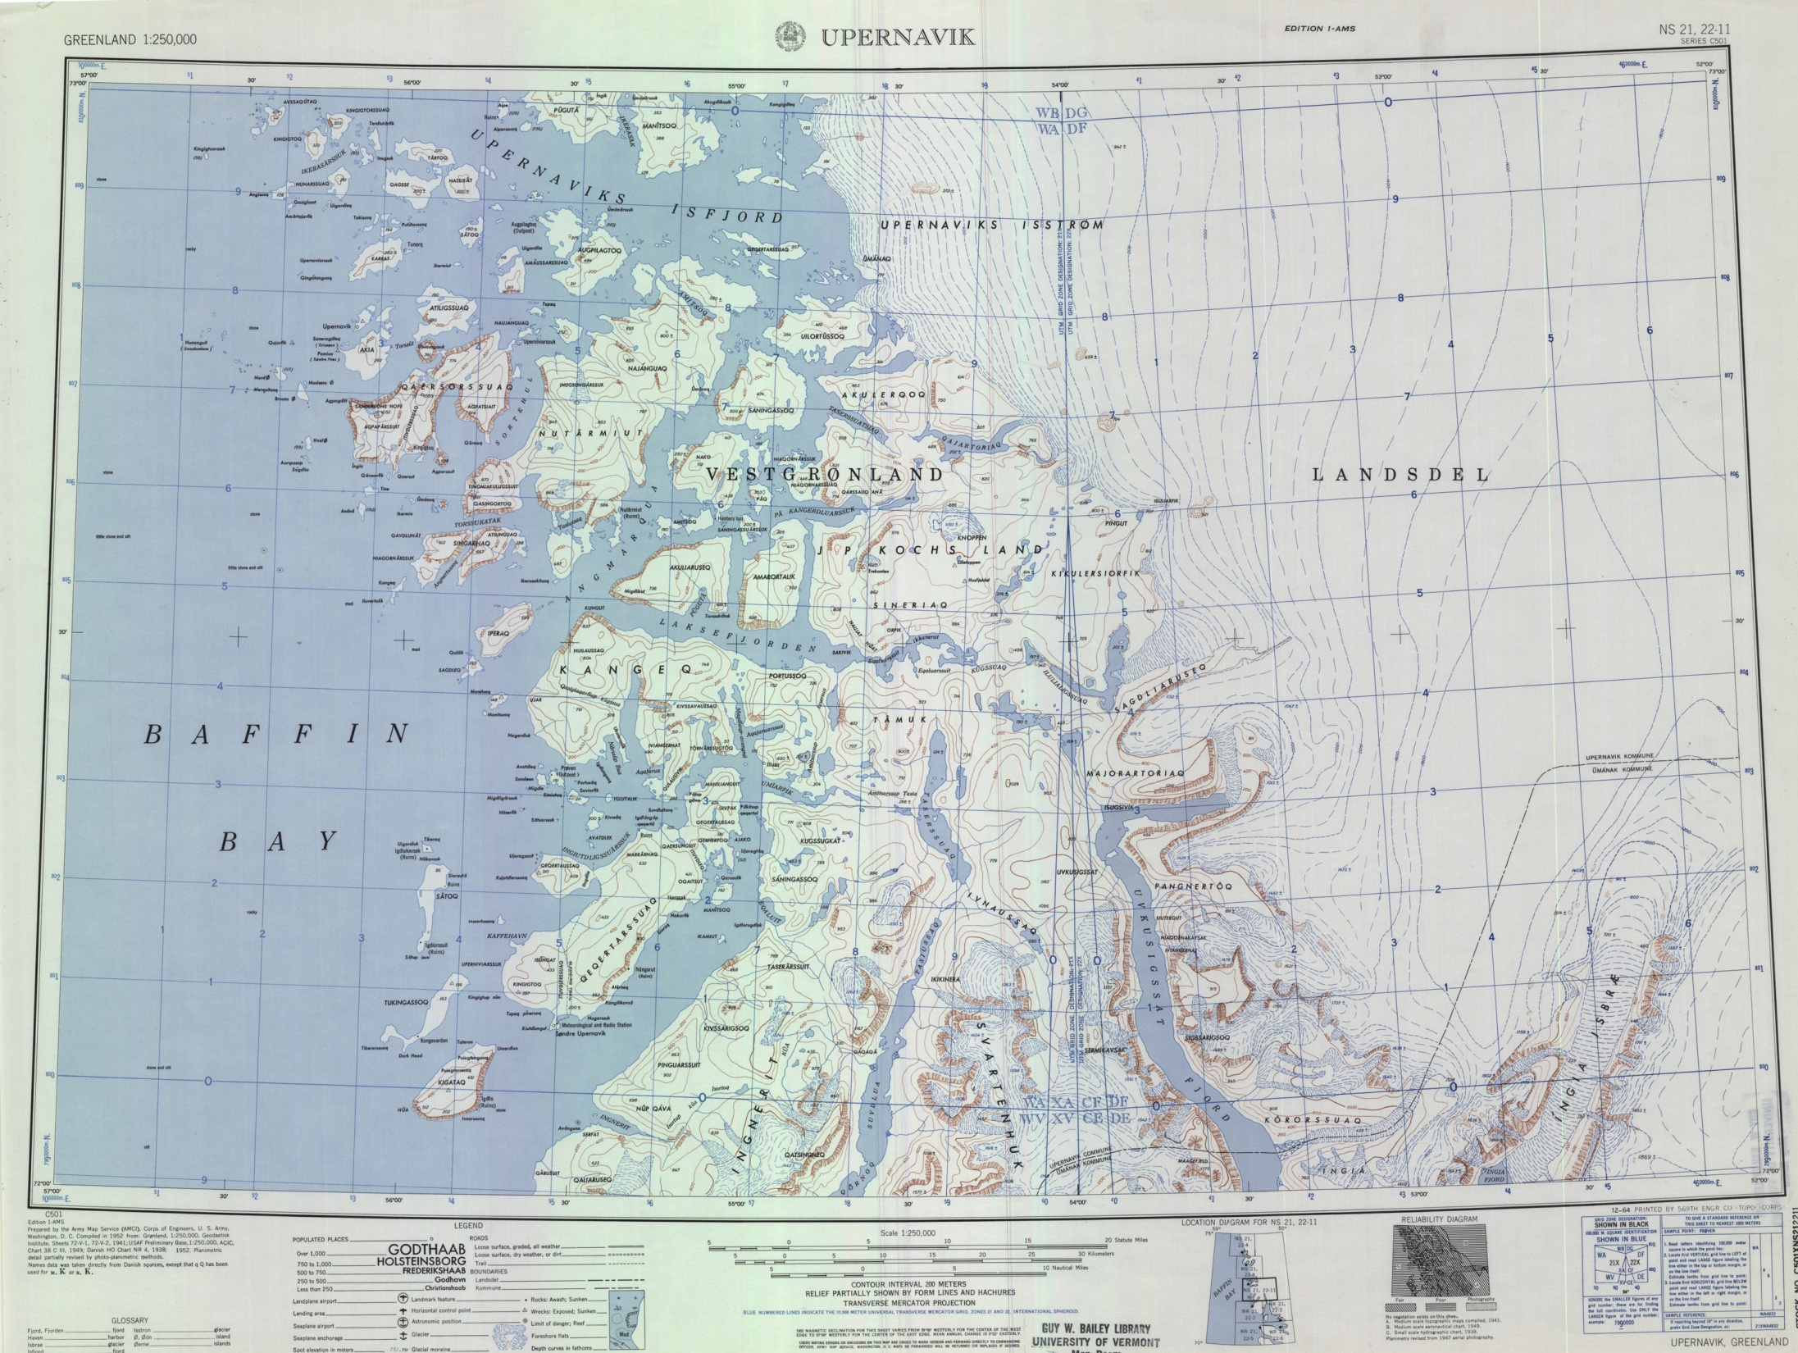

Slide 23
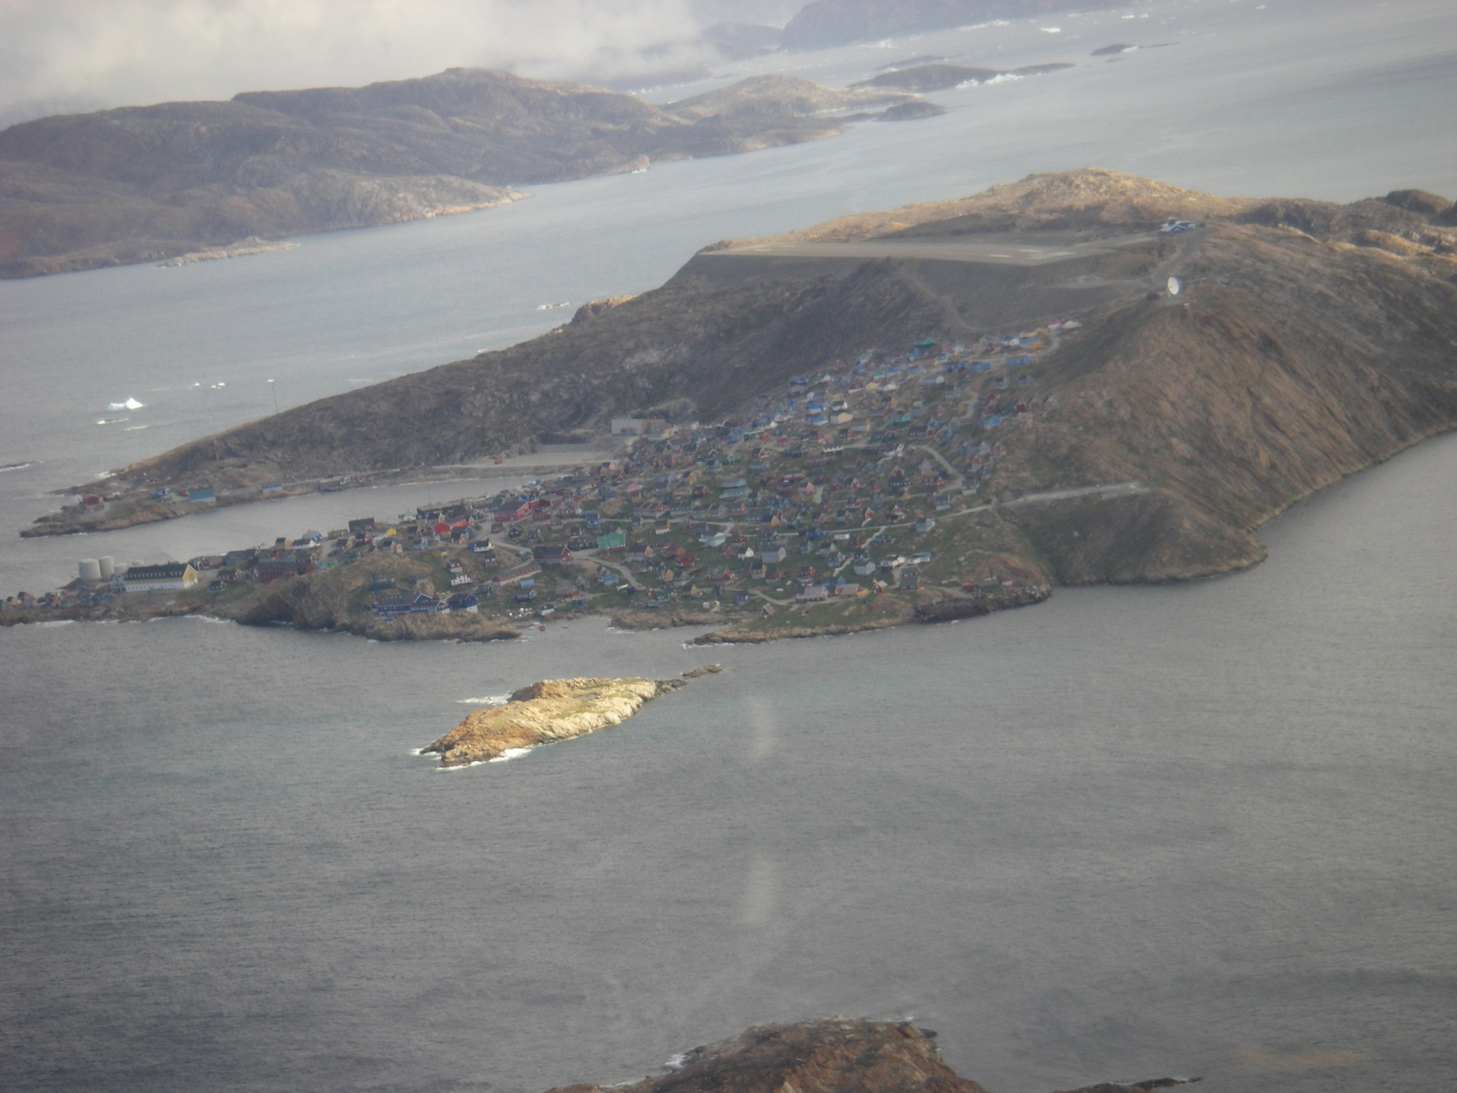
Site #2: Upernavik, 73°N

Slide 24
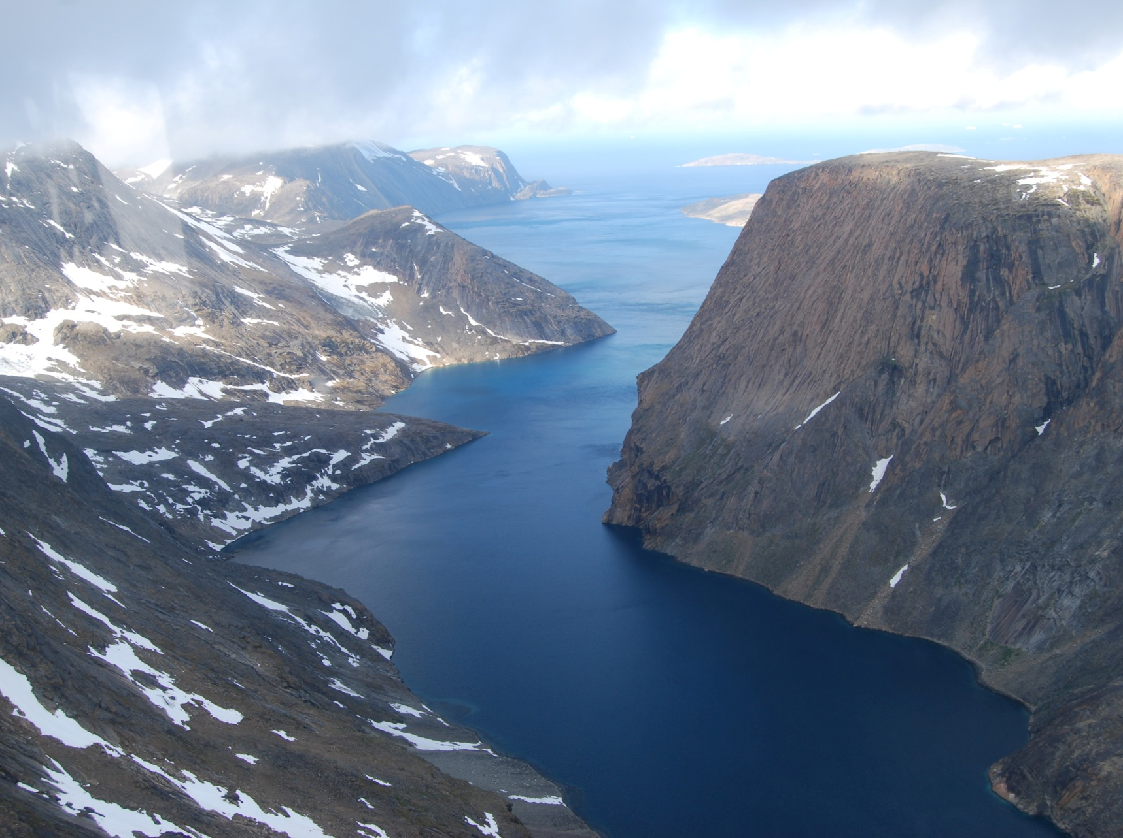
Site #2: Upernavik, 73°N

Slide 25
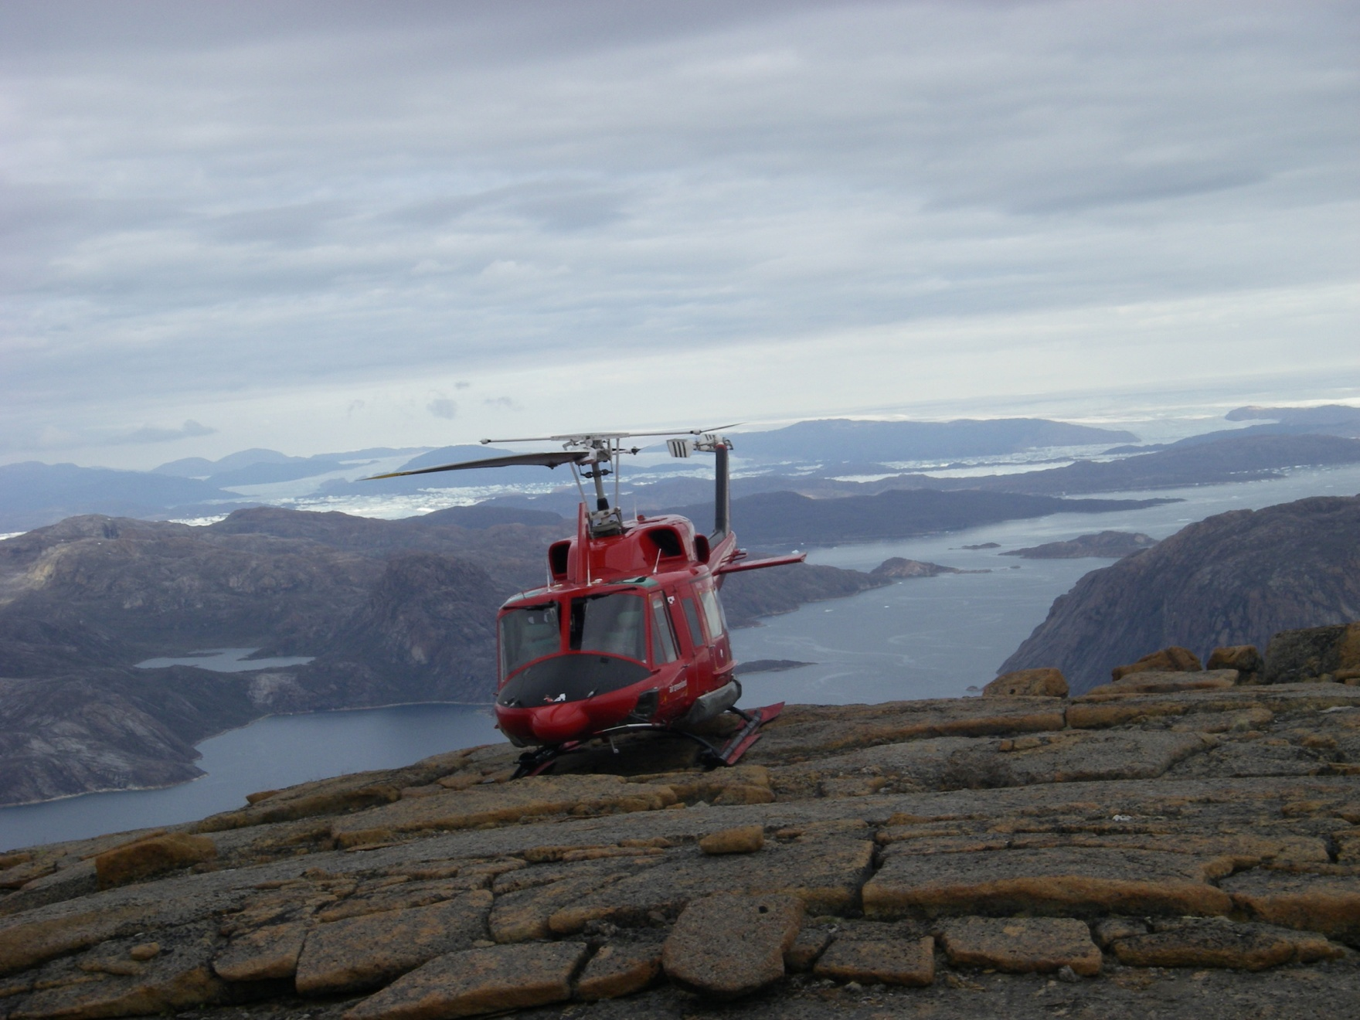
Site #2: Upernavik, 73°N

Slide 26
Recap
Tools,
Study Design,
&
Methodology
¹⁰Be and ²⁶Al are radioactive isotopes formed when cosmic rays interact with quartz
Use the production rate and concentration to calculate an exposure age
Two study sites in western Greenland: Ilulissat (69°N) and Upernavik (73°N)
Samples collected in “dipsticks”
Goal: to understand subglacial erosion efficiency and ice retreat characteristics

Slide 27
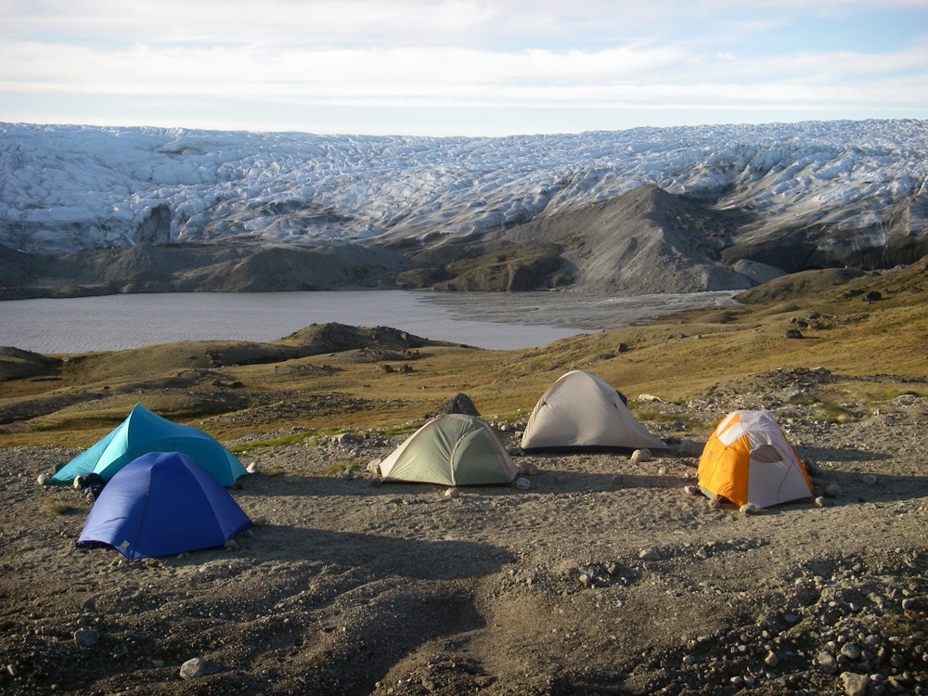
Thesis Part I: Methodological Development

Slide 28
Methodological Limitations
Part I:
Methodological
Development
Counting individual atoms!
Limited by the number of atoms that can be counted in a given amount of time
More atoms counted = higher precision
AMS counting efficiency is controlled by the “beam current”
Purity of sample
Amount of sample
Higher beam currents = higher counting efficiency = higher precision

Slide 29
Laboratory Methods

Slide 30
Methodological Optimization
Part I:
Methodological
Development

Slide 31
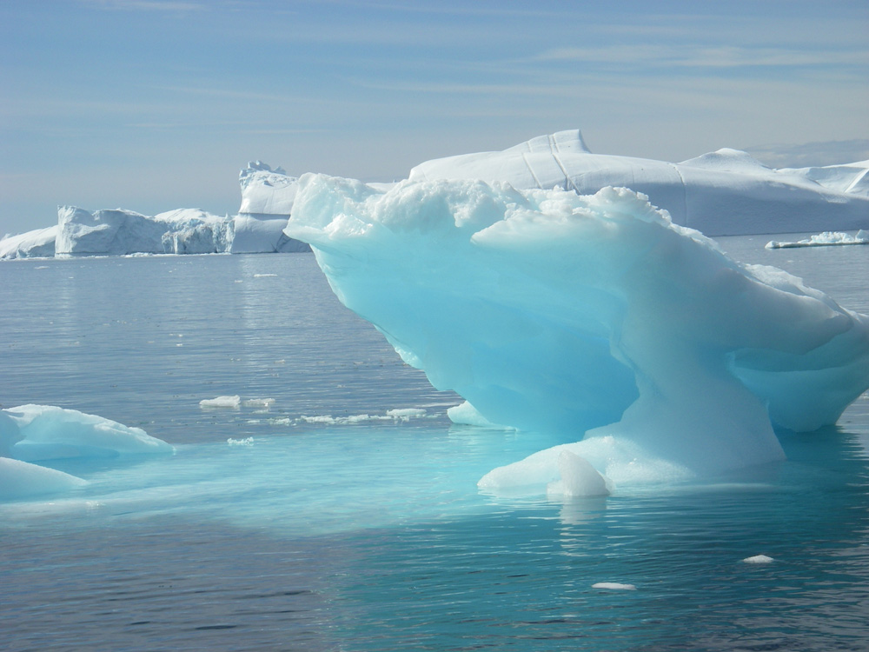
Thesis Part II: Ilulissat, Greenland

Slide 32
Outer
Inner
(Image courtesy of Landsat, 2000)

Slide 33
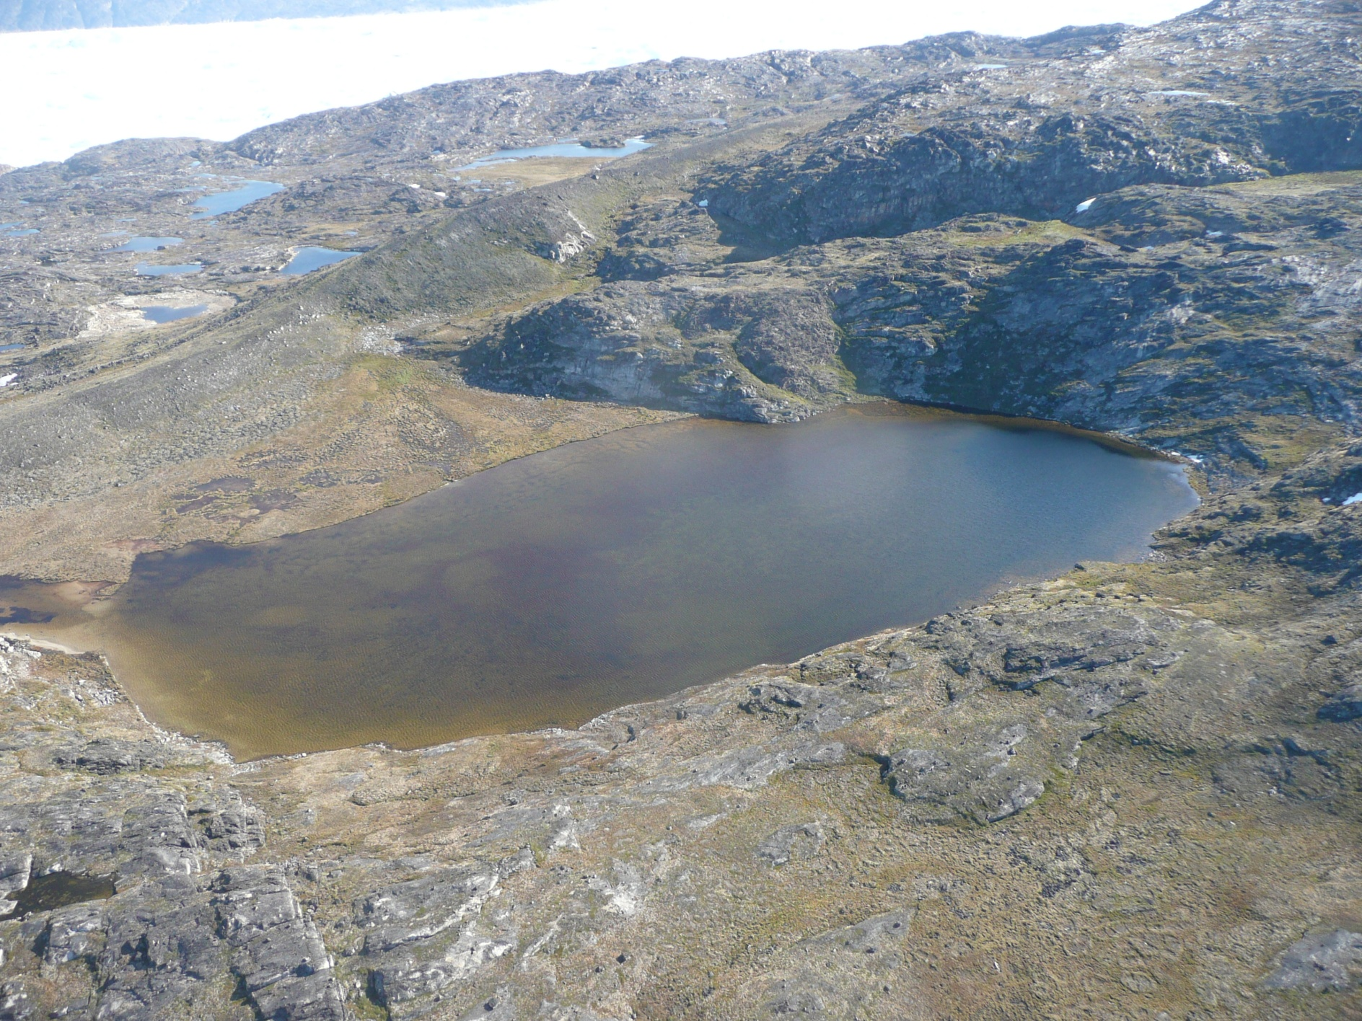
Fjord Stade Moraine
(Photo courtesy of Nicolas Young)

Slide 34
All ages are Holocene
(Image courtesy of Landsat, 2000)

Slide 35
Bedrock/Boulder Comparison
Part II:
Ilulissat,
Greenland
Bedrock and boulder samples are in close agreement
Little or no inheritance
Erosive glacial ice

Slide 36
Complicated Deglaciation Pattern
Part II:
Ilulissat,
Greenland
Age of outer land surface:10.3 ± 0.4 ka (n = 7)
Age of inner land surface: 8.0 ± 0.7 ka (n = 21)
Just inside moraine: 8.2 ± 0.1 ka (n = 2)
Complicated deglaciation pattern!
Age of the Fjord Stade moraine is ~8.2 ka

Slide 37
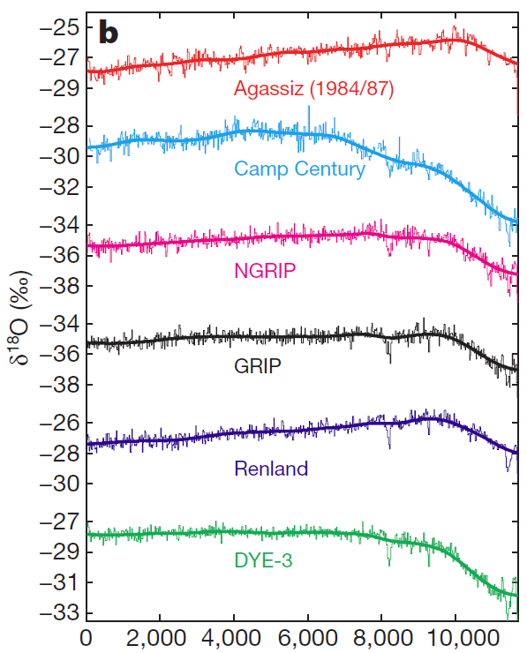
Formation of the Fjord Stade Moraine
Part II:
Ilulissat,
Greenland
Fjord Stade moraine formed due to an ice margin re-advance in association with the “8200 Event”
(Vinther et al., 2009)
Years before present

Slide 38
Spatial Variability of Exposure Ages
Part II:
Ilulissat,
Greenland
There is no statistically significant difference between sample ages at high, medium, and low elevations.
The ice sheet thinned rapidly, at rates greater than what we can detect within the uncertainties associated with ¹⁰Be dating.

Slide 39
Spatial Variability of Exposure Ages
Part II:
Ilulissat,
Greenland
Ice went behind the present-day margin ~7.6 ka
How do we quantify ice margin retreat rates?

Slide 40
Ice Margin Retreat
Part II:
Ilulissat,
Greenland
7.6 ka
40 km
8.0 ka
Retreat rate estimate:
40 km of retreat in 400 yrs ≈ 100 m/yr

Slide 41
Ilulissat Overview
Part II:
Ilulissat,
Greenland
All ages are Holocene
Agreement between bedrock and boulder samples indicates little to no inheritance
Efficient subglacial erosion (>2 m)
Deglaciation chronology is complicated due to the presence of a moraine: two land surfaces
Fjord Stade moraine may be associated with the “8200 Event”
Ice retreat began from the coast ~10.3 ka, ice went behind the present-day margin ~7.6 ka
Ice retreated at ~100 m/yr

Slide 42
Thesis Part III: Upernavik, Greenland

Slide 45
Sample Ages
Part III:
Upernavik,
Greenland
Something is going on here… why do we have such old exposure ages?

Slide 46
Bedrock/Boulder Comparison
Part III:
Upernavik,
Greenland
Bedrock samples are much older than paired boulder samples; inheritance is present. Glacial ice is non-erosive or weakly erosive.

Slide 47
Using Cosmogenic ²⁶Al
Part III:
Upernavik,
Greenland
Higher production rate than ¹⁰Be
Shorter half-life than ¹⁰Be
The two isotopes behave differently when burial occurs and production ceases

Slide 48
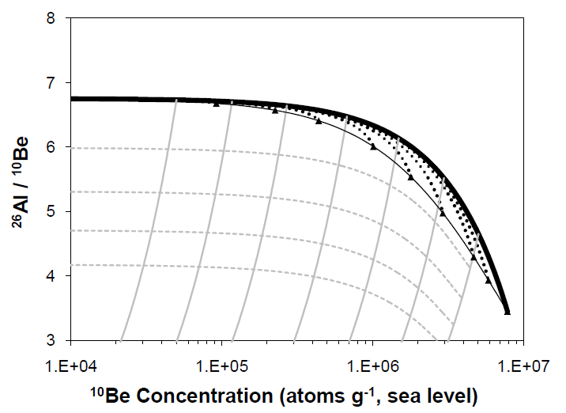
The Two-Isotope Plot
Part III:
Upernavik,
Greenland
Constant Exposure
Constant Exposure
With Erosion
Burial

Slide 49
The Two-Isotope Plot
Part III:
Upernavik,
Greenland
Samples have experienced both exposure and burial. They have long total histories.

Slide 50
Landscape History
Part III:
Upernavik,
Greenland
Landscape history represented by Upernavik samples
Landscape history represented by Ilulissat samples
Warmer
(Lisiecki and Raymo, 2005)
Colder

Slide 51
Inheritance and Elevation
Part III:
Upernavik,
Greenland
Bedrock samples
Boulder samples
There is more inheritance at higher elevations. High-elevation ice is less erosive.

Slide 52
Subglacial Erosion and Elevation
Part III:
Upernavik,
Greenland
There must be meltwater in order for ice to perform erosion
“Warm-based” ice has meltwater at its bed due to warmer basal temperatures
With thicker ice, overlying weight decreases the pressure melting point
Low elevations
“Cold-based” ice has no meltwater at its bed due to colder basal temperatures
With thinner ice, overlying weight is not sufficient to decrease the pressure melting point
High elevations

Slide 53
Spatial Variability of Exposure Ages
Part III:
Upernavik,
Greenland
Bedrock samples
Boulder samples
6 Youngest boulder samples
How do we quantify ice margin retreat rates?

Slide 54
Spatial Variability of Exposure Ages
Part III:
Upernavik,
Greenland
6 youngest samples have statistically indistinguishable ages of 11.3 ± 0.5 ka
Bedrock samples
Boulder samples
6 Youngest boulder samples
Numerical modeling yields a statistically most likely retreat rate of ~170 m/yr

Slide 55
Paleoclimate Context
Part III:
Upernavik,
Greenland
Rapid loss of ice may have occurred during warming after the Younger Dryas

Slide 56
Upernavik Overview
Part III:
Upernavik,
Greenland
Most ages are old, few are Holocene
Poor agreement between bedrock and boulder samples indicates ample inheritance
Low subglacial erosion rates
Ice retreat occurred rapidly at ~11.3 ± 0.5 ka
Ice retreated at ~170 m/yr
Rapid ice retreat may have coincided with warming after the Younger Dryas

Slide 57
Conclusions & The Big Picture

Slide 58
Comparisons Between Sites
Conclusions
&
The Big Picture
ILULISSAT | UPERNAVIK
Ages are Holocene- no inheritance | Many old ages- much inheritance
Ice is highly erosive everywhere | Ice has low erosion efficiency
Ice sheet is thicker | Ice sheet is thinner
Ice retreat lasted from 10.3 – 7.6 ka | Ice retreat occurred around 11.3 ka
Retreat rates were ~100 m/yr | Retreat rates were ~170 m/yr
Slower retreat rates due to fjord-based ice margin | Faster retreat rates due to floating ice margin
Fjord Stade moraine formed during the “8200 Event” (?) | Rapid ice retreat occurred after the Younger Dryas (?)
High degree of variability between two sites only 500 km apart

Slide 59
What Does It All Mean?
Conclusions
&
The Big Picture
Subglacial Erosion Rates
Subglacial erosion efficiency is controlled by local or regional factors
Ice can be incredibly erosive, leading to sculpted, fresh landscapes
Ice can be non-erosive, leading to old, heavily-weathered landscapes

Slide 60
Ice Retreat Rate Comparisons
Conclusions
&
The Big Picture

Slide 61
What Does It All Mean?
Conclusions
&
The Big Picture
Ice Retreat
Ice retreat rates are controlled by local or regional factors
When the ice margin is constrained, retreat rates are limited; when the ice margin is unconstrained, retreat rates are more rapid
Retreat rates of floating margins can be an order of magnitude faster than retreat rates of grounded margins
Ice-loss through calving has important implications for future sea-level rise

Slide 62
What Does It All Mean?
Conclusions
&
The Big Picture
Rates
Many geologic processes take place over geologic time scales.
Continents move at cm/yr
Mountains erode at fractions of a mm/yr
Ice retreat in Greenland has, and will again, retreat over human time scales.
Ice retreats at hundreds of m/yr

Slide 63
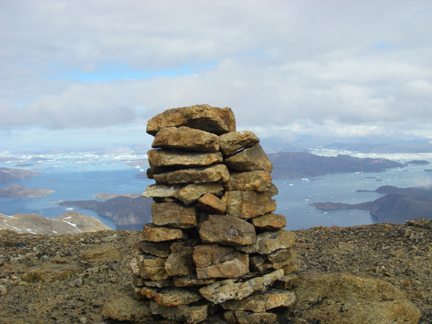
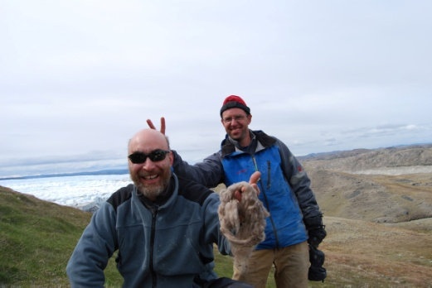
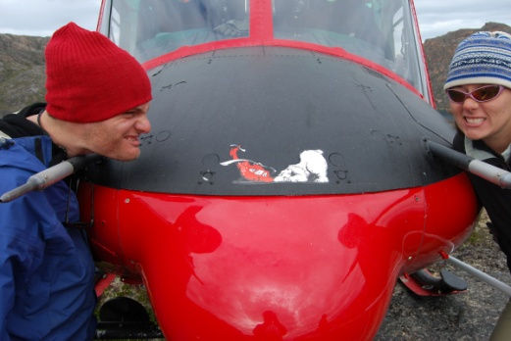
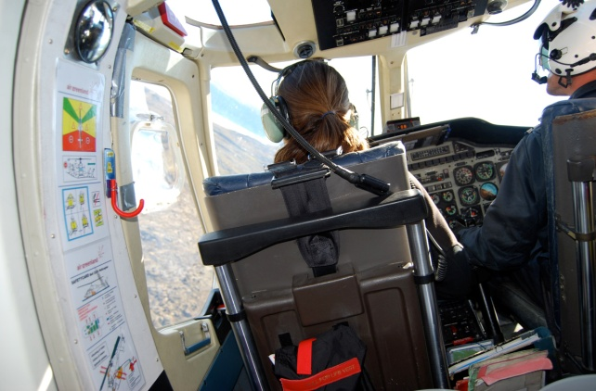
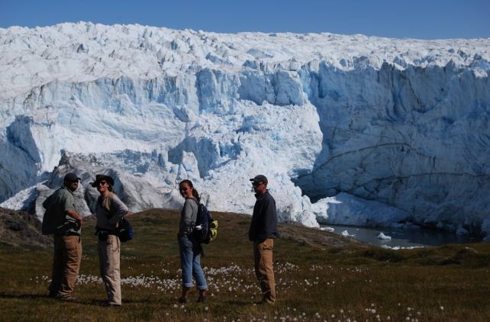
Paul Bierman, University of Vermont
Tom Neumann, NASA
Joseph Graly, University of Wyoming
Stephen Wright, University of Vermont
Shelly Rayback, University of Vermont
Bob Finkel, Lawrence Livermore
Dylan Rood, Lawrence Livermore
Jason Briner, SUNY Buffalo
Nicolas Young, SUNY Buffalo
Funding from:
NSF (ARC-0713956)
NSF Graduate Research Fellowship
University of Vermont
Field support from:
CH2MHILL
Laboratory support from:
Lawrence Livermore National Laboratory

Slide 64
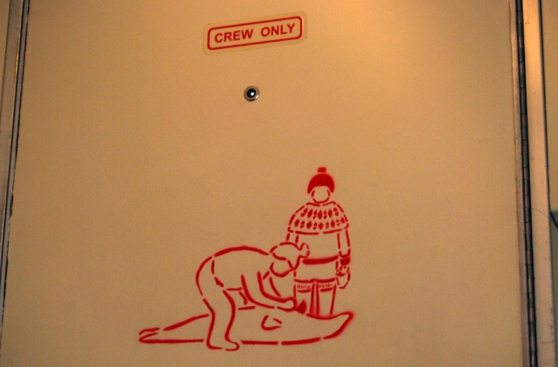
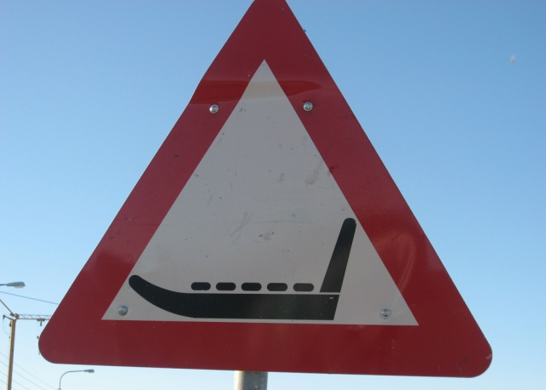
UVM Geology Faculty
UVM Geology Grad Students
Will Hackett
Eric Portenga
Luke Reusser
Charles Trodick
Pam and Pat Corbett
Middlebury Friends
Middlebury Geology Faculty

Slide 65
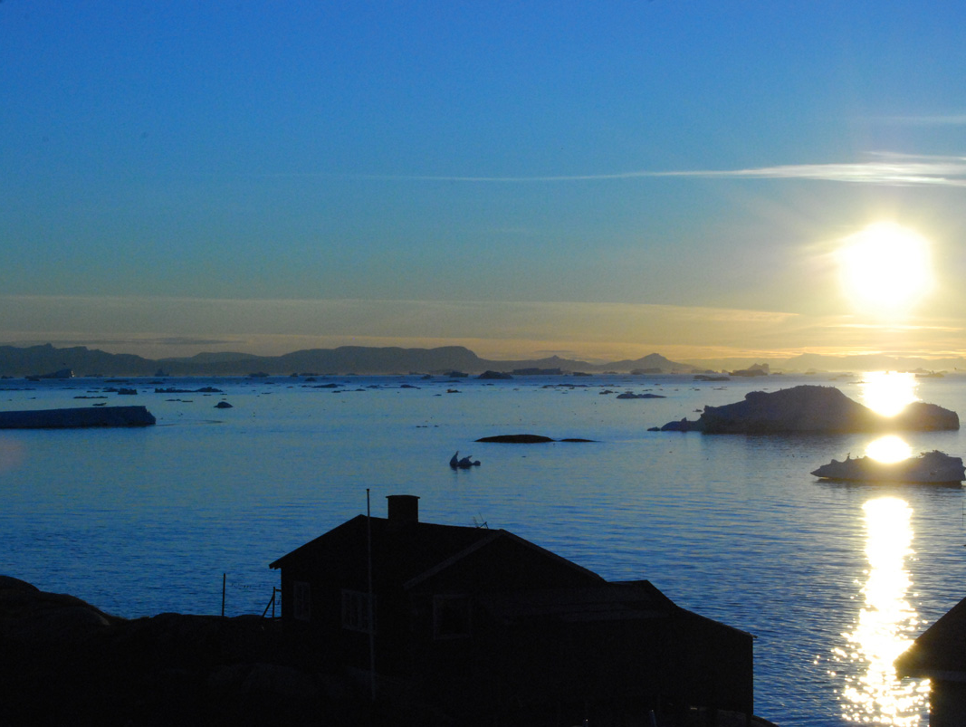

Slide 67
Burial Scenarios

