Slide 1
Quantifying Background Erosion Rates in Cuba Using Cosmogenic Nuclides
A thesis proposal by Mae Kate Campbell
Committee Members:
Paul Bierman, Advisor
Gillian Galford
John Hughes

Slide 2
Outline
Research Goal
Introduction to Project and Broader Importance
Background
Land Use History of Cuba
Use of Cosmogenic Nuclides for Determining Erosion Rates
Objectives
Methods
Summary
Timeline

Slide 3
Research Goal
My thesis research is focused on characterizing the background rates of erosion in Cuba using cosmogenic nuclide measurements
Cubawanderer.com

Slide 4
Introduction: Understanding Erosion
Soil erosion is a global issue impacting food production, water quality, and ecosystem health (Montgomery, 2000)
Natural process, accelerated by human actions
Source: Plant and Soil
Science eLibrary

Slide 5
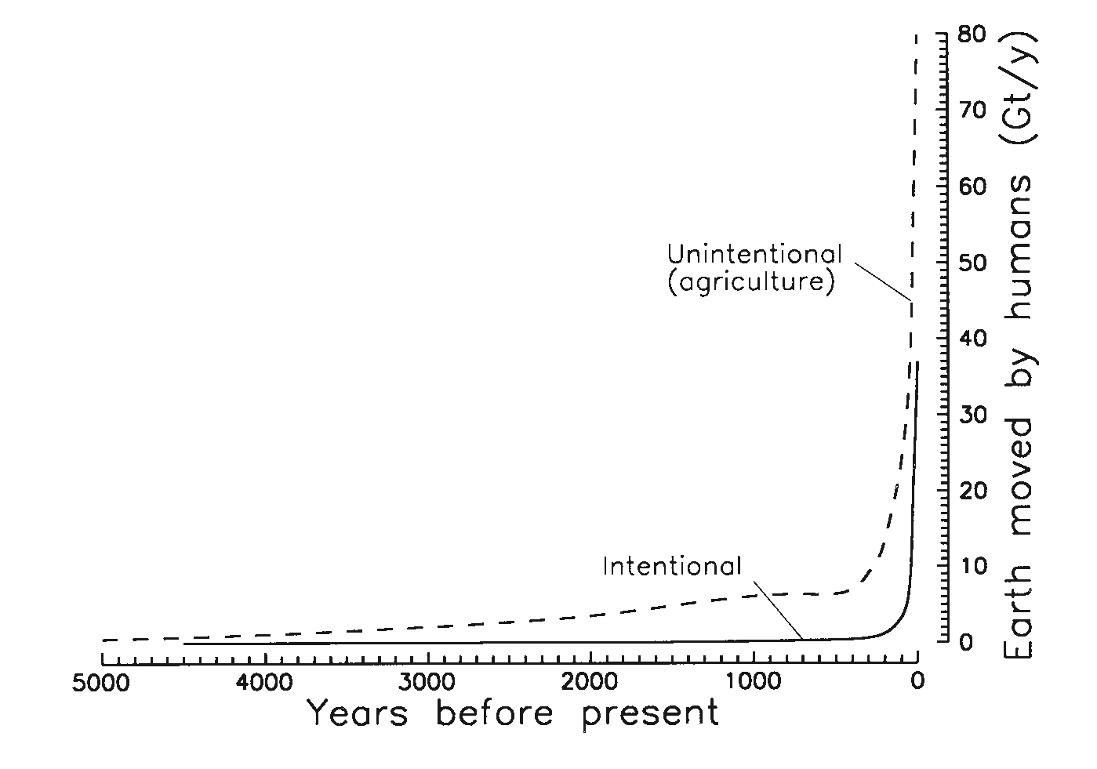
Introduction: Human Induced-Erosion
Hooke, 2000

Slide 6
Introduction: Human vs Natural Rates of Erosion
Bierman and Montgomery, 2013

Slide 7
Introduction: Human vs Natural Rates of Erosion
Soil compaction from farm machinery, frequent tilling, and leaving fields without cover crops contribute to these high erosion rates from agriculture (Montgomery, 2007)
~100,000 km² of arable land become unproductive each year (Dotterweich, 2013)
Wikipedia

Slide 8
Introduction: Sustainable Agriculture
PBS
DTN Progressive Farmer

Slide 9
Background: Land Use History of Cuba
15th century, an estimated 95% of Cuba was forested (CITMA, 1998)
Slash and burn agriculture for colonial sugarcane production
By the end of the 18th century, Cuba was producing 25% of the world supply of sugar (Houck, 2000)
Maps-Cuba.com

Slide 10
Background: Land Use History of Cuba
1959-1989: Highly mechanized industrial sugarcane production
More artificial fertilizer and tractors per land area than the US
75% of the land area of Cuba was affected by erosion, salinity, acidification, drainage problems, or a combination (CITMA, 1998)
Forested land was reduced to only 14% (CITMA, 1998)
Bybio.wordpress.com

Slide 11
Background: Land Use History of Cuba
Caloric consumption fell by as much as an estimated 50% (Enriquez, 2000)
Rapid conversion from industrial agriculture to soil- conserving, organic agriculture featuring minimal soil tillage, replacing tractors with draft animals, the use of cover crops, and more.
Videoblocks.com

Slide 12
Background: Measuring Erosion
Bierman and Montgomery, 2013

Slide 13
Background: Cosmogenic Nuclides
Primary Cosmic Rays (Protons)
Secondary Cosmic Rays
(Neutrons)
Atmospheric Atom
Target Nuclei
¹⁰Be
³⁶Cl
²⁶Al
¹⁰Be
³⁶Cl

Slide 14
Background: ¹⁰Be Erosion Rates from Quartz
Portenga and Bierman, 2011

Slide 15
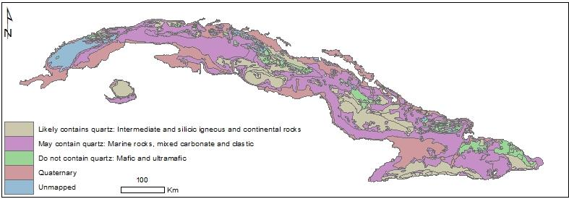
Measuring Erosion in Quartz-Poor Terrains
Schmidt and Bierman, 2017

Slide 16
Objectives
Refine a method for extracting the cosmogenic nuclide ²⁶Al from carbonate sediments
Determine the production rate of ²⁶Al in carbonate rocks near my study area
Measure background erosion rates in Cuba using the cosmogenic nuclides ¹⁰Be, ²⁶Al, and ³⁶Cl

Slide 17
Objectives
Refine a method for extracting the cosmogenic nuclide ²⁶Al from carbonate sediments
Determine the production rate of ²⁶Al in carbonate rocks near my study area
Measure background erosion rates in Cuba using the cosmogenic nuclides ¹⁰Be, ²⁶Al, and ³⁶Cl

Slide 18
Objectives
Refine a method for extracting the cosmogenic nuclide ²⁶Al from carbonate sediments
Determine the production rate of ²⁶Al in carbonate rocks near my study area
Measure background erosion rates in Cuba using the cosmogenic nuclides ¹⁰Be, ²⁶Al, and ³⁶Cl

Slide 19
Objectives
Refine a method for extracting the cosmogenic nuclide ²⁶Al from carbonate sediments
Determine the production rate of ²⁶Al in carbonate rocks near my study area
Measure background erosion rates in Cuba using the cosmogenic nuclides ¹⁰Be, ²⁶Al, and ³⁶Cl

Slide 20
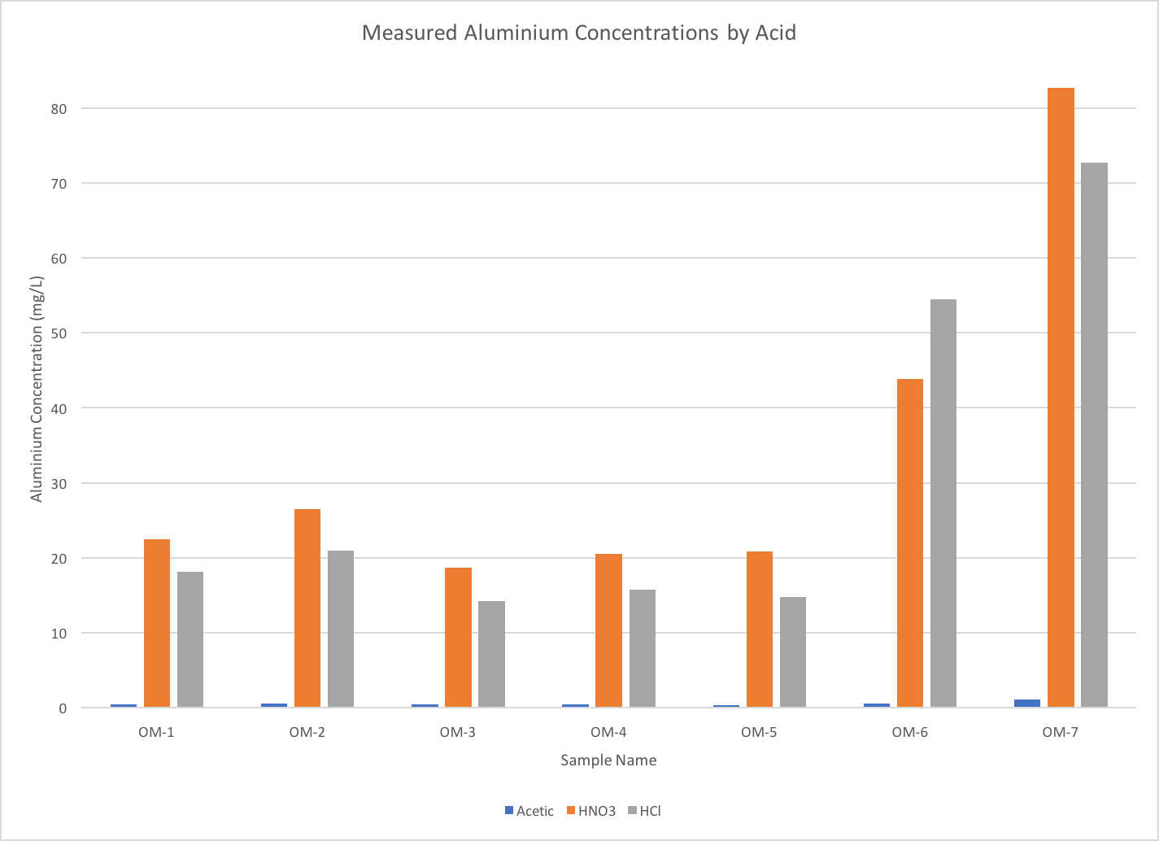
²⁶Al Method Refinement
Measured Al Concentrations by Acid
Carbonate sediments contain clay minerals
Clay minerals contain ²⁷Al, which can affect measurements of ²⁶Al
80
70
60
50
Aluminum Concentration (mg/L)
40
30
20
10
0
Fine Art America
OM-1 OM-2 OM-3 OM-4 OM-5 OM-6 OM-7
Acetic HNO3 HCl

Slide 21
Current ²⁶Al Extraction Method
Dissolve sediment in acetic acid, react for 24-48 hours on a shaker table
Centrifuge to separate solution and residue, quantify initial Al yields using ICP-OES
Neutralize solution to between pH 6-8 to precipitate Al gels, centrifuge to separate
Reacidify aluminum gels, column chemistry to completely isolate Al
Dry and burn resulting Al, mix with binder, pack onto cathodes for AMS measurement

Slide 22
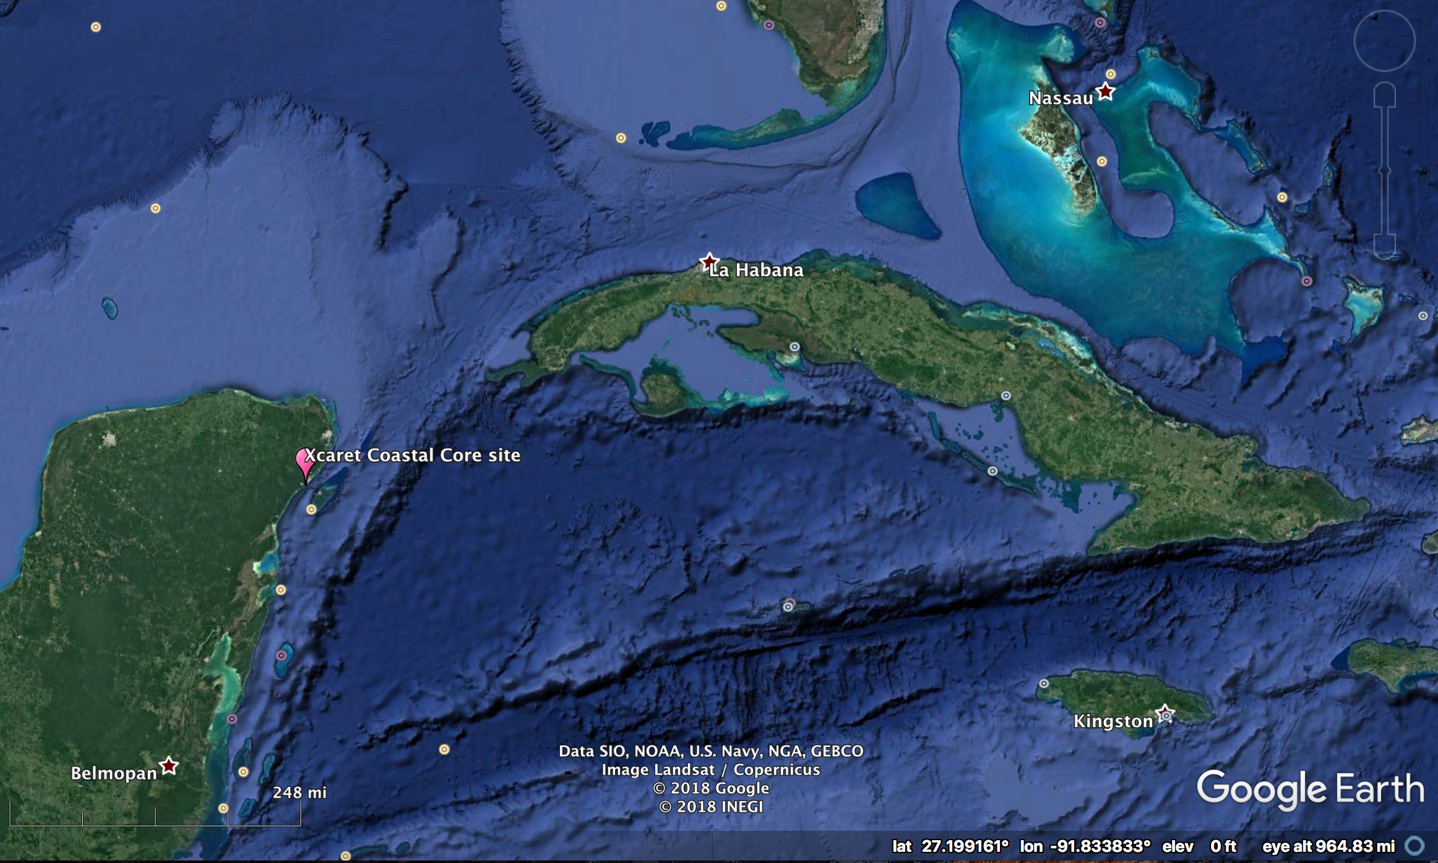
²⁶Al Production Rate Calibration

Slide 23
²⁶Al Production Rate Calibration

Slide 24
²⁶Al Production Rate Calibration
AWOL Americans

Slide 25
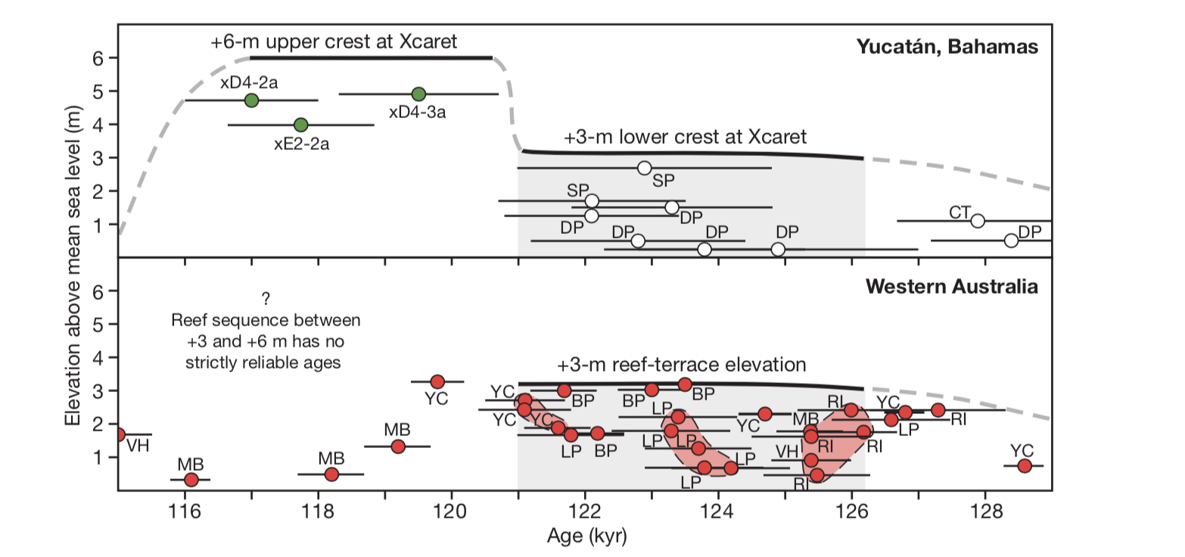
²⁶Al Production Rate Calibration
Marine Isotope Stage 5e
Blanchon et al., 2009

Slide 26
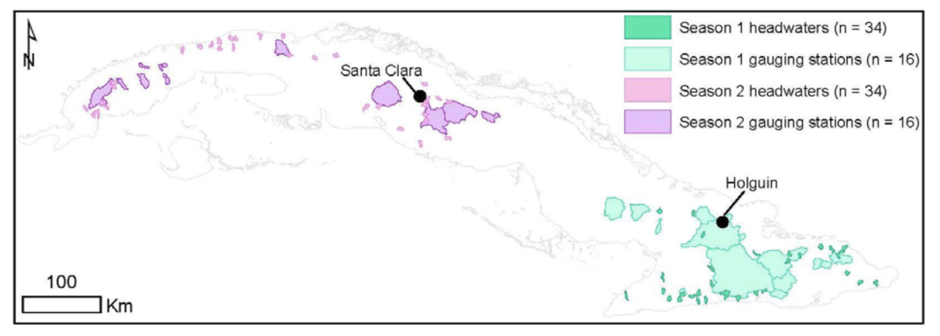
Field Sampling Plan

Slide 27
Hypothesis: Sediment yield >>> Background Rates of Erosion

Slide 28
Summary
I will use ²⁶Al, ¹⁰Be, and ³⁶Cl to constrain background erosion rates in Cuba
The background erosion rates I measure will be compared to modern records of erosion from sediment-yield data
I will work to refine a method for extracting ²⁶Al from carbonate sediments
I will calibrate production rates of ²⁶Al in a carbonate core near our study area

Slide 29
Timeline
Timeframe | Goals
Summer 2018 | Continue ²⁶Al method development Test method on carbonate core Extract and measure ³⁶Cl in carbonate core Begin writing intro and methods First field visit to Cuba
Fall 2018 | Begin processing samples from first field visit Complete 2 additional field visits to Cuba More sample processing Begin data analysis Begin writing methods and result/discussion
Spring 2019 | Process remaining samples Continued data analysis Present progress report
Summer 2019 | Finish data analysis Finish writing Prepare for defense in early fall

Slide 30
Topics I Need to Learn/Do More About
Aluminum chemistry
²⁶Al and ³⁶Cl production systematics
How to navigate the Cuban government
Geomorphic processes in tropical areas
Agricultural impacts in tropical areas

Slide 31
References
Barton, A. P., M. A. Fullen, D. J. Mitchell, T. J. Hocking, L. Liu, Z. Wu Bo, Y. Zheng and Z. Y. Xia (2004). "Effects of soil conservation measures on erosion rates and crop productivity on subtropical Ultisols in Yunnan Province, China." Agriculture, Ecosystems & Environment 104(2): 343-357.
Bierman, P. and E. Steig (1996). "Estimating rates of denudation using cosmogenic isotope abundances in sediment." Earth Surface Processes and Landforms 21(2): 103-203.
Blanchon, P., A. Eisenhauer, J. Fietzke and V. Liebetrau (2009). "Rapid sea-level rise and reef back-stepping at the close of the last interglacial highstand." Nature 458(7240): 881-884.
CITMA (1998). Situación Ambiental Cubana 1998. T. Ministerio de Ciencia, y Medio Ambiente.
Corbett, L. B., P. R. Bierman and D. H. Rood (2016). "An approach for optimizing in situ cosmogenic 10 Be sample preparation." Quaternary Geochronology 33: 24-34.
Dotterweich, M. (2013). "The history of human-induced soil erosion: Geomorphic legacies, early descriptions and research, and the development of soil conservation—A global synopsis." Geomorphology 201: 1-34.
Driscoll, C. T. and W. D. Schecher (1990). "The chemistry of aluminum in the environment." Environmental Geochemistry and Health 12(1-2): 28-49.
Gersper, P. L., Carmen S. Rodrfguez-Barbosa and L. F. Orlando (1993). "Soil conservation in Cuba: A key to the new model for agriculture." Agriculture and Human Values 10(3): 16–23.
Gran, S. E. (2000). Displacement History of the Nahef East Fault Scarp, Northern Israel: A Cosmogenic 36Cl Approach, The University of Vermont.
Granger, D. E., J. W. Kirchner and R. Finkel (1996). "Spatially Averaged Long-Term Erosion Rates Measured from In Situ-Produced Cosmogenic Nuclides in Alluvial Sediment." The Journal of Geology 104: 249-257.
Houck, O. A. (2000). "Environmental Law in Cuba." Journal of Land Use & Environmental Law 16(1): 1-81.
Kohl, C. P. and K. Nishiizumi (1992). "Chemical isolation of quartz for measurement of in-situ -produced cosmogenic nuclides." Geochimica et Cosmochimica Acta 56(9): 3583-3587.
Lal, D. (1988). "In situ-produced cosmogenic isotopes in terrestrial rocks." Annual Review of Earth and Planetary Sciences 16: 355-388.
Lal, D. (1991). "Cosmic ray labeling of erosion surfaces: in situ nuclide production rates and erosion models." Earth and Planetary Science Letters 104(2): 424-439.
Merchel, S., L. Benedetti, D. L. Bourlès, R. Braucher, A. Dewald, T. Faestermann, R. C. Finkel, G. Korschinek, J. Masarik, M. Poutivtsev, P. Rochette, G. Rugel and K. O. Zell (2010). "A multi-radionuclide approach for in situ produced terrestrial cosmogenic nuclides: 10Be, 26Al, 36Cl and 41Ca from carbonate rocks." Nuclear Instruments and Methods in Physics Research Section B: Beam Interactions with Materials and Atoms 268(7-8): 1179-1184.
Nishiizumi, K., J. Klein, R. Middleton and H. Craig (1990). "Cosmogenic 10Be, 26Al, and 3He in olivine from Maui lavas." Earth and Planetary Science Letters 98: 263-266.
Pimentel, D., C. Harvey, P. Resosudarmo, K. Sinclair, D. Kurz, M. McNair, S. Crist, L. Shpritz, L. Fitton, R. Saffouri and R. Blair (1995). "Environmental and Economic Costs of Soil Erosion and Conservation Benefits." Science 267(5201): 1117-1123.
Poppe, L. J., V. F. Paskevich, J.C. Hathaway and D. S. Blackwood. (2001). "A Laboratory Manual for X-Ray Powder Diffraction." Retrieved April, 2018.
Portenga, E. W. and P. R. Bierman (2011). "Understanding Earth’s eroding surface with 10Be." GSA Today 21(8): 4-10.
Schmidt, A. and P. Bierman (2017). Collaborative Research: The Cuban landscape, quantifying the effects of industrialized agriculture followed by country-wide soil conservation using sediment-associated isotopes. Cuba, The National Science Foundation.
Stone, J., G. L. Allan, L. K. Fitfield, J. M. Evans and A. R. Chivas (1994). "Limestone erosion measurements with cosmogenic chlorine-36 in calcite — preliminary resuts from Australia." Nuclear Instruments and Methods in Physics Research Section B: Beam Interactions with Materials and Atoms 92: 311-316.
Zorrilla, W. P. and G. Y. Karasik (1989). "El escurrimiento sólido y la erosión hídrica actual de Cuba." Ciencias de la tierra y del espacio 15-16: 67-76.

Slide 32
Questions?

Slide 33
Assumptions in Determining Erosion Rates from Cosmogenic Nuclides
“The rate of erosion is constant but not necessarily spatially uniform
The basin is in isotopic steady state
Sampled sediment is spatially and temporally representative of all sediment leaving the basin, i.e. it is well mixed
Mass loss from the basin is occurring primarily by surface lowering
The mineral selected for isotopic analysis is uniformly distributed through the basin”
Bierman and Steig, 1996

Slide 34
Half Lives of Isotopes of Interest
Isotope | Half Life (years)
¹⁰Be | 1.387×10⁶
²⁶Al | 7.17×10⁵
³⁶Cl | 3.01×10⁵

Slide 35
Cosmogenic Nuclide Production Pathways
Spallation – Secondary cosmic rays collide with target nuclei and knock off protons and neutrons
Neutron Capture – Secondary cosmic rays (neutrons) slow down enough that they are captured by target nuclei
Muon Reactions
Negative muons get captured by an atom’s electron cloud, decay, and neutralize a proton
Fast muons produce gamma photons that produce secondary neutrons from nuclei, which produce cosmogenic nuclides
Important at depth
Dunai and Lifton, 2014

