Slide 1
Accessible Web Design:
go.uvm.edu/accessibility
7 basic tips
Audrey Homan audrey.homan@uvm.edu

Slide 2
Contents:
7 basic tips for avoiding the most common web accessibility issues
Accessibility:
The Basic Bits
The Legal Bits
The CDCI Bits

Slide 3
Everything that makes for good graphic design
makes for good web design.
THE BASIC BITS

Slide 4
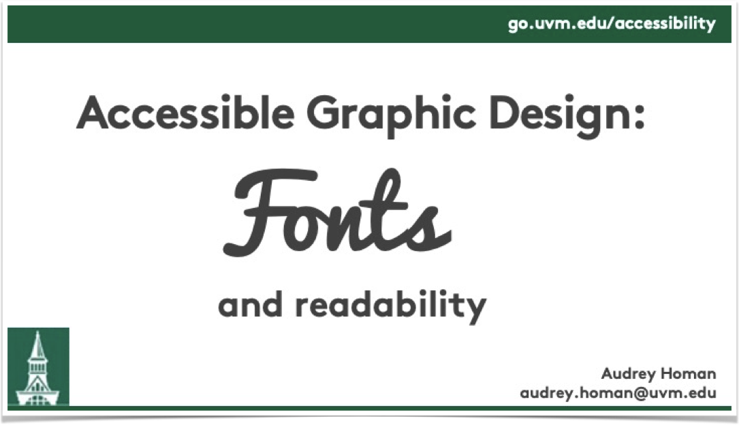
Accessible Graphic Design: Fonts and Readability
THE BASIC BITS
slides
video

Slide 5
Inaccessible design = bad design.
THE BASIC BITS
Always.

Slide 6
67%
THE BASIC BITS
of accessibility failures come down to design choices.
Reference

Slide 7
Accessible web design is
everyone’s job.
THE BASIC BITS
UVM Drupal managers
Drupal updaters
WordPress site creators
Noogle Site creators
Training module creators
meme creators
fan art creators
Reddit commenters
YouTube influencers
TikTok weasels

Slide 8
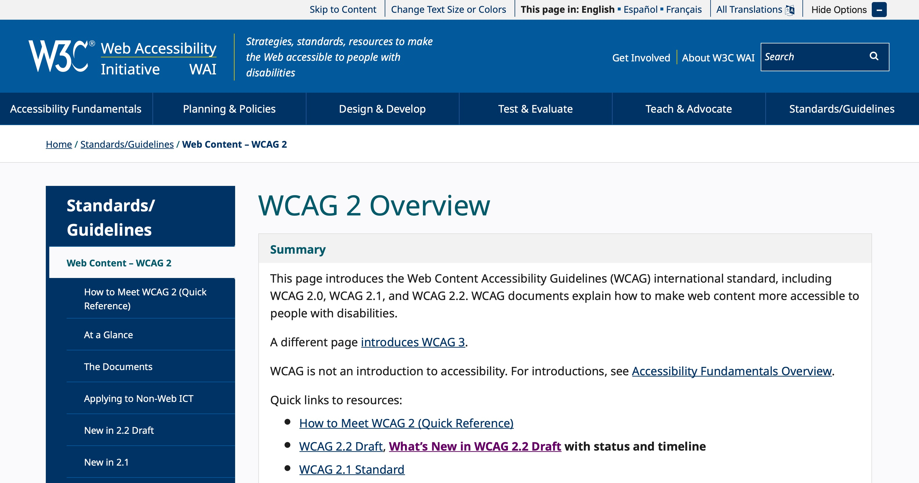
But who decides what’s
“accessible”?
THE LEGAL BITS
Enter:
the WCAG.

Slide 9
What’s WCAG?
THE LEGAL BITS
Web Content Accessibility Guidelines
International standards
Currently, in the U.S., accessibility is enforced by lawsuit
In the U.S., public & government entities are required to meet WCAG’s AA level

Slide 10
WCAG 2.1 Guidelines
THE LEGAL BITS
A-level: basic website functionality
AA-level: reasonable website functionality
AAA-level: gold-standard website functionality

Slide 11
Web Accessibility @ CDCI
THE CDCI BITS
Per UVM, CDCI must maintain AA-level compliance
Required for Drupal, WordPress, and any site that has CDCI branding
Every year, CDCI runs two website audits and a satisfaction survey

Slide 12
Images
1: IMAGES
1
Don’t assume everyone can see images
Don’t include text in an image unless it’s available elsewhere on the page as plain text
Always use alt-text, or mark your image as “decorative”

Slide 13
Images: alt-text
1: IMAGES
Don’t start with “a photo of” or “an image of” — screen reader software has you covered.
1-3 sentences
Focus on the most important elements of the image

Slide 14
The Alt-Text Exercise
1: IMAGES
If you’re sighted, how would you describe this image to someone on a phone call?

Slide 15
The Answer to the Alt-Text Exercise
1: IMAGES
“A group of people in their mid-twenties sit around a picnic blanket in a forest, grinning, while their small white dog wanders off.”

Slide 16
Color & Contrast
2: COLOR & CONTRAST
2
Don’t assume everyone can see all colors.
Don’t use color to indicate meaning.

Slide 17
Don’t use color to define meaning.
2: COLOR & CONTRAST
To sign up for trainings, click the purple button.
For general questions, click the red button.

Slide 18
Color: Contrast
2: COLOR
 | Small text | Large text | Icons & Graphics
WCAG LEVEL AA | 4.5:1 | 4.5:1 | 3:1
AAA | 7:1 | 4.5:1 | 3:1

Slide 19
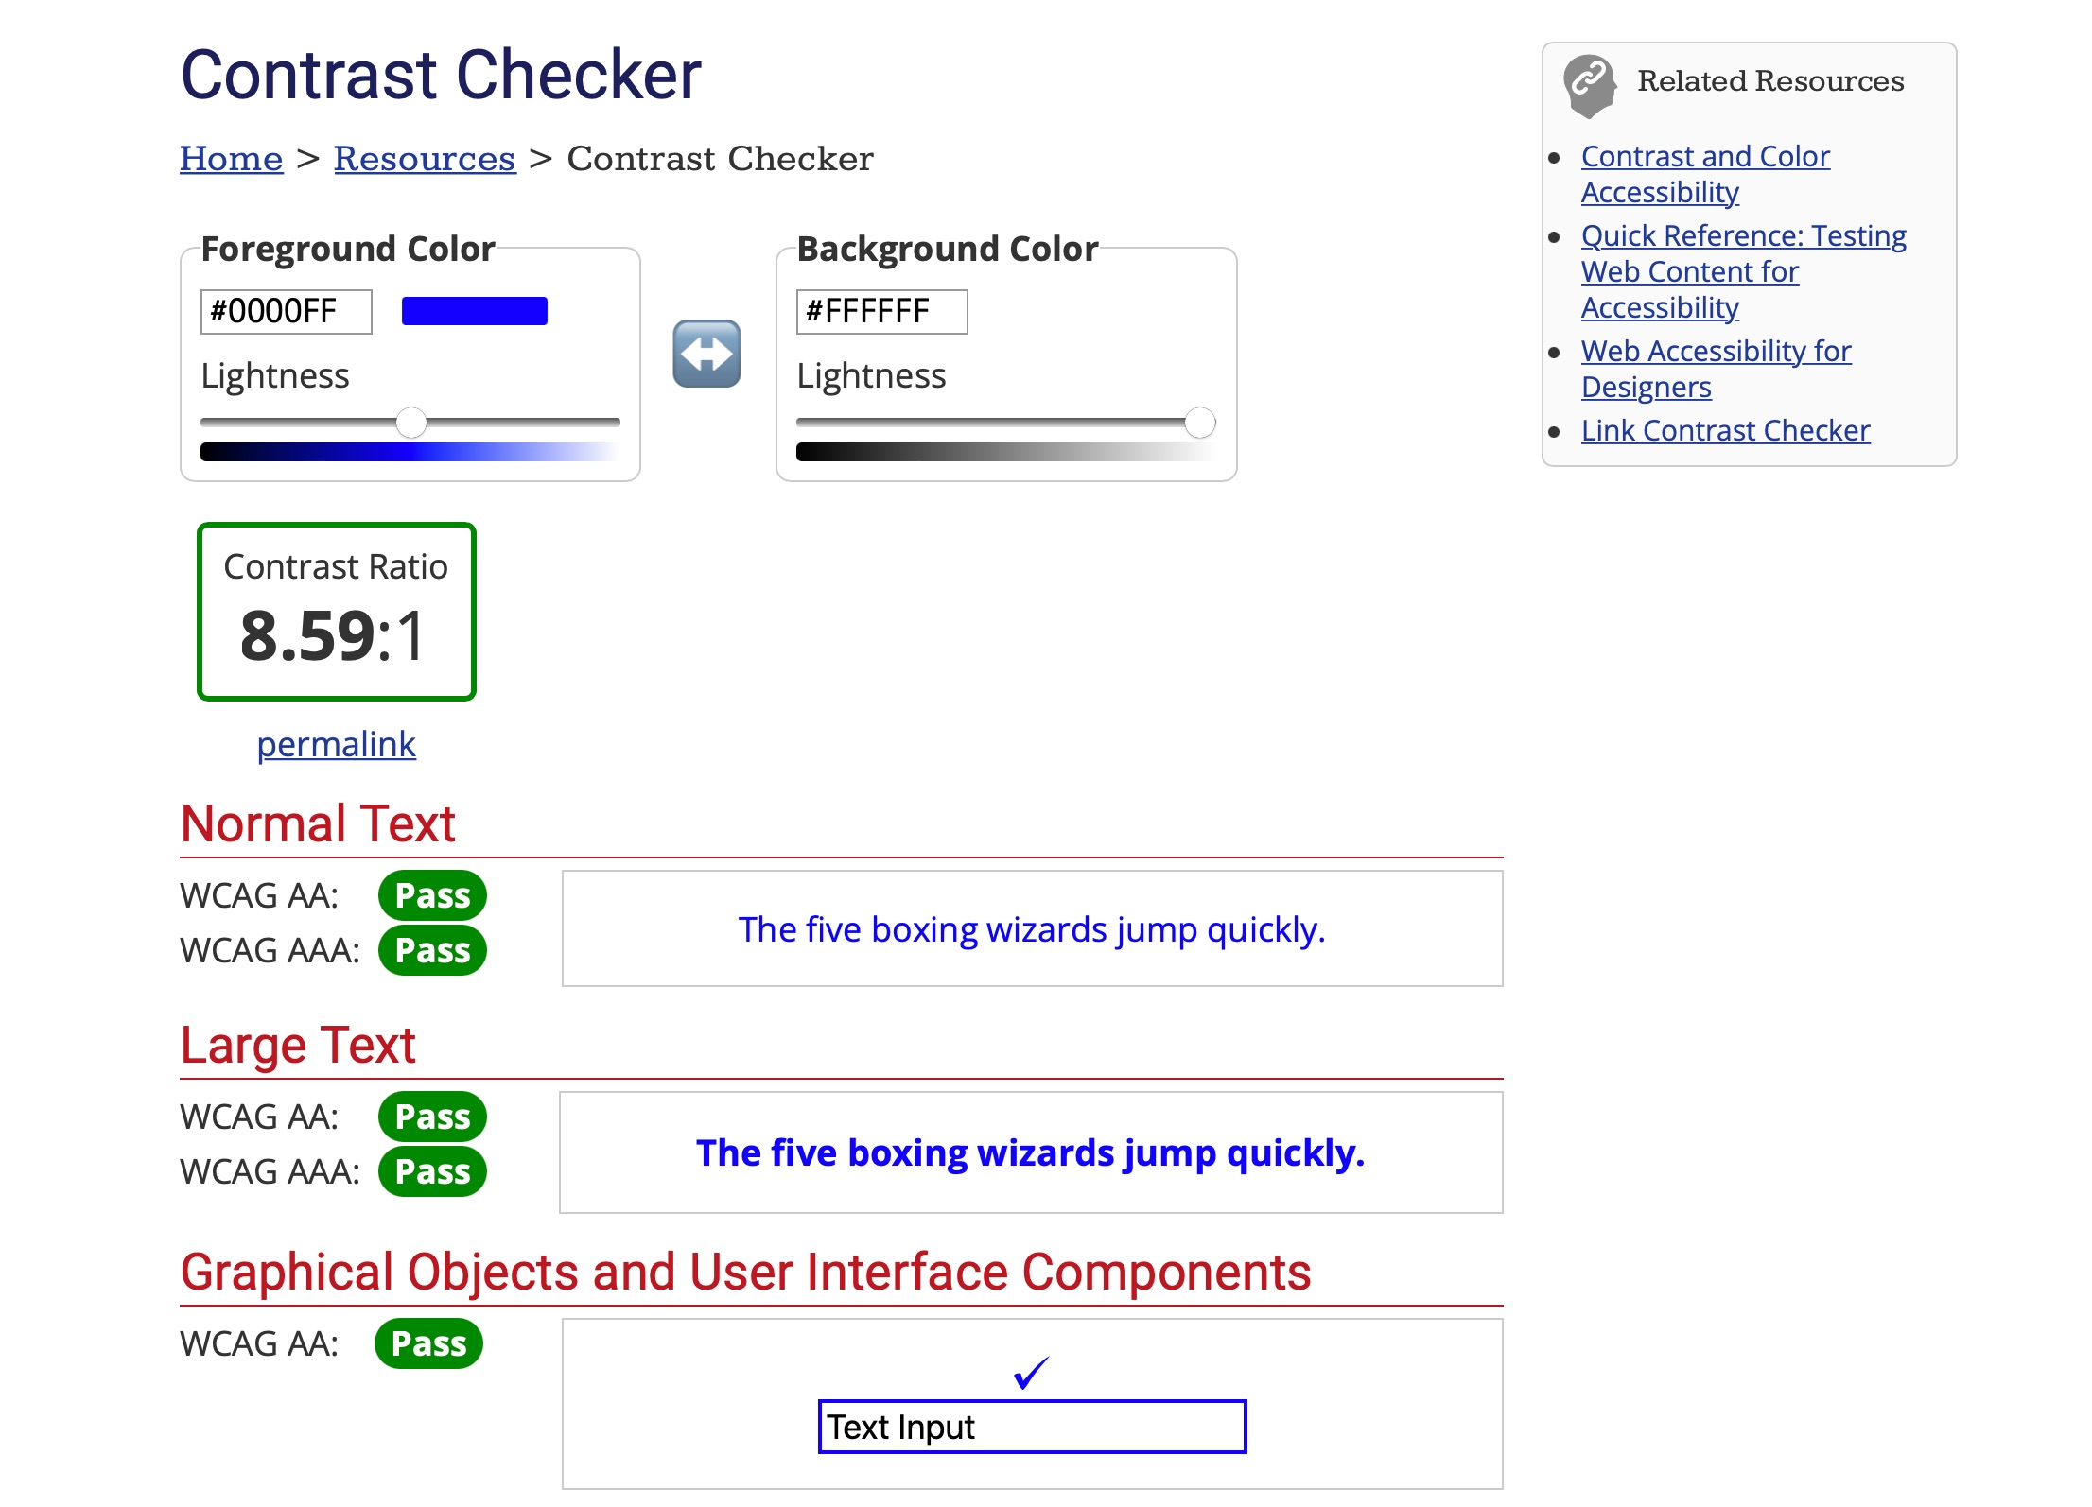
How do you measure contrast?
2: COLOR
WebAIM Contrast Checker

Slide 20
Audio & Video
3: AUDIO & VIDEO
3
If you have content available as audio or video, you also need a text version. You cannot have audio or video be the only way for visitors to access that information.

Slide 21
Audio & Video accessibility needs
3: AUDIO & VIDEO
Audio: needs a transcript
Video: needs non-automated captions
Audio description for videos: recommended but not required (AAA-level)

Slide 22
Links: Format
4: LINKS
4
Links should be underlined
They should be a different color from non-link text
Do not underline any text that is not a link
Links should be 3-4 words, not just one.
Shortlinks are friendly to screen readers.

Slide 23
Links: Destination
4: LINKS
Download the slides from this presentation (.pptx)
This is a really useful Sensory Preference Assessment (.docx)
And now a brief word from our sponsor (video).
Indicate in parentheses when a link goes to something other than a webpage, such as a video, or starts a download.

Slide 24
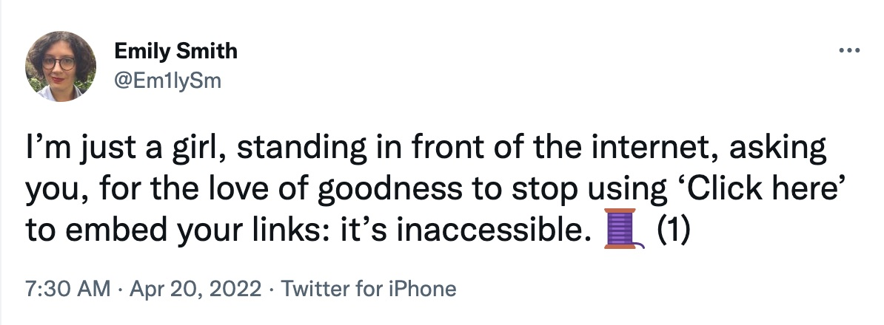
Links: Do not click here.
4: LINKS
Destination: it must be clear from the link where clicking that link will take you.
Do not use “click here”.

Slide 25
Meaningful text links
4: LINKS
To find out more about the conference, check out the schedule of programming.
To find out more about the conference, click here.

Slide 26
Meaningful short urls
4: LINKS
To find out more about the conference, click this link: go.uvm.edu/schedule
To find out more about the conference, click here.

Slide 27
Use headings to structure your content.
5: HEADINGS
5
Helps make your page accessible to keyboard navigation and screen readers.

Slide 28
Headings are an outline for your content.
5: HEADINGS
2022 Spring Conference
Programming
Track 1: Badger-Poking
Track 2: Weasel-Wrangling
Track 3: First Aid
Registration

Slide 29
What does your outline look like as HTML headings?
5: HEADINGS
Heading 1:
2022 Spring Conference
HEADING 2:
PROGRAMMING
Track 1: Badger-Poking
Track 2: Weasel-Wrangling
Track 3: First Aid
Heading 3:
HEADING 2:
REGISTRATION

Slide 30
In WordPress:
5: HEADINGS

Slide 31
Moving, flashing and blinking
6: FLASHING & BLINKING
6
Don’t have anything blinking at 3 times per second or faster
Don’t set things up to autoplay
Users should always have a way to make it all stop and start.

Slide 32
Write for accessibility
7: WRITE FOR ACCESSIBILITY
Use plain language: active voice, short sentences, and defining jargon.
Page titles: Give each page a clear and distinct title
Provide clear, concise instructions
7

Slide 33
When websites attack
WHEN WEBSITES
ATTACK

Slide 34
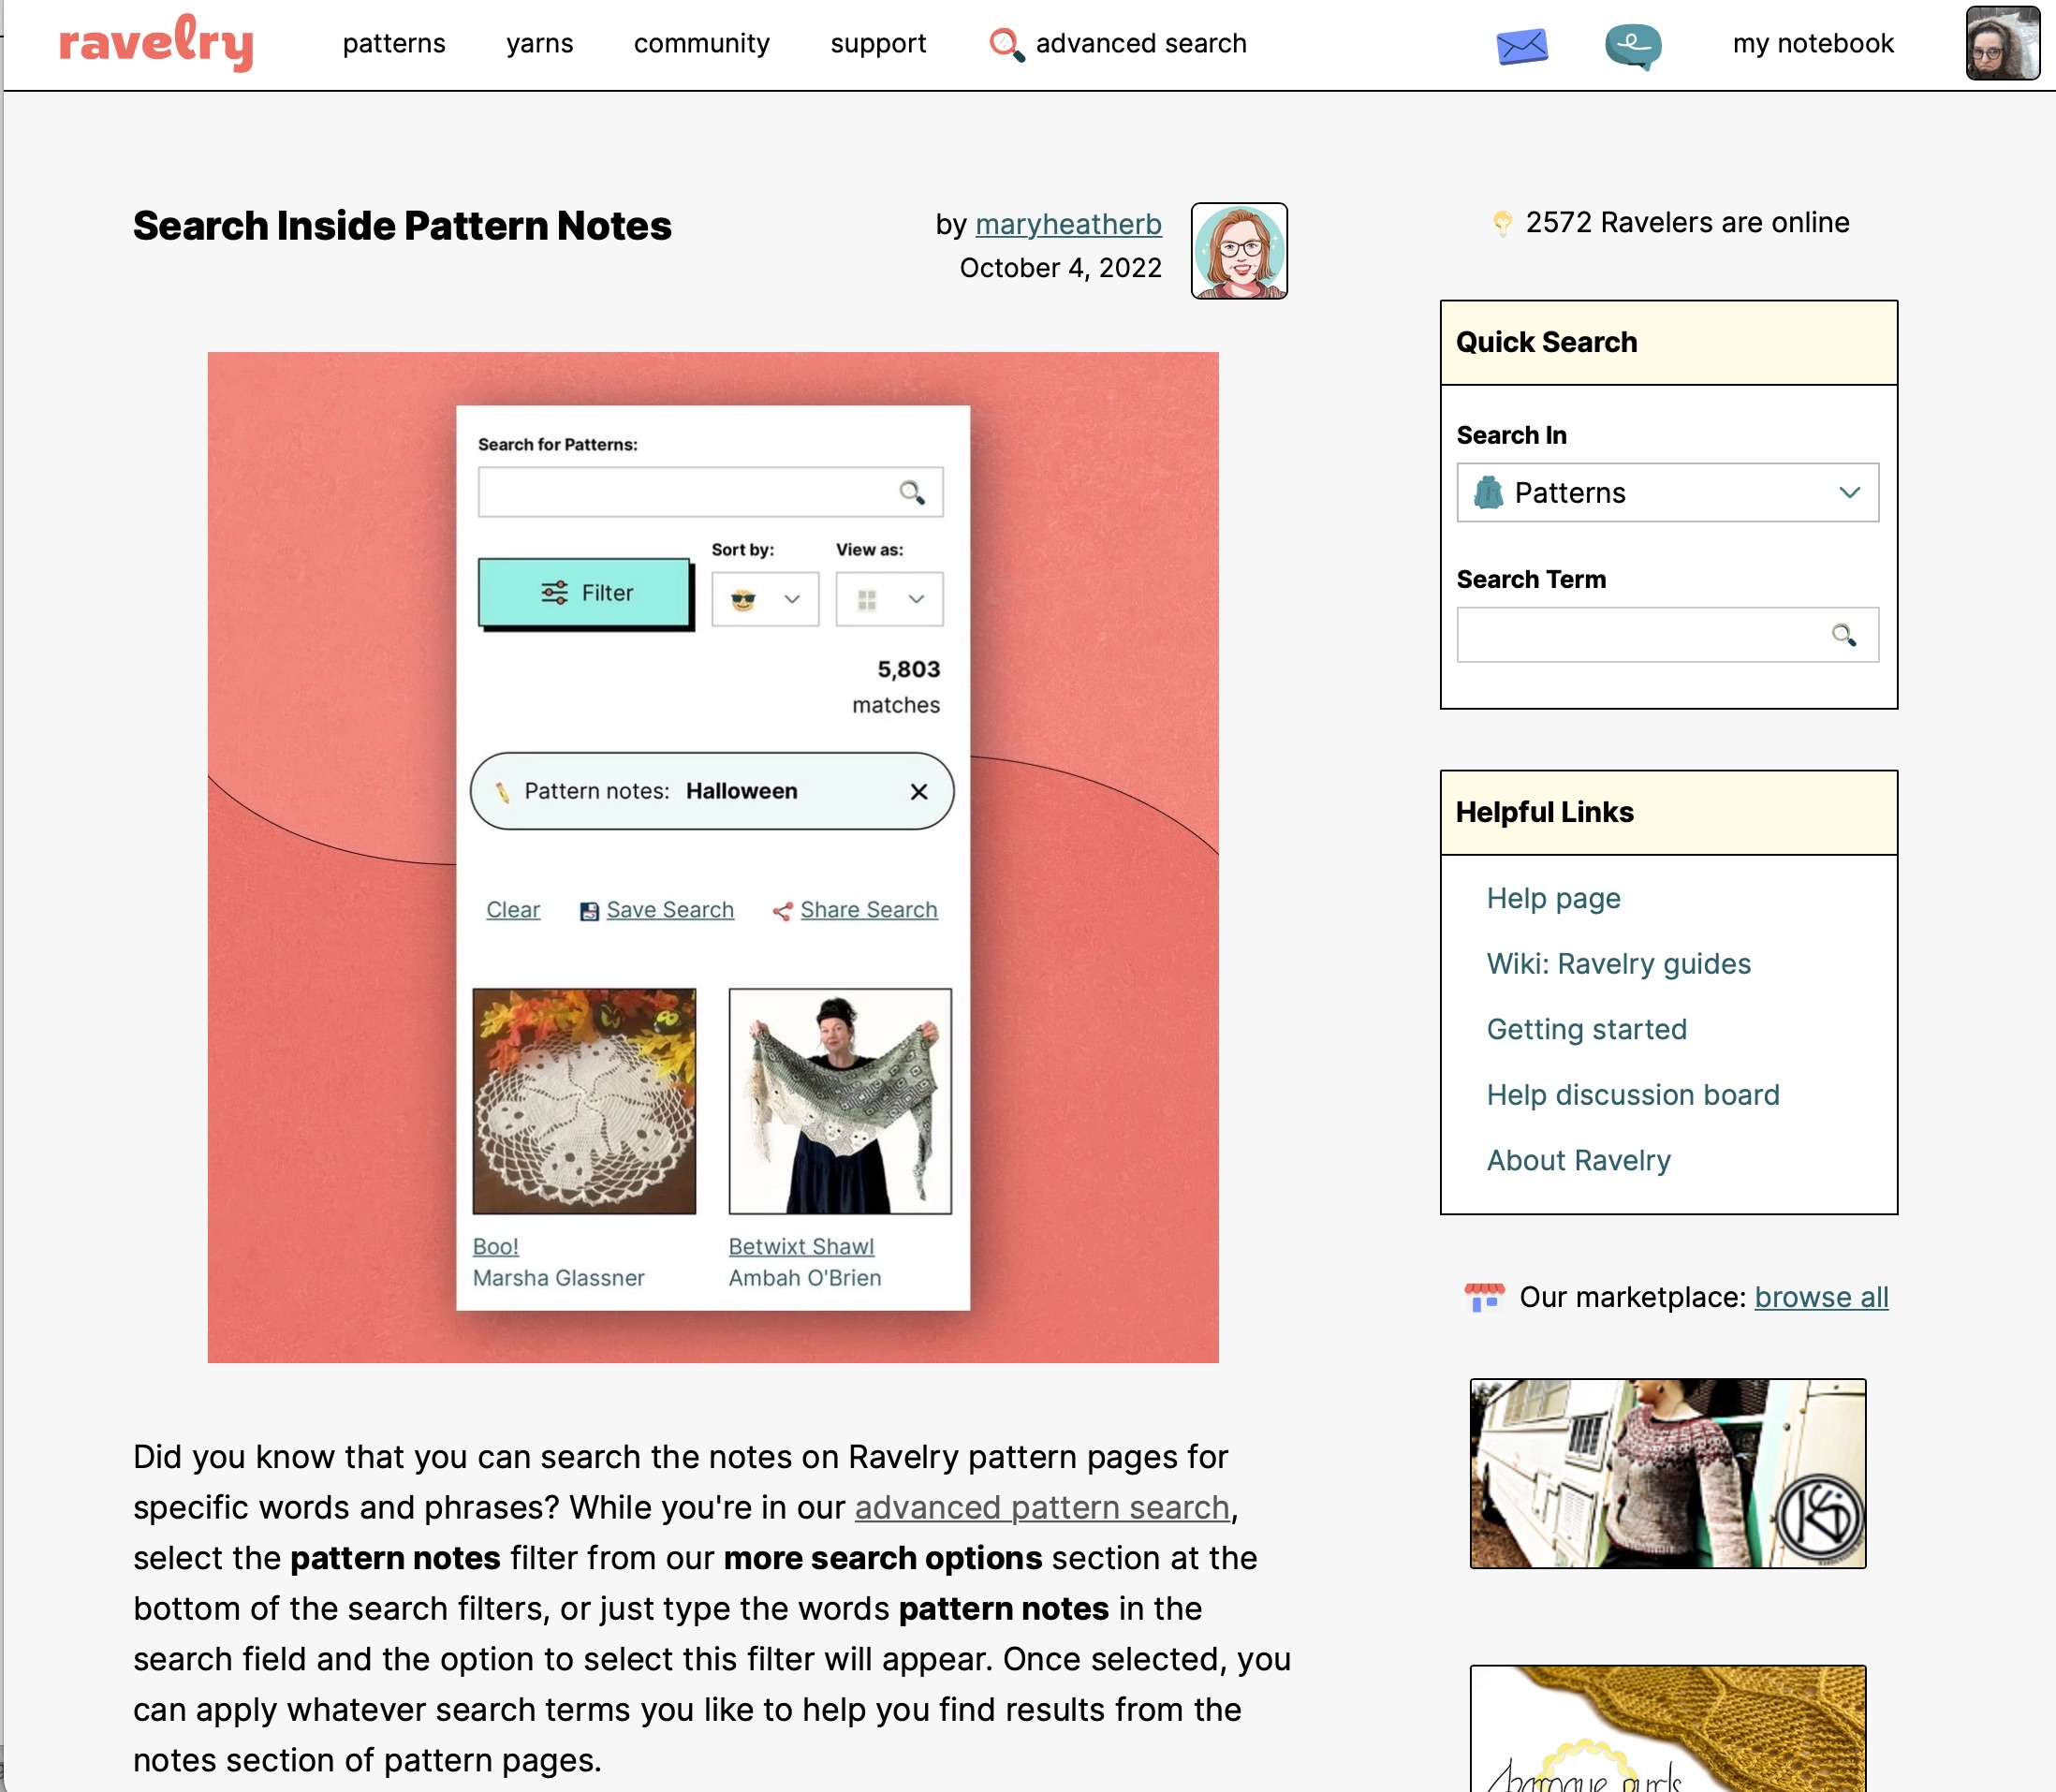
Ravelry: An Accessibility Case Study
WHEN WEBSITES ATTACK
Ravelry: An Accessibility Case Study
Old design: problematic
New design: problematic
Ravelry Response: run away

Slide 35
Again, an accessible web is
everyone’s job.
THE BASIC BITS
UVM Drupal managers
Drupal updaters
WordPress site creators
Noogle Site creators
Training module creators
meme creators
fan art creators
Reddit commenters
YouTube influencers
TikTok weasels

Slide 36
Accessibility = a process
THE BIG TAKEAWAYS
Try your best
Ask for help
Incorporate user feedback from people with disabilities

Slide 37
Finally, realize two things:
BACK TO THE BASIC BITS
1. No one should have to disclose their disability to you in order to access your website effectively.
2. Use human data to supplement general guidelines.

Slide 38
Thank you for your time.
go.uvm.edu/accessibility
Feel free to share it, and remix it for non-commercial use, with attribution.
This presentation is licensed under CC-BY-NC-SA.

