Slide 1
Accessible PowerPoint Documents
go.uvm.edu/accessibility
Jesse Suter

Slide 2
CONTENTS
We will cover:
CDCI requirements for accessible files
Automated testing
Manual testing
We will not cover:
Accessible presentations
Tables
Converting to PDF

Slide 3
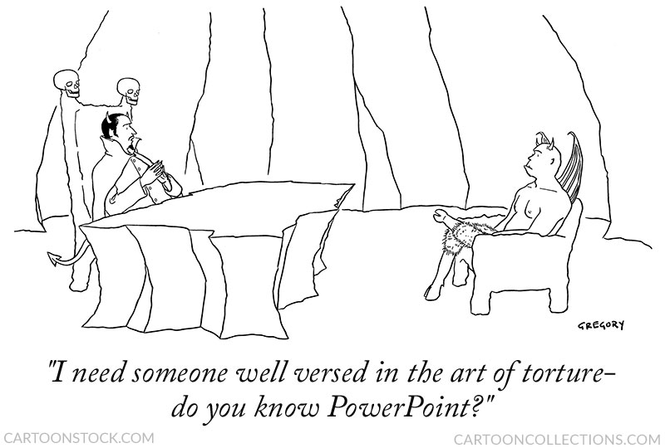
DEATH BY POWERPOINT OR JUST TORTURE?

Slide 4
New CDCI guide to accessible events!
go.uvm.edu/accessibility
go.uvm.edu/accessible-events

Slide 5
WHY NOT TABLES?
Microsoft:
“In general, avoid tables if possible and present the data another way, like paragraphs with headings.”
From: Make your PowerPoint presentations accessible to people with disabilities

Slide 6
POWERPOINT ACCESSIBILITY @ CDCI
AUTOMATED
Alt-text for images
Slide titles
Reading order
Section names
MANUAL
Font size, family, & style
Text alignment
Color & contrast
Links format
Video & audio
Room for captions
Readable file name
Properties

Slide 7
THE ASTERISK
Addressing these items should* get you to the level of accessibility for PowerPoint files that CDCI is requesting.
*Ask for and respond to user feedback on the accessibility of your documents.

Slide 8
MICROSOFT ACCESSIBILITY CHECKER

Slide 9
POWERPOINT HAS ACCESSIBILITY CHECKER
PowerPoint has an automated Accessibility Checker. Review > Check Accessibility
Notes:
The Accessibility Checker is a tool that reviews your content and flags accessibility issues it comes across. It explains why each issue might be a potential problem for someone with a disability. The Accessibility Checker also suggests how you can resolve the issues that appear.
In PowerPoint, the Accessibility Checker runs automatically in the background when you're creating a presentation. If the Accessibility Checker detects accessibility issues, you will get a reminder in the status bar.

Slide 10
What the accessibility Checker Should Look Like

Slide 11
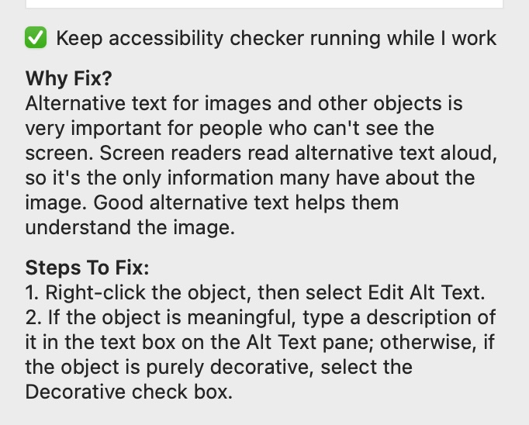
ACCESSIBILITY CHECKER : ALT-TEXT
“Missing Object Description”
=
no alt-text on an image.

Slide 12
DECORATIVE OBJECTS
Decorative objects are items that do not contain meaning necessary to understand the document, such as arrows, starbursts, and lines.
This also includes decorative elements between chunks of text.

Slide 13
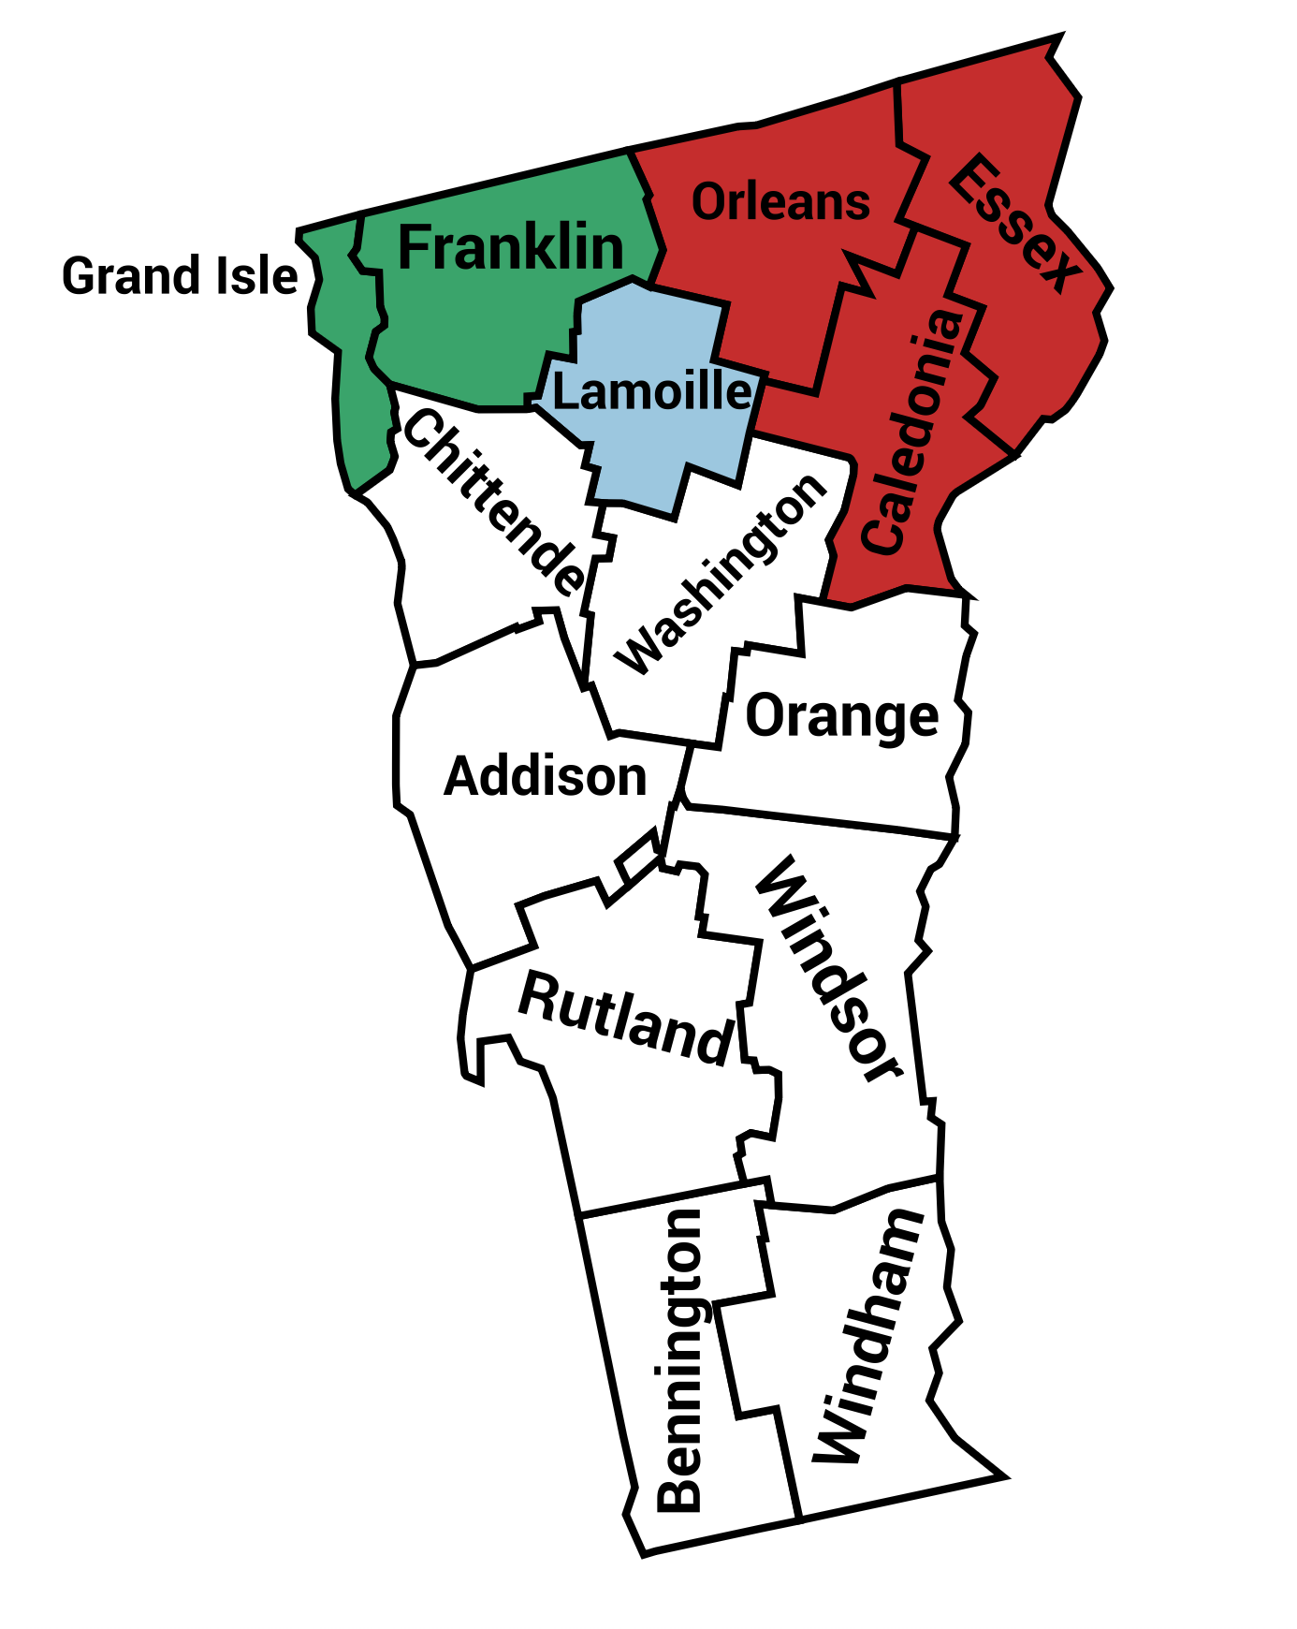
AUTOMATIC ALT-TEXT
You should not rely on automatic alt-text.
Microsoft automatic alt-text: “Map”
Human: “Map shows 14 counties of Vermont. Franklin and Grand Isle counties are shaded green, Lamoille is blue, Orleans, Caledonia, & Essex are red. The remaining counties are white: Chittenden, Washington, Orange, Rutland, Windsor, Bennington, and Windham.”

Slide 14
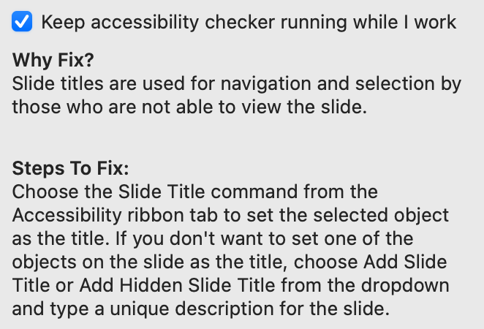
ACCESSIBILITY CHECKER : SLIDE TITLES
“Missing Slide Title” OR
“Duplicate Slide Title”
Every slide needs unique & descriptive title.

Slide 15
CHECK SLIDE TITLES IN OUTLINE VIEW
View >
Outline View

Slide 16
Unwanted Title

Slide 17
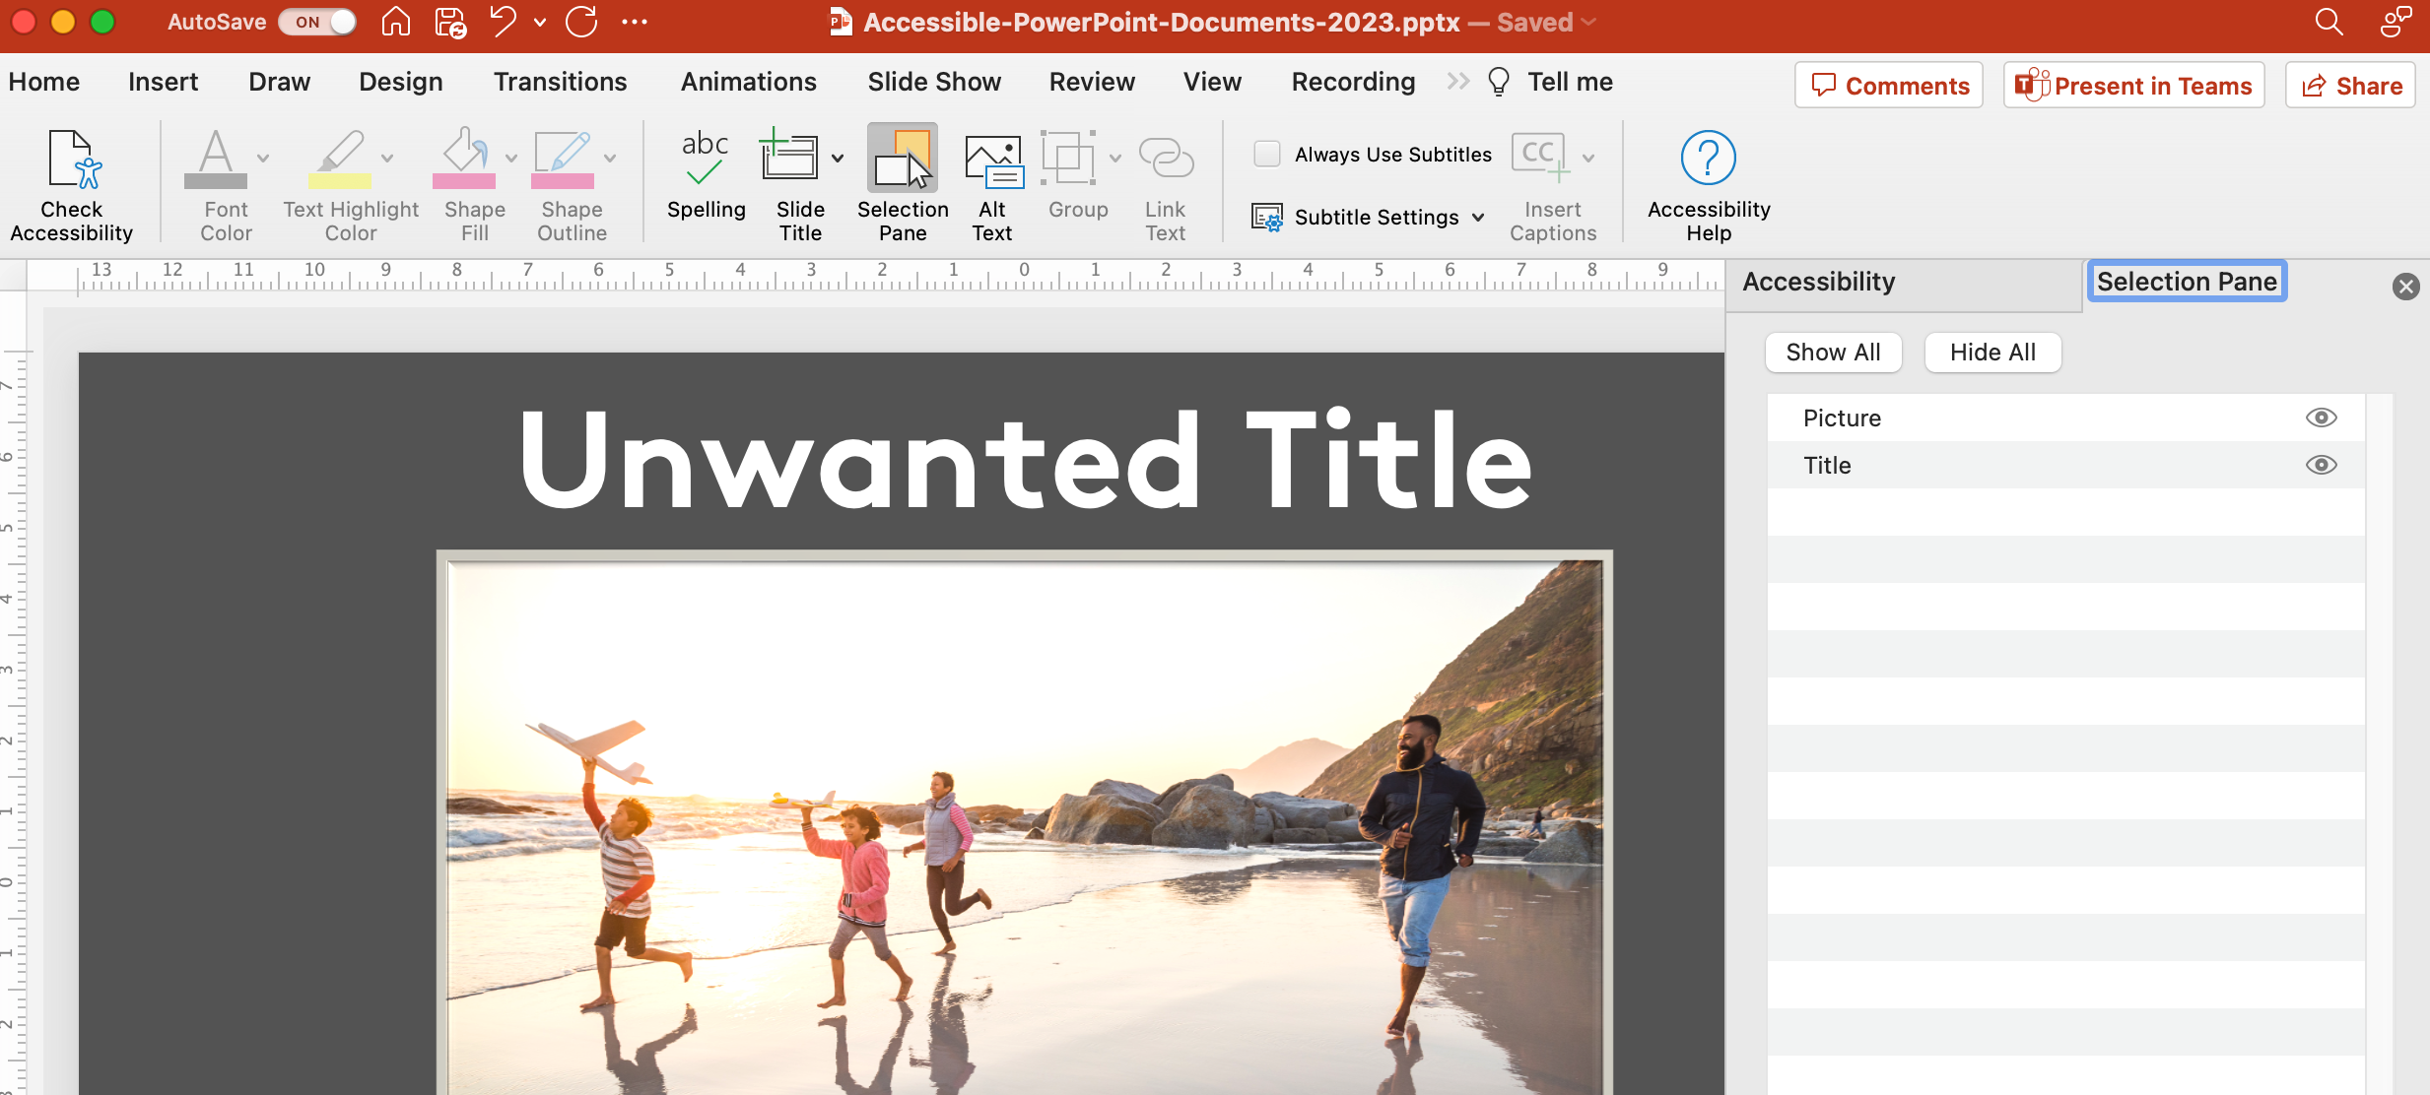
HOW TO HIDE A TITLE
Review > Check Accessibility > Selection Pane
Select eyeball to turn on or off visibility.

Slide 18
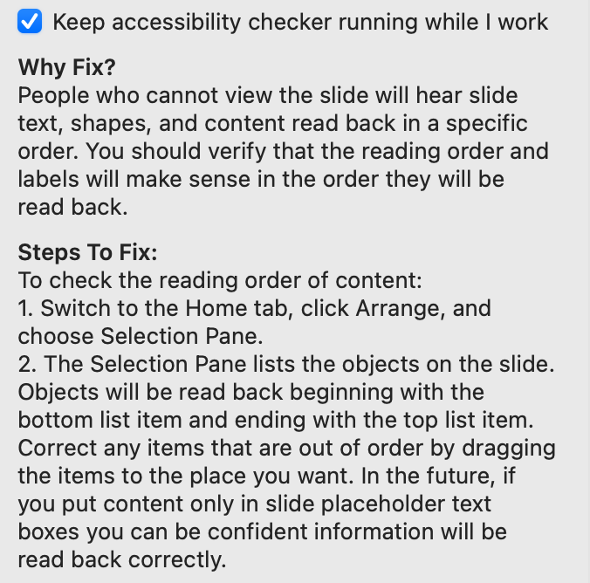
ACCCESSIBILITY CHECKER: READING ORDER
“Check Reading Order”
Generally, everything is ordered based on when it was added to the slide.

Slide 19
The reading order of this slide is wrong.
go.uvm.edu/accessibility
The
order
of your text
matters.
And it might
not be
clear just by
at it.

Slide 20
This is the actual reading order.
order
matters.
of your text
clear just by
go.uvm.edu/accessibility
The
And it might
not be
at it.

Slide 21
HOW TO FIX READING ORDER
Review > Check Accessibility > Selection Pane
Move elements into correct order. Bottom to Top!

Slide 22
HOW TO FIX READING ORDER PART 2
Start with a built-in template and do not change place holders for text and graphics.
If you change or add to the slide, check reading order.

Slide 23
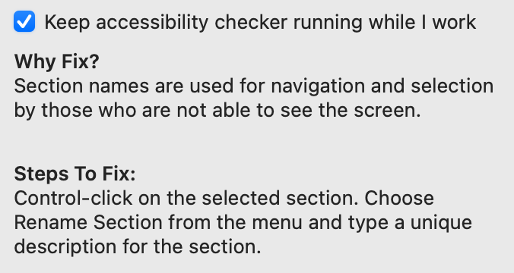
ACCESSIBILITY CHECKER : SECTION NAMES
“Default Section Name”
Sections are helpful to navigate longer presentations.
Insert > Section

Slide 24
MANUAL ACCESSIBILITY TESTING

Slide 25
MANUAL ACCESSIBILITY TESTING LIST
You also need to do some manual accessibility testing.
Font size, family, & style
Text alignment
Color & contrast
Links format
Video & audio
Room for captions
Readable file name
Properties

Slide 26
MANUAL TESTING: FONT SIZE, FAMILY, AND STYLE
Check your minimum font size on the body text and headings.
Choose a readable font family for the type and length of text you’re working with.
Think about how much of your text is italicized, bolded, or in ALL CAPS — and why.
Use underlined text only for links.

Slide 27
MANUAL TESTING: TEXT ALIGNMENT
Left-justify your text.
If you choose to justify text on both sides, have a good reason for it, or better yet, test its readability with some users.

Slide 28
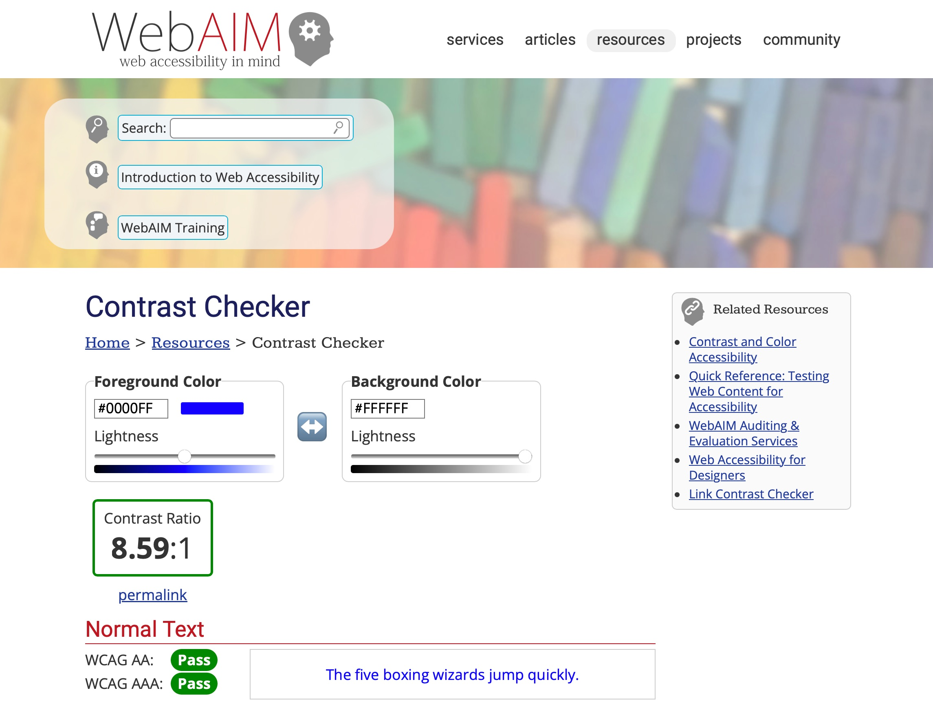
MANUAL TESTING: COLOR CONTRAST
Check color contrast throughout the document.
small text: 4.5: 1
large text: 3:1
icons and graphics: 3:1
WebAIM Contrast Checker

Slide 29
MANUAL TESTING: LINKS
Link text = clear and accurate information about destination.
Avoid “Link,” "Click here," "See this page," "Go here," or "Learn more."
Use title or short description of destination.
Use underlines only for links.

Slide 30
MANUAL TESTING: VIDEO & AUDIO
Audio & video in (or linked to) your PowerPoint should be accessible.
Videos need captions.
Audio descriptions narrate visual information.
Hello, world!

Slide 31
MANUAL TESTING: UVM SERVICES
UVM Student accessibility services can provide captions and audio descriptions.
It may be free or not depending on your audience.
You need to submit a request form. Plan ahead.
Hello, world!

Slide 32
MANUAL TESTING: ROOM FOR CAPTIONS
Leave 10-15% at the bottom of each slide for captions.
Live and recorded presentations can have captions.
Random icons are distracting
15% FOR CAPTIONS

Slide 33
MANUAL TESTING: ACCESSIBLE FILE NAMES
Don’t start or end your filename with a space, period, special character or underline.
Keep your filenames to a reasonable length.
Use lowercase or Camel Case.

Slide 34
MANUAL TESTING: MORE TIPS FOR ACCESSIBLE FILE NAMES
To be accessible to screen readers, file names should not contain spaces and/or special characters.
Don’t use spaces and underscores; use hyphens instead. Use lowercase.
RESOURCES:
ACCESSIBLE FILE NAMES: Please…No Spaces and/or Special Characters
Characters to Avoid in File Names and Directories

Slide 35
RESOURCES: FILE NAMES
ACCESSIBLE FILE NAMES: Please…No Spaces and/or Special Characters
Characters to Avoid in File Names and Directories

Slide 36
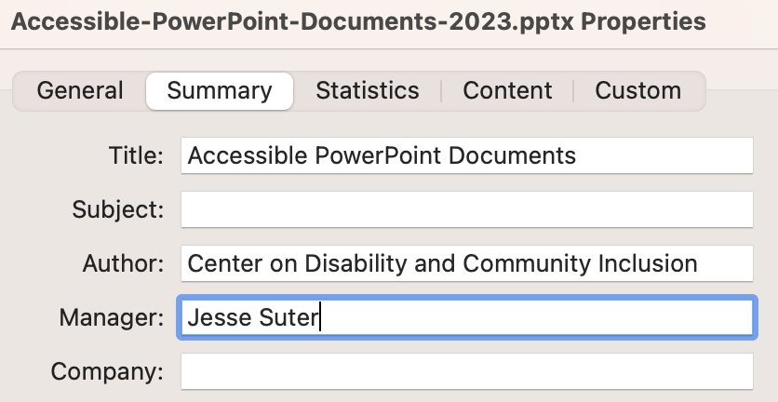
MANUAL TESTING: PROPERTIES
Open Properties
File > Properties…
go to the Summary tab.
Title: Document Title
Author: Project or Organization Name
Manager: Your Name

Slide 37
FOUR FOR THE ROAD
Resist the freakout. This is a lot to train yourself to do. Pick one thing from today’s workshop and try it for 30 days.
Accessibility is a continuum. We are all doing our best. And we can all do better.
Ask for help. This is all our jobs, and we’re all learning.
Trust human data over automation.

Slide 38
RESOURCES: GENERAL
Microsoft: Make your PowerPoint presentations accessible to people with disabilities
WebAIM: PowerPoint Accessibility
CDCI Accessibility Resources
CDCI Checklist for Designing Accessible Documents

Slide 39
RESOURCES: IMAGES
About Decorative Images
WebAIM Contrast Checker
Colorblind WebPage Filter
The Alt-Text Decision Tree

Slide 40
Thank you for your time.
go.uvm.edu/accessibility
Feel free to use it and remix it for non-commercial use, with attribution.
This presentation is licensed under CC-BY-NC-SA.

