Slide 1
The Realities of Housing and Homelessness on the Healthcare System
Ken Schatz, Commissioner
VT Department for Children and Families
http://dcf.vermont.gov

Slide 2
Social Determinants of Health
Economic Stability | Physical Environment | Education | Food | Social Supports | Health Care
Employment Income Expenses Debt | Housing Transportation Safety | Early Childhood Education Vocational Training Higher Education | Food Security Access to Healthy Options | Social Integration Support Systems Community Engagement | Health Coverage Provider Availability Quality of Care
HEALTH OUTCOMES
Notes:
Research has shown that social determinants have a significant impact on health outcomes.
Nationally, there has been increased attention on the relationship between health and housing and how Medicaid can support housing-related activities including referral, support services and case management that connect and retain homeless individuals and families to stable housing.

Slide 3
Homelessness and Health
Homeless individuals have higher rates of acute and chronic illness when compared to non-homeless individuals.
Pre-existing health conditions
New health problems
Behavioral health issues
(National Health Care for the Homeless Council)
Notes:
High blood pressure, diabetes and asthma are difficult to manage when living on the streets or in shelter.
Exposure to communicable diseases, violence, malnutrition and harmful weather conditions can create new health issues
Mental illness and substance use is often exacerbated by homelessness

Slide 4
Agency of Human Services’ Blueprint to End Family Homelessness by 2020
Adopts the national “Family Connection” framework on homelessness.
Brings together supportive services, housing and rental assistance to improve housing stability for families, landlords and communities.
Constructs and rehabilitates affordable rental housing for households with extremely low incomes; accessible to families/individuals who have experienced homelessness.
http://humanservices.vermont.gov/end-family-homelessness/overview-ending-family-homelessness-in-vermont
Notes:
A - Family Connection framework: 4 key components to an effective homeless Continuum of Care:
1. Coordinated entry system to assess needs and connect families to targeted prevention and shelter as needed
2. Services are tailored to the needs of families: rapidly re-house homeless families, increase access to affordable housing and direct intensive housing services to highest need families
3. Connect families to benefits, employment and services needed to sustain housing
4. Use evidence-based practices
B – Foster partnerships between property managers and service providers around rapid re-housing and supportive housing initiatives.
C – Promote public and private development of affordable rental housing stock.

Slide 5
DCF’s Emergency Housing Program
In Vermont, the homeless are served through the DCF General Assistance Program which provides emergency housing to the following individuals and families:
Vulnerable Populations
Catastrophic Situations including victims fleeing domestic violence
Cold Weather Exception
Notes:
Vulnerable – households with a member 65 or older, in receipt to SSI or SSDI, has a child age 6 or younger, or in 3rd trimester of pregnancy
Catastrophic – sudden loss of housing due to flooding, fire or other disaster including DV
Cold Weather Exception – temp or wind chill less that 20 degrees or less than 32 degrees with over 50% chance of precipitation

Slide 6
DCF’s Emergency Housing Program
Vermont’s historical reliance on motels to provide emergency housing had many drawbacks:
Limited access to case management and other support services
Challenging living conditions for families and children
Lack of food storage and preparation

Slide 7
DCF’s Emergency Housing Program
The number of Vermonters needing emergency shelter steadily rose from 2011 – 2015:
Fiscal Year | # of Unique Cases | # of Days
2011 | 1448 | 31,934
2012 | 1954 | 38,350
2013 | 2851 | 71,770
2014 | 2796 | 52,087
2015 | 2981 | 52,502
Notes:
Reliance on motels was costly and unsustainable

Slide 8
DCF’s Emergency Housing Program
The Harbor Place Transitional program opened on November 1, 2013 and provided the following:
New 30 bed Facility
Case management and support services
Community partners engaged in program
Cost effective alternative to motels - $38/night compared to $62 for motel
Notes:
AHS, DCF, Champlain Valley Office of Economic Opportunity and UVM Medical Center worked together to expand shelter capacity in Chittenden County that included a service component
Community partners include Champlain Valley Office of Economic Opportunity, Women Helping Battered Women and Safe Harbor who provide case management and other resources to help Harbor Place residents identify and address underlying needs and barriers to securing housing.
Provided over 7,500 nights of emergency housing in FY 16

Slide 9
DCF’s Emergency Housing Program
DCF launched it’s Emergency Housing Initiative in April of 2015
transforming its motel-centered program
to a
community-based program
Notes:
The DCF Housing Team engaged community stakeholders and housing partners across the state who worked together to create a community-based approach to addressing homelessness

Slide 10
DCF’s Emergency Housing Initiative
Key parameters of this community-based model include:
Collaboration with local housing Continua of Care
Reduced Reliance on Motels
Evidence-based approaches of the Family Connection Framework
Provides coordinated intake and assessments for homeless individuals and families

Slide 11
DCF’s Emergency Housing Initiative FY 2016
DCF’s Housing Opportunity Program (HOP):
Strategically invested $790,000 from the General Assistance Emergency Housing program into new community-based programs designed to provide shelter, case management, homelessness prevention and rapid re-housing services.

Slide 12
DCF’s Emergency Housing Initiative
HOP’s funded proposals included:
4 seasonal warming shelters in Burlington, Barre, Newport and St. Johnsbury
16 additional spaces to provide emergency housing for families with children, year-round through master-leased apartments with services
Innovative partnerships with Domestic Violence organizations to better deliver shelter and services to victims fleeing domestic and sexual violence
Additional capacity to serve unaccompanied youth ages 18-24
Notes:
Partnered with Brattleboro’s Domestic Violence Shelter (Women’s Freedom Center) to accept 100% of DV referrals from ESD and use their existing shelter and a pool of GA funds for shelter overflow in motels which they managed independently. Allowed DV victims in motels to access services thru the shelter.

Slide 13
2016 Outcomes
General Assistance Emergency Housing Program Utilization for 2016:
Results:
A 24% reduction in the number of motel nights from 2015
Overall spending on emergency housing decreased from $4.3M in FY15 to $3M in FY16
Fiscal Year | # Unduplicated Cases | # of Days
2015 | 2981 | 52,502
2016 | 3834 | 39,953
Notes:
Data is encouraging that we are making progress. While the number of cases increased, the number of shelter nights decreased significantly. Overall spending decreased.

Slide 14
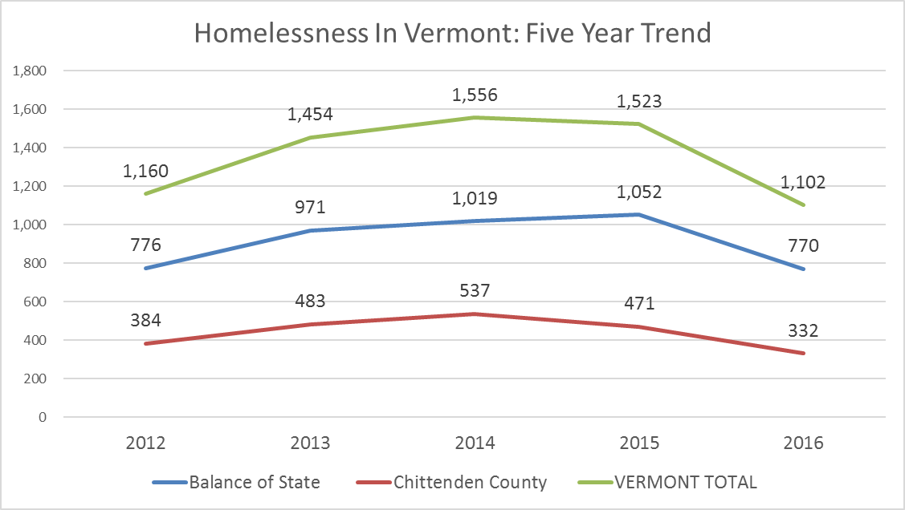
2016 Outcomes
Second Year Decline in Homelessness in Vermont
Notes:
The annual Point-in-Time Count is an unduplicated count of persons experiencing homelessness on January 26, 2016. Data from the count is released in April. For the second year in a role, the rate of homelessness has declined in Vermont. 2015 – 2% drop and 2016 – 28% drop.

Slide 15
2016 Outcomes
DCF’s Housing Opportunity Program (HOP):
86% of households who were stabilized in transitional or permanent housing continued to be stably housed 90 days following assistance.
http://dcf.vermont.gov/sites/dcf/files/OEO/Docs/HOP-Final-Report.pdf
Notes:
Financial assistance and case management services together thru rapid re-housing demonstrates an effective combination of resources to help families achieve and maintain housing stability.

Slide 16
2016 Outcomes
Domestic Violence:
There has been a 10% increase in the number of individuals/households seeking emergency housing fleeing from domestic violence;
And a 42% increase in the number of children.
Notes:
One continuing challenge is the emergency housing needs of women and children fleeing domestic violence
Will continue to work with DV partners to find solutions to this growing problem
Brattleboro initiative with Women’s Freedom Center is showing promising results in reducing the number of motel nights

Slide 17
New Initiatives for FY 2017
Community Investments include:
Bennington County Coalition for the Homeless: $80,000
10-bed expansion of emergency shelter for single adults
Rutland’s Open Door Mission: $230,000
16-bed expansion of emergency shelter for single adults

Slide 18
New Initiatives for FY 2017
Domestic Violence Initiative
Expansion of partnership with domestic violence organizations to the Rutland and Bennington DV shelters: $256,875
Victims have one-stop to receive shelter, and
DV programs are able to engage families with essential services and support more quickly.
Notes:
Expanded partnership that was piloted with the Brattleboro DV shelter to the domestic violence shelters in Bennington and Rutland.
Shelters accept 100% of DV referrals from ESD office and use their existing shelter and a pool of GA funds for shelter overflow in motels which they manage independently.

Slide 19
DCF Promising Practices
The Family Supportive Housing Program provides intensive case management and service coordination for 91 families with children.
Of these 91 families:
75 families (82%) were in permanent housing at end of first the year;
11 of 17 (65%) of adults in recovery maintained their sobriety after 12 months;
24 families (26%) had open cases with the Family Services Division;
8 of these cases (33%) were favorably resolved.
http://dcf.vermont.gov/sites/dcf/files/OEO/Docs/FSH-July2014-June2015.pdf
Notes:
Preference given to families who had an open case with Family Services, enrolled families had been homeless for almost 6 months (181 days) on average, Model uses Medicaid dollars to fund intensive case management and support services for these high need families

Slide 20
DCF Promising Practices
Vermont Rental Subsidy (VRS) Program is a rapid-rehousing intervention that allows households to pay 30% of their income toward monthly rent for 12 months.
Of these households:
33 households (25%) increased their earnings or found alternative housing
66 households (49%) bridged to longer-term federal rental assistance programs
35 households (26%) were removed from program for non-compliance
Notes:
Participants work with a Housing Support Worker who helps families to connect to services, increase income or find long-term affordable housing.

Slide 21
The Value of Stable Housing
AHS study of 134 VRS households found that over the two-year period from homelessness to housing stability, Medicaid costs for:
Emergency, inpatient and observation status care among family members declined by $196,561 or 51% below baseline, and
Preventive and primary care among family members declined by $55,257 or 11% below baseline.
http://humanservices.vermont.gov/departments/value-of-stable-housing
Notes:
Study looked at health utilization and Medicaid cost for 6 months prior to entering program (homeless period) and at 6, 12 and 18 months following participation in program.
Study found a correlation between stable housing and reduced health care costs.

Slide 22
Next Steps
Accelerating Vermont’s Effort to End Homelessness
Assessment of the state’s current systems and resources
Development of a Comprehensive Roadmap
Report to the Legislature with Recommendations
Final Report Due December 2016
Notes:
While gains have been made to address homelessness in VT, progress is uneven across the state and more needs to be done.
FY 17 Budget Bill included $40,000 in funding to create a roadmap which leverage an additional $45,000 from housing partners: VT Community Foundation, VT Housing & Conservation Board, VHFA and NeighborWorks Alliance of VT
Roadmap will provide action steps to make services, rental subsidies and housing units available for supportive housing throughout the state
Will include a cost analysis of proposed solutions
And a plan for technical assistance and training to local communities to implement roadmap

