Slide 1


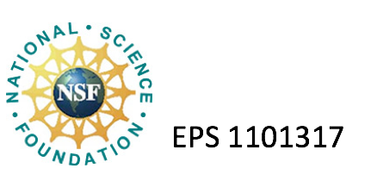


Basin Resilience to Extreme Events (BREE):
Brief Overview of the Integrated Assessment, Behavioral and Policy Implications
Christopher Koliba, Ph.D.
Professor, Community Development & Applied Economics Department
Director, Master of Public Administration Program
Fellow, Gund Institute on the Environment
Social Science Leader, Vermont EPSCoR
University of Vermont

Slide 2
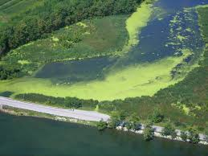
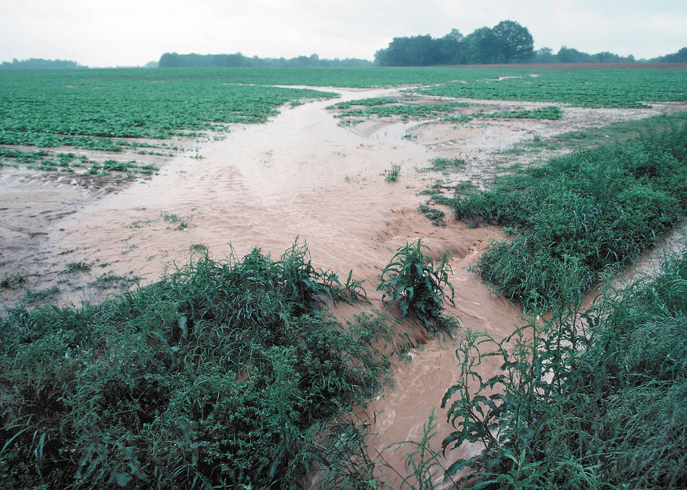
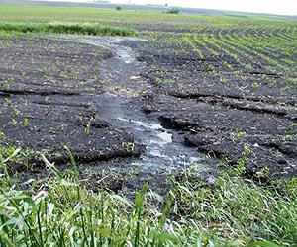
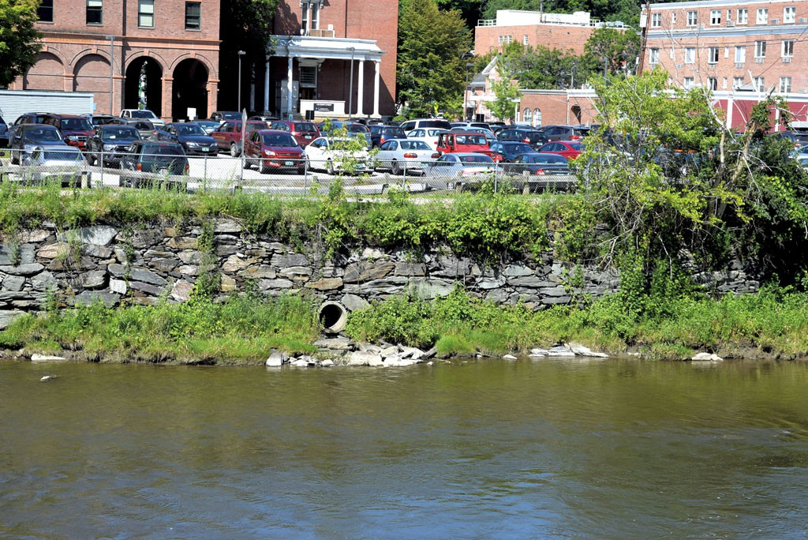
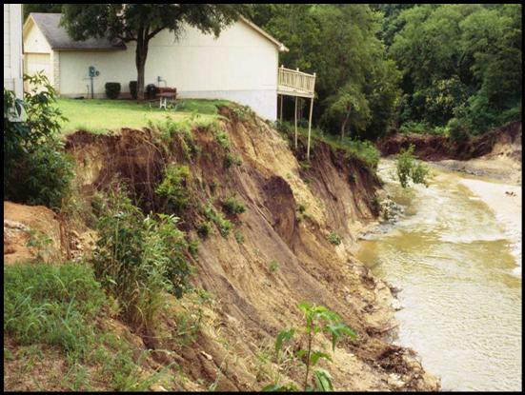
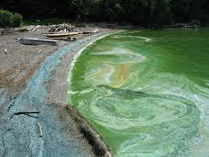

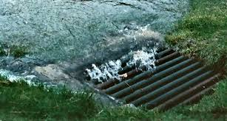
Our “Wicked Problem:”
Algae blooms and phosphorus loading…
“BEST MANAGEMENT PRACTICES”

Slide 3
Integrated Assessment Results As a result of climate change:
Zia et al., 2016
MISSISIQUOI BAY WILL LIKELY BE GETTING WARMER
MISSISIQUOI BAY WILL LIKELY HAVE LONGER/MORE PERSISTENT ALGAE BLOOMS

Slide 4
Behavioral Analysis (sample):
Farmers in Vermont are more inclined to adopt best management practices if they feel that they have control over the management of the practice.
Households need more information and technical assistance in order to be prompted to adopt best management practices.
General Public places a high value on water quality and have expressed a strong willingness to pay for clean water.

Slide 5

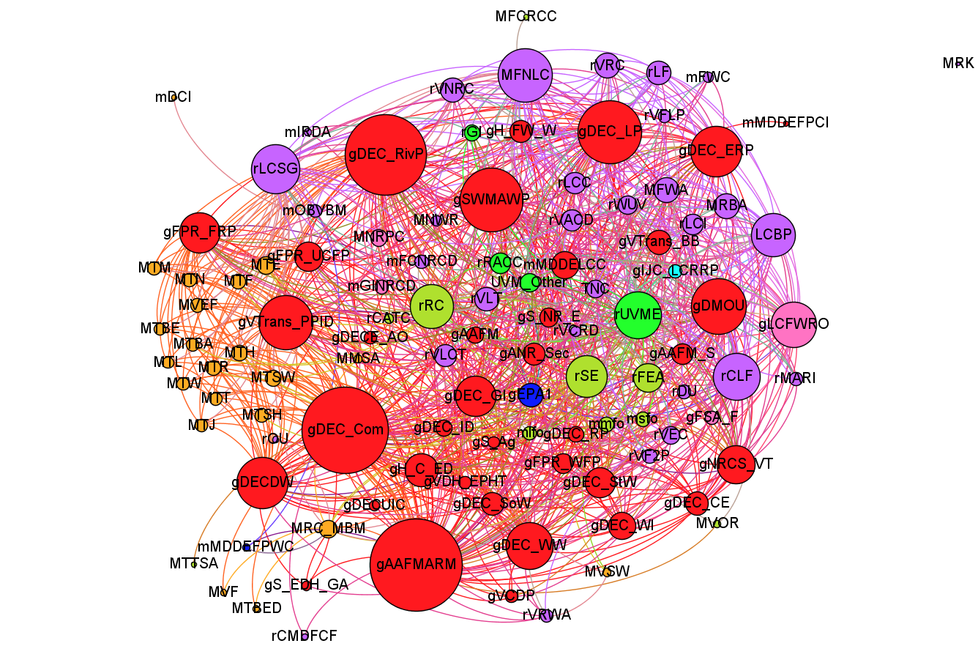
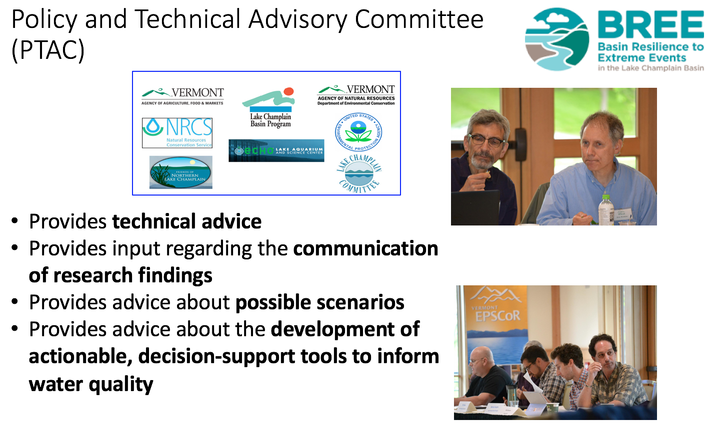
Science – Policy Interface:
Modeling Governance
Engaging Stakeholders
Educating the Public

Slide 6
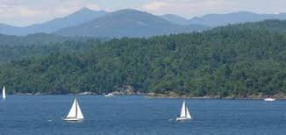
Thank you!
CONTACT:
Chris Koliba
ckoliba@uvm.edu

