Slide 1
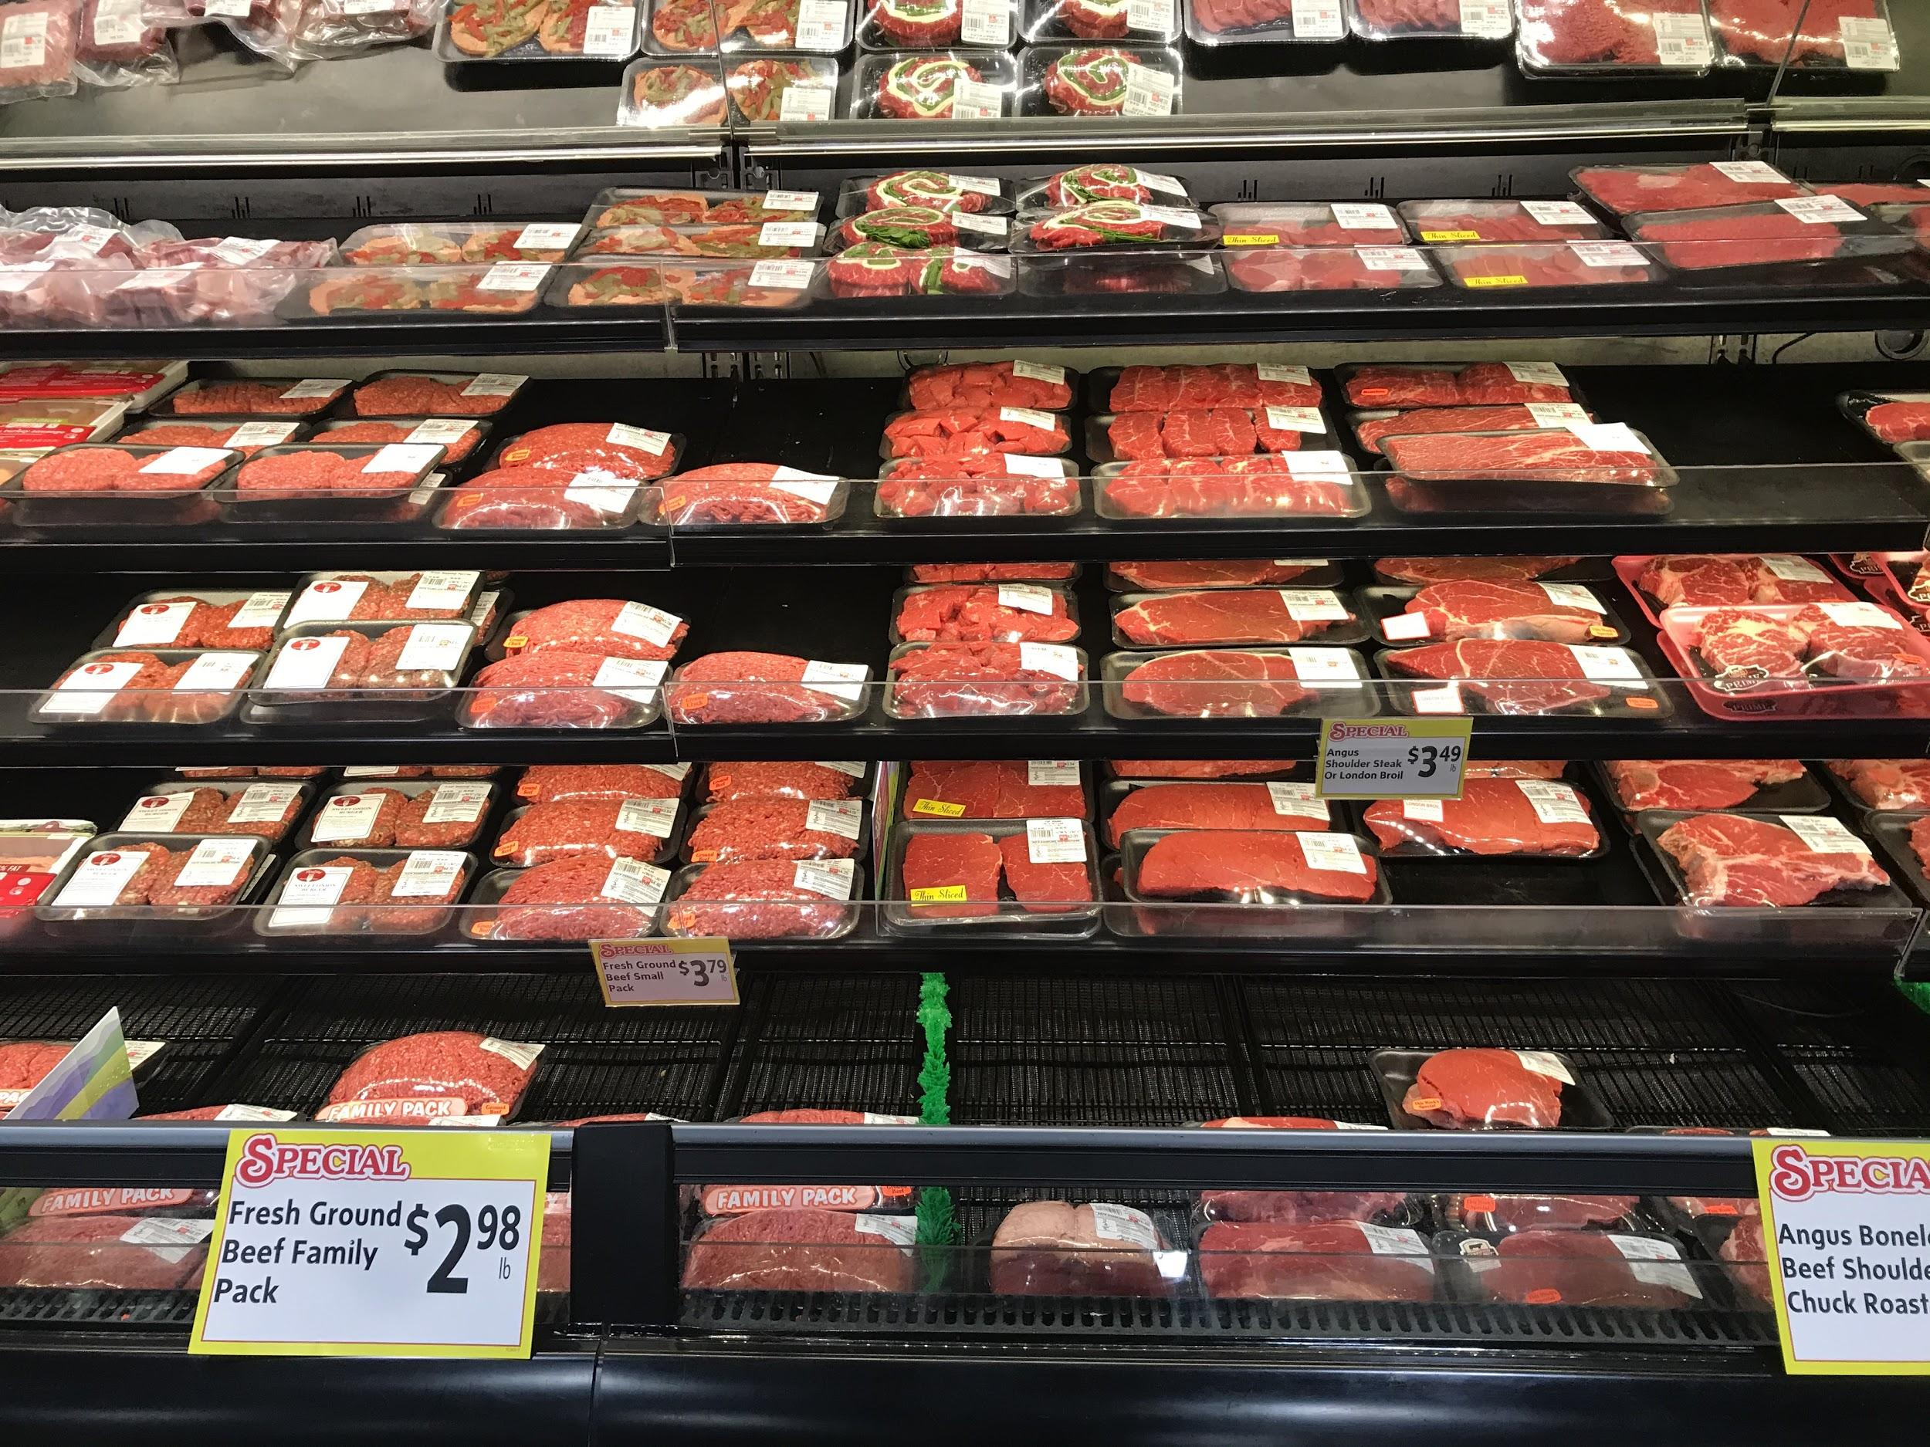
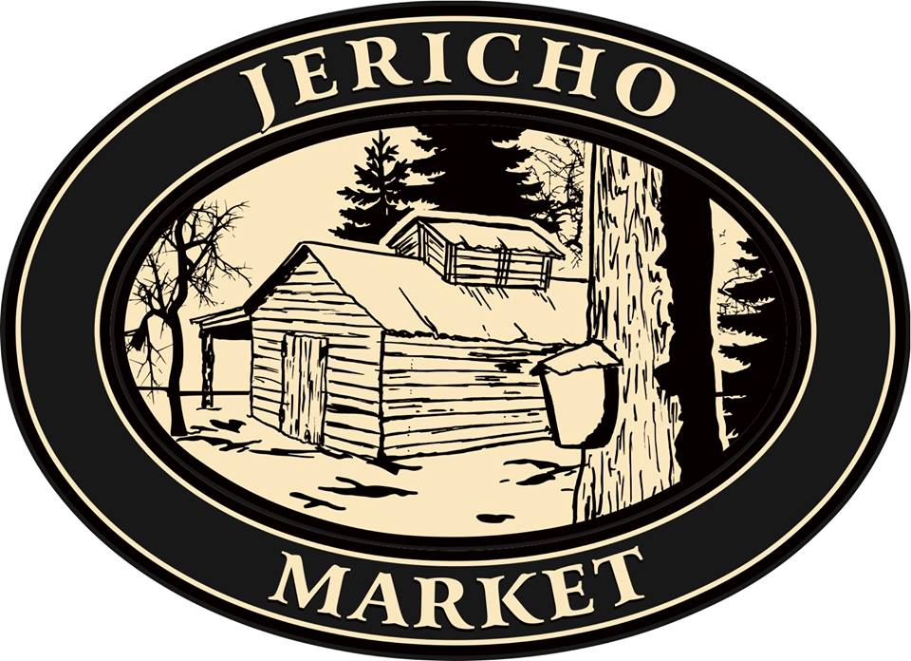
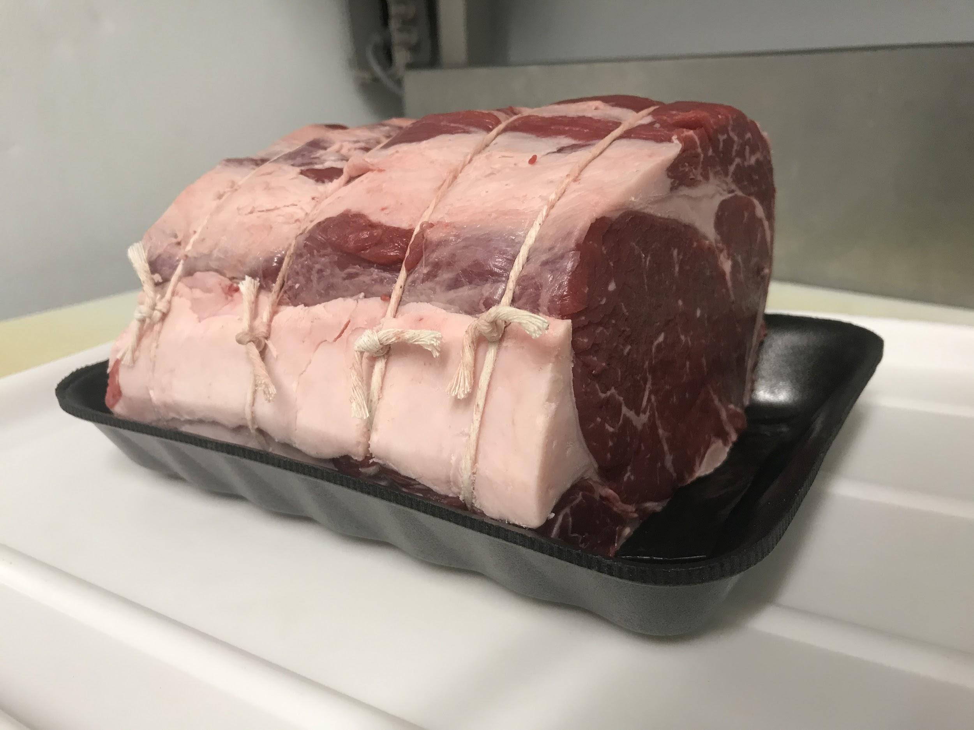
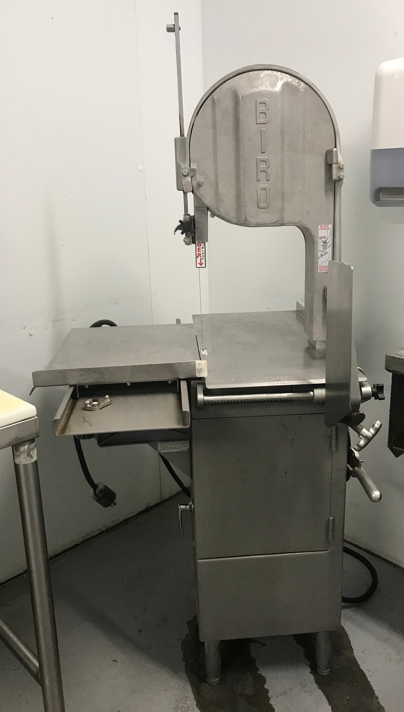
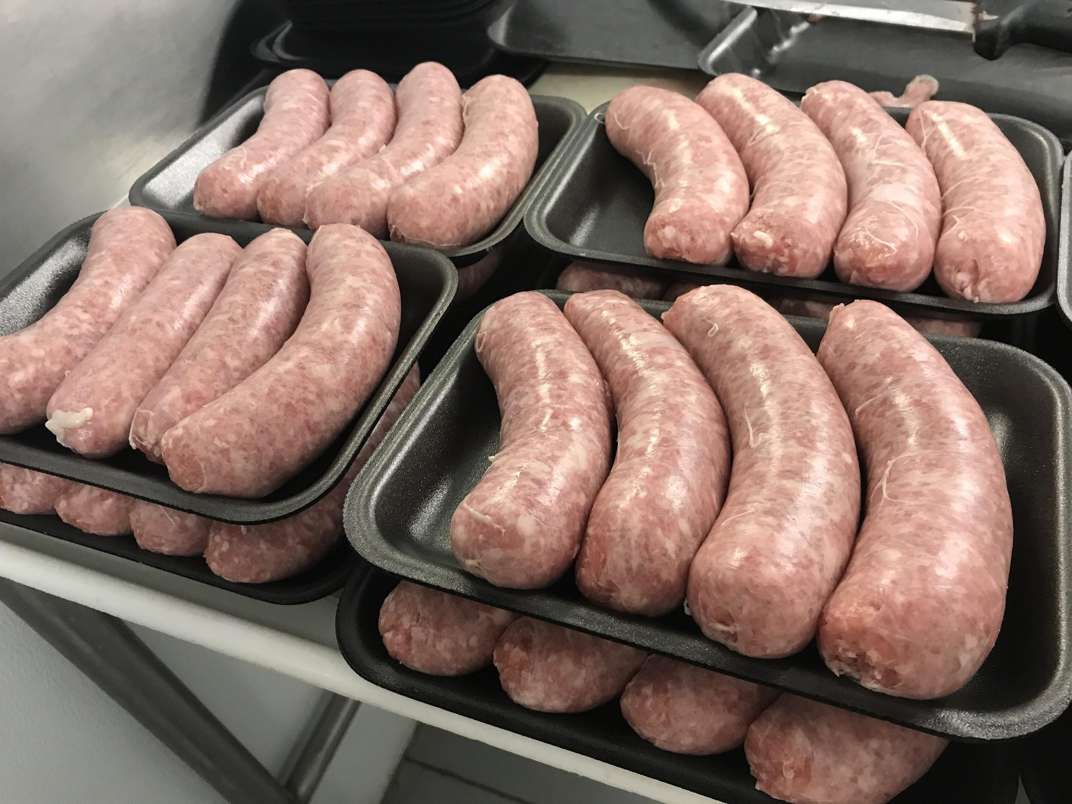
Meat Cutting Apprenticeship
364 VT Route 15, Jericho Vermont 802-858-6300 www.jerichomarketvt.com
The Jericho Market is a supermarket located in Jericho, Vermont.
Specially tailored for its small community, the Jericho Market sells local products, including locally-grown meats.
Knife handling
Identification of meat loins
Meat grinding
Bandsaw to cut bone-in loins
Sausage making
Daily responsibilities included:
Executing various cuts of meat, including red meat, pork, poultry, and seafood
Managing sanitation routines to fully comply with Vermont Meat & Poultry Inspections by the State of Vermont Agency of Agriculture
Evaluate and manage profit margins through inventory counts and adjusting variable product pricing
Communication with vendors about upcoming sales, orders, and inventories
My favorite experience was learning to cut ribeye steaks or sirloin grilling tips. It took a little while to learn good knife control, but once I did, meat cutting got to be a lot more enjoyable!

Slide 2
Part of the Red Meat Case at the Jericho Market. It was expected to be full as often as possible.

Slide 3
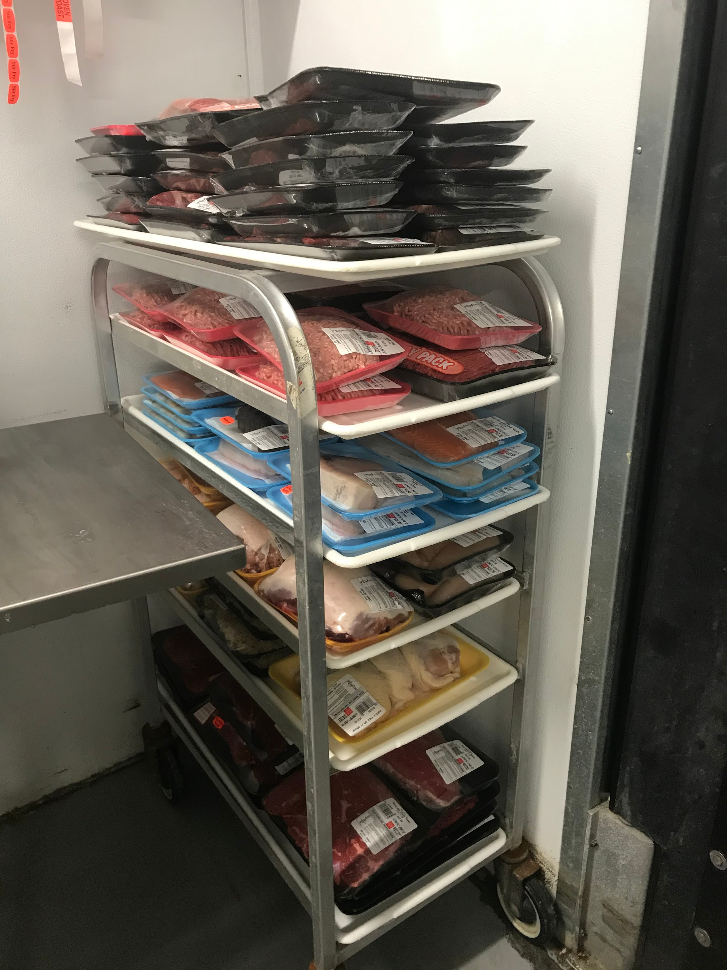
A Particularly Rough Day for Daily Product Markdowns, Far More Product Than Usual.

Slide 4
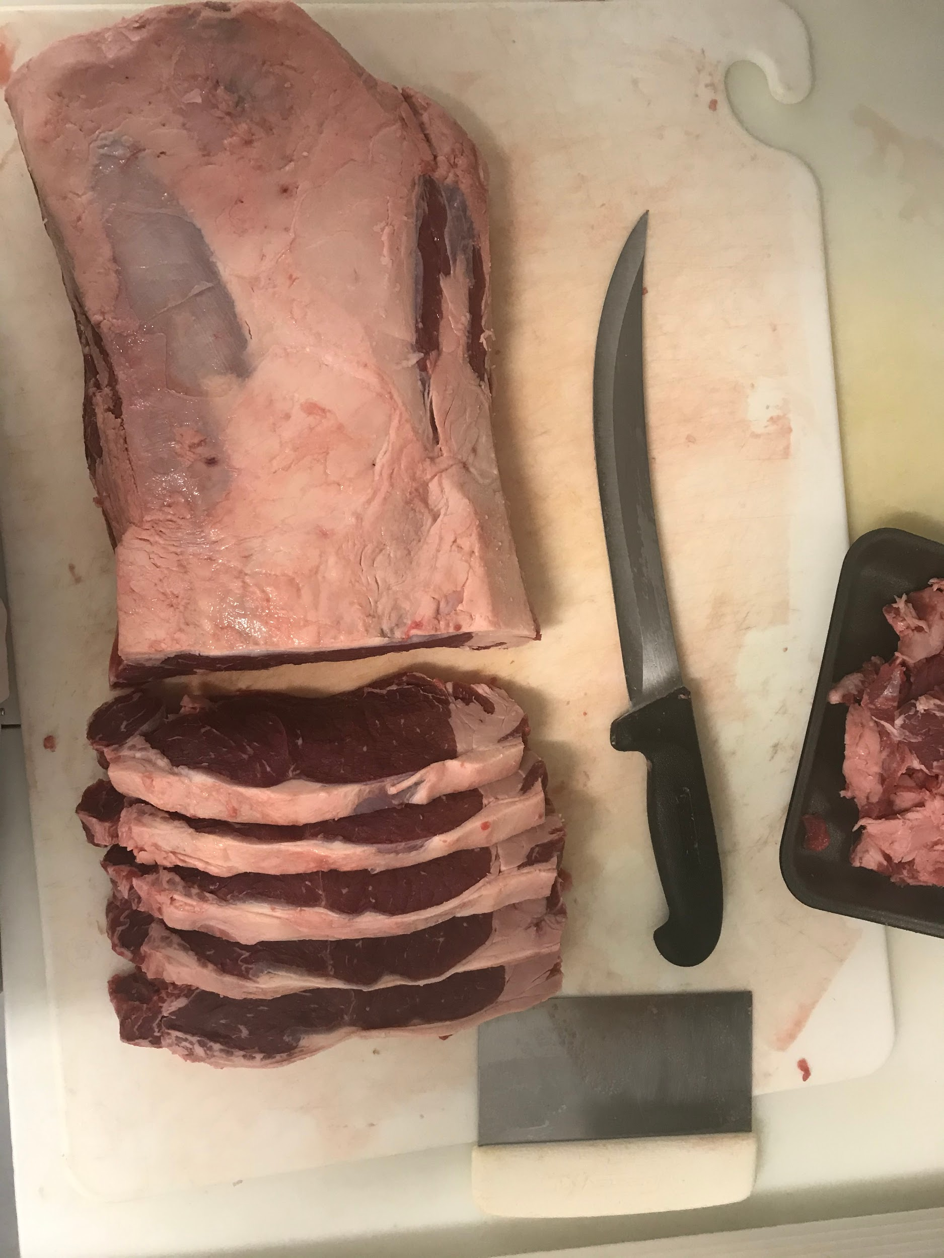
My First NY Strip Steaks

Slide 5
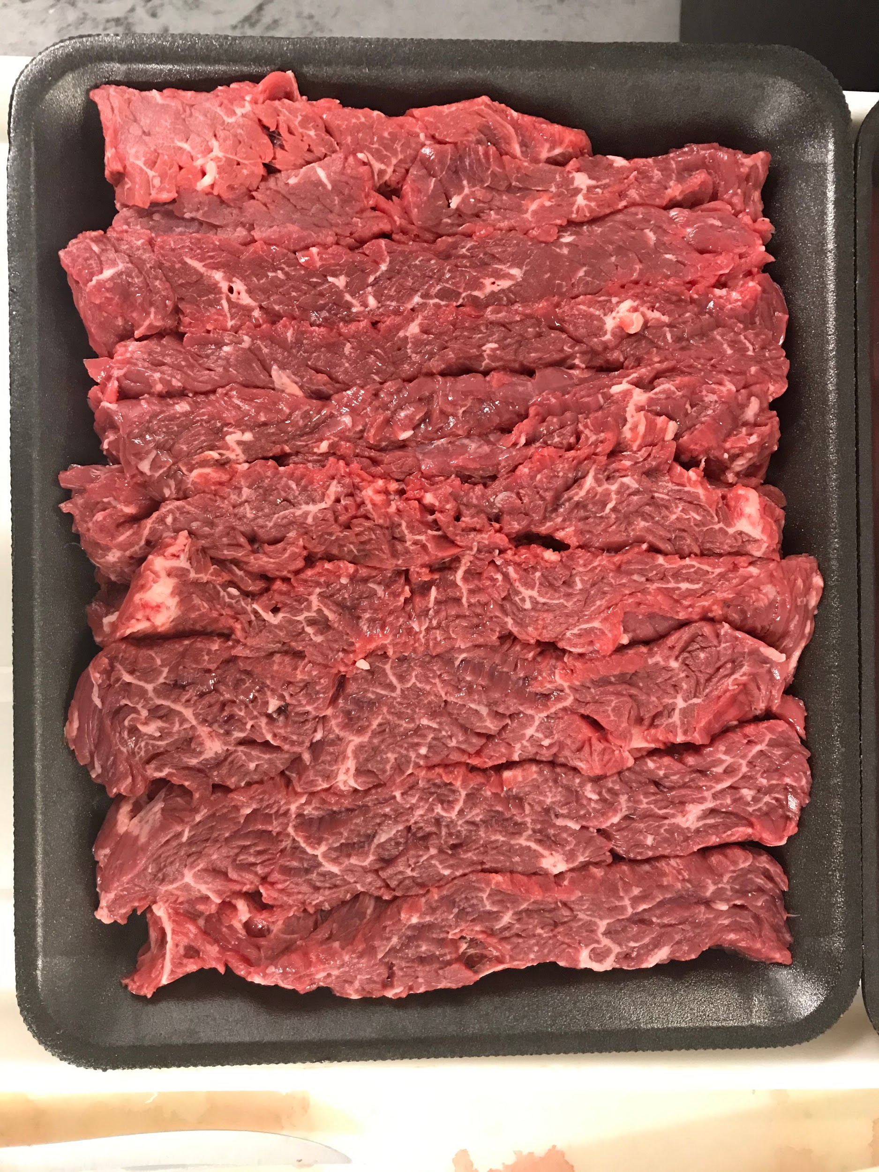
My First Sirloin Grilling Tips

Slide 6
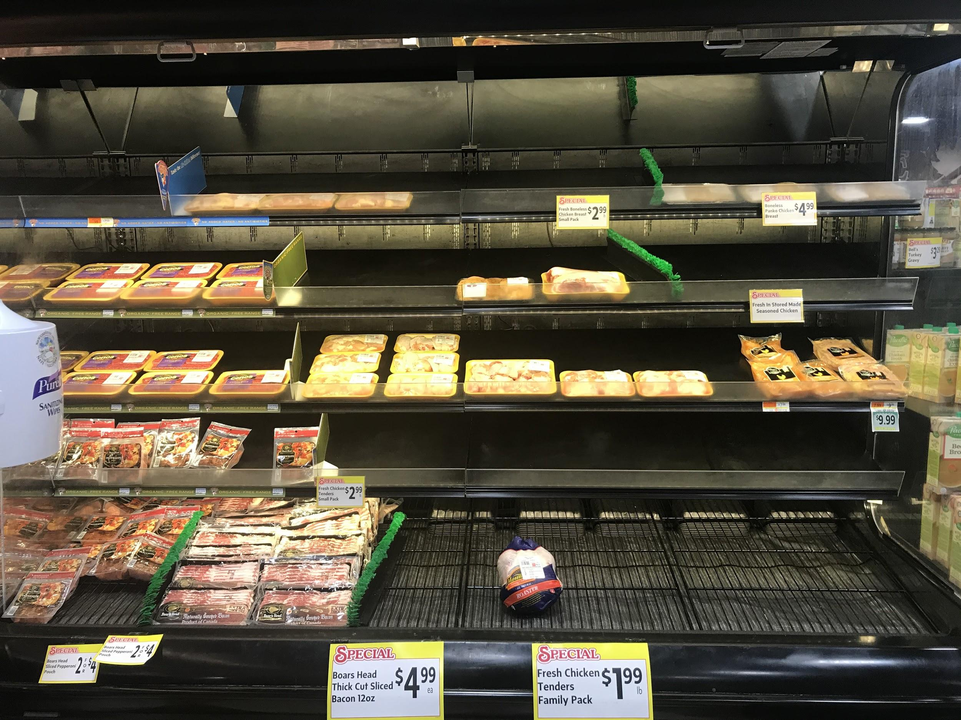
The Chicken Case Nearly Empty at the Jericho Market During the First Week of Coronavirus Quarantine. Most Chicken Was Out of Stock That First Week.

