Slide 1
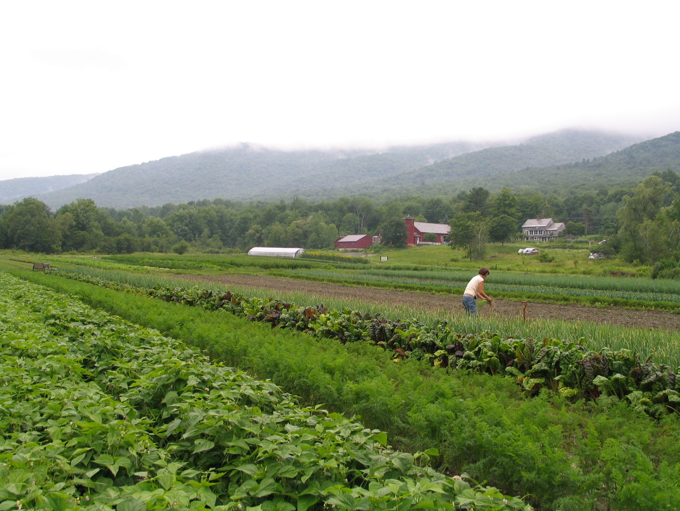
Growing Vermont’s Food System: a vegetable specialist’s perspective
Vern Grubinger

Slide 3
The success of Vermont’s vegetable farms is supported by a ‘fabric’ of federal, state and local support
An alphabet soup of service providers:
ACORN RAFFL
EMC UVM
F2P VAAFM
FSA VFF
GMF2S VFVC
IFH VHCB
NESARE VLT
NOFA-VT VTC
NRCS WFFN and more…

Slide 4
farmland conservation
16 vegetable farms with 2,200 acres conserved since 2010
30 farms vegetable farms with 4,300 acres conserved over past 30 years
$4,938,000 purchased easements on 2,876 acres
An additional 13 farms have vegetables as a secondary use; these farms have 2,700 acres

Slide 5
business planning
151 commercial vegetable farms with 8,369 acres enrolled in business planning over the past 13 years
Gross income increased 22%, from an average of $82,864 to $101,225 per farm
Net income increased 127%, from an average of $6,907 to $15,2649 per farm

Slide 6
soil testing and recommendations
Provided to commercial vegetable and berry farms:
2010 442
2011 473
2012 546 (Irene)
2013 433
2014 461
2015 524 (thru October)

Slide 7
networking and inter-farm commerce
Member farms Listserv members
2010 213 216
2011 242 255
2012 274 289
2013 256 380
2014 333 450
2015 389 556

Slide 8
grants for vegetable farms
Specialty Crop $310,000 2009-15
Working Lands $302,000 2013-15
Local Marketing $ 80,000 2014-15
GAP infrastructure $ 87,000 2012-13

Slide 9
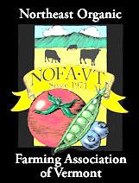
organic certification
veg farms acres GH sq. ft.
2010 142 1,143 644,000
2012 142 1,127 702,000
2014 154 1,483 1.1 million

Slide 10
high tunnel funding
199 ‘seasonal high tunnels’ from 2010-2015
Average cost paid by government: $6,250
Average install size: 1,890 square feet
Total amount paid by NRCS: $1.24 million

Slide 11
increasing local food sales
gross sales of fresh produce from 33 VT farms:
2010 $129,119
2011 $171,617
2012 $256,232
2013 $258,392
2014 $290,971

Slide 12
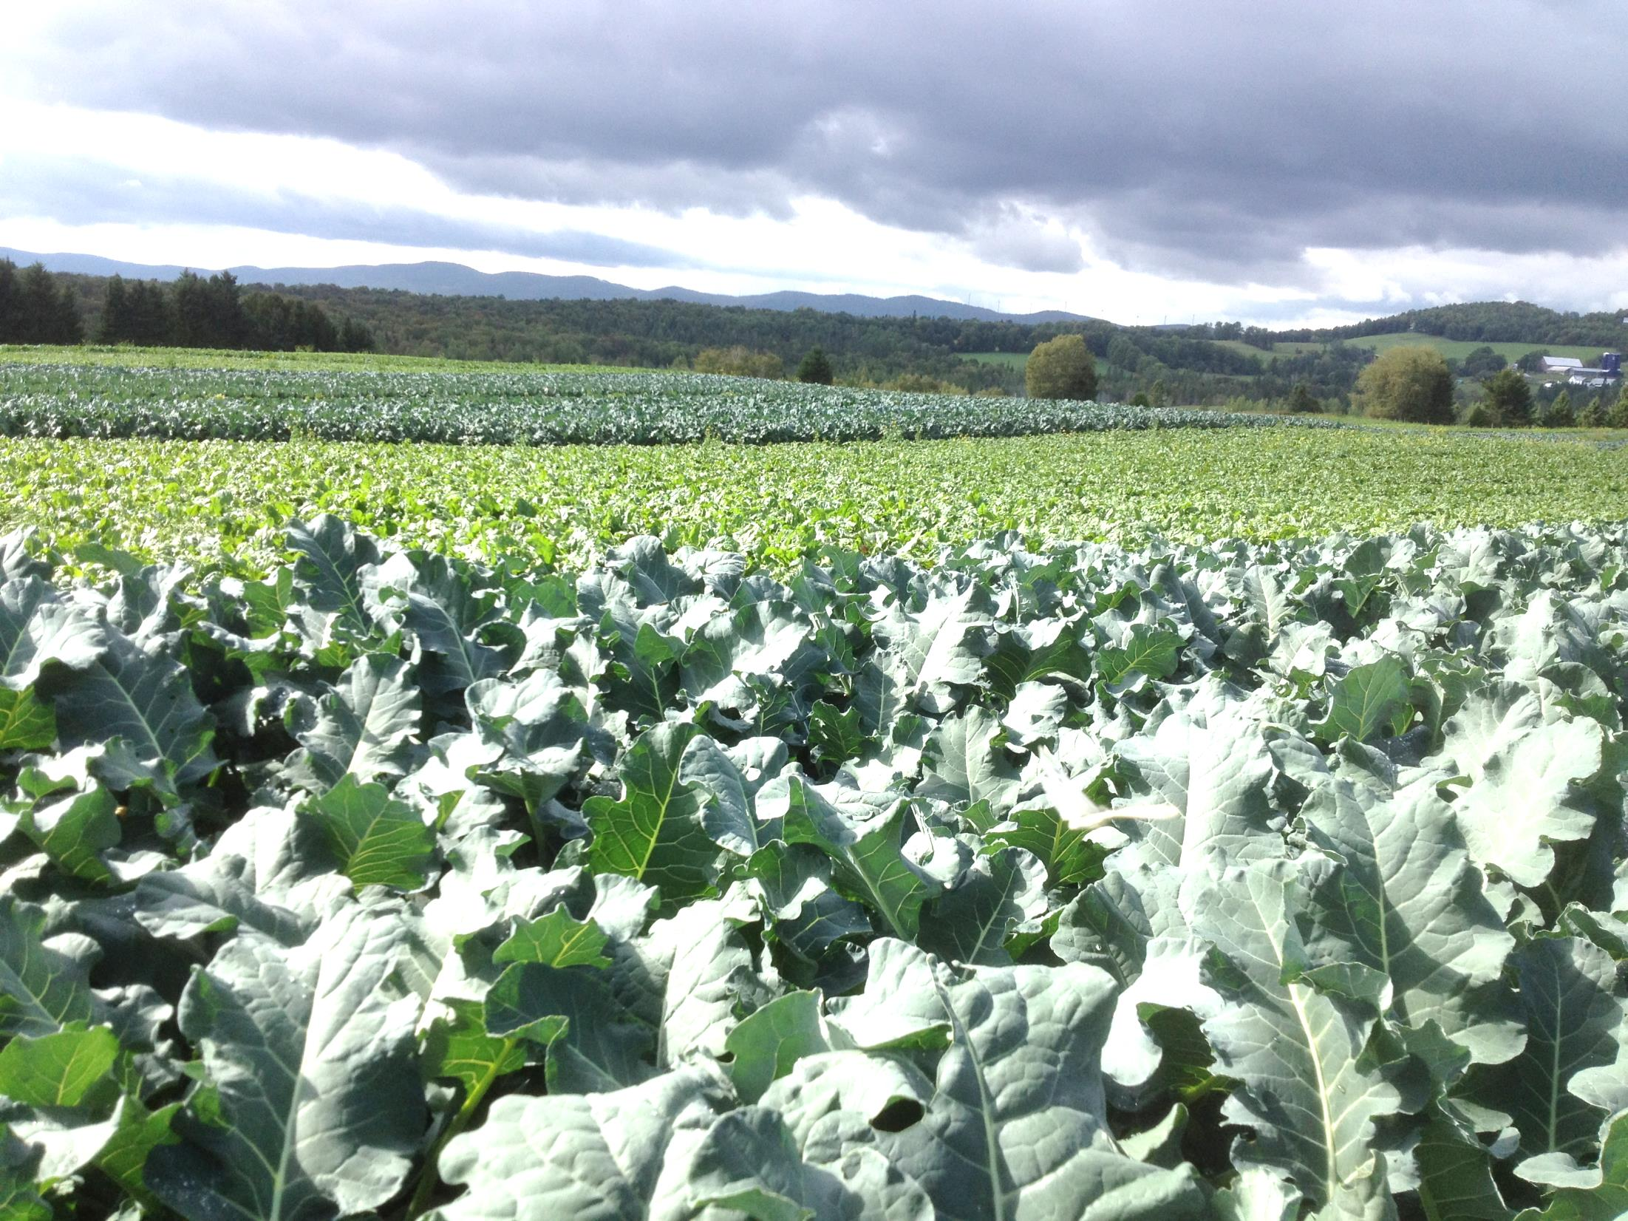
Three ‘case studies’
Pete’s Greens, Craftsbury

Slide 13
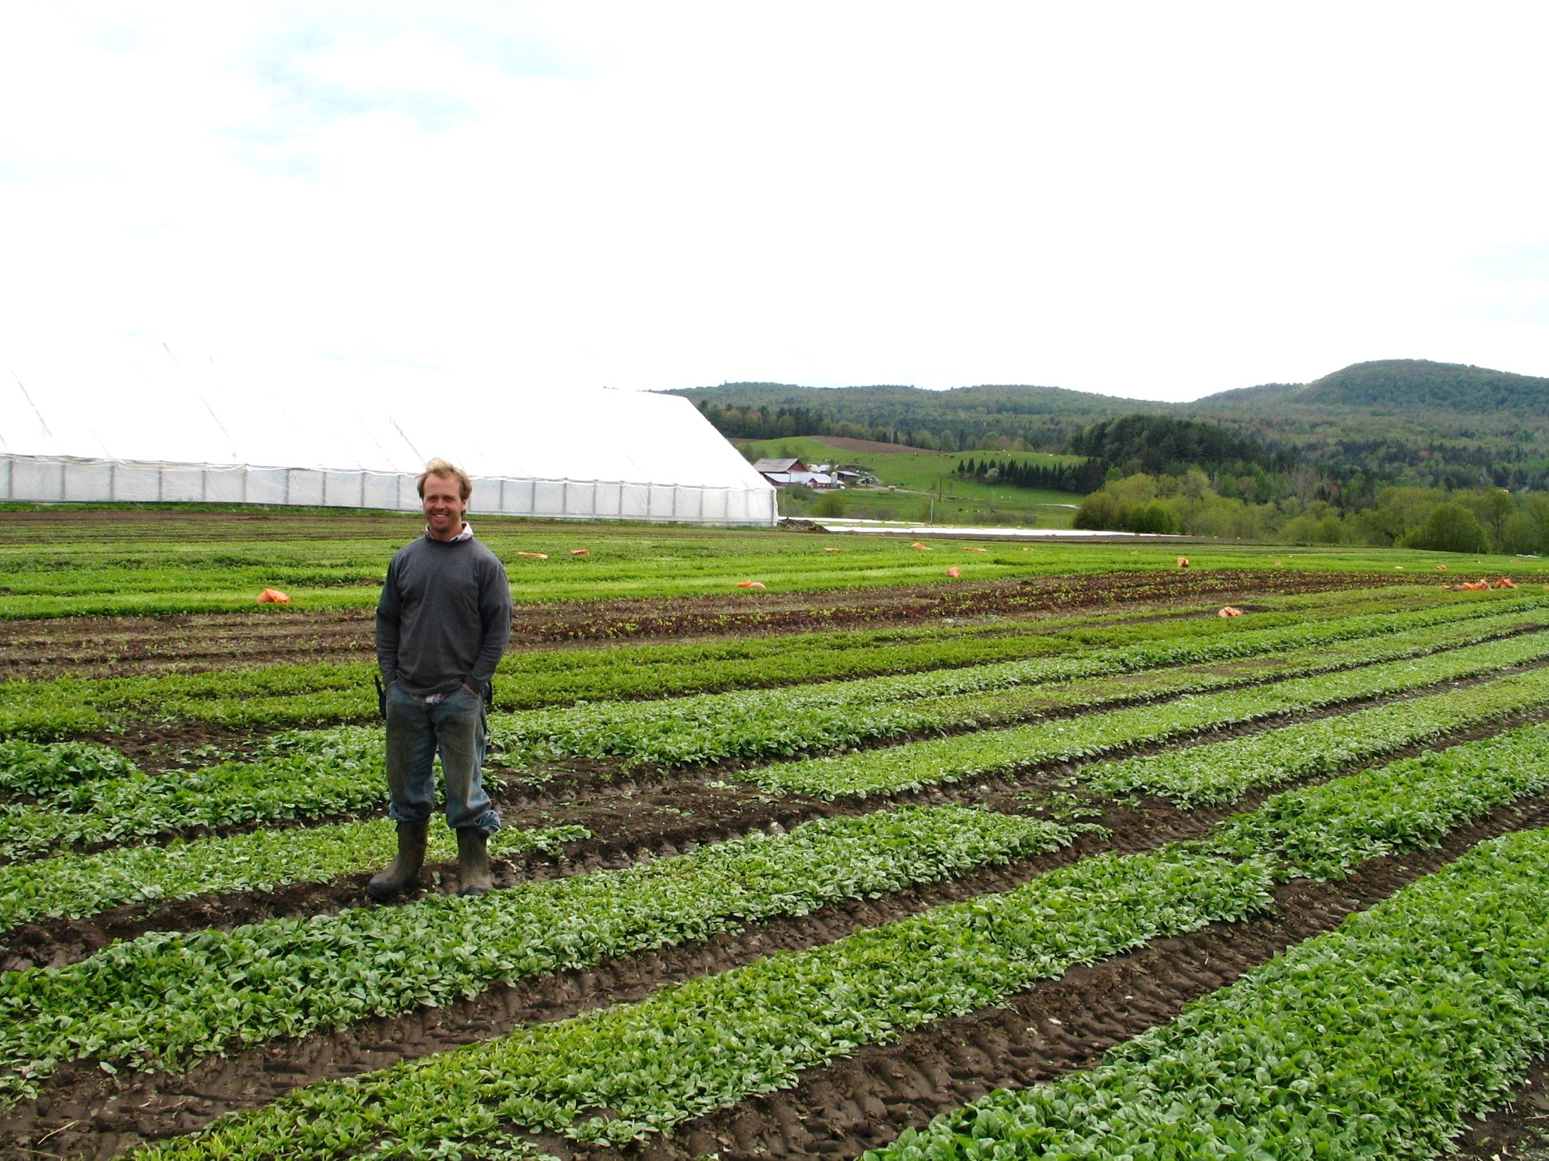
VEDA
financing
Yankee Farm Credit
financing
UVM Extension:
production information
NOFA, VVBGA
networking
Pete Johnson
Started business: 1997
85 acres vegetables, 300 farmed
Peak employment: 37 people
Annual payroll: $800,000

Slide 14
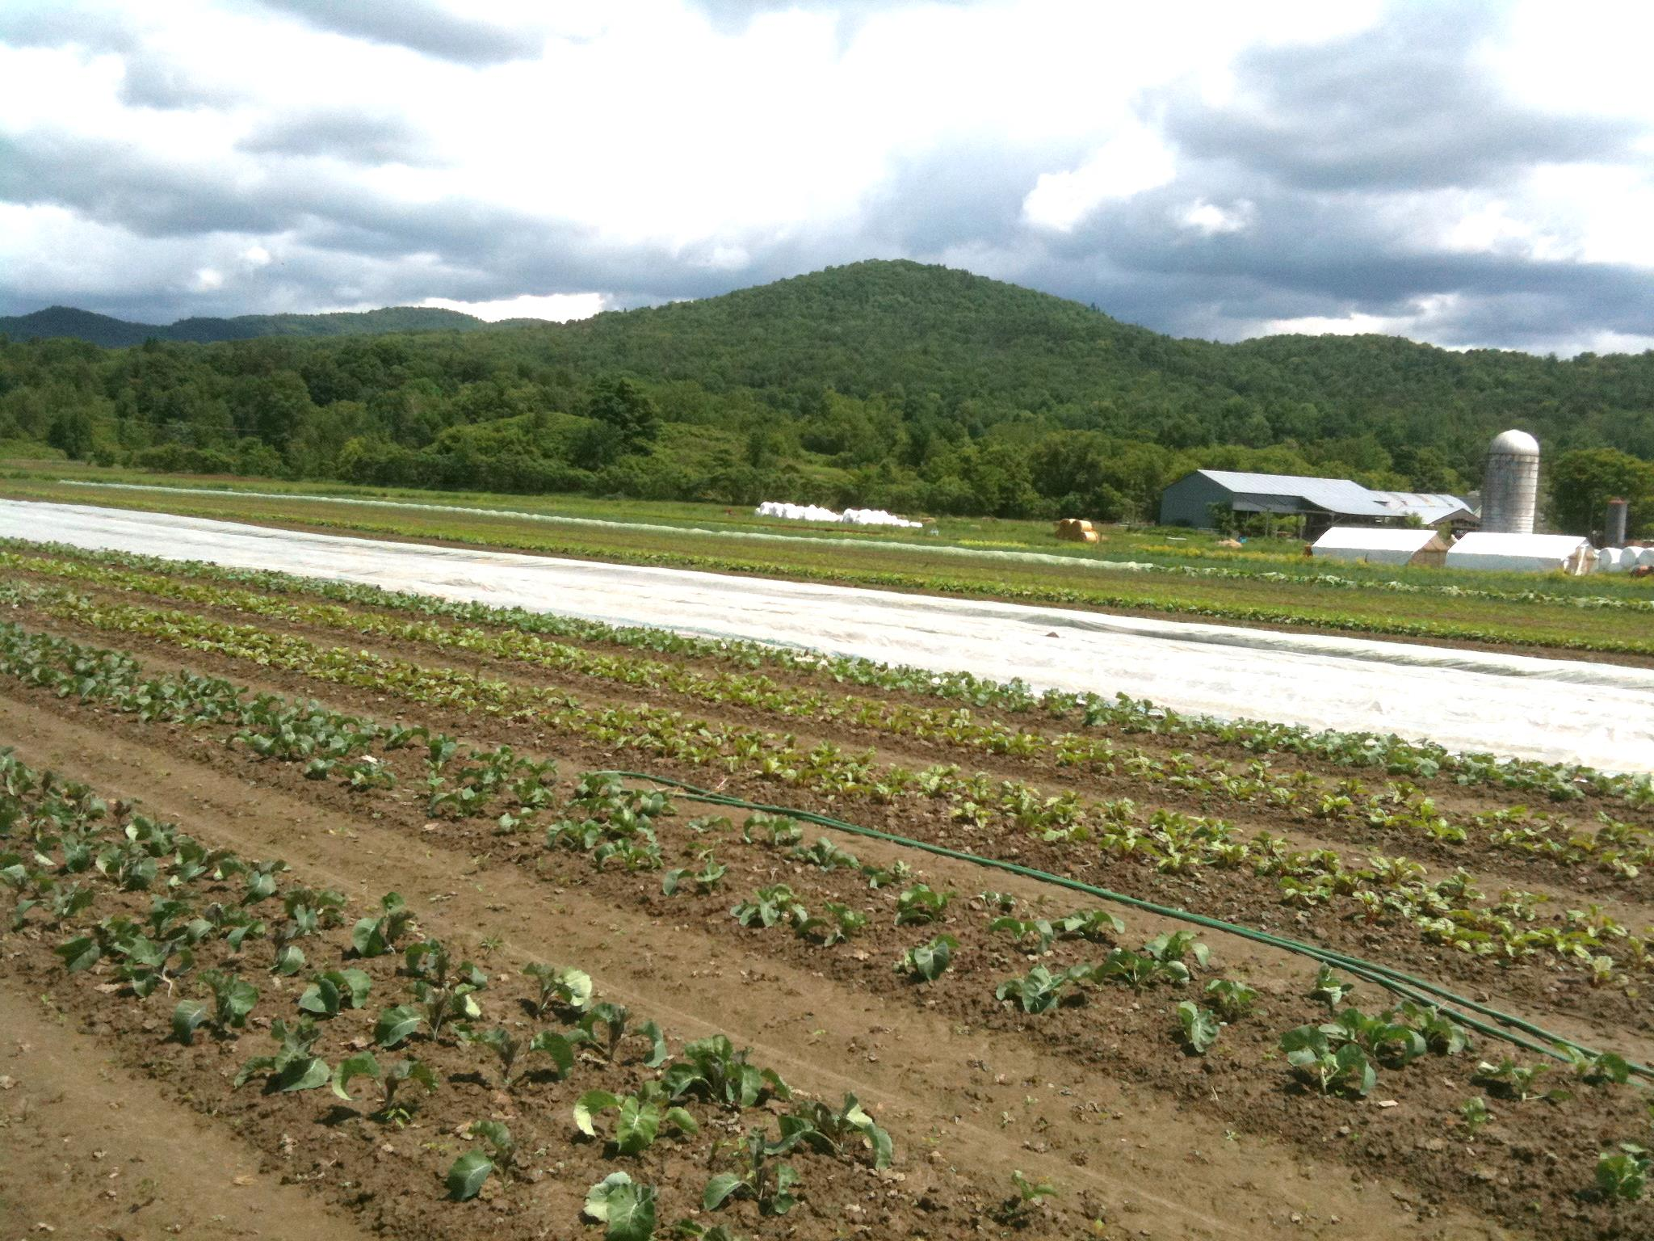
Jericho Settlers’ Farm, Richmond

Slide 15
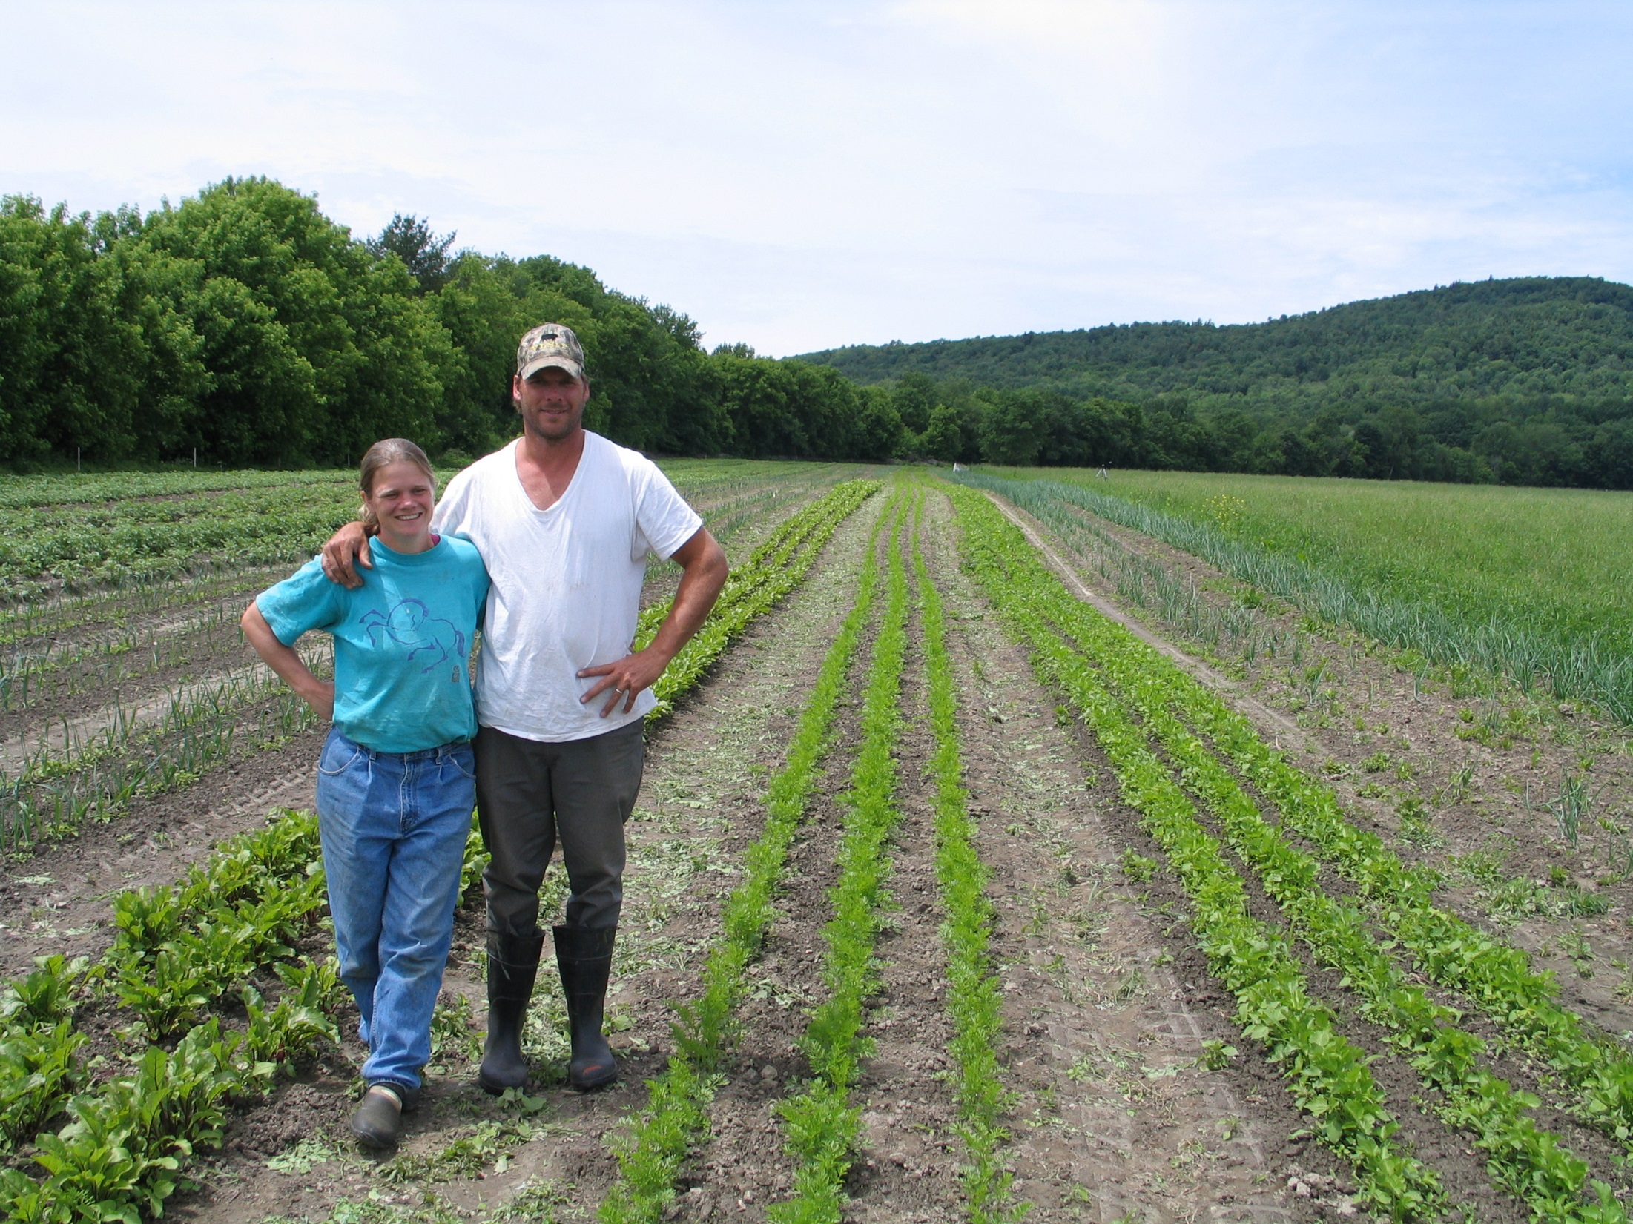
Farm Viability:
business planning
VT Farm Fund
emergency and business loans
UVM Extension:
WAgN, Tilling the Soil
NRCS
hoophouse funding
Working Lands Fund
business grants
Christa Alexander, Mark Fasching
Started business: 2002
Gross annual sales: $900,000
30 acres vegetables, 250 total
Peak employment: 17 people
Annual payroll: $330,000

Slide 16
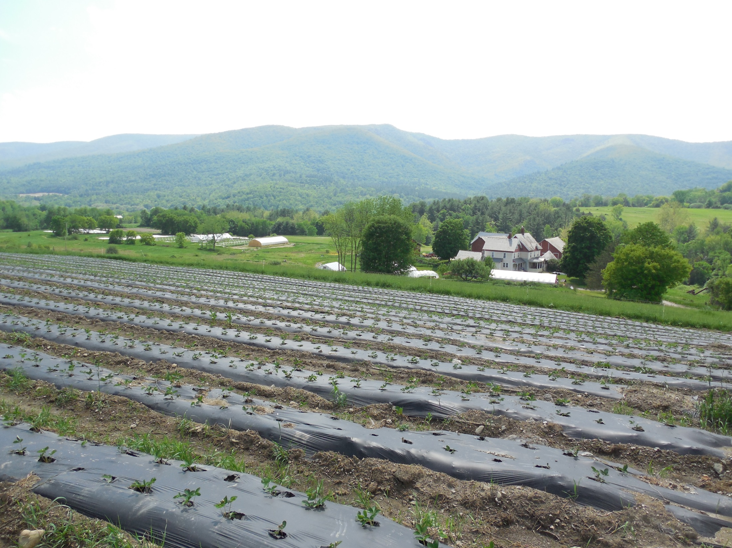
Mighty Food Farm, Pownal

Slide 17
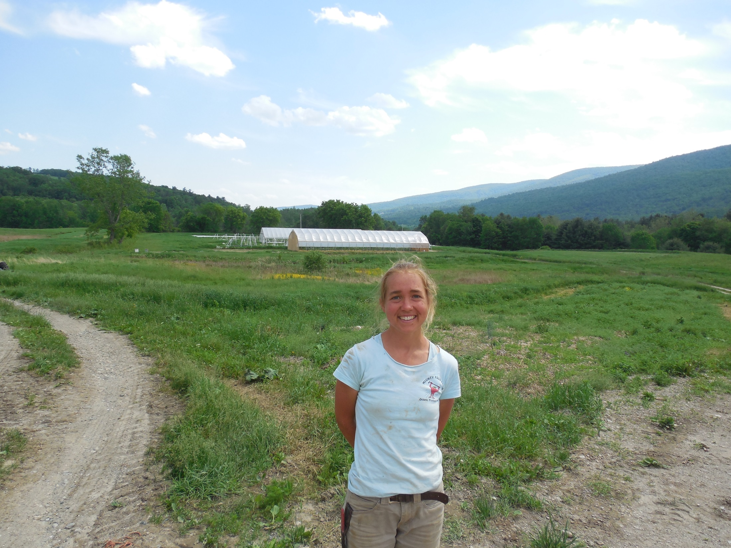
Farm Viability:
business planning
Environmental Mediation Center:
legal issues
UVM Extension:
nutrient management
NOFA-VT:
marketing and labor education
Lisa McDougall
Started business: 2007
Gross annual sales: $320,000
22 acres farmed
Peak employment: 11 people
Annual payroll: $110,000

Slide 18
some observations
Many organizations with shared clients and goals.
More communication and coordination would be helpful to address key challenges across all sectors of Vermont’s agriculture:
access to affordable land and labor
development of new markets
farm transfer to younger generation
regulations: food safety, water quality…

Slide 19
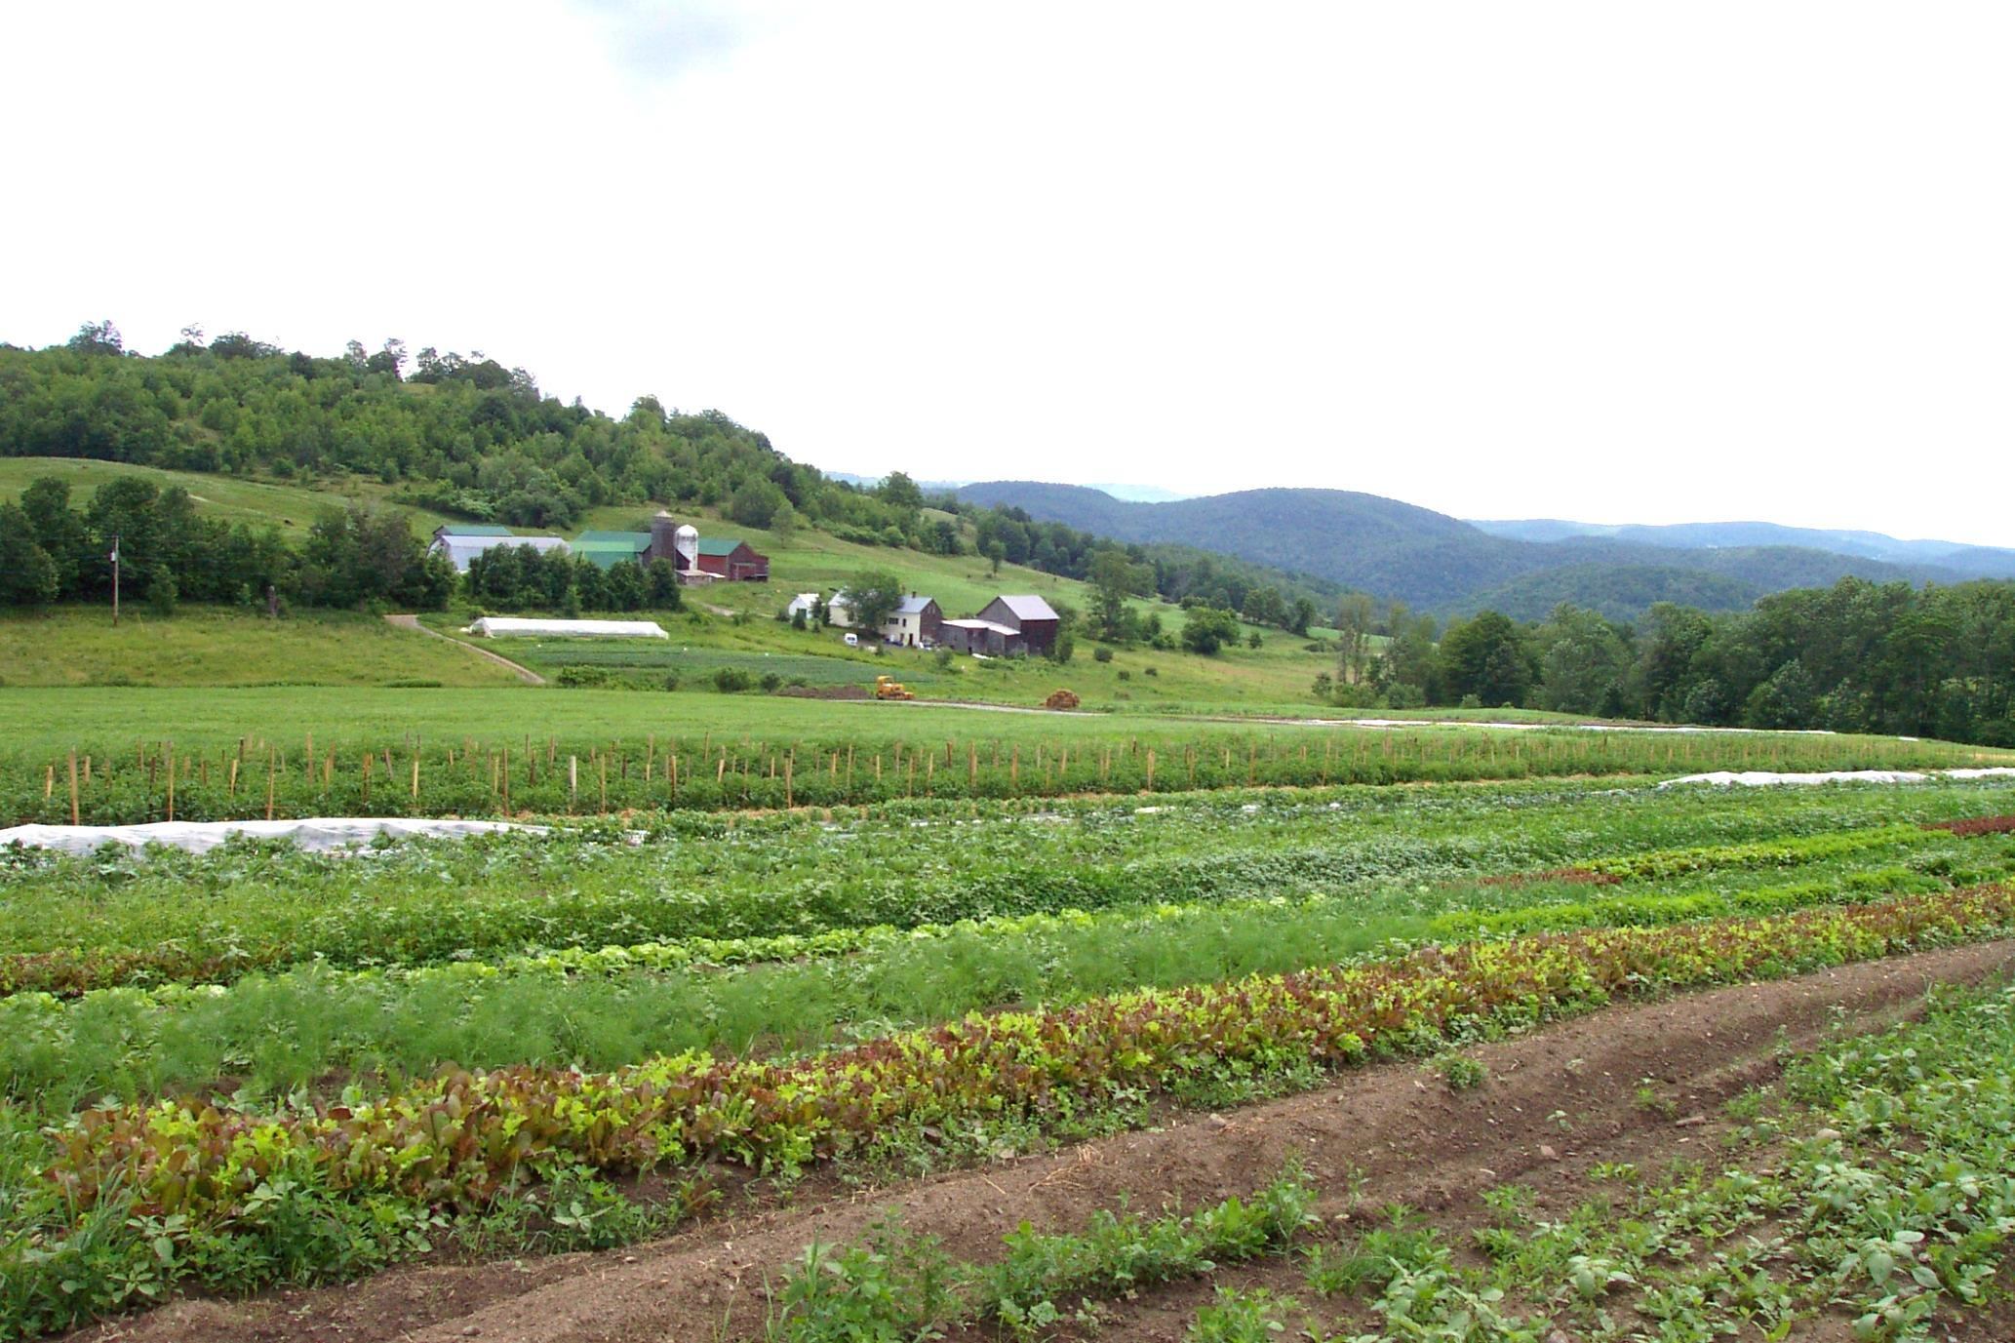
thanks for listening; questions?
Tunbridge Hill Farm, Tunbridge

