Slide 1
Energy System Change for Economic Resilience in Vermont
November 17, 2015
UVM Legislative Policy Summit
Vermont's 21st Century Economy: Building an Entrepreneurial Ecosystem
Jennie C. Stephens, Ph.D.
Associate Professor
Blittersdorf Professor of Sustainability Science and Policy
Rubenstein School of Environment and Natural Resources
College of Engineering and Mathematical Sciences
The Energy-Climate
Transitions Research
Group

Slide 2
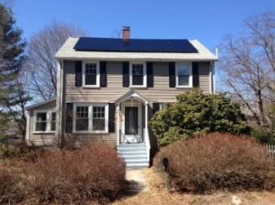
The Renewable Energy Transition
My Research: Social, Political & Cultural Dimensions of the Renewable Energy Transition
Fossil fuel
based energy
systems
Renewable
based energy
systems
So much more than a technical substitution
A shift from fierce competition for a scarce resource (fossil fuels) to
system based on abundant, plentiful, perpetual energy
Tend to focus on supply but changes in energy demand/consumption also required
More inclusive and distributed energy system could facilitate social changes in
expectations and assumptions regarding how much energy we use

Slide 3
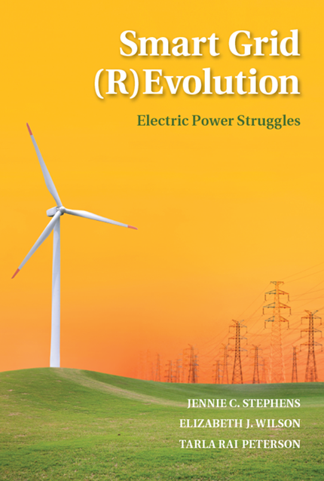
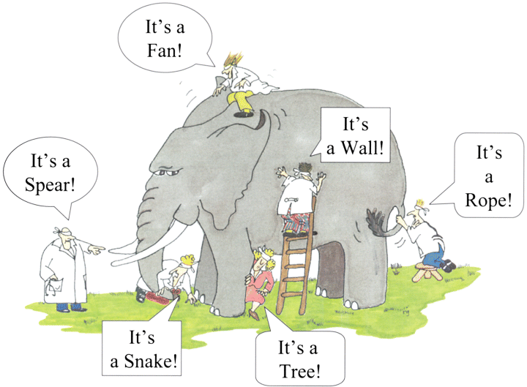
Diverse Perspectives on Energy System Change & Smart Grid
G. Renee Guzlas, artist
Centralization vs. decentralization
Centralized systems offer scale
Decentralized systems more flexible, modular,
and adaptive includes more social change
Multiple opportunities for broader civic engagement in energy system change
More inclusive
Distributed benefits and wealth
Cambridge University Press
February 2015

Slide 4
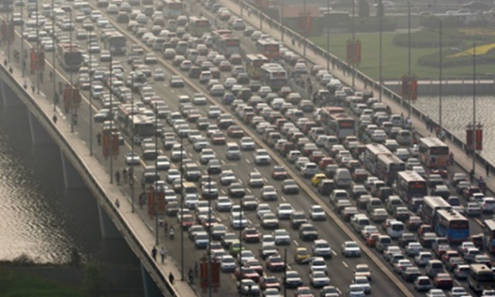
Electricity as well as transportation & heat
The renewable energy transition includes heat, light, & mobility
HEAT
ELECTRICITY
TRANSPORT
earthatnight
http://greenacton.org/outdoorlighting.htm
In China, Bosker, 2014.
The Guardian. August 2014
McMansions, 6 bedrooms, 5.5 baths,
almost 7,000 sq. feet -

Slide 5
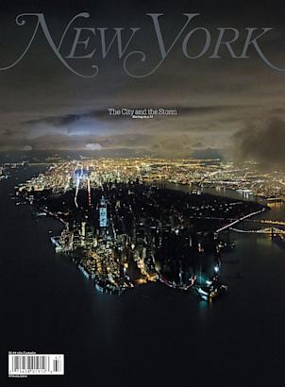
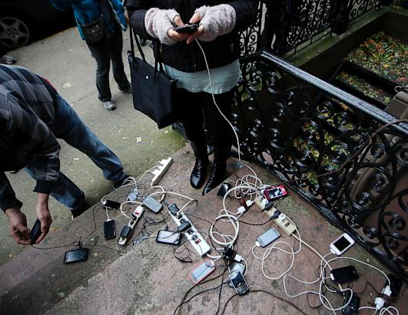
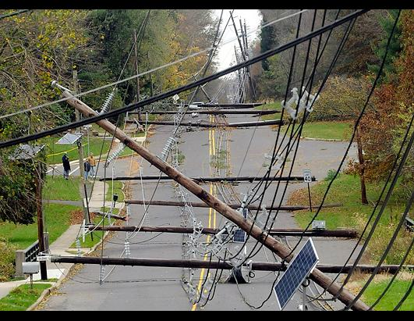
Energy transition for climate mitigation – but also for climate resilience
Superstorm Sandy (October 2012) and Hurricane Irene (2011) revealed energy system vulnerabilities
Electricity infrastructure damage
8.6 million customers lost power
Hoboken, NJ. Charging
electronic devices
(Jeff Zelevansky/Getty Images)
Highlighted increasing reliance on
electricity for basic needs:
communication, food, etc.
Hopewell Township, NJ three days after the storm. The Trentonian, Jackie Schear/AP Photo.

Slide 6
Transitions are necessarily disruptive Resistance from powerful entrenched actors inevitable With disruption comes opportunity for social/cultural change
Fossil fuel
based energy
systems
Renewable
based energy
systems
Not a simple technological substitution
Social, political, cultural and institutional change too

Slide 7
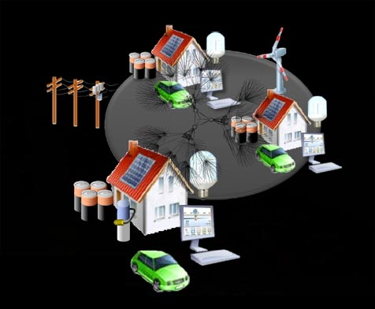
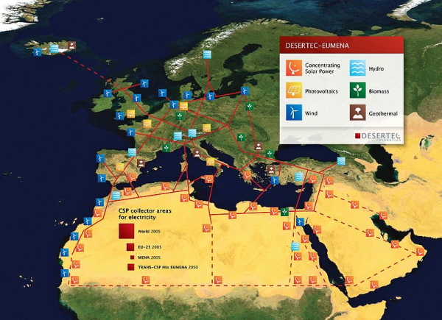
Fundamental Tension: Centralization vs. Decentralization
Decentralized Local Control
Community-based energy
Microgrids & locavolts
Centralized – Supergrid with Long Distance Transmission
Reinforcing current institutional arrangements/control
Desertec
Desertec - Eumena 2012
Smart Grid Enterprise 2013

Slide 8
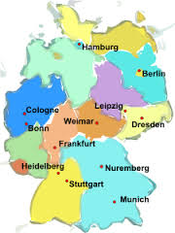
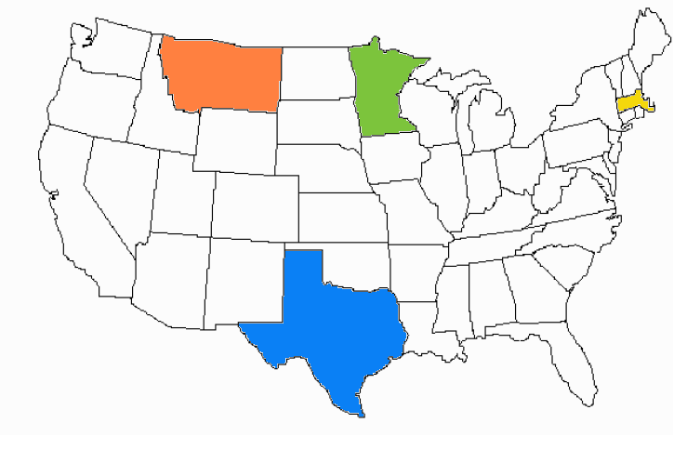
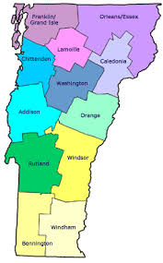
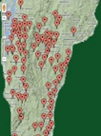
Learning-by-Doing: Leaders in the Renewable Energy Transition
Vermont - a leader in the US
Germany – a leader in the EU
Comprehensive Energy Plan
90% renewables by 2050
Electricity, heating & transportation
Energiewende (energy revolution)
60% renewables by 2050
National commitment to renewables
Town Energy Committees
Source: VT Energy and Climate Action Network

Slide 9
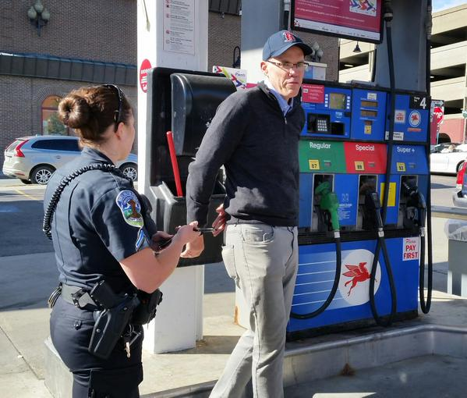
Reed, E. (2015). How Vermont became a clean-power powerhouse. Christian Science Monitor. September 12, 2015. http://www.csmonitor.com/Environment/2015/0912/How-Vermont-became-a-clean-power-powerhouse
McKibben, B. (2015). "Power to the People: Why the rise of green energy makes utility companies nervous." The New Yorker. http://www.newyorker.com/magazine/2015/06/29/power-to-the-people
http://www.burlingtonfreepress.com/story/news/2015/10/15/bill-mckibben-arrested-vermont-gas-pump-protest/73999386/

Slide 10
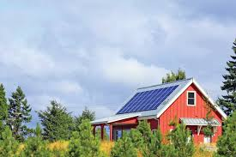
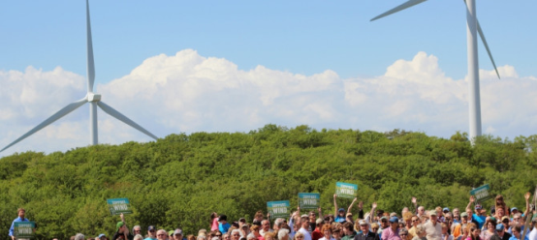
Distributed Renewable Energy in VT offers……
Flexibility
Modularity
Adaptive
Community autonomy
Energy Independence
Self-Sufficiency
Economic stability
Engagement
Photo Source: Georgia Mountain Wind

Slide 11
Diversity in Energy: Multiple societal benefits of greater gender diversity in the energy workforce……
Mothers Out Front:
Mobilizing for a Livable Climate
“It is time for a swift and
complete transition to
clean energy”
Mothers Out Front Massachusetts State House
Promote more sustainable energy practices
More inclusive engagement in energy system change
Accelerate innovation
Enhance economic opportunities for women
Photo Source: Georgia Mountain Wind

Slide 12
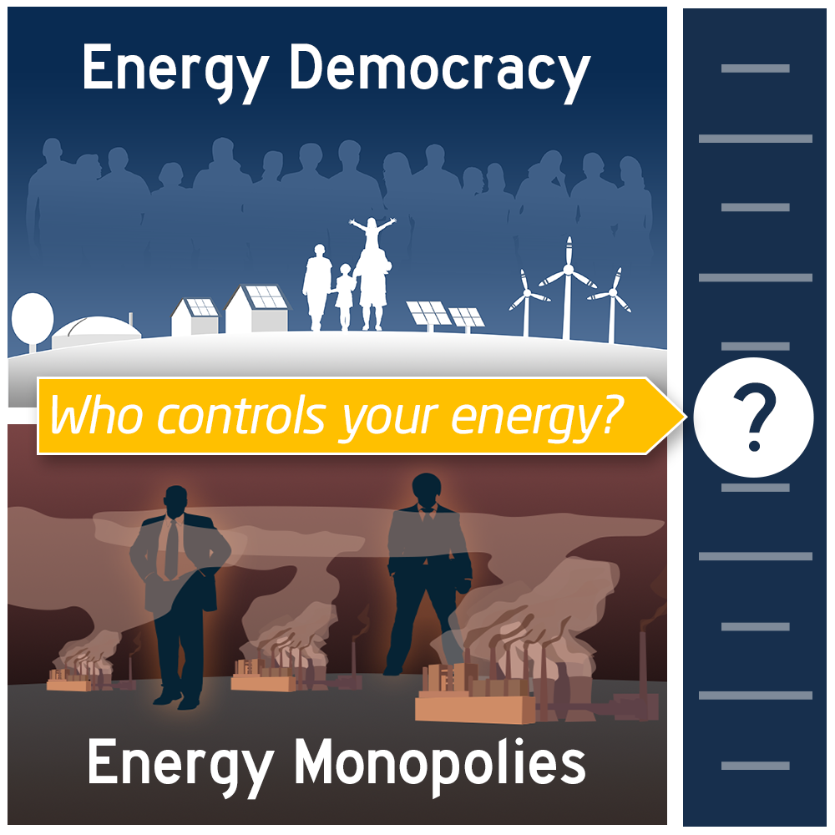
Energy Democracy Framework (Fairchild, 2015) (1) A set of values: includes environmental, climate, and social justice (2) An alternative economic model: shared, distributed wealth, addresses income inequality (3) new legal & governing structures, community-based rather than corporate control (4) incorporates emerging renewable technologies Alternative to current fossil fuel dominated context Fossil Fuel industry….. most profitable industry in the world characterized by income inequality failure to distribute wealth top 5 CEOs make 400X median income public resources supporting this $14 billion in tax breaks and subsidies Concentration of wealth and power Energy democracy movement part of inequality movement, black lives matter movement, human rights movement, etc…
Cleantechnica.com

Slide 13
Growing Acknowledgement of the Need to Expand Energy Research, Teaching, & Learning
Webler, T. and S. P. Tuler (2010). Energy Policy 38: 2690-2691.
Sovacool, B. K. (2014). "Energy studies
need social science." Nature 511: 529-530
Under-evaluation of social dimensions
Under-representation of women and minorities
Minimal integration of engineering and social science
Minimal collaborative efforts

Slide 14
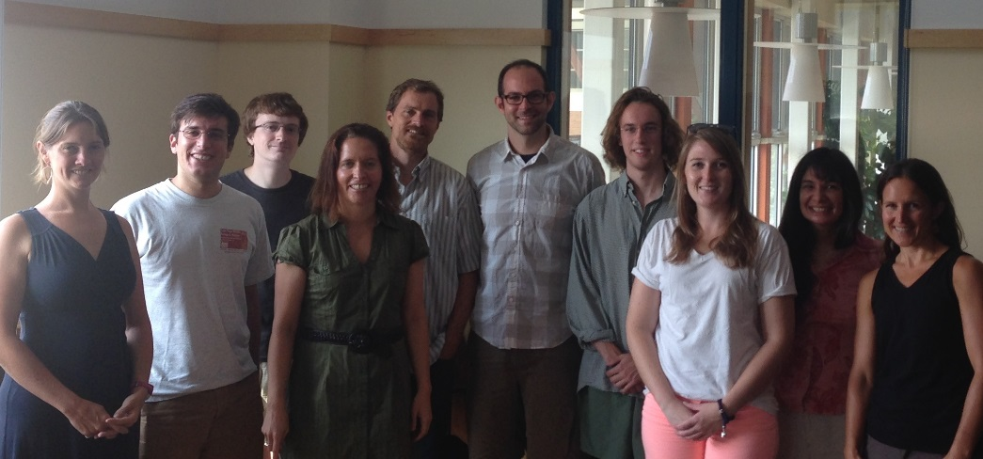
Acknowledgements
The UVM Energy-Climate Transitions Research Team
Publications available on website
Email: jennie.stephens@uvm.edy
Website: blog.uvm.edu/jstephe1
Thank you!

