Slide 1
Leveraging UVM Innovation Into Private Companies
A case study for leveraging local talent and dollars to move a technology toward becoming a product.

Slide 2
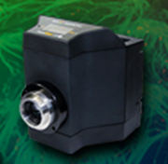
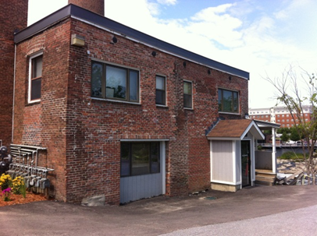
The Players
Who am I?
Who is 89 North?
Scientific instrumentation
OEM optical equipment
Wholly owned subsidiary of Chroma
Who is Chroma?
Optical filters
100% employee owned
UVM
Office of Technology Commercialization
Jeff Marshall, Prof. College of Engineering

Slide 3
How it starts

Slide 4
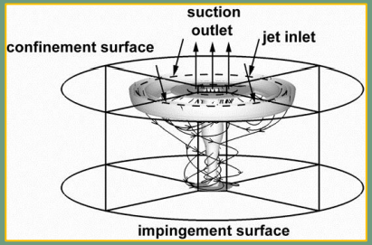
Assessment
Benefits:
Non-contact
High shear forces
Debris containment
Applications:
Clean manufacturing
Optics is just one example
Not really right for VC
Not likely an explosive grower
More a tech that needs to be nurtured and have sound strategy
Still likely to have a sizable market

Slide 5
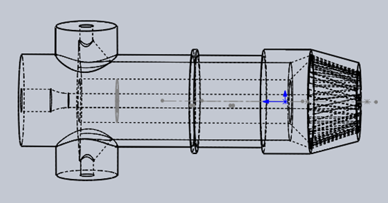
What had to happen
We needed something testable, verifiable and demonstrable
Flexible
Easy to use
Ready for outside world
We needed a place to test, verify and demonstrate
Representative cleaning problem
Controlled enough environment to do the testing and get data
Time to understand the value proposition in the context of the market and data
In this case the science, theory and experiment, wasn’t enough to demonstrate the value.

Slide 6
Constraints
Jeff Marshall is a happy professor: teaching and research
Not really the right place to build the next prototype even with funding
Not on the main path for Jeff’s career
Nor the right place to do those things you might like to do with a prototype
89 North couldn’t expend resources off of our main path
Hiring for short-term project that was speculative was a non-starter
Needed to cover some of the basic costs of putting an instrument together
Office of Technology Commercialization
Not their mission to build a prototype
One of many technologies whose marketing they must support
So how does something like the Aeroacoustic Cleaner become part of someone’s main path?

Slide 7
How? OTC Made a 3-legged Stool
89 North, Chroma and UVM
89 North proposed a contract engineering project to make a usable device
UVM ventures funded Jeff Marshall, who contracted 89 North
The testing was carried out as a co-development between Chroma and UVM
Chroma contributed material to clean, space to work, expert inspection
UVM contributed the device, developed by 89 North, and particular 3D-printed parts
Device belongs to UVM, data is shared, but Chroma gets right of first refusal to negotiate a license

Slide 8
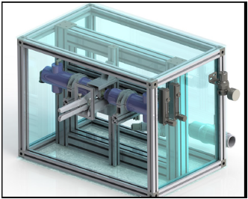
Optical Cleaning Configuration

Slide 9
Outcomes
Working device: always easier to get someone interested when you can show them a functioning prototype
Data: not only can we show others the quantitative capability for cleaning, we honed our understanding of the value
The system isn’t necessarily stronger for ripping dirt off of a surface as compared to existing compressed air devices
But it is:
Just as good
Faster
More reliable/repeatable
Able to contain the dirt
Amenable to automation
Relationship between a substantial Vermont company and our flagship educational and research institution

Slide 10
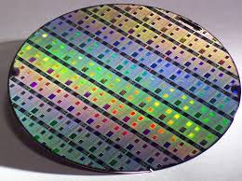
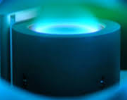
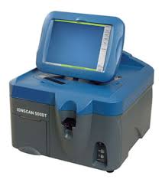
Next
Chroma and 89 North reevaluate the market landscape in the context of data and improved understanding of what is possible
Being part of the vacuum coating world gives us an easy and obvious place to start
Manufacturing history of our engineers also yields contacts in several industries (aerospace, automotive, coating, semiconductor)
Our hooks in the analytical instrumentation world offers a second pathway for a product
The technology is a crucial step closer to market and there is a good chance it will remain a contributor to the VT economy

Slide 11
A chance to keep it in VT
VT’s limited size means not all skills for technological development are available
Some innovation has to leave the state to develop further and pay royalties
If tech does stay in VT, usually that means Chittenden County
But not this time….
Project has given a VT company first crack at the technology
~$40,000 stayed in VT economy and home-grown companies
Provided a great experience for an intern
Planted seeds for future in-state opportunities
Chroma is based in Bellows Falls
Even better…

Slide 12
What might happen?
Chroma is 100% employee owned
Accumulation of company value is shared with the employees, not held by a few people that had the capital to start the company
Yearly stock distribution, buy back on departure
Profit sharing
SEP IRA
110 employees, 100 working in Vermont, most living in Vermont
Chroma’s has the highest standards of social responsibility in business
We have our own minimums, lowest paid worker begins at $18/hour
Benefits among the best in the state
Democratic work place
Certified B-Corp
If this goes forward with Chroma, the jobs created will be in Vermont and they will be some of the best jobs imaginable in manufacturing and product development.

Slide 13
What would make this easier?
Stronger work pool of engineers
Strengthen the cooperative model in the engineering college
Students leave school experienced
More of our locally educated students staying here
Strengthen the cooperative model in the engineering college
Having had a local coop experience they have local contacts
Funding for the OTC
Business and faculty need to know about the OTC in order to want to engage
OTC needs the resources to create and respond to greater activity
More funding to repeat this model
OTC being able to say, “I think we can help you seed that” made a huge difference

Slide 14
Ecosystems and Entrepreneurship
Many more technologies could fit this model than the VC model
Requires a real ecosystem
Connections and information flow
Skilled people available in VT
Seed funding
SBIR grant writing support
Awareness among business community
Organic, home-grown
Creates VT jobs, not just royalties
Feeds itself
Still allows for the occasional big winner

