Slide 1
The Intersection of Higher Education, Private Sector and
Government in Technology and Economic Development:
Accelerating the Process Through Service Learning
UVM Legislative Policy Summit
Vermont's 21st Century Economy: Building an Entrepreneurial Ecosystem
Erik Monsen, Ph.D.
17 November 2015

Slide 2


Teaching Technology Commercialization:
A Partnership & Portfolio Approach
Service Learning Model
  Researchers pitch technologies
  Student consulting teams
    Learn technology from researcher
    Write plan for researcher
Portfolio of Classes
  UG – Spring
  SEMBA – Mar/Apr
  MS/PhD – Autumn
  Faculty – SPARK VT
Teaching
SPARK^{VT}
Research
Business

Slide 3
Wide Array of
Pioneering Technologies
Medicine
  Genetic markers for addictive behaviors
  Suicide prediction app for hospital patients
  Alginate-based bandage for lung repair
  Non-invasive heart performance balloon test
  Mobile app to diagnose childhood ailments
  Grafting cells to repair diseased hearts
  Protecting brain cells from chemotherapy
  Augmenting chemotherapeutic effectiveness
Agriculture
  Humidity measurement for cold food storage
  Nutrient management app for small farmers
Engineering
  Bamboo vertical wind turbine power system
  Face tracking recognition & motion controller
  Green building power monitoring system
  Highway speed ground penetrating radar
  Reinforcing concrete with shrimp chitin
Computer Science
  Sentiment analysis of text streams
Education
  Teaching geometry with motion-based game controllers

Slide 4
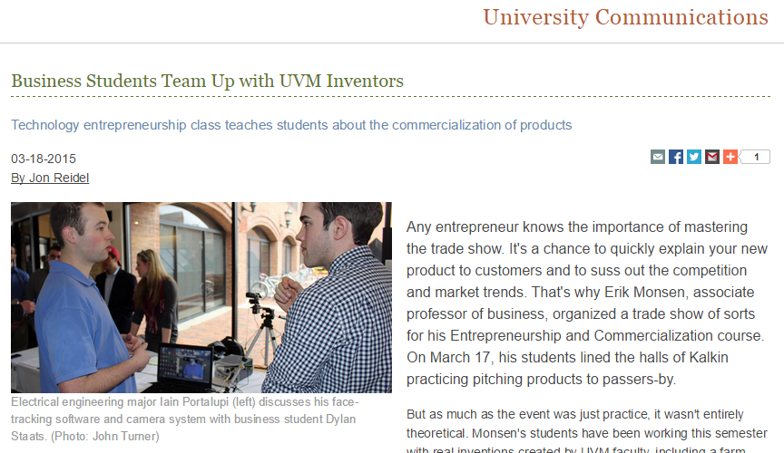
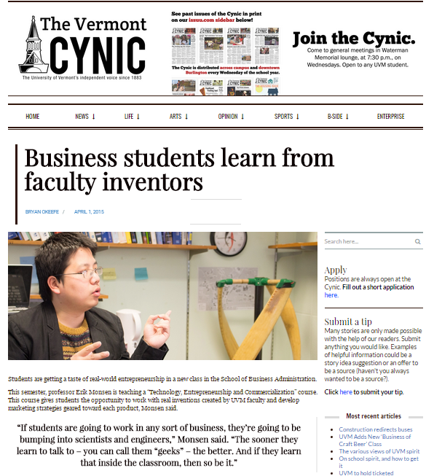
UVM Press Coverage

Slide 5
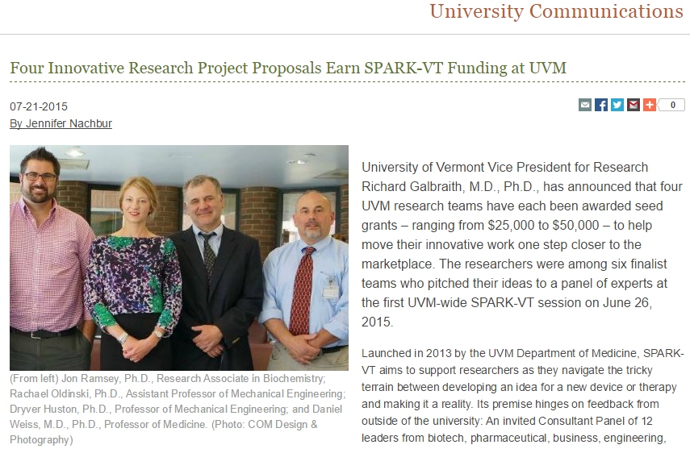
Paying it Forward
Across Campus
SPARK^{VT}
$50k grant for Alginate Lung Bandage

