Slide 1
UVM LEGISLATIVE SUMMIT
PEOPLE PLACES CAPITAL New Models and Infrastructure for Entrepreneurial Growth and Success

Slide 2
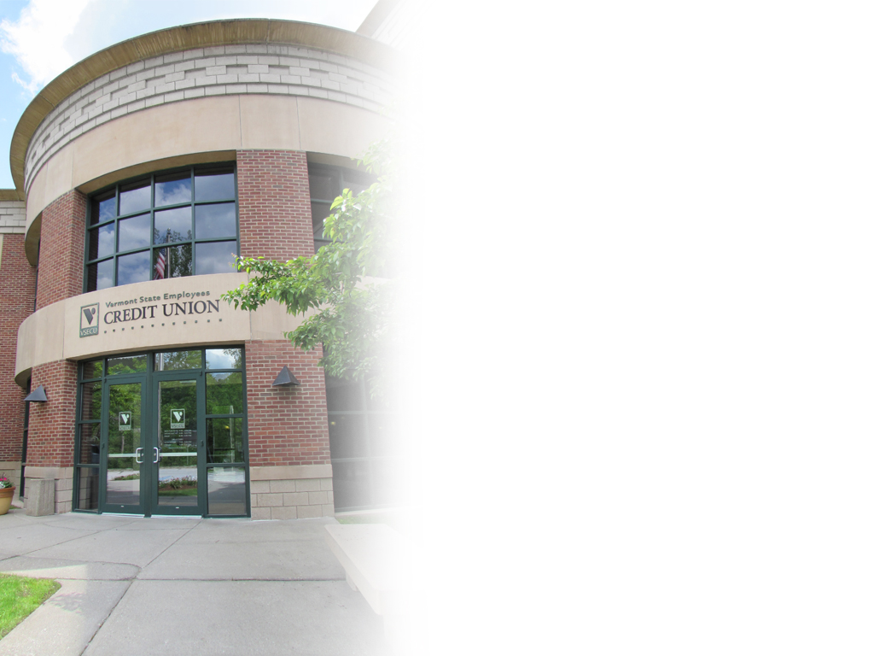
ABOUT VSECU
A CREDIT UNION FOR EVERYBODY IN VERMONT
Member-owned cooperative
Locally owned and managed
Democratically controlled
Improving lives of Vermonters

Slide 3
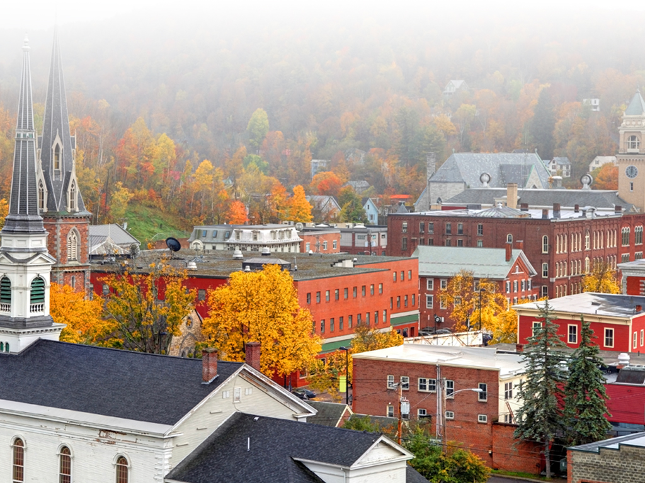
VERMONT’S CHALLENGE
WHAT WE KNOW
Sluggish job growth
Stagnant population growth
Rising median age
Shrinking labor force
Business climate perceptions
Sustainable affordability

Slide 4
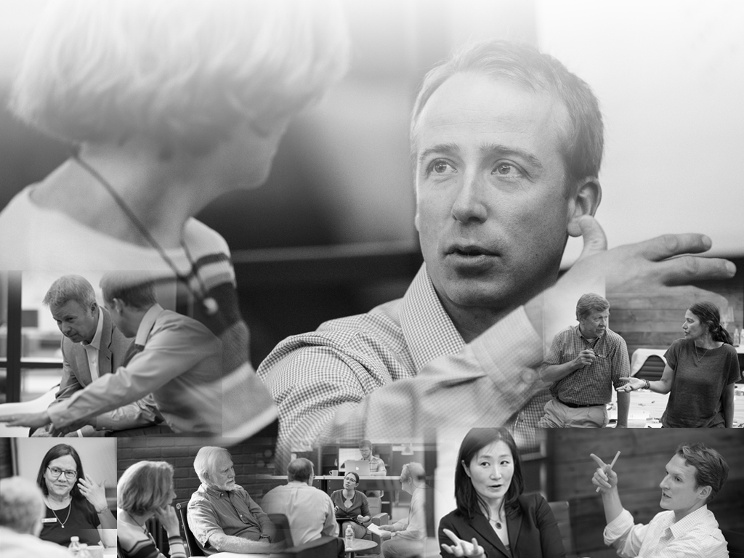
DIGGING DEEPER
COMMUNITY SUMMITS
Vermont thought leaders
Things we learned

Slide 5
VERMONT’S OPPORTUNITY
40% of the workforce will be independent by 2020
17 million “solo-preneuers” in the U.S.
30% of U.S. workers are untethered
2,500 co-working spaces worldwide; 850+ in the U.S. alone

Slide 6
A PATH FORWARD
BUILDING A CULTURE OF ENTREPRENEURIALISM

Slide 7
TOOLS FOR ORGANIC GROWTH FROM WITHIN
Business planning and counseling
Access to capital
Business incubators
Networking opportunities
Entrepreneurship programs
Business guide/training resources/service providers

Slide 8
VSECU’S IMPACT

