Slide 1
Vermont Economic Development Authority

Slide 2
Economic Development Lender;
Quasi-State Instrumentality;
Self-Funded (Moral Obligation);
Board of Directors – 15:
5 Ex-Officio:
State Treasurer, Secretary of Commerce, Secretary of Agriculture, Commissioner of Public Service, Commissioner of Forest Parks and Recreation;
10 private citizens appointed by Governor;
Staff – 36;
Total Assets – $249 Million;
Loan Portfolio – $210 Million.

Slide 4
Entrepreneurial Loan Program
Vermont-located businesses (sole proprietorships, partnerships, corporations, LLC’s);
Businesses in seed, start-up or early growth stage who do not meet the underwriting criteria of other public and private entrepreneurial financing sources;
Businesses with innovative products or services that have the potential for long-term organic growth;
Businesses unable to access adequate capital because the primary assets used to secure loans are typically intellectual property or similar nontangible assets;
Businesses must demonstrate potential to create/retain employment opportunities for Vermonters;
Started in 2014;
2015 - $1.9 Million; 12 loans;
Average loan size - $150,000.

Slide 5
Special Consideration Given To:
Businesses that create jobs in strategic sectors, such as the knowledge-based economy, renewable energy, advanced manufacturing, wood products manufacturing, and value-added agriculture;
Businesses located in a designated downtown, village center, growth center, industrial park or other significant geographic location recognized by the State;
Businesses that adopt energy and thermal efficiency practices in their operations or otherwise operate in a way that reflects a commitment to green energy principles;
Businesses that will create jobs that pay a livable wage and provide significant benefits to employees.

Slide 6
Direct Commercial Lending
$1.5 Million limit;
40% of project;
2% Interest Rate (2 yrs.); 3.75 %;
$13.3 Million in 2015; 30 loans;
Average Loan $445,000.

Slide 7
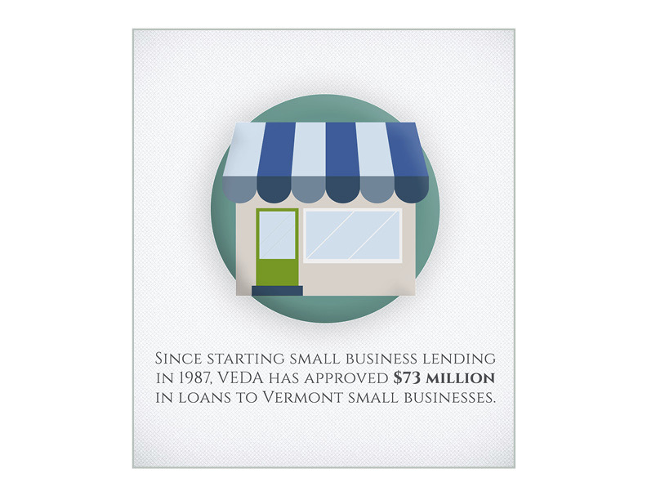
Small Business Lending
Loan Limit $350,000
4% Fixed Rate;
2015 $9.3 Million; 47 Loans;
Average Loan Size $198,000.

Slide 8
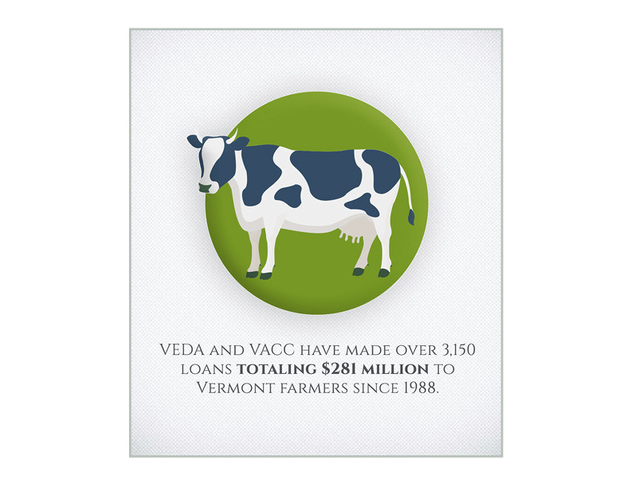
Vermont Agricultural Credit Corporation
40% of Portfolio;
836 Loans;
2015 $19.5 Million; 154 Loans;
Average Loan $126,900.

Slide 9
Commercial Energy Loan Programs
To finance qualifying renewable energy
generation and energy efficiency improvement projects.
Maximum loan size
under this program is $2.0 Million.

