Slide 1
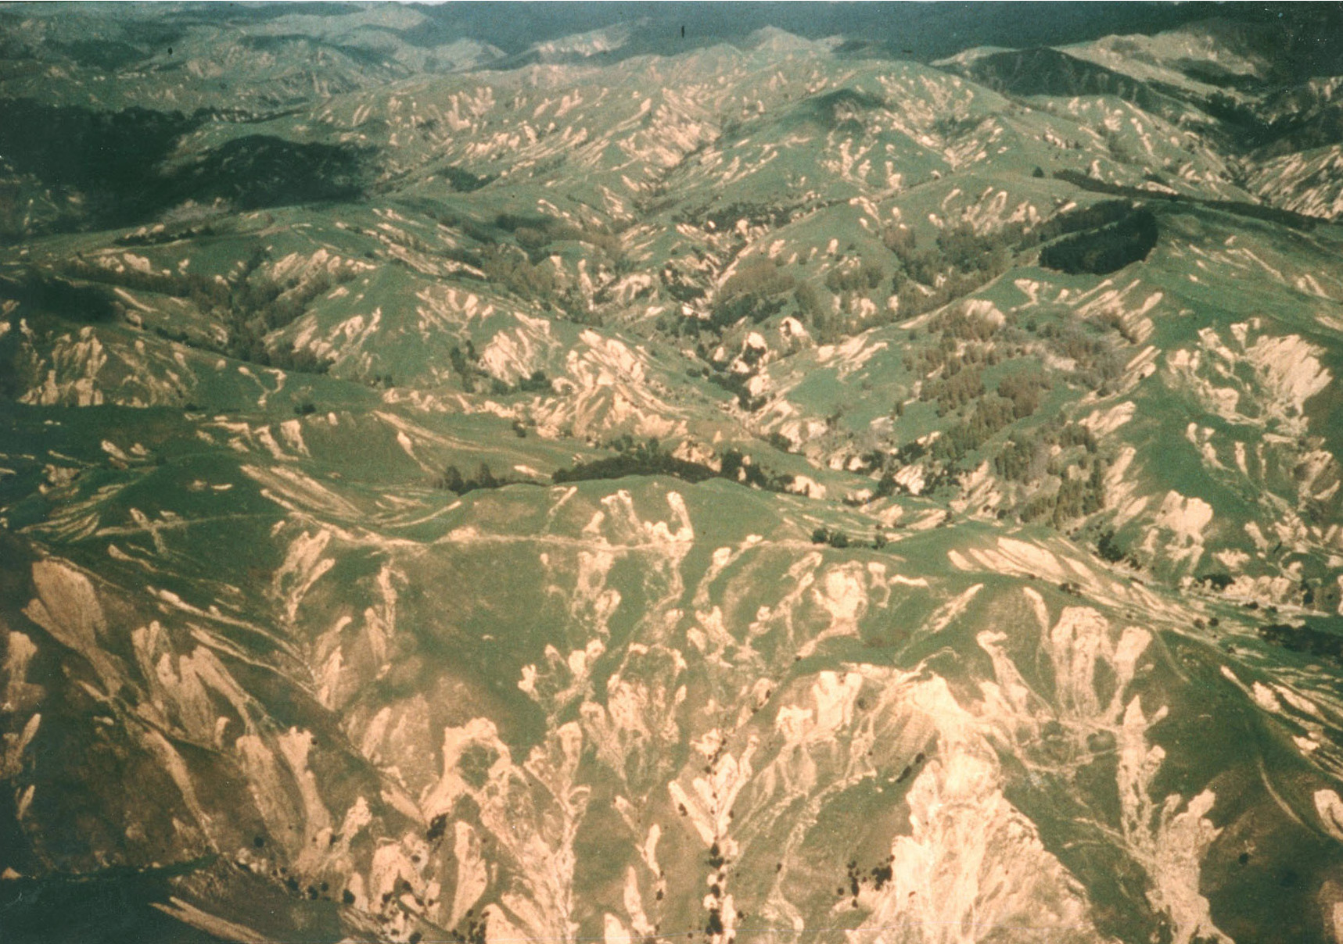
Quantifying Human Impacts on Natural Rates
Of Erosion Along Continental Margins
A dissertation presented
By
Lucas Jonathan Reusser
December 2nd, 2013
Landslides, Waipaoa Basin, NZ after cyclone Bola, 1988

Slide 2
Seminar outline
Overview of Research
  Landscape erosion – natural and human-induced
  Methods of measurement
  Background rates with ¹⁰Be vs. Short-term rates
  Introduction to Study Sites
Primary Objectives
In situ and meteoric ¹⁰Be systematics
Background erosion and erosion prediction along the southern Appalachian Piedmont, Atlantic Passive Margin
Sediment mixing and background erosion in the active and non-uniformly eroding Waipaoa Basin, North Island, New Zealand
Summary and conclusions

Slide 3
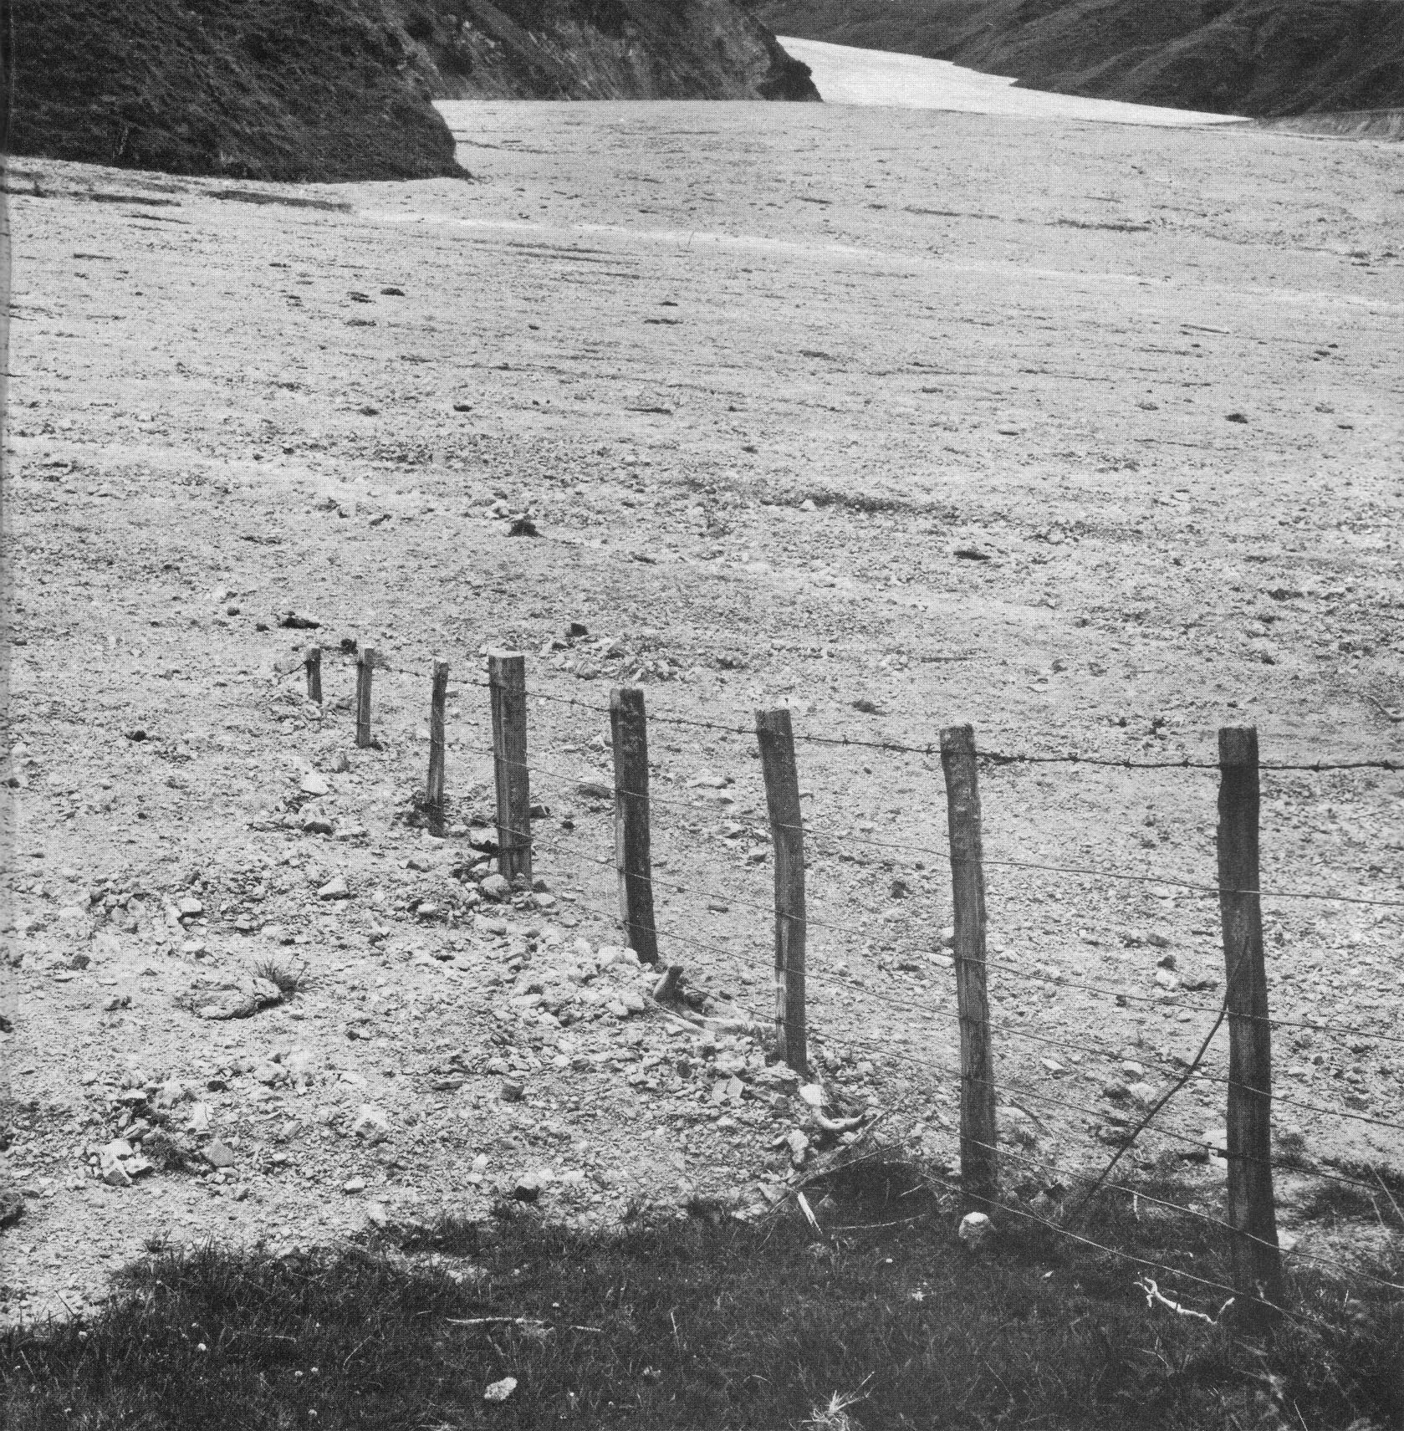
Why study erosion?
Human activities elevate rates of erosion and change how sediment moves
along hillslopes and in river channels.
Can cause deposition on flood plains and in estuaries and bays and cause increased
flooding.
These changes have very real, and very costly repercussions.
Need to know BACKGROUND rates of sediment generation and erosion
for effective management strategies!
Important Questions to ask:
How do you measure erosion?
What are the best ways to compare natural and human-induced
rates of erosion?

Slide 4
Methods of measuring erosion:
Intermediate Time Frame:
(Typically thousands to tens of thousands)
Long-term:
(millions to hunderds of millions)
Short-term:
(years to decades)
Reservoir Infilling Rates
Water body infilling rates
Sediment Yields (Delivery)
from Rivers
Cosmogenic Isotopes
such as ¹⁰Be
Thermochronometry
  Fission Track
  (U-Th)/He
Offshore Sedimentation
Rates
Erosion at discrete points
-or-
Spatially and Temporally Averaged Drainage Basin-Scale Erosion Rates
Limitations:
Limitations:
Good for comparing natural and human- induced rates
Very short integration
periods (episodic delivery)
Extreme sensitivity to
landuse history
Long integration time.
Records reflect
periods of vastly different climatic and potentially tectonic conditions

Slide 5
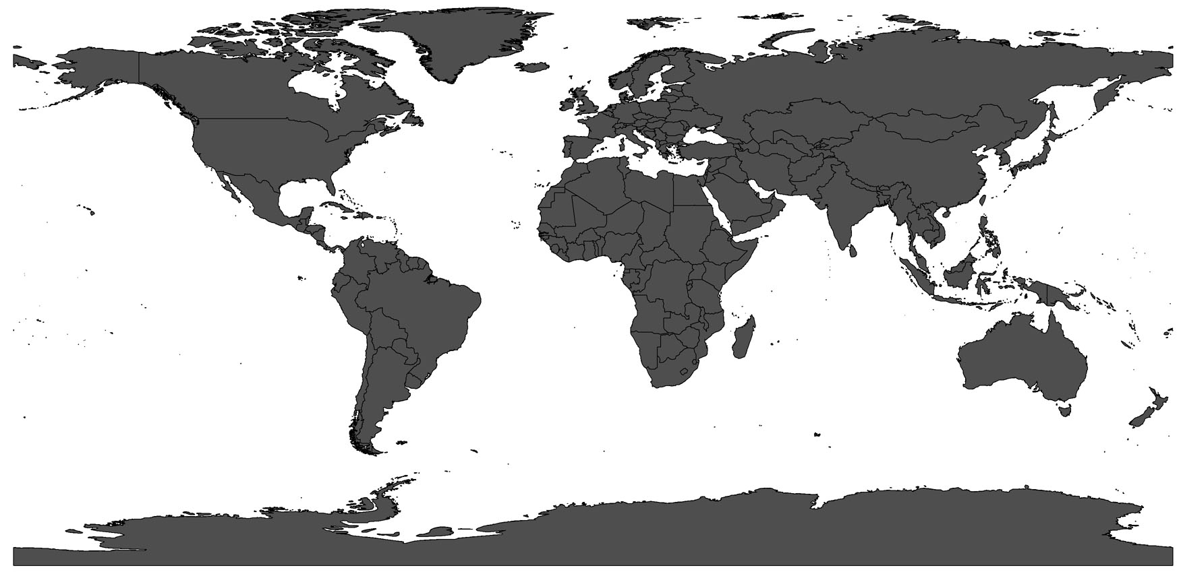
Study regions:
Broad geographic regions along several well-
characterized continental margins
Widely differing tectonic and climate gradients,
But share similar landuse histories (agricultural)
Southern Appalachian
Piedmont
Waipaoa River Basin
North Island, NZ
Passive Margin Environment
Intense agricultural disturbance
Between 1700 and ~1920
Active subduction margin
Widespread agricultural land-
Clearance. Modern afforestation
Efforts.
~9000 miles

Slide 6
Primary Objectives of Research:
Comparison of natural long-term (in situ ¹⁰Be), and modern-day, human-induced (sediment yield derived) rates of erosion.
    Potential implications for resource management.
Investigate the sourcing and mixing of sediment in disturbed landscapes with meteoric ¹⁰Be.
        Primarily in the Waipaoa River Basin, NZ where quartz is scarce.
        Apportion the relative contribution of sediment from different regions across a landscape.
Explore relationships between tectonics, climate, and land-use history with one of the largest coherent ¹⁰Be datasets collected to date.
    Provide ¹⁰Be erosion rates in previously untestable environments
    Compare and contrast ¹⁰Be findings to other measures of landscape change.
    Further develop relationships between erosion and physical landscape characteristics.

Slide 7
Production and accumulation of
In situ ¹⁰Be
Meteoric ¹⁰Be

Slide 8
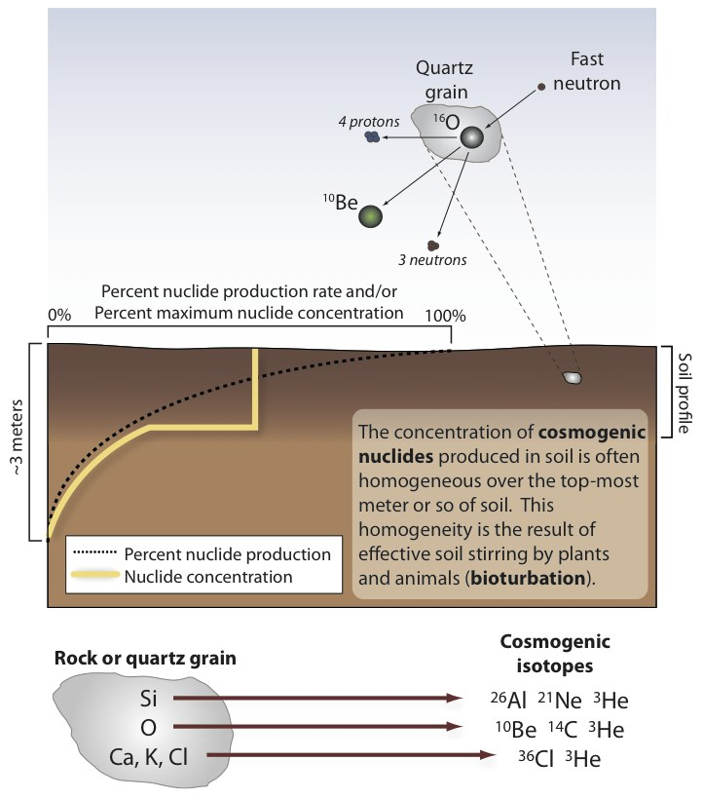
In situ production of ¹⁰Be:
Produced in upper several meters
of rocks and sediment exposed at
Earth’s Surface.
Production rate: ~5.2 atoms per gram of quartz per year - measurable
with AMS.
Half-life of ~1.36 millions years –
residence time of near surface
materials much shorter meaning
¹⁰Be behaves as a stable nuclide
over period of measurement.

Slide 9
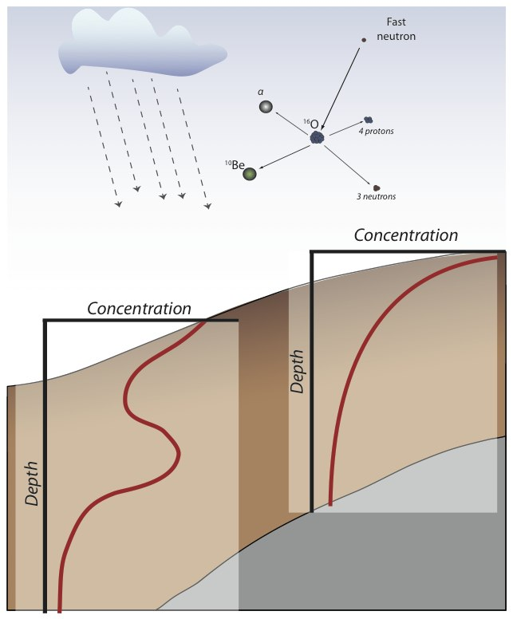
Accumulation of meteoric ¹⁰Be in soils:
Produced in the atmosphere by the
same processes as in situ ¹⁰Be
Delivered to soils across landscapes
in rain, and to a lesser extent in NZ
in dust.
Accumulates over time in hillslope
materials that eventually make their
way to river channels.
Accumulation rate: ~1.7 x 10⁶ atoms per cm² annually – easily measurable
with AMS.
Half-life of ~1.38 millions years –
residence time of near surface
materials much shorter meaning
¹⁰Be behaves as a stable nuclide
over period of measurement.

Slide 10
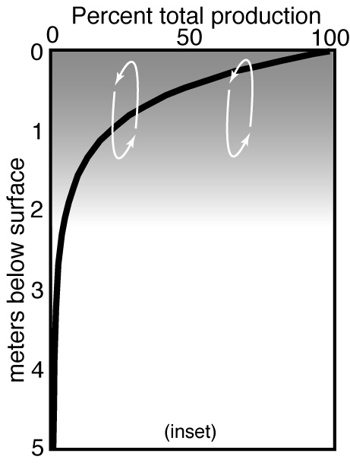
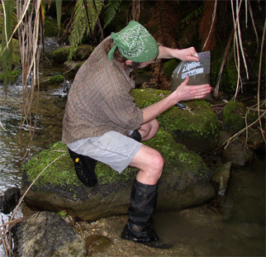
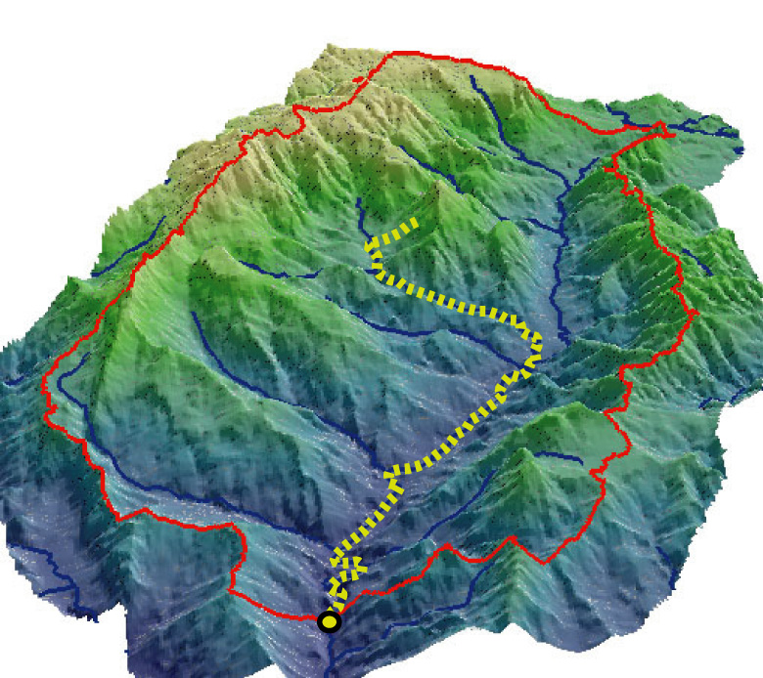
Drainage basin-scale erosion rates with in situ ¹⁰Be
And sediment sourcing meteoric ¹⁰Be:
Production at Surface:
Sediment Sample:
Rivers Mix millions
Of sediment grains
Each grain has unique
history of Exhumation
Erosion and
Transportation
To sample site
Represents
the spatially averaged
history of erosion within a drainage basin
Steadily Eroding
Landscape:
Exponential decay with depth
Production limited to upper several meters - Isolates near-
surface process rates
Thorough mixing homogenizes ¹⁰Be inventory - relatively
insensitive to Human
Landuse Practices
Sample Site

Slide 11
Erosion Along Continental Margins:
Southern Appalachian Piedmont and Blue Ridge,
draining the North American Atlantic passive margin.
Waipaoa River Basin along the tectonically active eastern margin
of New Zealand’s North Island.

Slide 12
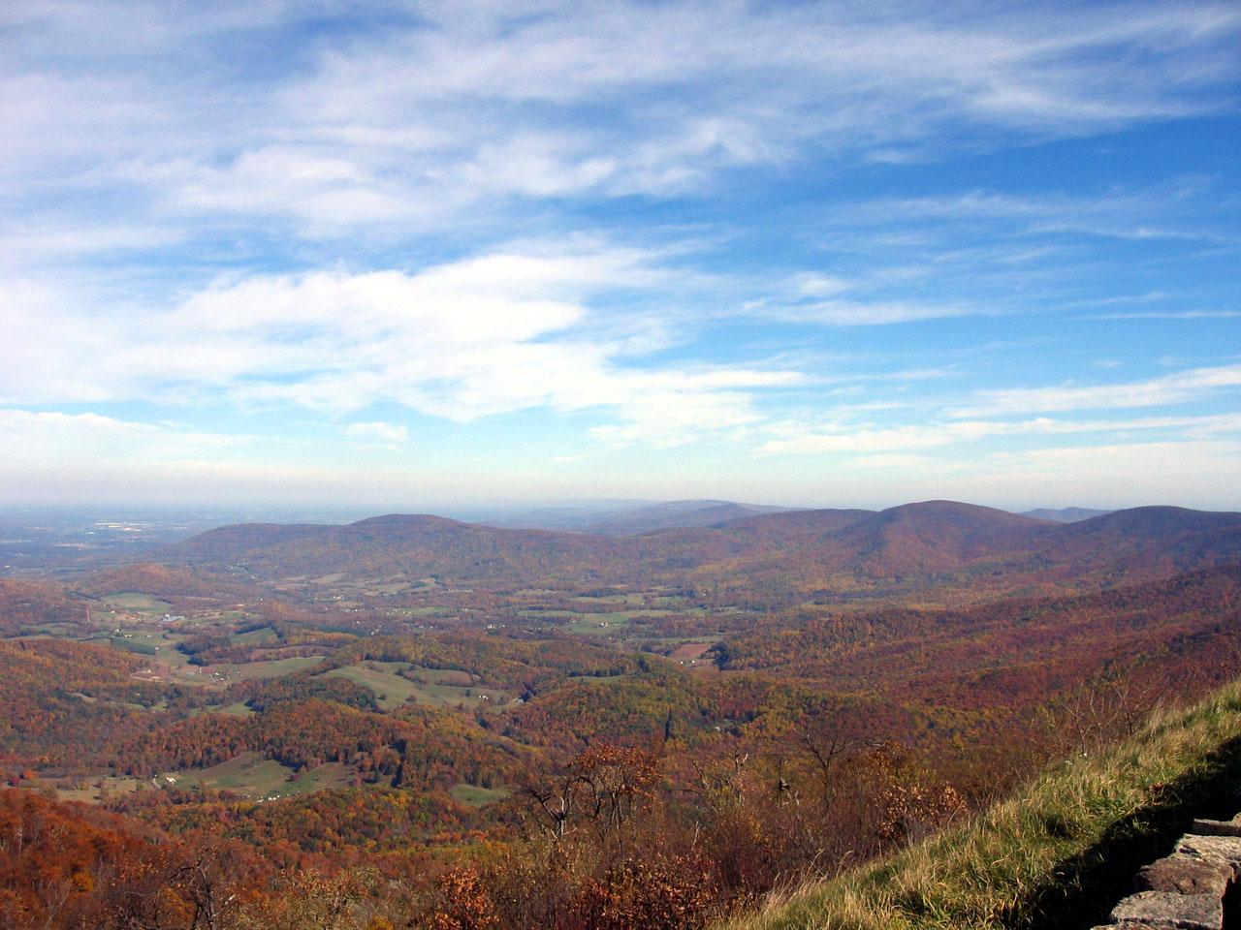
1. Southern Appalachian Piedmont, USA
Relatively stable environment:
Comparatively uniform erosion
Long history of cosmogenic isotope study
so we have a good foundation to start from.

Slide 13
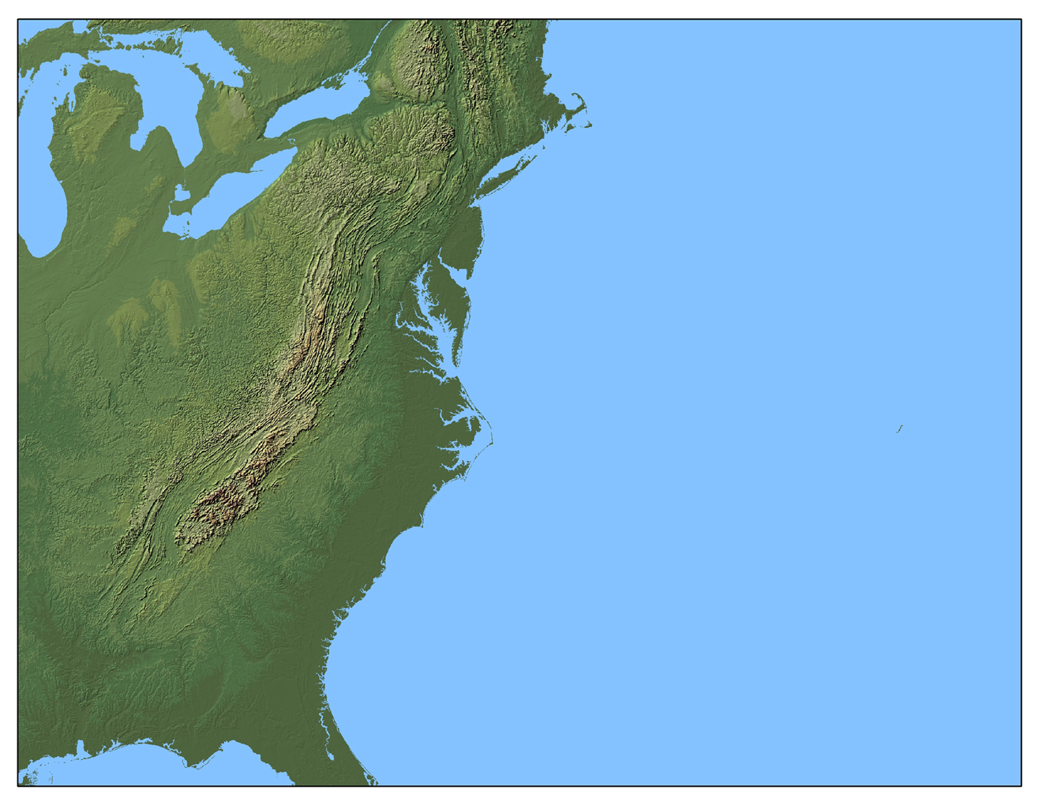
Appalachian Mountain Chain
Stretches more than 2500 km from Newfoundland, CAN to Alabama, USA
Largely stable environments. Tectonically quiescent for >200 My
Uplift driven by erosion - isostacy
Inspired more than a century of research into:
The growth and decay of landscapes.
The persistence of topography.
The erosional consequences of human-
landscape interactions.
Modern different than background

Slide 14
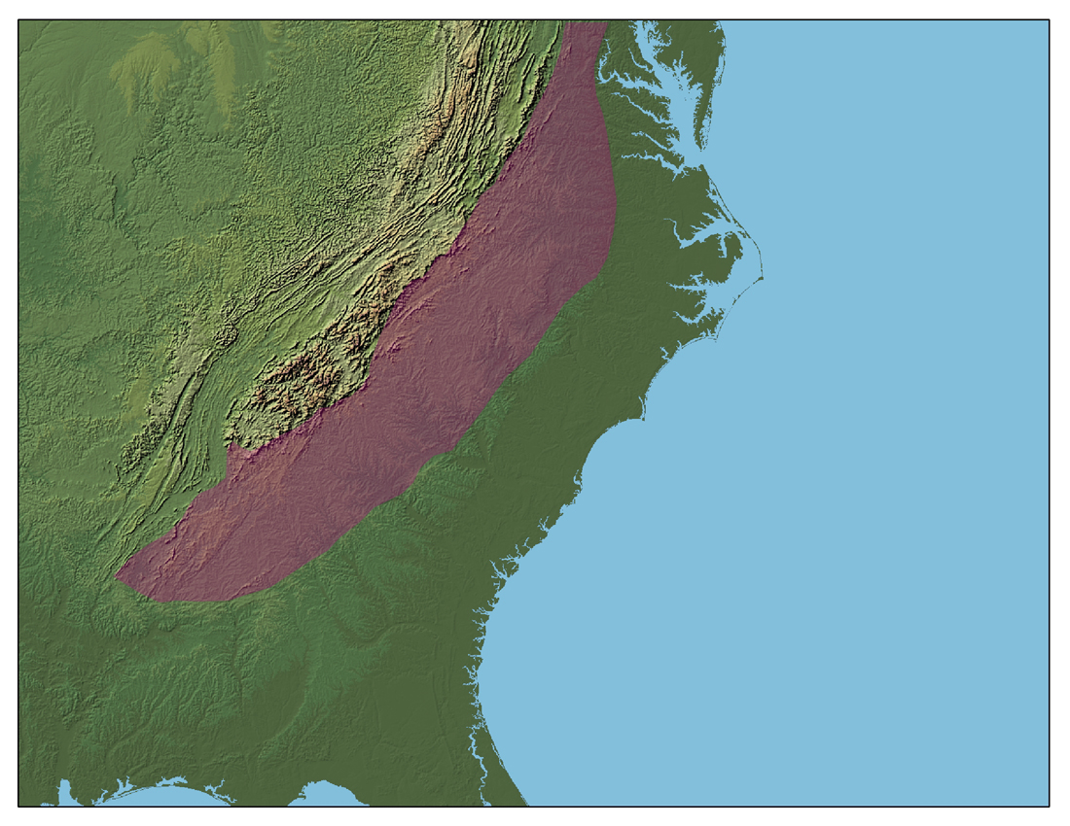
Southern Appalachian Piedmont
Valley and Ridge
Broad, low-relief
surface. Drains east
to the Atlantic Ocean
Blue Ridge
Piedmont
Coastal Plain
Rich Soils, humid climate,
long growing season and subdued
topography.
Intensive agriculture beginning in
1700’s through 1920’s. At peak, virtually entire piedmont cultivated
for tobacco and cotton production.
Severe hillslope erosion and
channel aggradation.

Slide 15
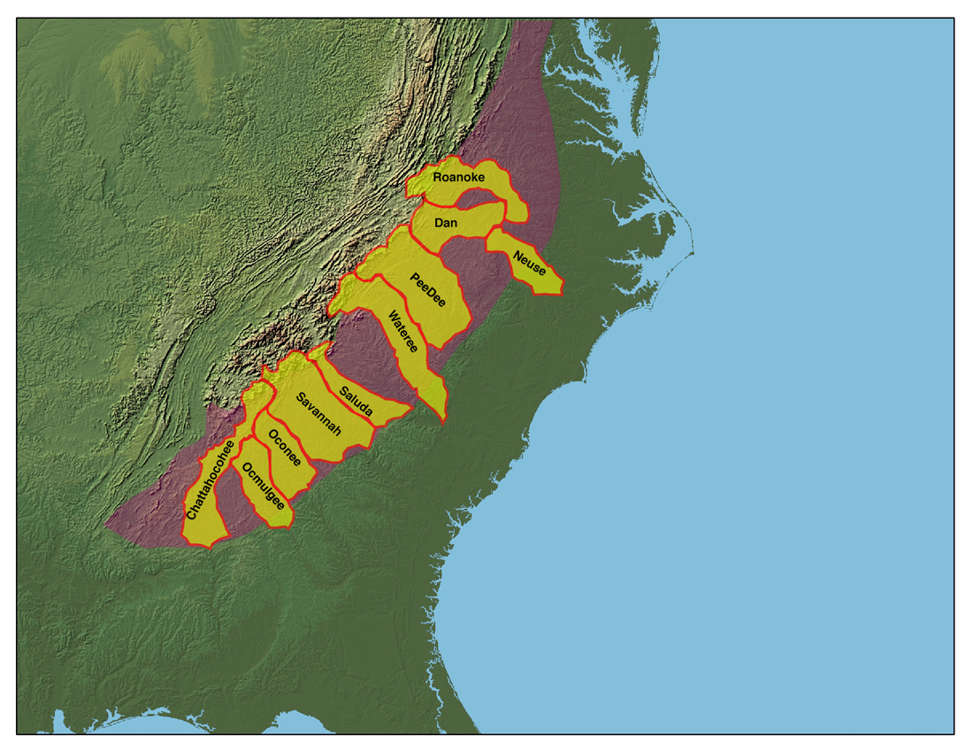
“Un-equilibrium streams” - Trimble, 1977
Area-averaged upland
erosion rate
~950 m/My
Area-averaged erosion rates inferred from sediment yield data
50 m/My
Area-averaged delivery ratio
~ 5 %
Implication: Sediment yield data are “dubious Indicators” of backgroud or human-induced erosion rates in large humid region catchments
Transport Limited System
carrying capacity of streams

Slide 16
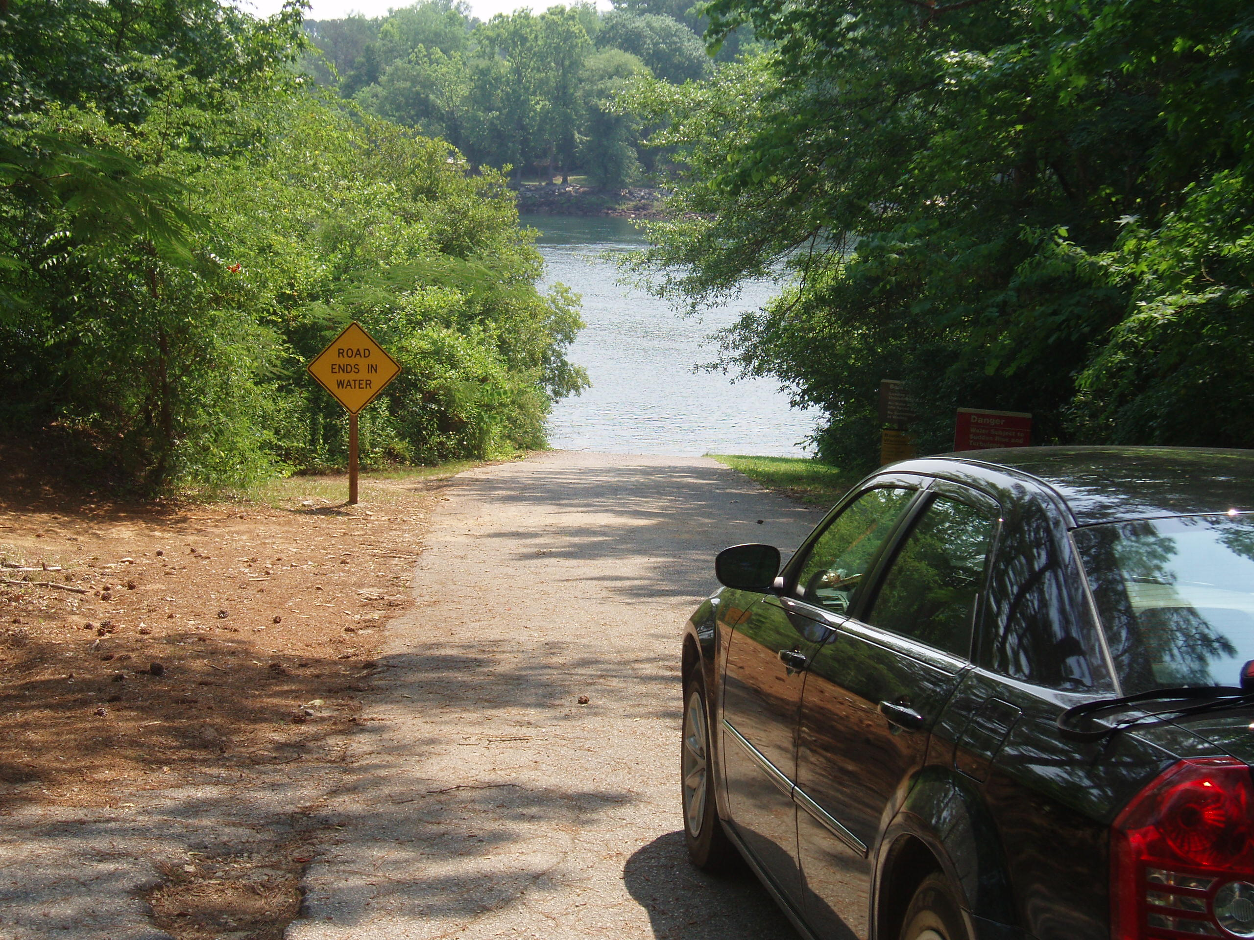
Frist testable hypothesis with ¹⁰Be:

Slide 17
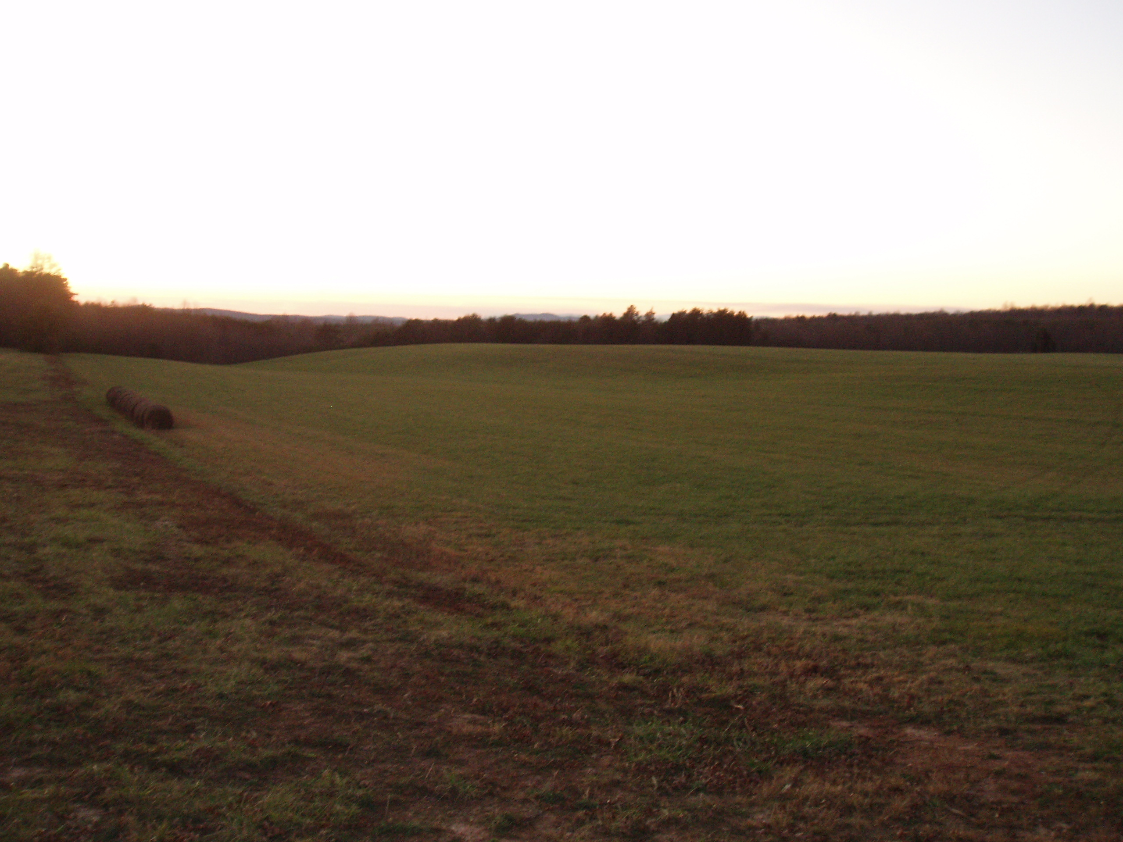
Frist testable hypothesis with in situ ¹⁰Be:
Background ¹⁰Be erosion rates from large Piedmont basins
are lower than human-induced hillslope or sediment yield
rates.

Slide 18
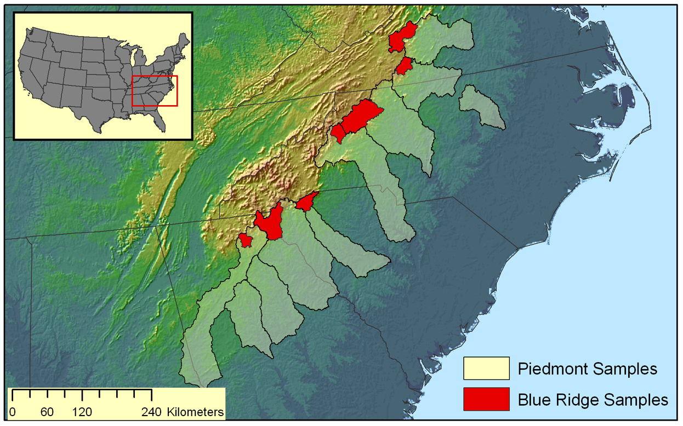
Sampling strategies – large basins
Large Trimble
Catchments

Slide 19
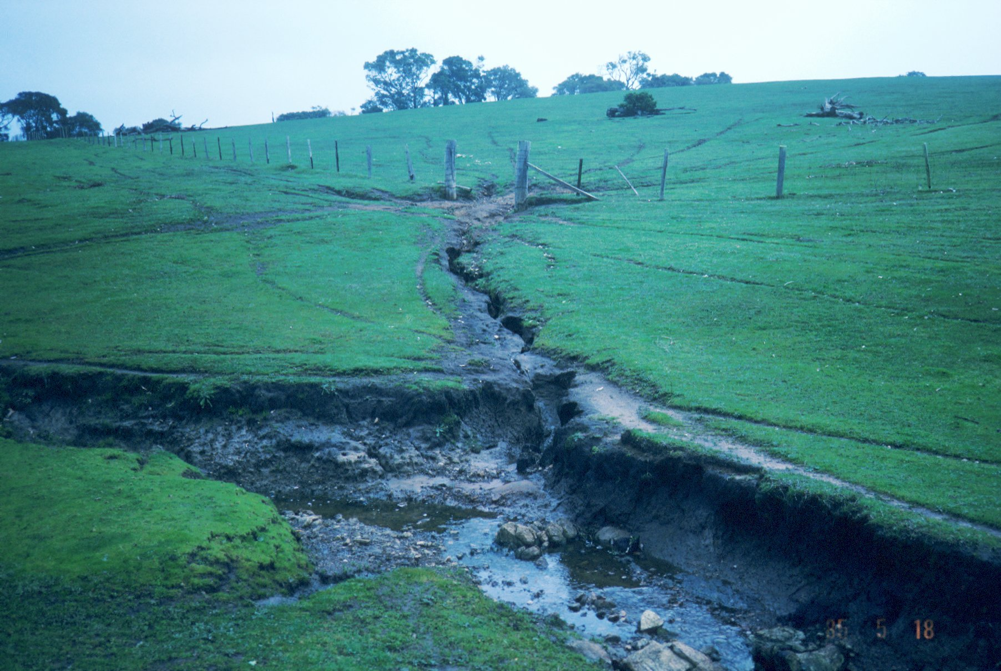
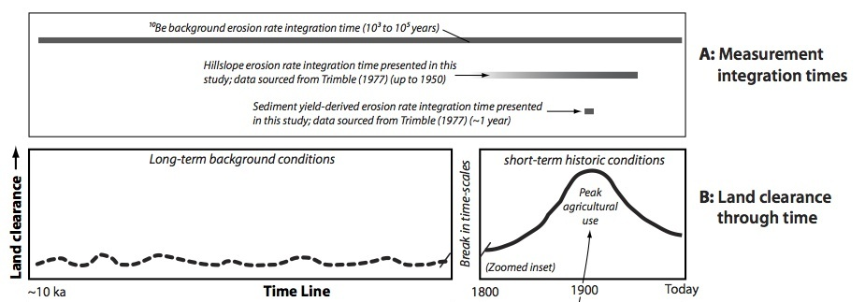
Conceptual models of long- vs. short-term erosion:
Rates of hillslope erosion integrated from 1700 - ~1950.
Sediment yield inferred rates ~1 year (1909)
In situ ₁₀Be rates provide much longer-term averaged background rates.

Slide 20
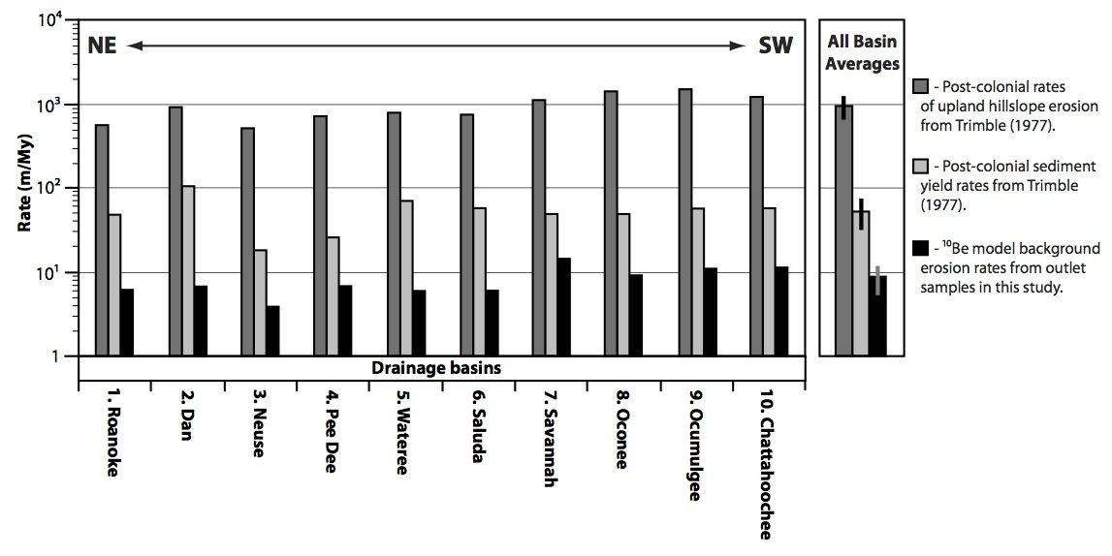
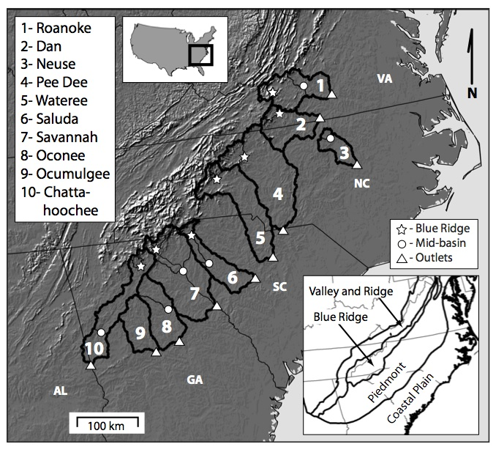
In situ ¹⁰Be results from this study compared
to hillslope erosion rate and sediment yield-
derived erosion rates from Trimble, (1977).
Hillslope rates
~950 m/My
Sediment yield
inferred rates
~50 m/My
Our in situ ¹⁰Be background erosion rates
~9 m/My
Naturally, the Piedmont erodes >100 times
slower than during peak agriculture

Slide 21
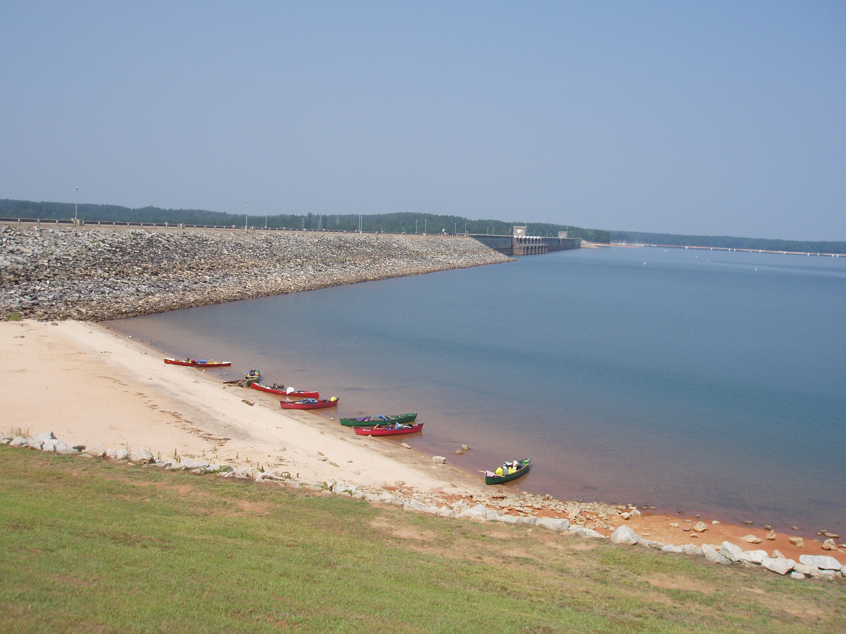
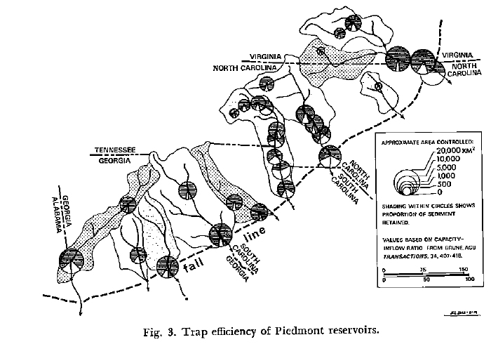
Where is all the sediment now?
Recovery from past landuse disturbances:

Slide 22
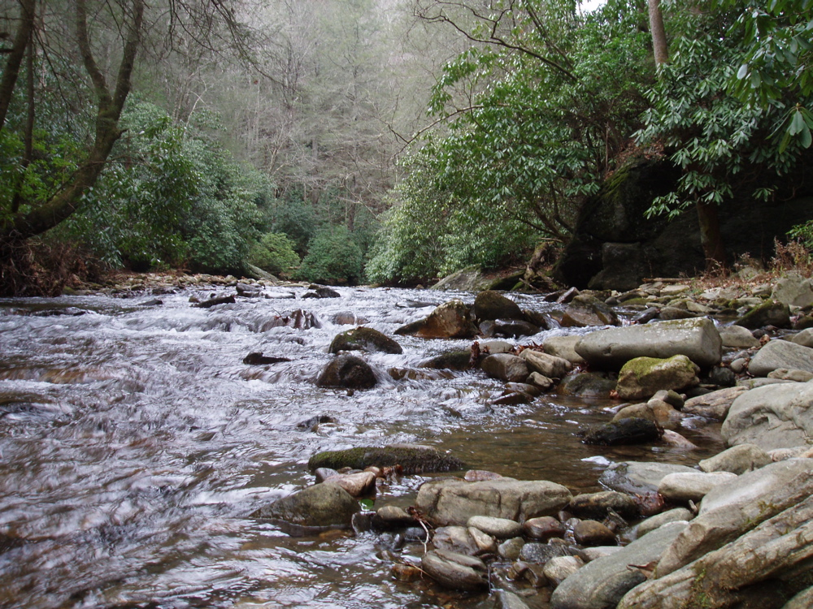
Testable hypotheses with ¹⁰Be for small basins:
Background rates of erosion in small sub-basins are related
to their average basin slopes.
The relationship between average basin slope and background in situ ¹⁰Be erosion rates can be used to predict rates in drainage basins without ¹⁰Be data.

Slide 23
Previous Appalachian ¹⁰Be research
Potential controlling variables of erosion
Rate tested in higher slope Appalachian terrain:
Physiographic province
Mean elevation
Land cover and land use
Mean basin slope
Duxbury, 2006
- 4 to 14 m/My
Only significant variable appears to be SLOPE
Sullivan, 2006
- 6 to 37 m/My
This Study:
Can the lower slope piedmont help us
understand better erosion of the Appalachians?
Matmon, et al. 2003
- 17 to 35 m/My
~2 to ~20 degrees

Slide 24
Rationales' for testing slope-dependence
At small-basin scales:
Represent the full range of slope conditions across the
southern Piedmont.
Generate a statistically robust relationship representa- tive of the slope-erosion rate relationship at a landscape-scale.
Avoid the influence of dams along rivers draining very large
drainage basins

Slide 25
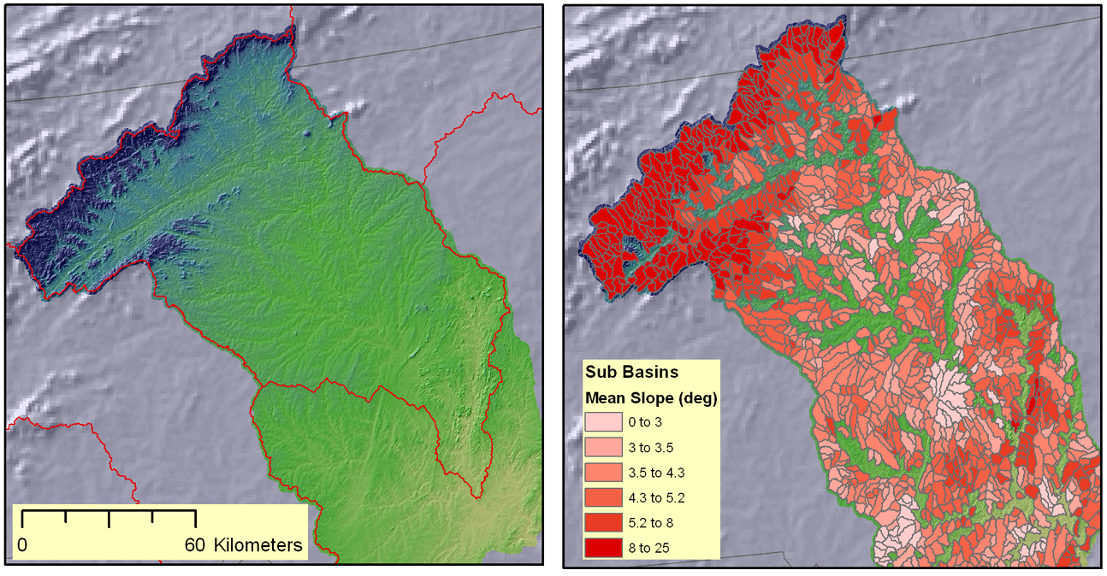
Sampling strategies - small slope basins
1
2
3
4

Slide 26
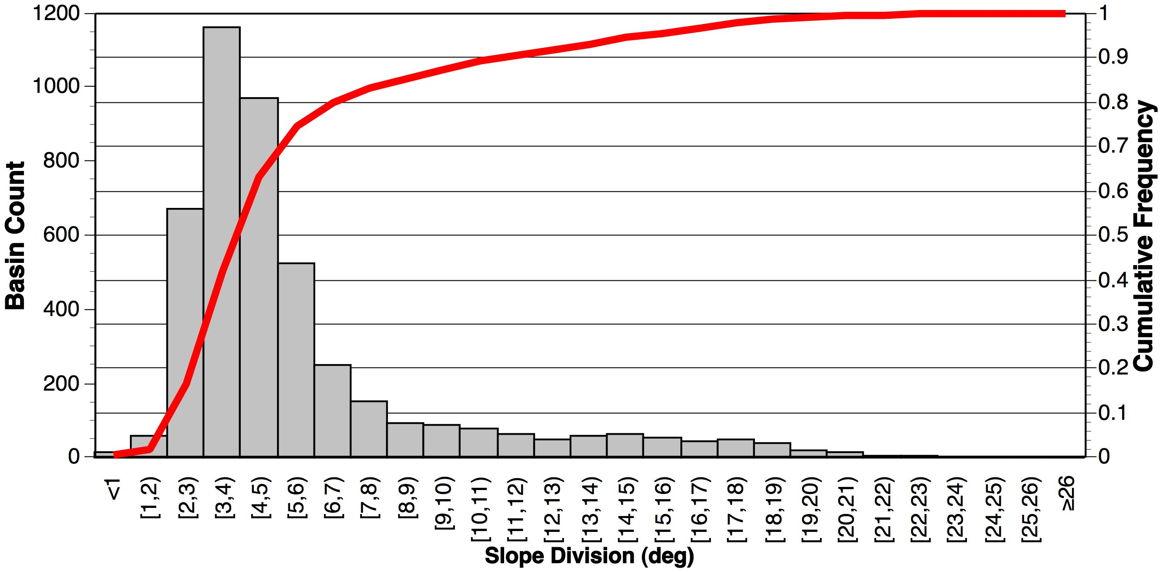
Slope distribution of potential sample basins
Cumulative Probability

Slide 27
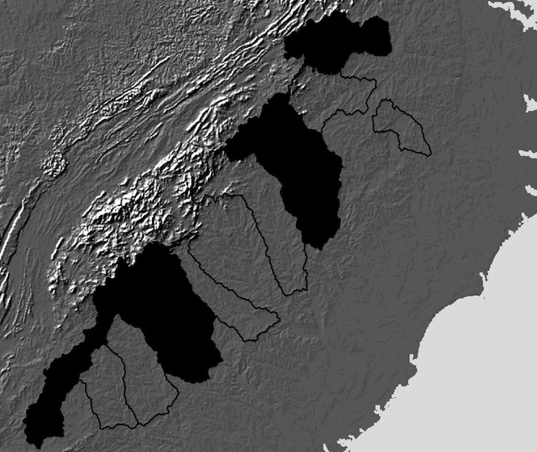
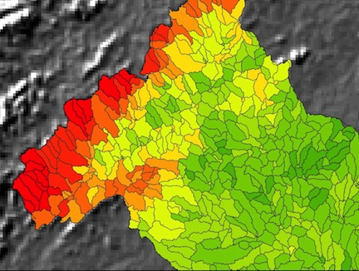
What we find for the 37 small slope-test basins:
1
2
3
Average basin slope
4
-Roanoke, Pee Dee, Savannah, and Chatahoochee basins
-Represent the NE to SW range across the entire study area
~3050 potential sample basins ~20 km² in size

Slide 28
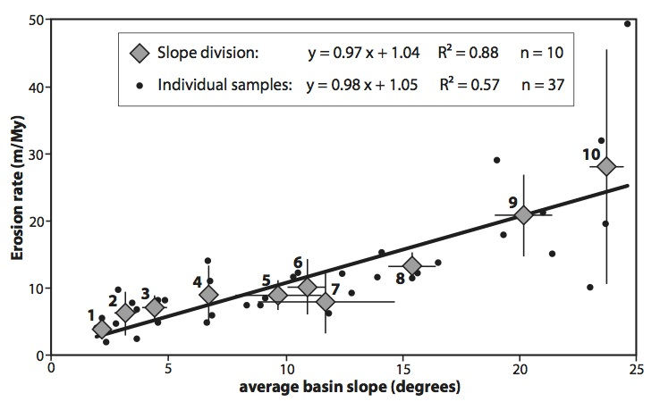
What we find for the 37 small slope-test basins:

Slide 29
Also generated a stepwise multiple regression model using these 37 small basin-test results:
Significant variables included in the model:
Average basin elevation
Basin relief
Average basin slope
MAP
MAT
Adj. R² = 0.63
p<0.0001

Slide 30
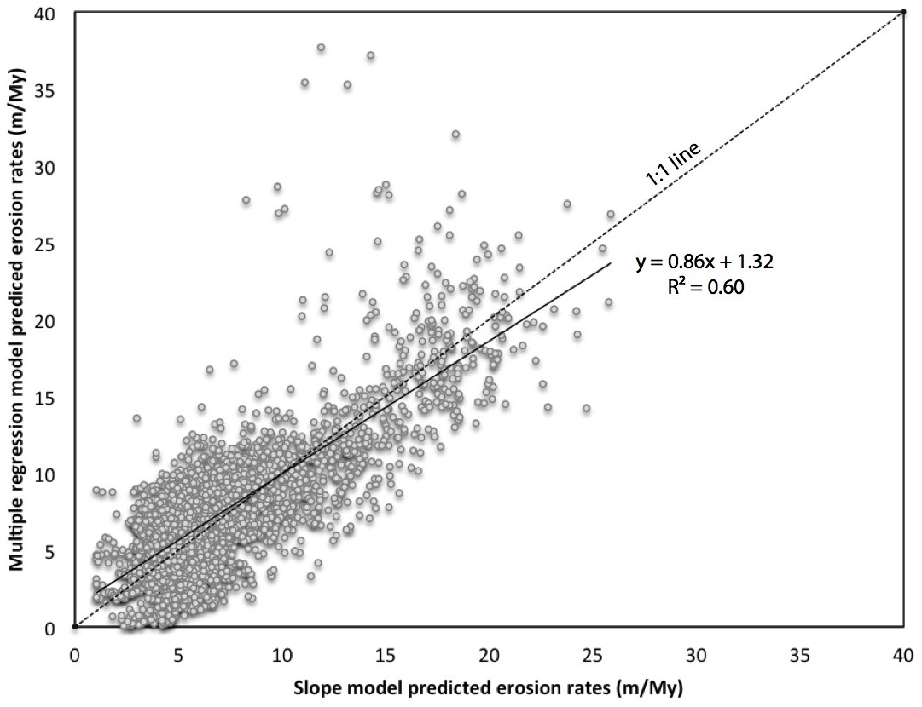
Predicted small-basin erosion rates made with both models:
Predicted erosion rates
for all
5100
small basins
within the
10
large Piedmont
drainage basins

Slide 31
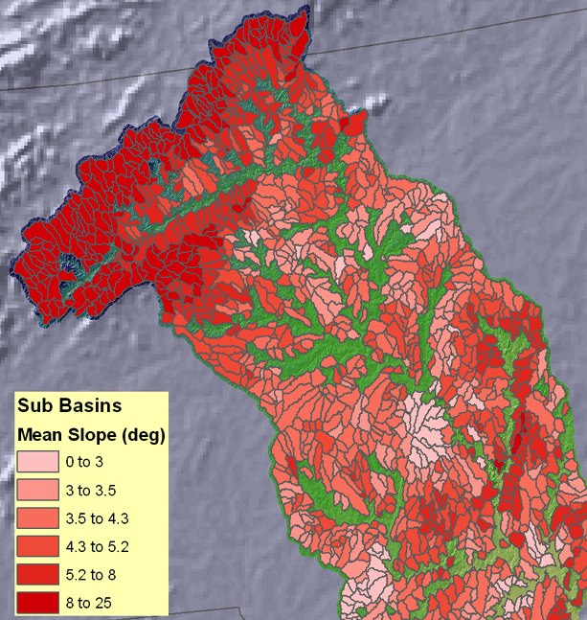
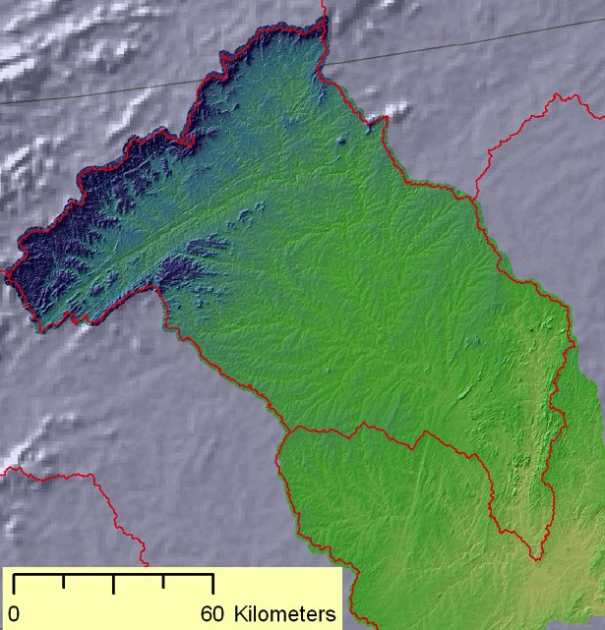
Scaling up:
Predicting large basin erosion rates from models:
Using lots of erosion rate predictions for small
basins made with both models…
To predict an area-weighted amalgamated
erosion for a large basin (E_{ps} and E_{pm}).
Sample point

Slide 32
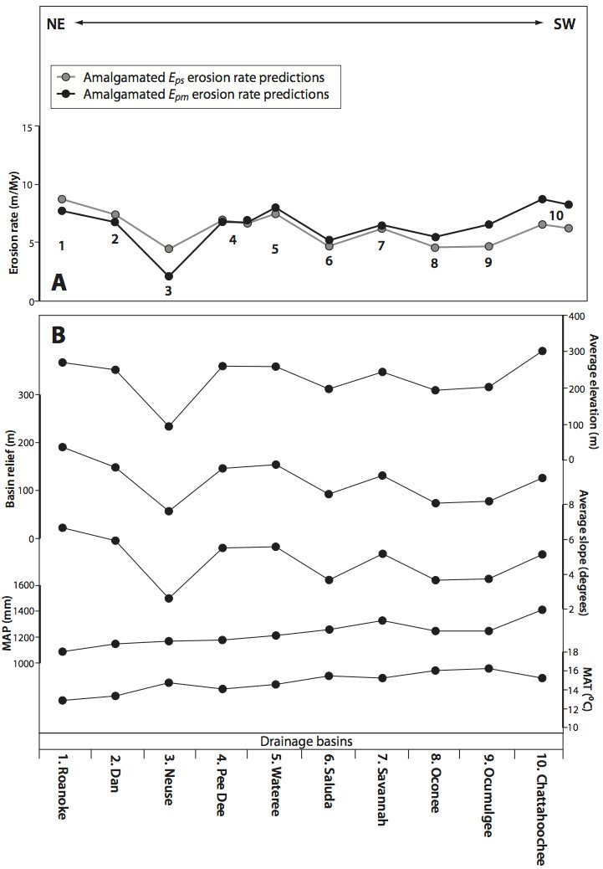
Does it work?
Multiple regression model tracks the
rends of all variables included well.
Amalgamated erosion rate predictions
made with both models match
each other well.
Implication:
Average basin slope alone
Is a powerful and robust
predictor of erosion rates.

Slide 33
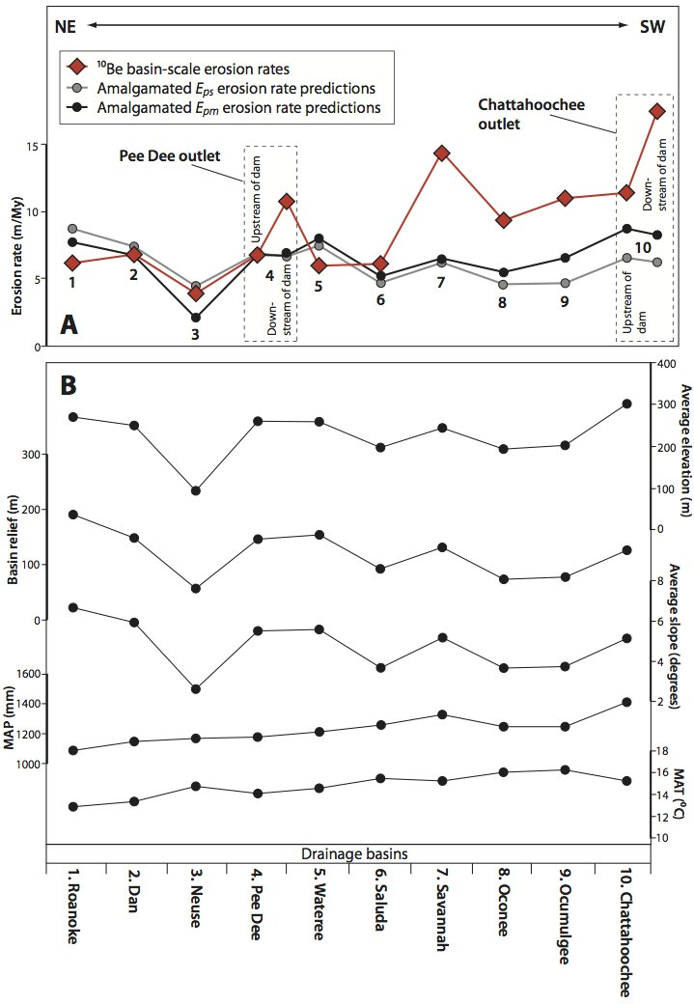
How do predictions compare to ¹⁰Be data for outlets?
Predicted and measured rates
agree well in the northeastern
basins
But not so well for the
southwestern basins

Slide 34
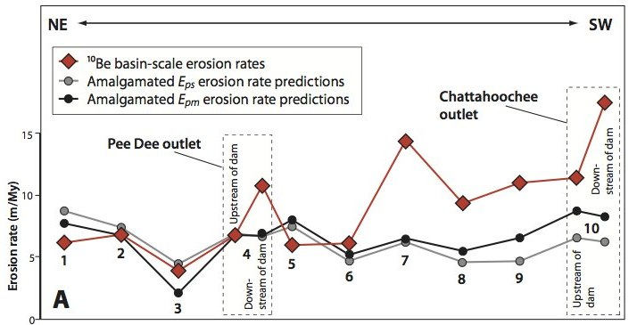
Potential explanation for N vs. S differences:
No discernable differences in geology
climate, or landuse history, BUT…

Slide 35
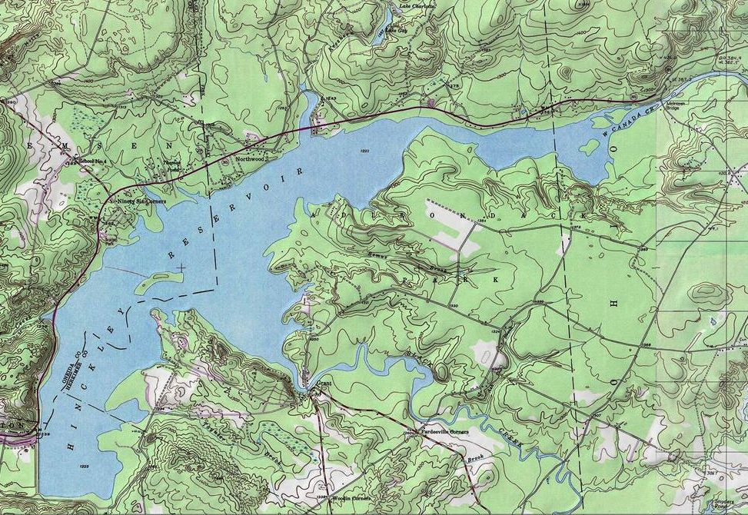
Damn dams – (dam-pair sampling):
Dams impede flow of
water AND
river sediment
Upstream of reservoir
I collected samples up and downstream of dams
All southern rivers sampled below dams
Implication:
Samples collected downstream may reflect
locally sourced material
Thus
Don’t represent basin-scale erosion
Downstream of dam

Slide 36
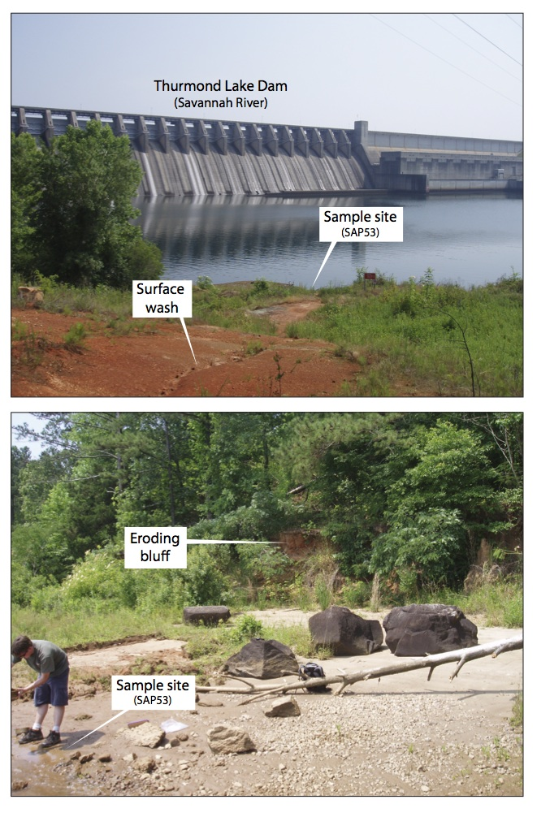
Never before tested assumption:
Very real implication for
interpreting drainage basin background
erosion rates made with
in situ ¹⁰Be in large river basins.
Our small-basin in situ ¹⁰Be-derived
amalgamated erosion rates may
be more reliable estimates
of background erosion rates.

Slide 37
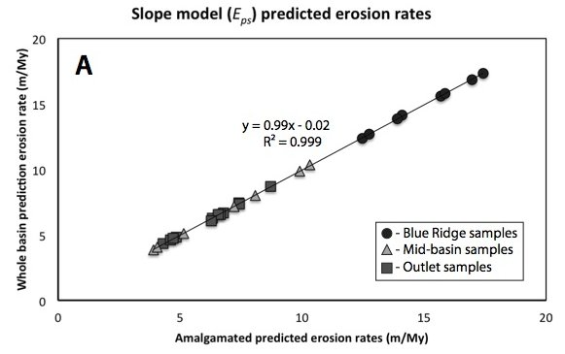
Scalability of small-basin slope-based model:
Amalgamated small basin
approach
Whole-basin average
slope
Simple slope model is fully scalable
Implication:
Potentially, we can predict a background
Erosion rate at any point along a river network.

Slide 38
Summary of finding from the southern Piedmont:
Human landuse practices on the Piedmont increased rates of hillslope erosion by more than 100-fold above background.
Much of the sediment is still stored on the landscape and trapped in dam reservoirs.
We can predict background erosion rates with simple statistical models.
The influence of dams must be considered with using in situ ¹⁰Be to infer background erosion in LARGE basins.

Slide 39
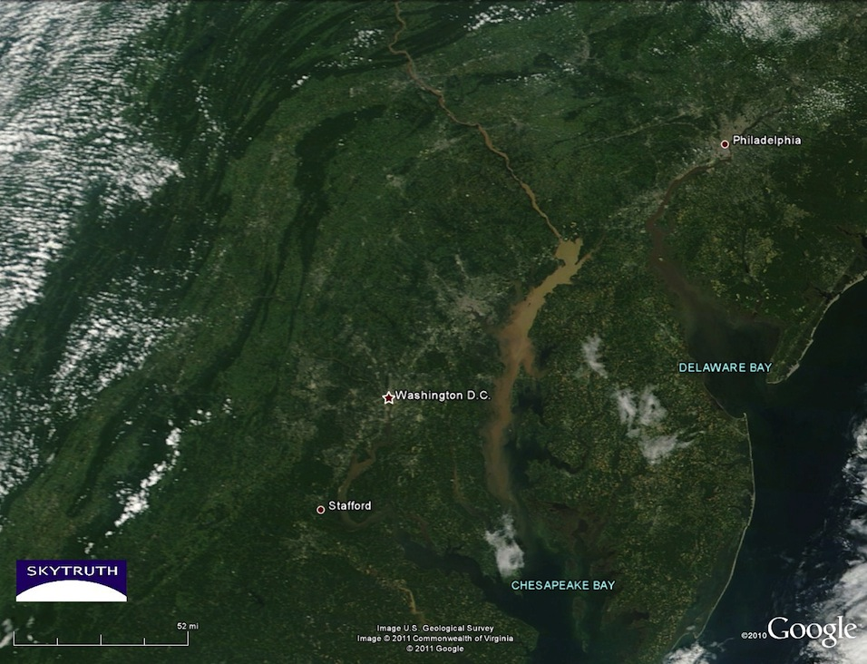
Real-world implications:
Using the simple, and scalable average basin slope – based model we can predict erosion rates and mass fluxes of sediment at any point along a river network on the southern Piedmont.
Could be used to establish realistic TMDL levels of sediment and associated pollutants.

Slide 40
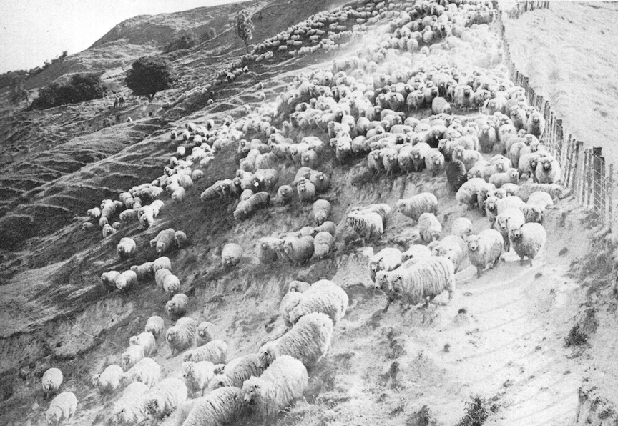
Lets transition to an utterly different environment

Slide 41
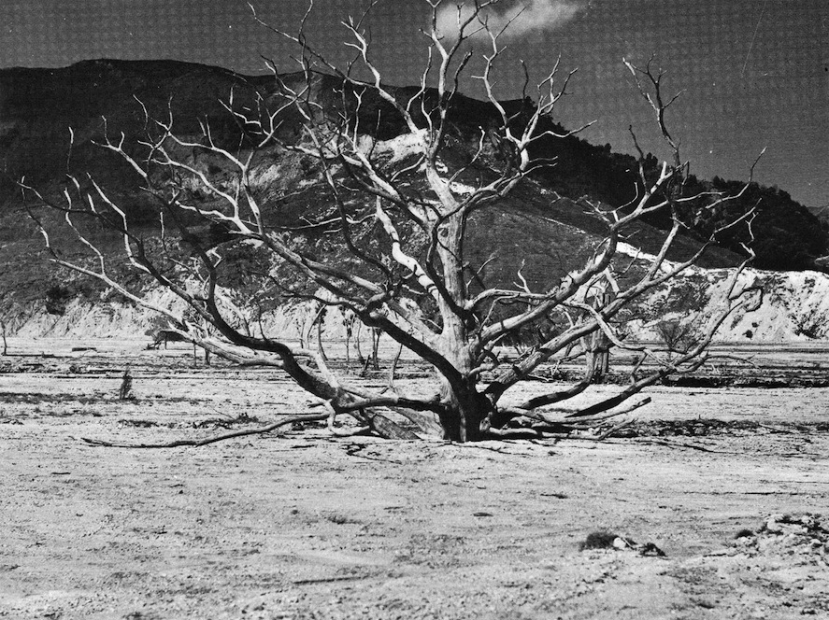
2. Waipaoa Basin, North Island, NZ
Very different from Appalachians:
Episodic and non-uniform erosion
Challenging environment for application of
cosmogenic techniques.

Slide 42
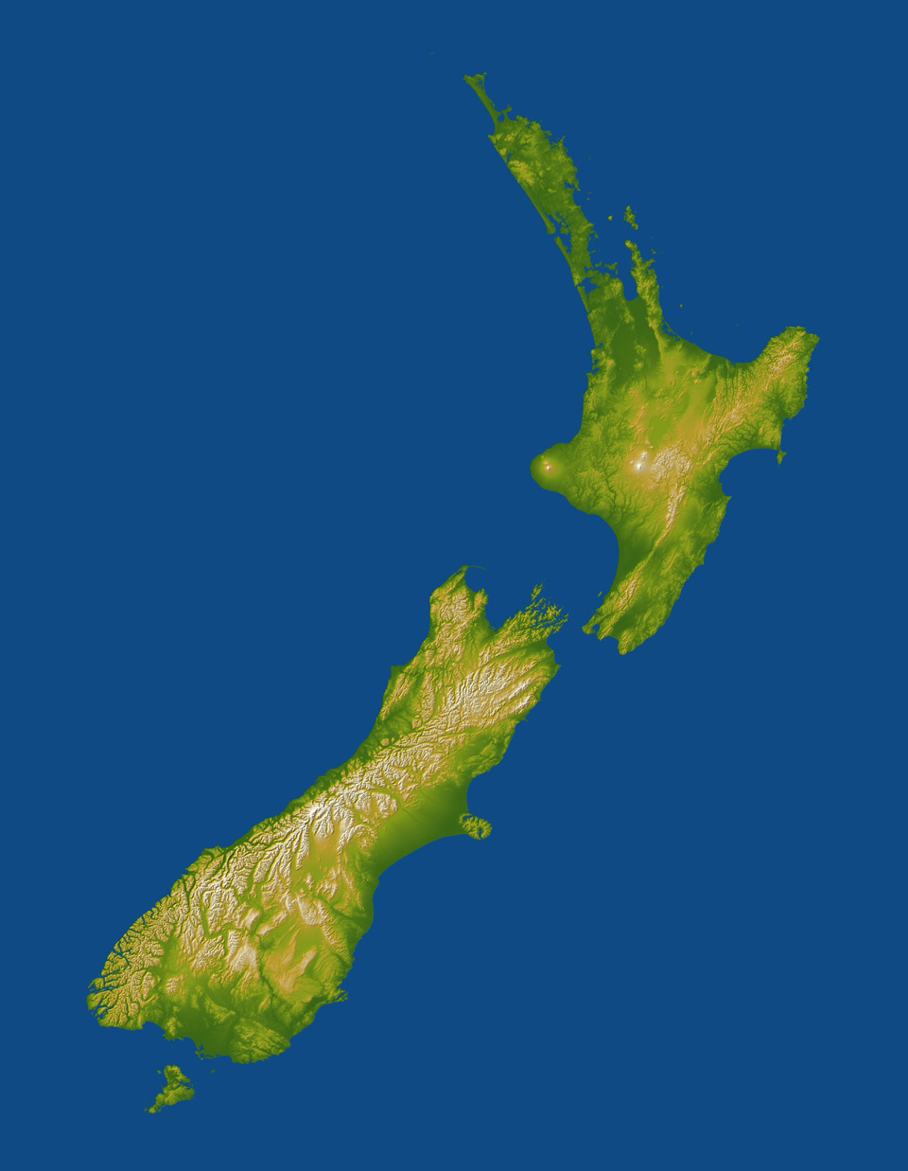
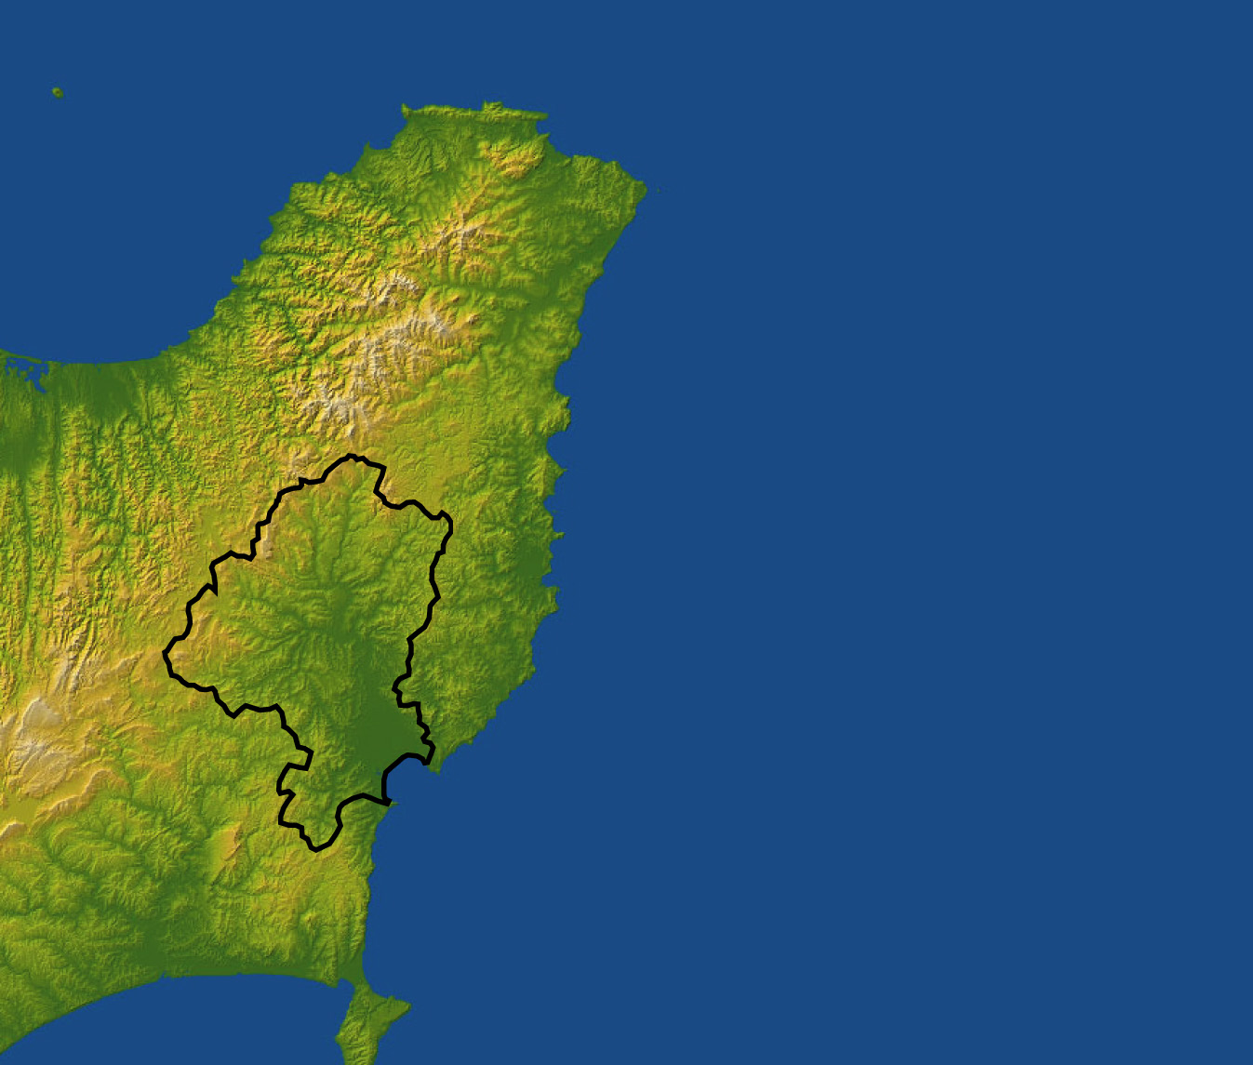

Erosion in the Waipaoa Basin:
Tectonically-active -
Subduction Margin:
1-10 mm/yr
Area:
2200 km²
Sediment yield:
~15 Million tons per year
Inferred short-term rate:
3 km/My
One of the fastest on
earth
Appalachian Mtns:
20 m/My
More than 100 times faster
Waipaoa Basin

Slide 43
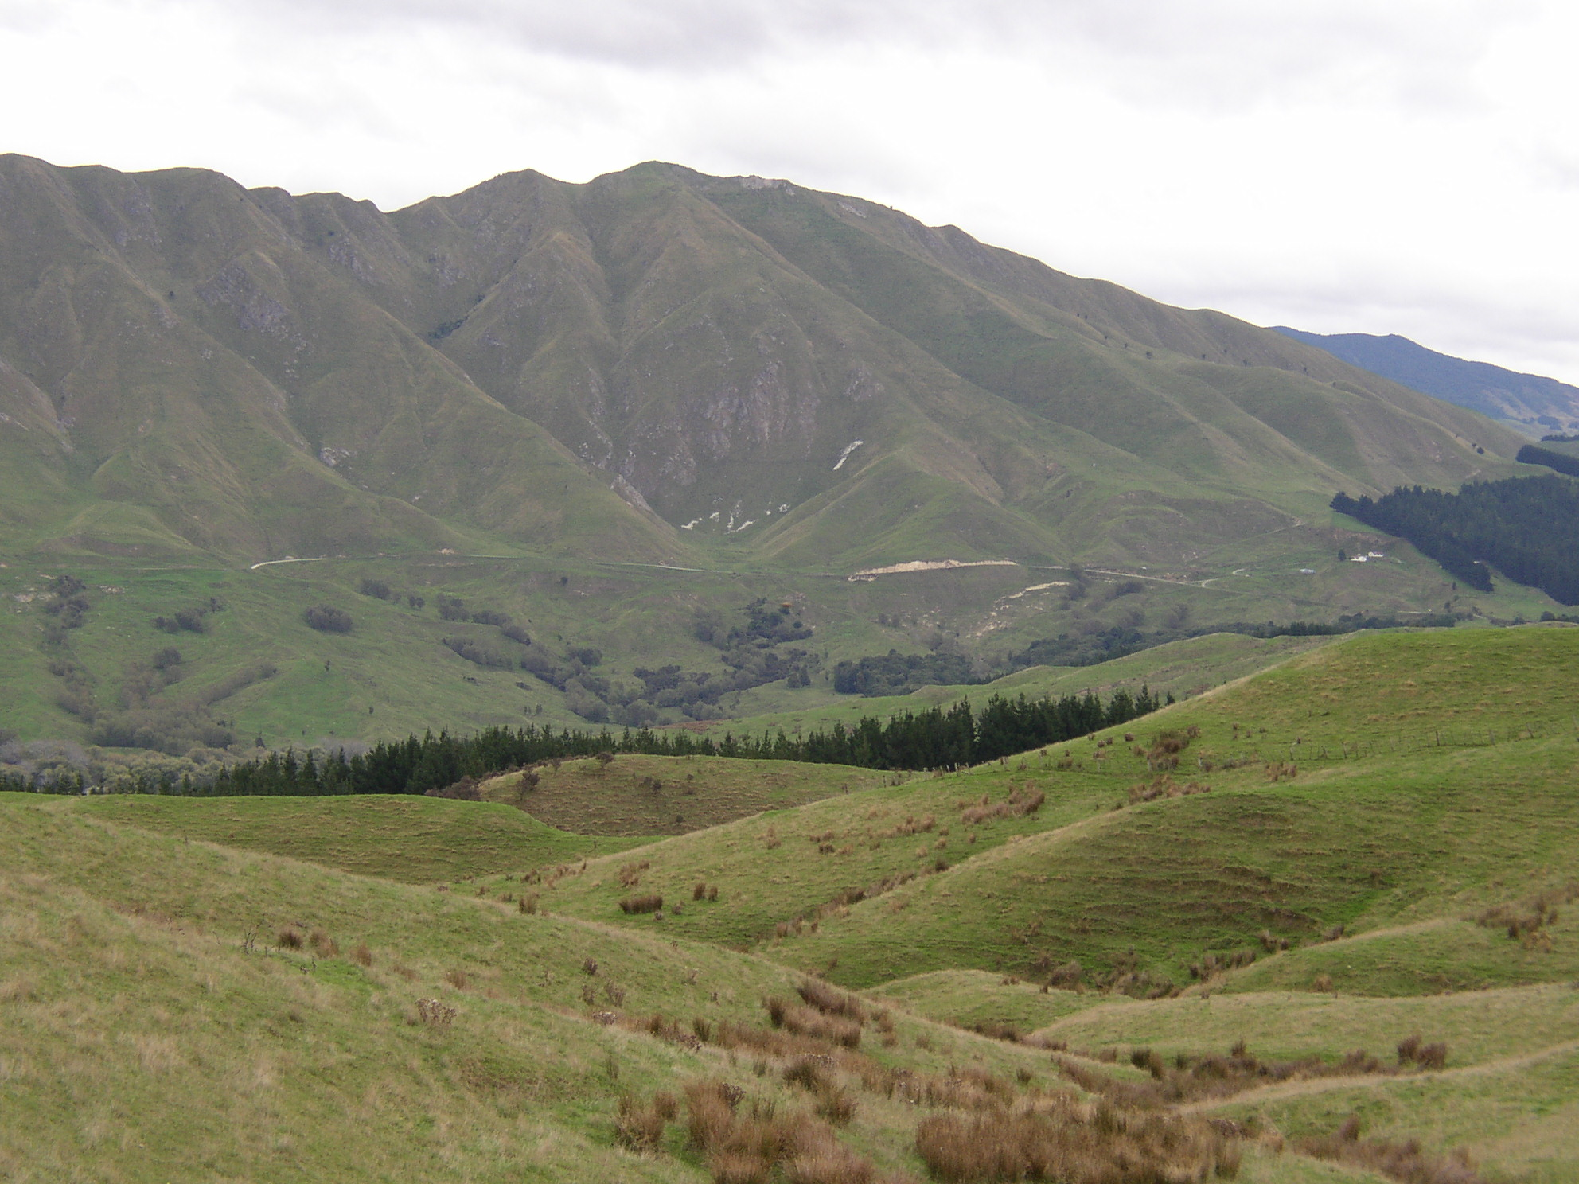
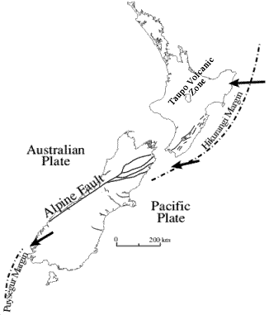
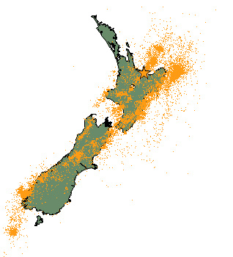
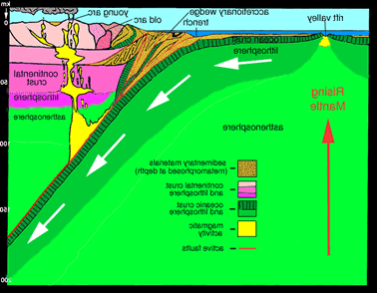
Erosion in the Waipaoa Basin:
Waipaoa Basin displays some of the most
dramatic erosional features found anywhere in the world
Has attracted researchers from around the globe over the past
several decades
Complex story of natural erodibility, extensive landclearance for
agriculture, and subsequent reforestation efforts.
Natural Causes for Erosion:
Active Subduction
Margin
Physical Rock Strength:
Frequent Volcanic and
earthquake activity
Temperate Maritime Climate:
-highly seasonal precipitation (1.3 to 2.5 m/yr)
-periodic cyclonic activity (ENSO related)
-frequent intense rainfall events
(29% chance every year, 99% every ten)
-hydrologically triggered mass movements (landslides)
Earthquake,
March 31st, 2007

Slide 44
Region Primed For Erosion:
No More Trees!

Slide 45
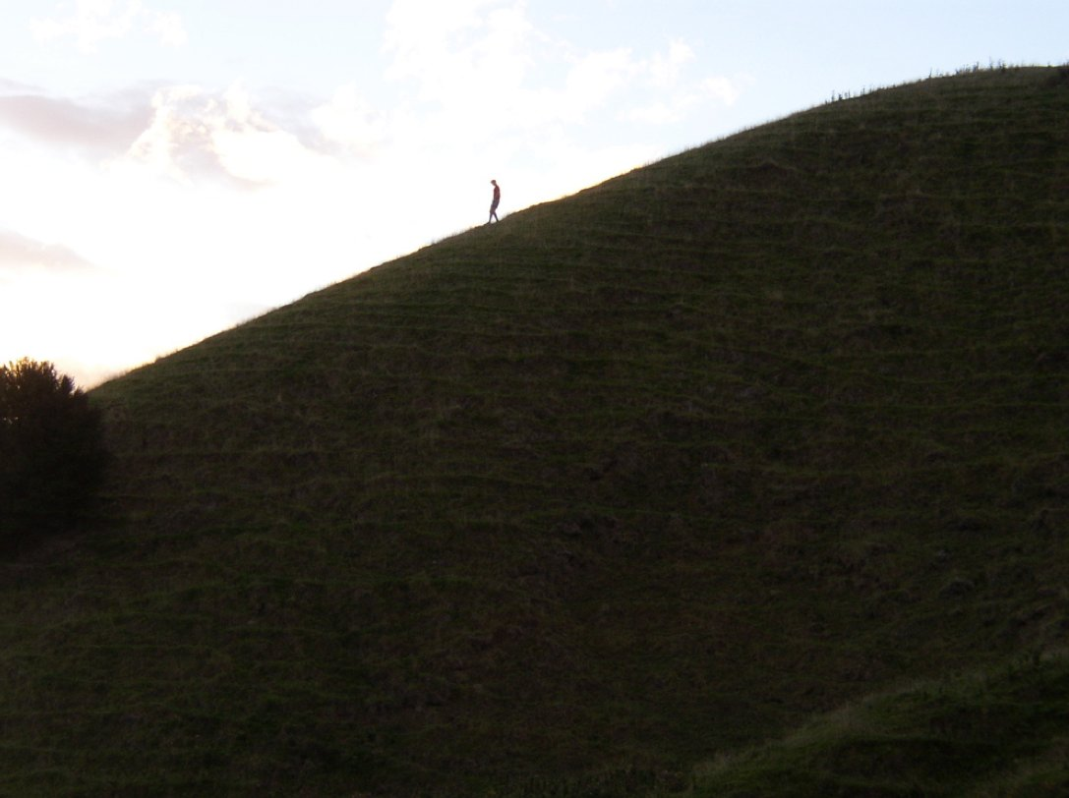
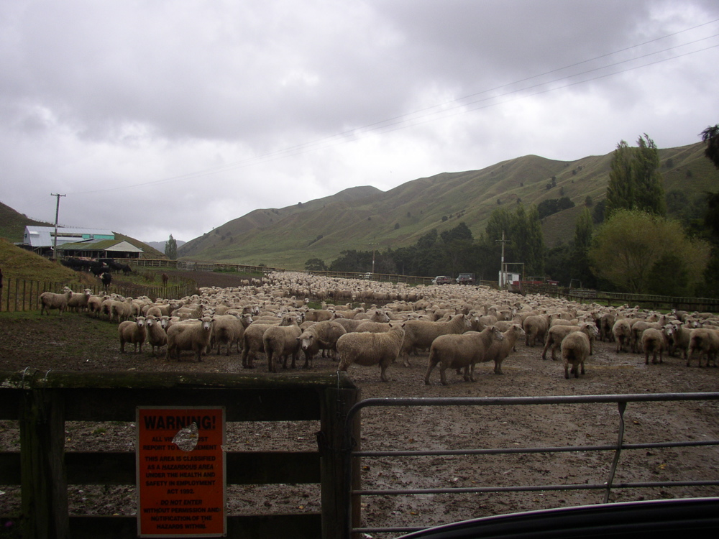
Deforestation = massive erosion in the Waipaoa
Mauri settlement ~700 yr BP.
Commenced in early 1800’s with European settlement of NZ
By 1880, downstream portions of basin cleared
By 1920, upstream portions cleared
Today, only 3% of basin
remains covered in
native vegetation

Slide 46
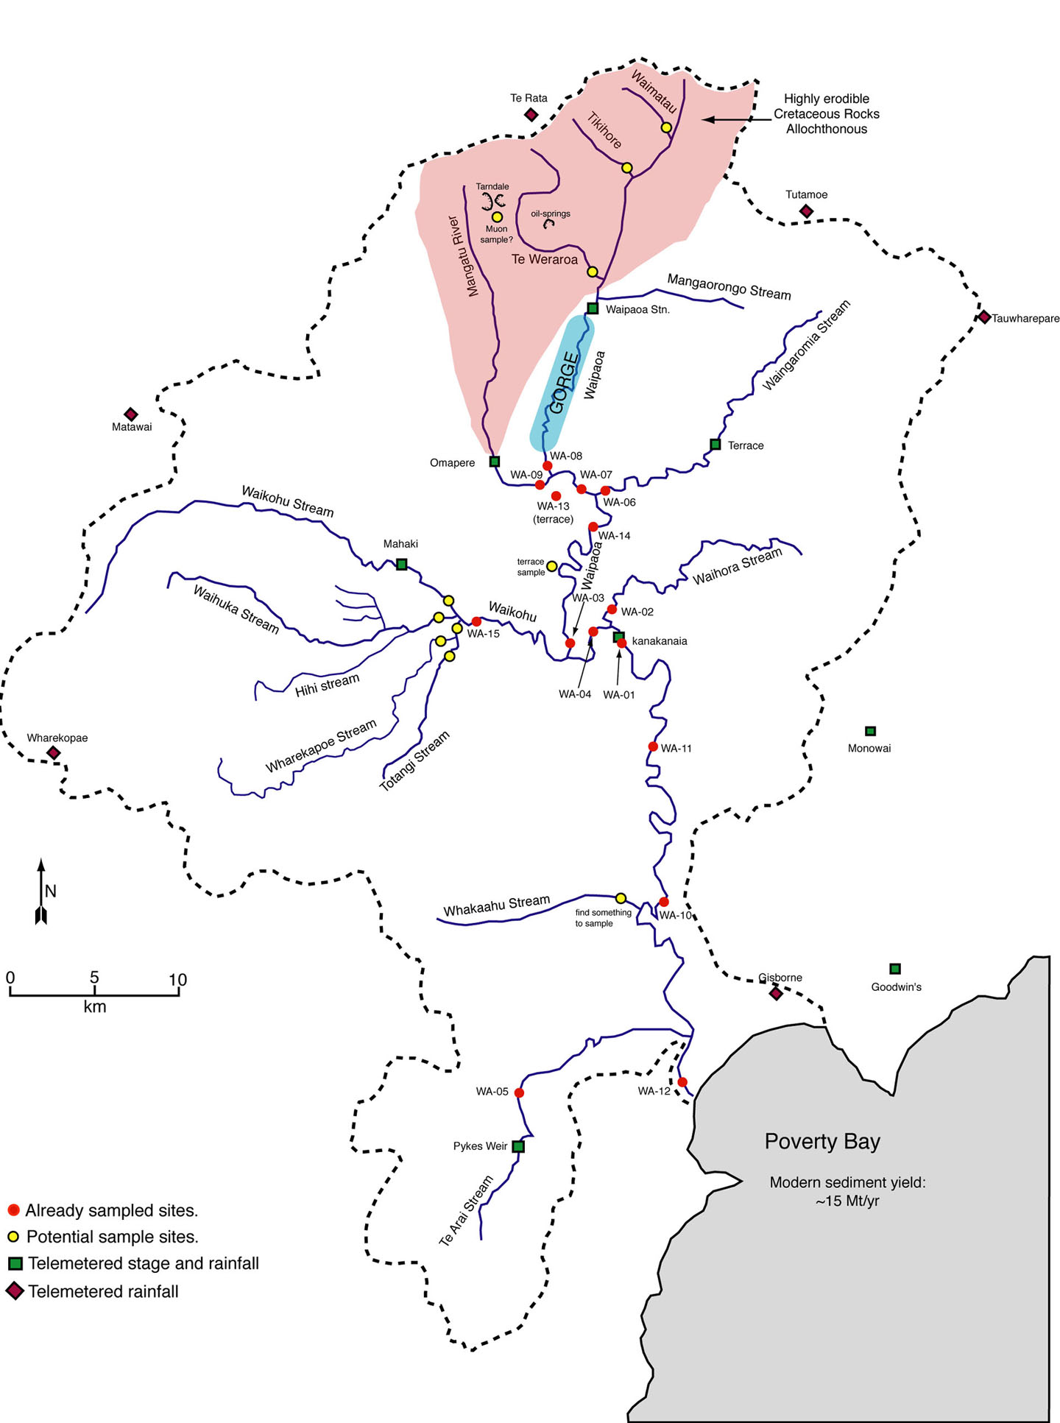
Variable response to land clearance:
Severe Gullying:
weak rocks, faulted, fractured
Widespread Landsliding:
Channel Aggradation:
deposition of upstream
sediment
Only remaining Native
Vegetation

Slide 47
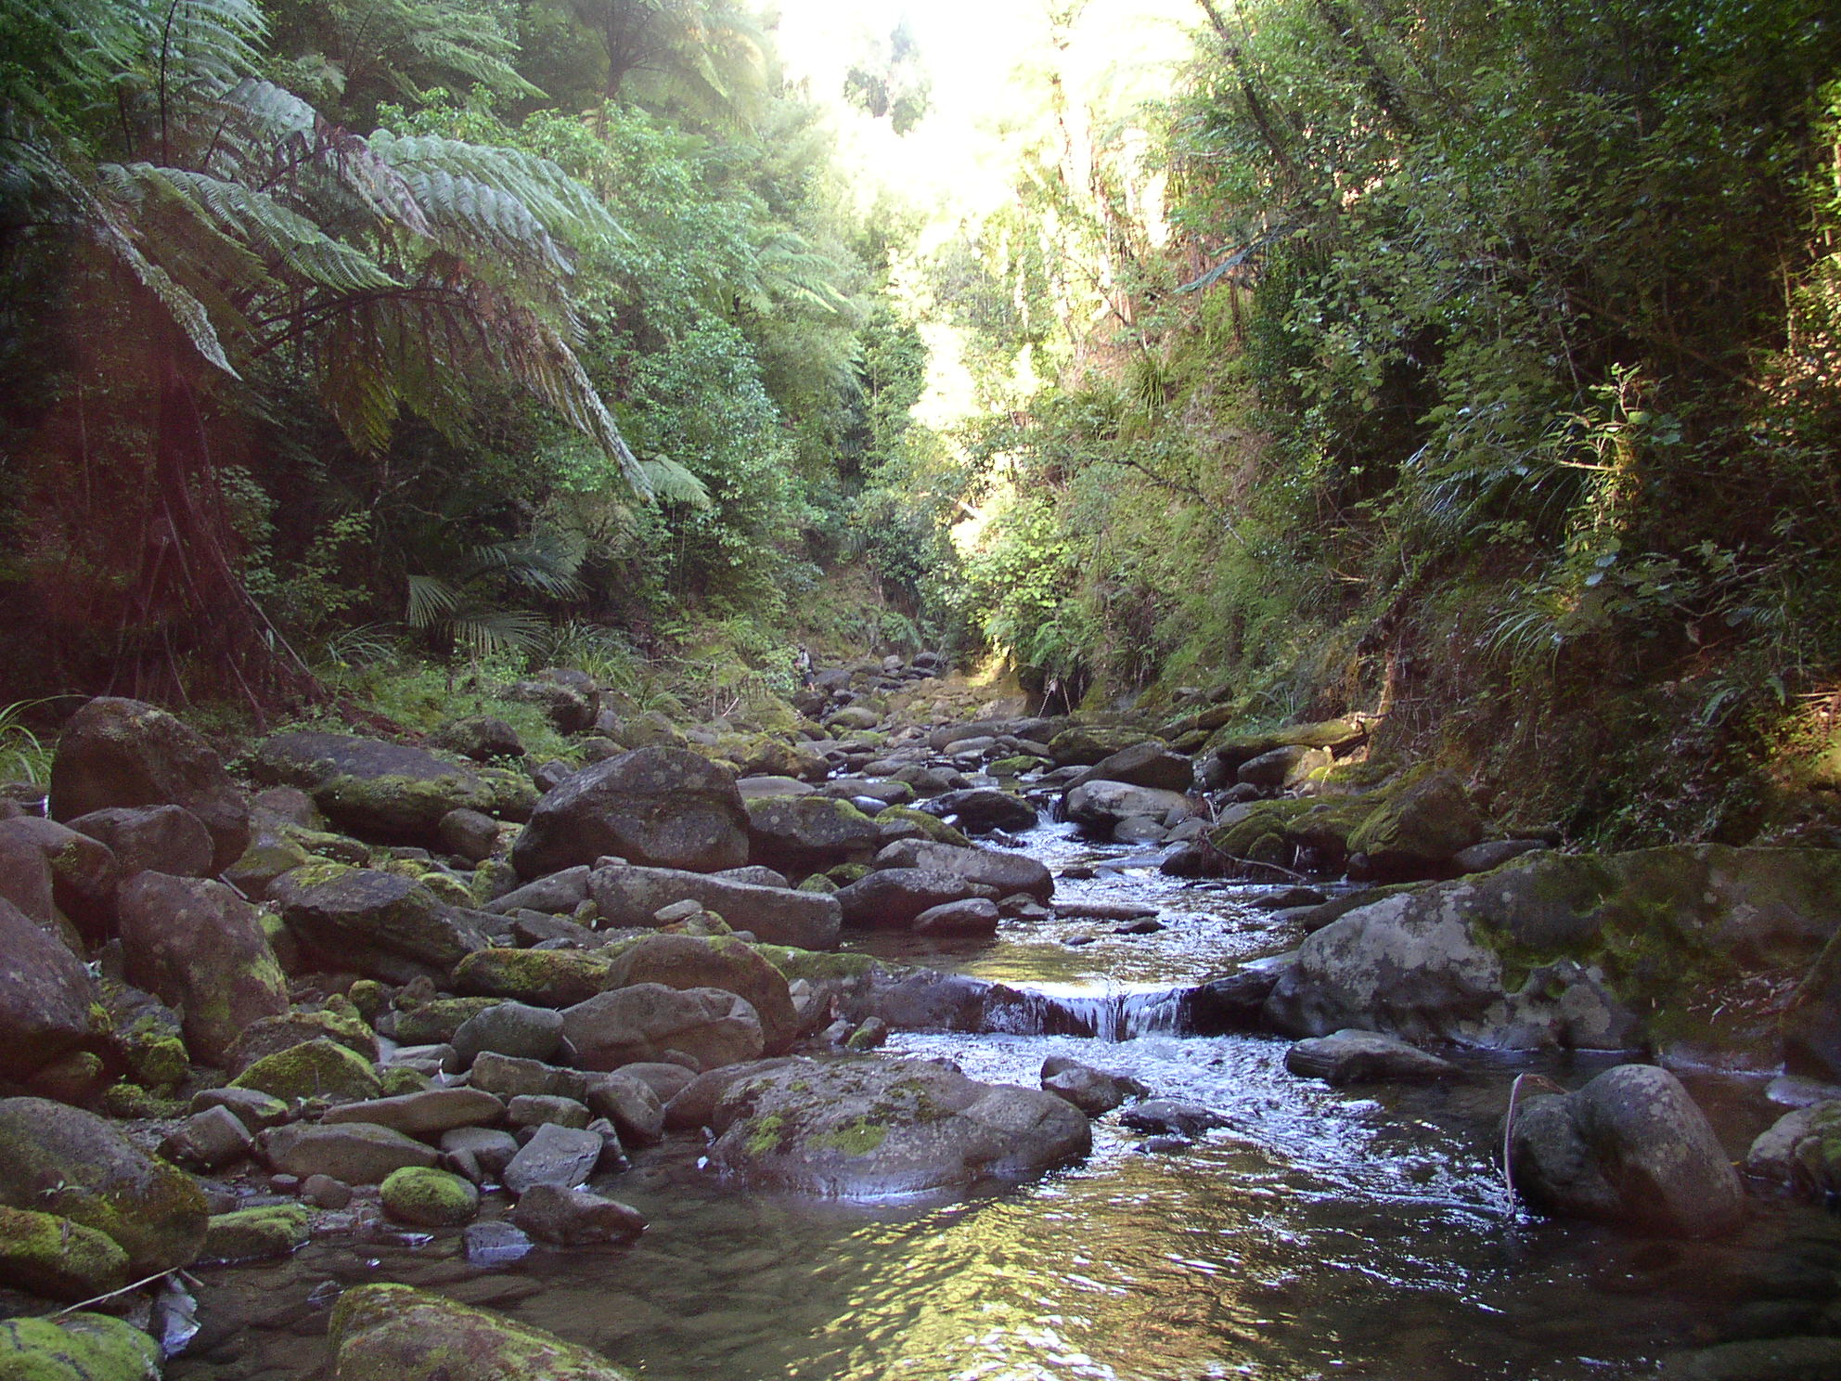
Native Vegetation:
what we think the
Waipaoa used
to look like

Slide 48
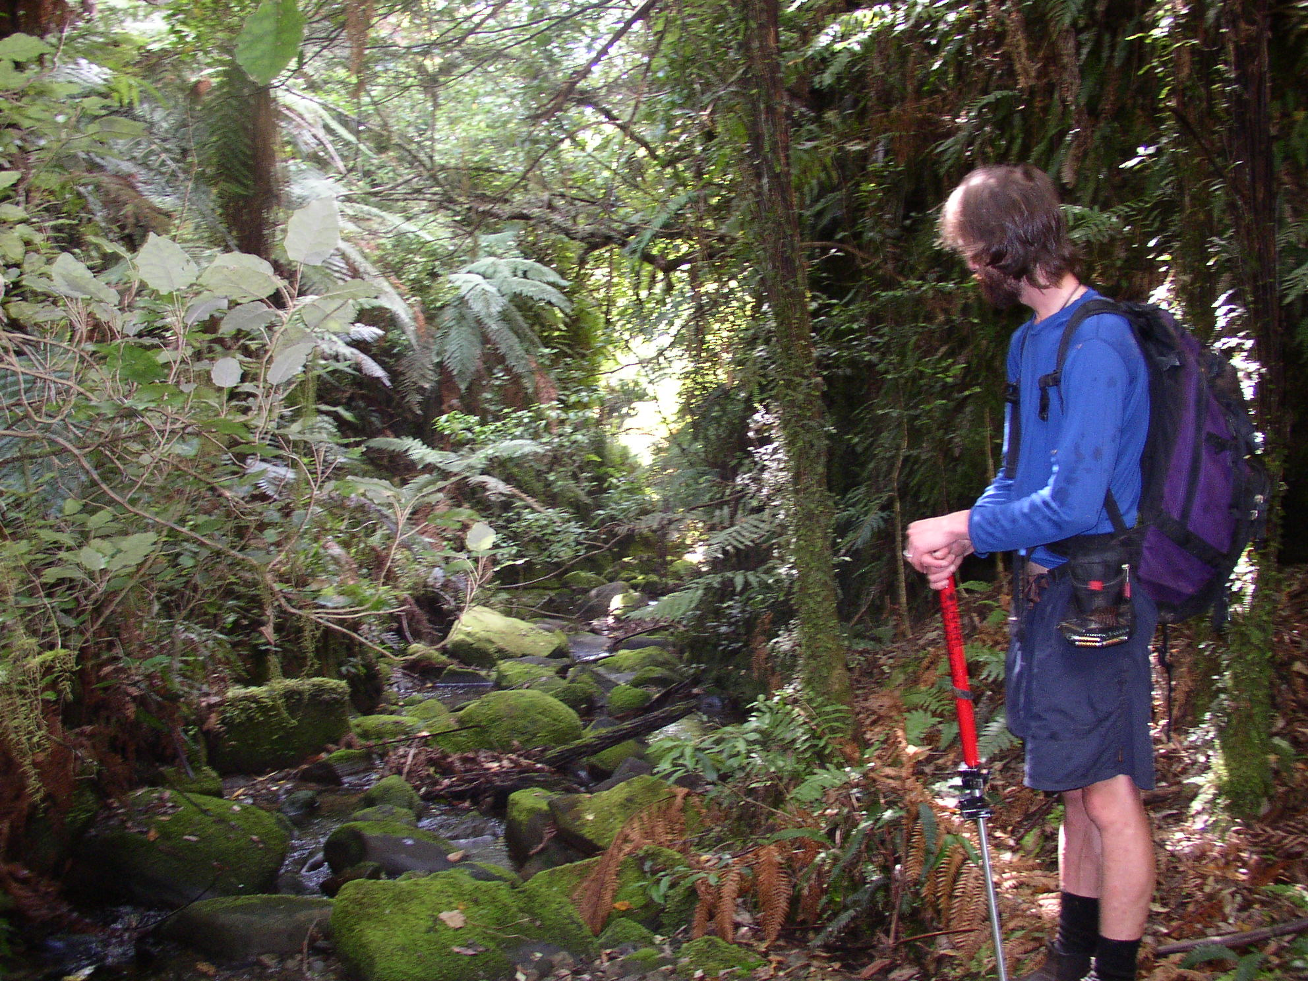
Native Vegetation:
what we think the
Waipaoa used
to look like

Slide 49

By 1910, the erosional effects of clearance were widespread
Pervasive landsliding
-Hydrologically triggered
-Extreme rainfall events
-No trees to anchor hillslopes

Slide 50

By 1910, the erosional effects of clearance were widespread
Gully
-Rapidly eroding weak terrain
-Constant erosion and sedimentation
Fan
Temporary storage
River Channel
Truck

Slide 51

Tarndale and Mangatu Gullies
1972

Slide 52

Today, gully-derived sediment overwhelms material in the Waipaoa mainstem channel

Slide 53

Channel aggradation 1994
Rip Bridge

Slide 54

Channel aggradation late nineties
Rip Bridge

Slide 55

Channel aggradation 2002
No more bridge

Slide 56

Continual flood plain deposition of sediment increased rates of flooding in regions downstream (Poverty Bay Flats):

Slide 57
Testable hypothesis with meteoric ¹⁰Be:
Concentrations of meteoric ¹⁰Be can be used to track the sourcing and
mixing of sediment in the Waipaoa River Basin.
    Isotopically distinct signatures of sediment from gullies vs. shallow
    landsliding dominated tributary basins.
These isotopic signatures can be used to apportion the relative
contribution of sediment from different parts of the Waipaoa Basin.

Slide 58
Accumulation of meteoric ¹⁰Be in soils:
Produced in the atmosphere by the
same processes as in situ ¹⁰Be
Delivered to soils across landscapes
in rain, and to a lesser extent in NZ
in dust.
Accumulates over time in hillslope
materials that eventually make their
way to river channels.
Accumulation rate: ~1.7 x 10⁶ atoms per cm² annually – easily measurable
with AMS.
Half-life of ~1.38 millions years –
residence time of near surface
materials much shorter meaning
¹⁰Be behaves as a stable nuclide
over period of measurement.

Slide 59



Chasing sediment in the Waipaoa Basin:
Continuous
and large
Episodic
and less
Mix of both

Slide 60



Isotopic signatures of sediment:

Slide 61

Spatial distribution of meteoric ¹⁰Be concentrations:
Raw averages of data
Vast majority of sediment
In mainstem channel comes
From gullies
~2.7 x 10⁷ at/g
~2 x 10⁷ at/g
~2.1 x 10⁷ at/g
~3 x 10⁶ at/g
~3.3 x 10⁶ at/g

Slide 62



Mixing of sediment with different isotopic signatures:
Tarndale gully is the starting isotopic signature
Tarndale signal is augmented with higher
concentration sediment from incoming
tributaries.

Slide 63

Mixing model – apportioning relative contribution:
[N_{up}][m_{up}] + [N_{trib}][m_{trib}] = [N_{down}][m_{up} + m_{trib}]
and
[m_{up}] + [m_{trib}] = 100 %
“cold”
low-concentration
gully sediment
“hot”
high-concentration
western trib. sediment
“hot”
high-concentration
eastern trib. sediment
Areas of the headwaters
and the eastern and western
tribs. combined are roughly
equal
“luke-warm,”
Downstream mix
Gullied headwaters produce
sediment at a rate
20 times
that of the east and west

Slide 64



Testable hypotheses with meteoric ¹⁰Be:
We can track temporal changes in meteoric ¹⁰Be concentration by
resampling the same sites at different times.
We can infer how source area change through time, and at different flow
conditions.
May 2004 – fluvial sediment
March 2005 – fluvial sediment
August 2008 – fluvial sediment
August 2008 – overbank flood deposit (event deposit)
Basin-
wide
deposit

Slide 65

Temporal variable in meteoric ¹⁰Be:
Eastern outlet
Te Arai outlet
Mainstem outlet
Not exactly sure why concentration are increasing
through time in fluvial sediments?
Flood deposit likely reflects episodic input of
shallow sediment with higher concentration
landslide sediment from 7/31/2008 event.

Slide 66
Temporal variable in meteoric ¹⁰Be:
Western
outlet
Gullied
headwaters
Don’t see distinct temporal variability in the headwaters or gully dominate points
along the mainstem channel.
Gullies continuously feed deeply-sourced, low concentration sediment to channels.
These regions aren’t as sensitive to stochastic weather events like landslide-
dominated basins.

Slide 67

Testable hypothesis with in situ ¹⁰Be:
From a limited number of samples that actually contained quartz (18 out of 105) we an generate a reasonable estimate of background erosion in the Waipaoa Basin.

Slide 68

In situ and meteoric ¹⁰Be comparison samples:
Quartz only:
Only reflects the exposure
History of lithologies
That contain quartz.
East
West
Te Arai
Mainstem
Bulk sample:
theoretically reflects
entire drainage basin.
Gullies

Slide 69

Reasonable estimate of background erosion:
Background rate ~250 m/My
(in situ ¹⁰Be)
Just about 100 times slower than contemporary sediment-yield-inferred
Erosion rate reflecting agricultural disturbance

Slide 70


Brings us full circle back to the Appalachians:
-Tectonically active
-Non-uniform erosion
-Event driven (cyclones)
-Intense human disturbance
-Human ~100 >
Background rates
-Largely passive
-Relatively uniform erosion
-Humid temperate climate.
-Intense human disturbance
-Human ~100 >
Background rates

Slide 71
Summary and conclusions of research:
For the southern Appalachian Piedmont:
Background in situ 10Be rates are ~100 times slower than agricultural rates of hillslope erosion.
At peak disturbance, streams were incapable of transporting the majority of sediment fed to them. Even today, most of it is stored across the landscape in valley bottoms, toe-slopes and impounded in dam reservoirs.
Generated a statistically robust dataset and predictive model from the slope-erosion rate relationship for small-basins.
Model is scalable and can be used to predict erosion at any point along a river network in the southern Piedmont.

Slide 72
Summary and conclusions of research:
For the Waipaoa River Basin, NZ:
Proof of concept: Meteoric 10Be can be used to track fluvial sand within a tectonically active river network, severely disturbed by past human landuse practices
Simple mixing models allow us to assess the relative contribution of sediment from different regions within a watershed.
Temporal replicates demonstrate how source areas, and erosion style change through time and as a function of flow conditions.
As for the southern Piedmont, human landuse practices appear to have increased inferred erosion rates by 100 times above background.

Slide 73
Implications for land management:
For the southern Appalachian Piedmont:
With the scalable slope-based model, we can predict a background erosion rate at any point along the southern Piedmont.
  These predictions could be used to inform TMDL levels for sediment and associated pollutants in waterways and water bodies.
For the Waipaoa River basin, New Zealand:
Can apportion the relative contribution of sediment from different tributary basins within a watershed using a simple mixing model.
  Gully-sourced sediment in the Waipaoa systems is visibly obvious, but a similar approach could be used in other, less disturbed basins where the contribution from various regions is less obvious.

Slide 74
Acknowledgments:
Funding sources: NSF, DEPSCoR, U.S. Geological Survey
My Committee: Paul Bierman, Donna Rizzo, Austin Troy, and
Beverley Wemple.
UVM Folks:
All my fellow Geology Grads
Cosmo Crew
Geology faculty
Family and Friends for all their support along the way!
And special thanks go to……..

Slide 75
Matt Jungers for endless help in the field
at so many location around the globe

Slide 76

Will Hacket for countless hours of driving through the
Appalachian Mountains.
And for tallying the number of Waffle Houses by region

Slide 77

And of course Paul Bierman for providing endless help
and guidance over many many years!!

Slide 78

Questions?
?

Slide 81


In situ production of ¹⁰Be:
Si
O
Ca, K, Cl
²⁶Al ²¹Ne
¹⁰Be ¹⁴C ³He
³⁶Cl ³He
Produced in upper several meters of rocks and sediment exposed at Earth’s Surface.
Production rate: 5.2 atoms per gram of quartz per year - measurable with AMS
Half-life of 1.5 millions years - residence time of near surface materials much shorter meaning ¹⁰Be behaves as a stable nuclide over period of measurement.

Slide 82
Equilibrium Stream Concept
Primary motivation for this project:
“There is a balance between the material transported by the stream
and that produced on the hillslopes” (Judson and Ritter, 1964)
  Steady-state between hillslope erosion and sediment leaving a catchment
  Essential requirement when modeling denudation rates from sediment yields
SELDOM TRUE TODAY…Especially when humans get involved!
Stream “Un” Equilibrium Along the Southern Pidemont
(Trimble, 1977)
Ten large catchments draining the majority of the southern Piedmont
(2,000 - 20,000 km²)
Sediment yield data reflecting peak agricultural disturbance.
Sediment yield vs. hillslope erosion vs. rates of denudation.
Does Stream Equilibrium hold??

Slide 83

Background (¹⁰Be) vs. short-term (sed. yields)
Drainage basin-scale Erosion Rates
Sediment Yield Derived Rates of Erosion:
-Typically short - decades
-Sensitive to land-use practices - good for human-induced modern rate
-Sensitive to sediment delivery regime - episodic delivery
Background Erosion Rates Estimated with ¹⁰Be:
-Integrates over 10⁴ to 10⁵ years
-Insensitive to land-use disturbances
-Episodic sediment delivery reflected in ¹⁰Be Rates
Sri Lanka:
-Short-term >100 X background
-pervasive deforestation
-tropical, monsoon dominated climate
(Hewawasam, etal, 2003)
Idaho Mountain Streams:
-Background ~20 X short-term
-large infrequent events missing from record.
(Kirchner, etal, 2001)

Slide 85


Slide 87


Slide 88


Slide 89


Slide 90


Slide 91


Slide 92



Slide 93




Slide 94


Slide 95


Slide 97


Slide 98


Slide 99


Slide 100


Slide 103
Template

Slide 104
Template 2:

Slide 105
Template

