Slide 1
DETECTING LANDSCAPE RESPONSE TO PERTURBATIONS BY CLIMATE AND BASE LEVEL USING IN-SITU ¹⁰Be AND ²⁶Al IN CENTRAL PENNSYLVANIA
Alison Denn, M.S. Candidate
Advisor: Paul Bierman
Department of Geology
The University of Vermont
March 8th, 2016

Slide 2
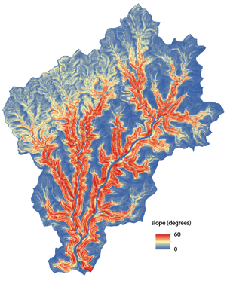
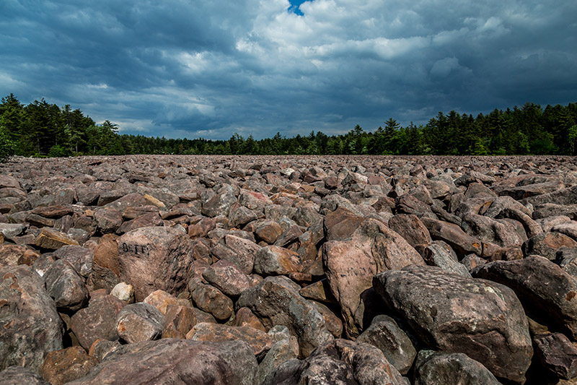
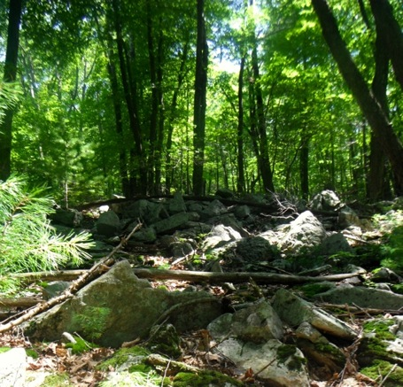
Today’s talk:
1. Introduction
2. Study Sites
a. Hickory Run Boulder Field
b. Young Womans Creek
c. Garner Run

Slide 3
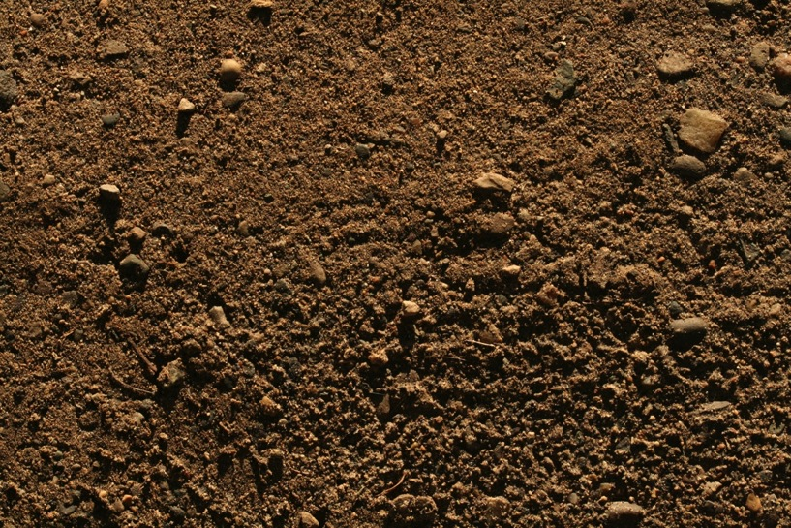
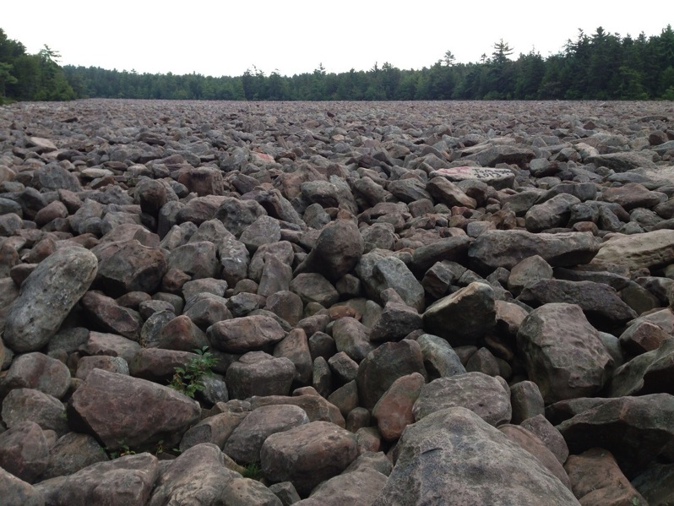
As a geomorphologist.
I ask questions such as…
How long has that dirt been there?
How old are those boulders?
Do landscapes persist, or do they erode quickly?
I think in timescales of 1,000’s to 100,000’s of years
http://www.texturemate.com/image/view/1441/_original

Slide 4
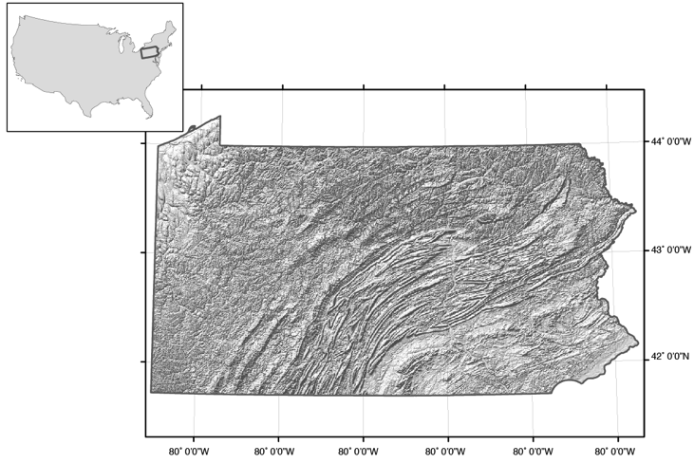
My project focuses on Pennsylvania, a complex landscape

Slide 5
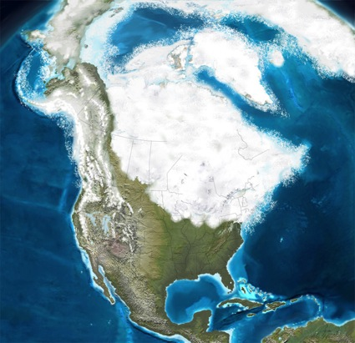
My project investigates the influence of two perturbations in the ‘recent’ geologic past in PA
river profile
old base level
incision moves upstream
new
1. CLIMATE
2. BASE LEVEL FALL

Slide 6
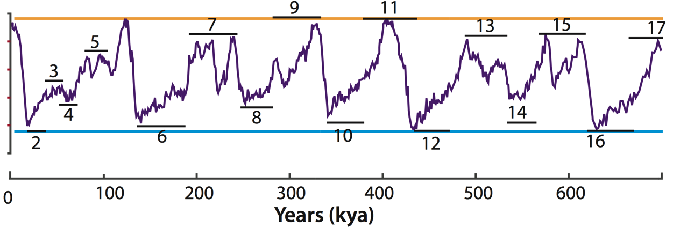
1. CLIMATE: GLACIAL/INTERGLACIAL CYCLES
TODAY
WARM
COLD
Adapted from Railsback et al. 2015

Slide 7
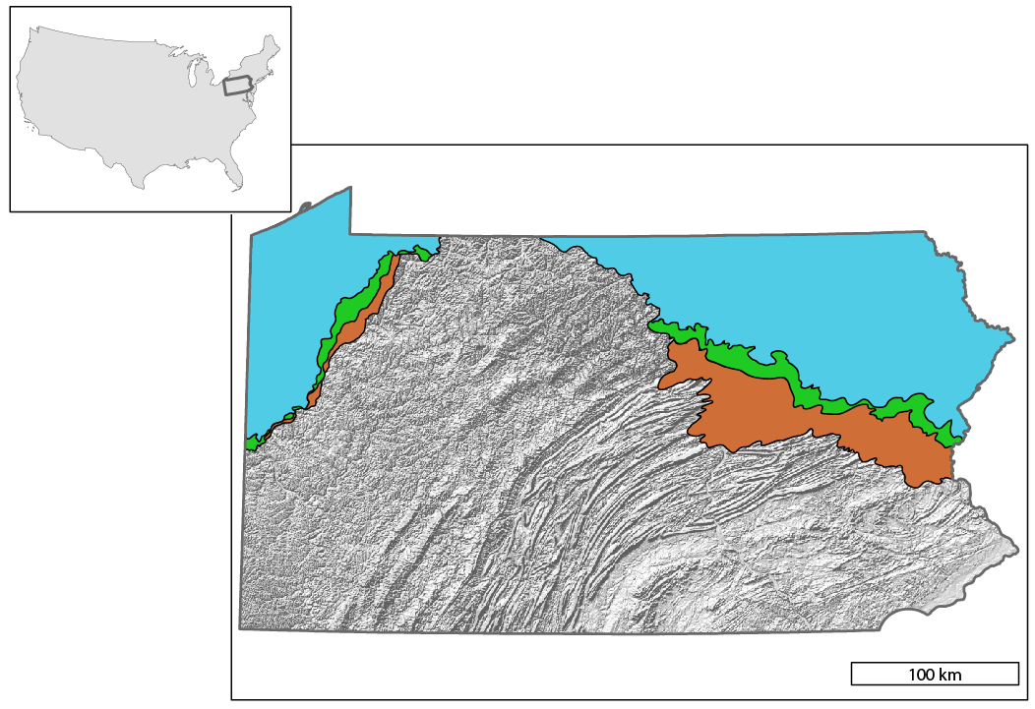
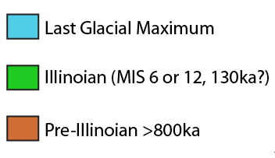
~26,000
Pennsylvania glacial advances followed similar paths
~130,000
>>770,000

Slide 8
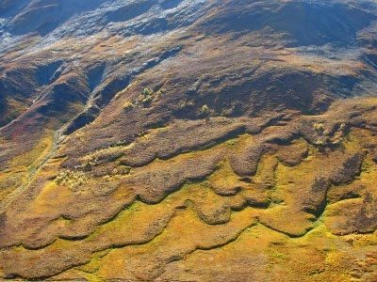
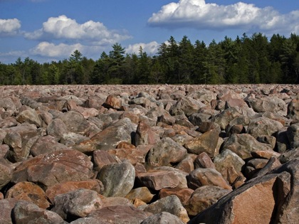
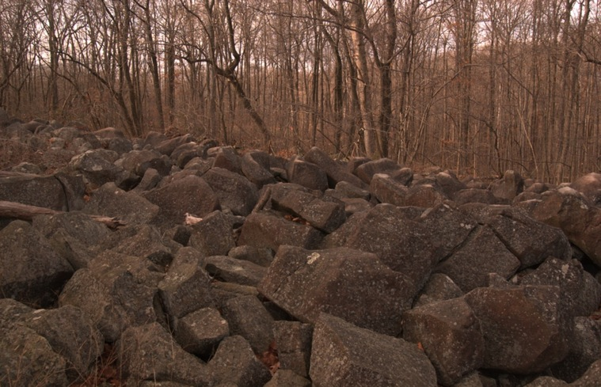
Most of Pennsylvania was ‘periglacial’ at glacial maxima
boulder deposits
solifluction lobes
block streams and boulder fields
https://qph.ec.quoracdn.net/main-qimg-d6ce63e03305007eb89181483bcaaacf-c
Notes:
Mention the solifluction lobes that joanmarie showed everybody. Periglacial: proximal to, but not covered by the glacier.
-Freeze thaw, frost cracking, and ice-mediated creep.
-Periglaciation ‘wipes the slate clean’?

Slide 9
2. BASE LEVEL FALL
INCISED LANDSCAPE
BASE LEVEL FALLS
initial river profile
Time 1
Time 2: Incision moves upstream
‘Base level’: elevation of land relative to ultimate drainage. Changes with tectonics, sea level, stream capture, or glacial drainage rearrangement.

Slide 10
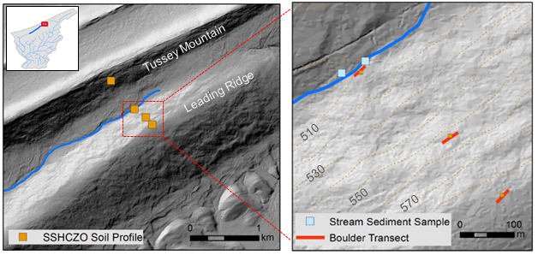
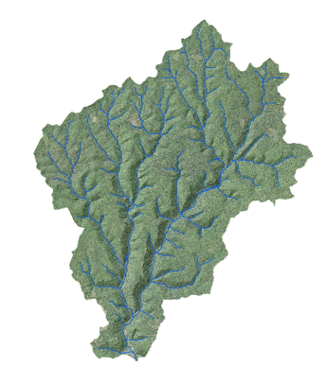
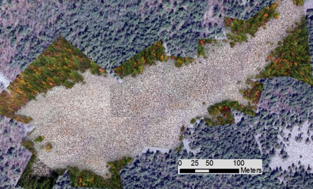
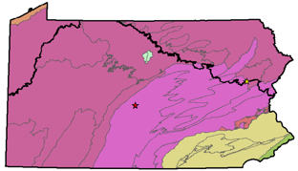
My central question : How have changes in climate and base level influenced the development of the landscape in Pennsylvania?
I analyze in-situ cosmogenic ¹⁰Be in soils, boulder transects, and stream sediments at Garner Run (CZO) and two endmember sites.
BASE LEVEL
CLIMATE
Hickory Run Boulder Field
Young Womans Creek Watershed
How have glacial/interglacial cycles impacted the generation of regolith from bedrock?
What are erosion rates like in a landscape adjusting to base level change?

Slide 11
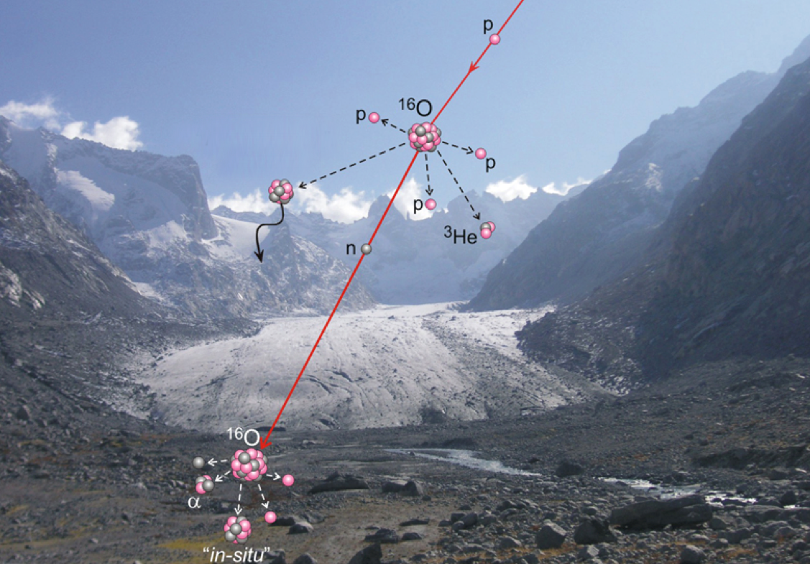
My tool: in-situ cosmogenic nuclides Isotopes produced by cosmic rays within the crystal structure of quartz; I use ¹⁰Be and ²⁶Al.
http://www.gfz-potsdam.de/en/media-communication/news/details/article/ehrung-fuer-prof-f-v-blanckenburg/

Slide 12
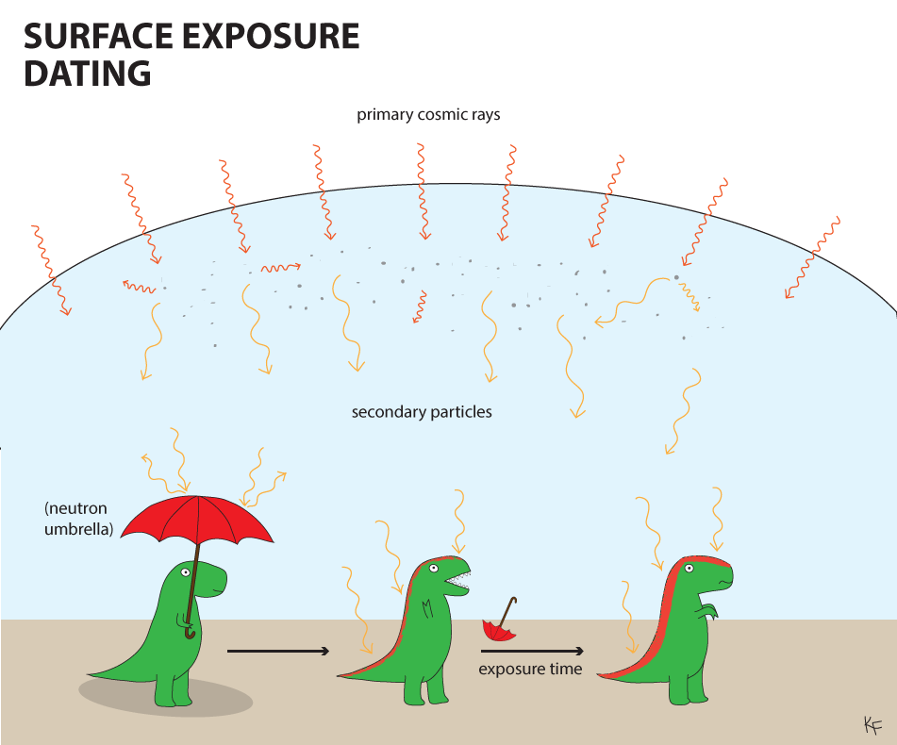
Nuclides are used to date rocks
https://dinotopes.files.wordpress.com/2015/03/surface-exposure-dating-copy.png

Slide 13
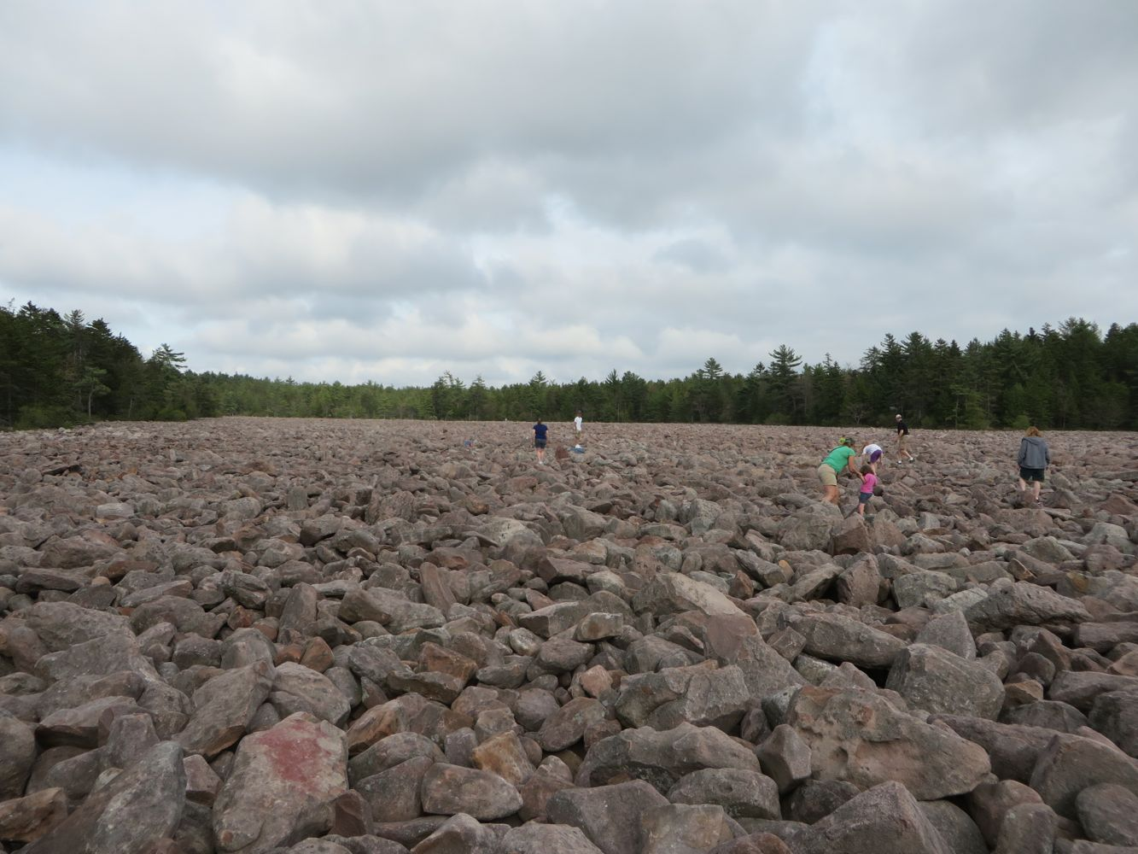
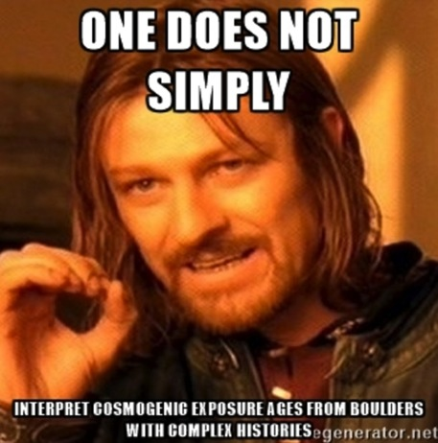
DATING AND ASSUMPTIONS
In order interpret ¹⁰Be concentration as an exact age I have to assume:
No erosion after exposure
No inheritance of ¹⁰Be at initial exposure
No intermittent shielding or complex exposure history (rolling, re-exposure, burial)

Slide 14
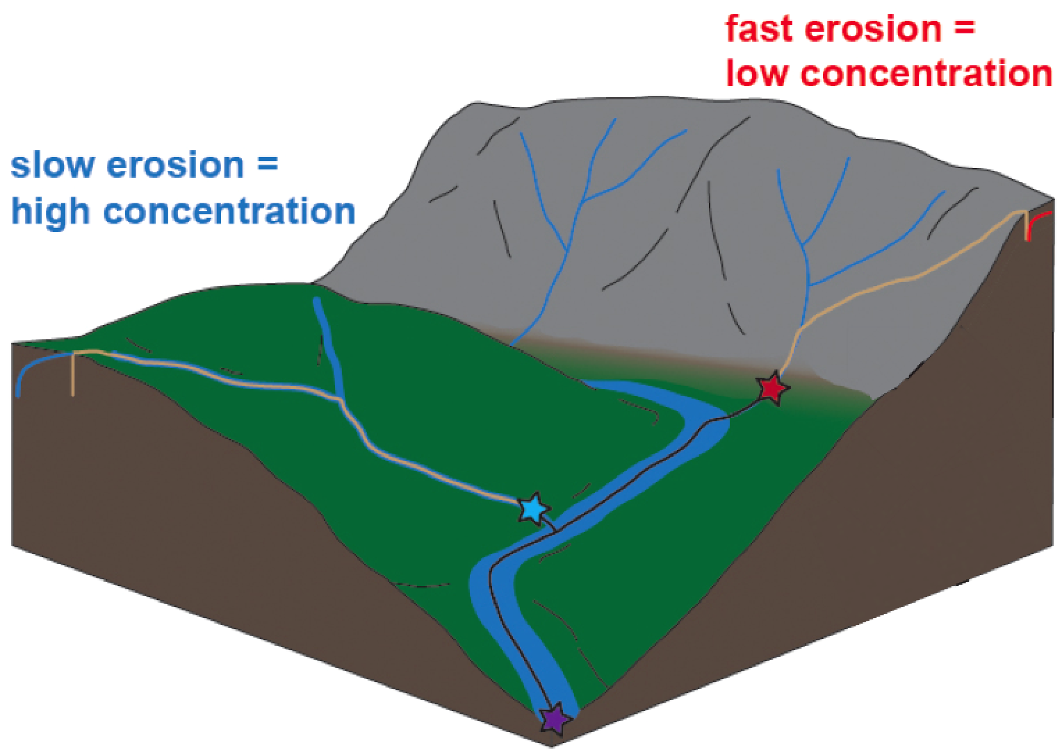
Nuclides are also used for erosion rates
https://www.google.com/url?sa=i&rct=j&q=&esrc=s&source=imgres&cd=&ved=0ahUKEwjk9eihi8XSAhWH7YMKHTOtAHMQjxwIAw&url=https%3A%2F%2Fgeomaps.wr.usgs.gov%2Fbigfoot%2Ftask5.html&psig=AFQjCNEqLjMGTAWB7y42MZUq01vG-DioAA&ust=1488999965917230
Ratio decreases when a sample is buried as ²⁶Al decays more rapidly.

Slide 15
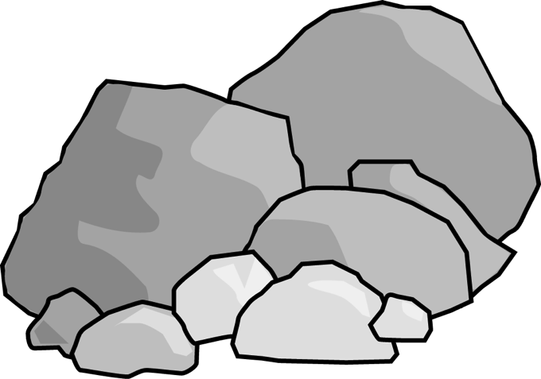
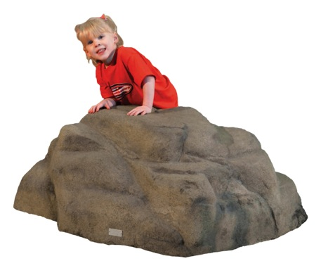
Two isotopes can be used together for ‘burial dating’
²⁶Al and ¹⁰Be accumulate at a rate of ~7:1 at the surface
When an object is buried the ratio drops, as ²⁶Al half life (7.2 x 10⁵) is shorter than ¹⁰Be half life (1.4 x 10⁶)
boulder exposed to cosmic rays
shielded from cosmic rays
boulder exposed at surface
boulder gets covered for thousands of years
²⁶Al:¹⁰Be = 7:1
²⁶Al:¹⁰Be << 7:1
https://img.clipartfox.com/b7bf79ad8228f8551d551ea62155fe3d_boulders-clip-art-boulder-clipart-free_984-690.svg
http://www.nicros.com/wp-content/uploads/2011/02/boulders-lil-buddy.jpg
Ratio decreases when a sample is buried as ²⁶Al decays more rapidly.

Slide 16
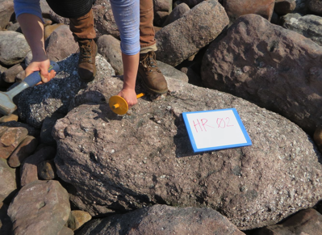
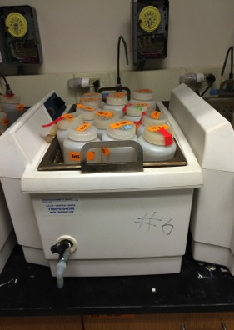
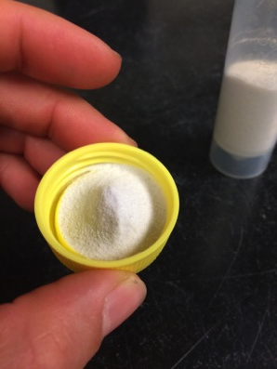
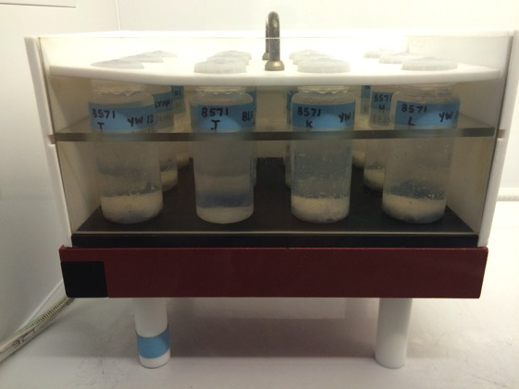
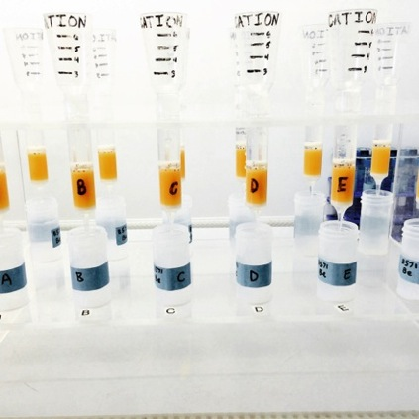
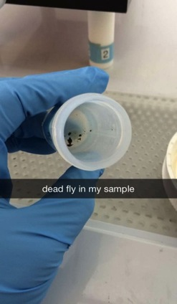
From rock to ¹⁰Be…
Find a sample, crush it, etch it, get it clean, dissolve it, get the gunk out, precipitate it, dry it, pack it, fly to CA, count atoms!

Slide 17
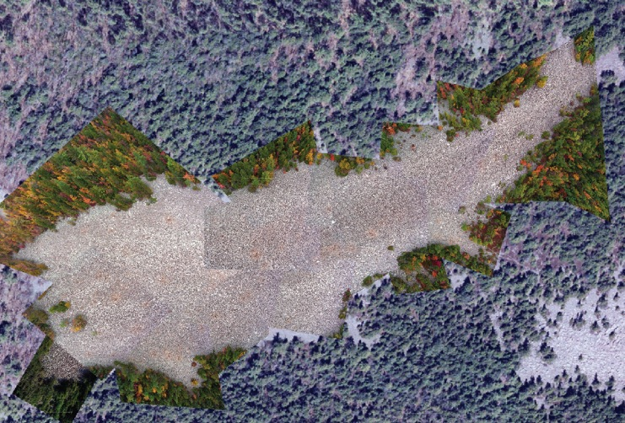
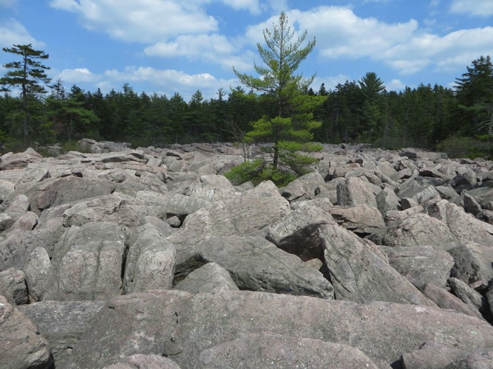
PROJECT 1: HICKORY RUN BOULDER FIELD

Slide 18
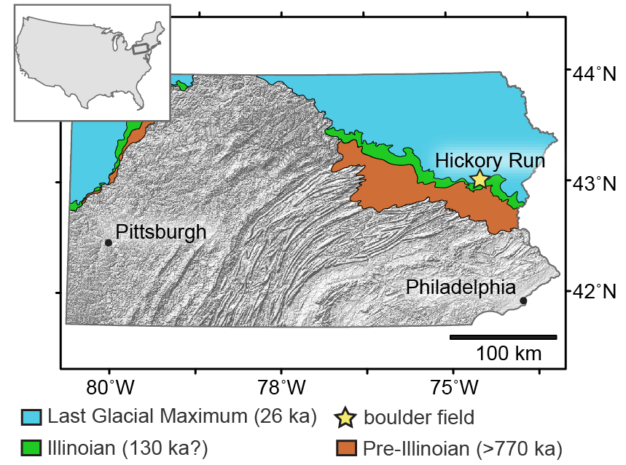

Slide 19
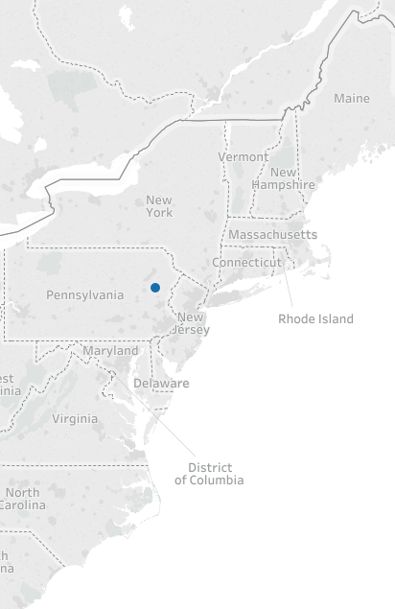
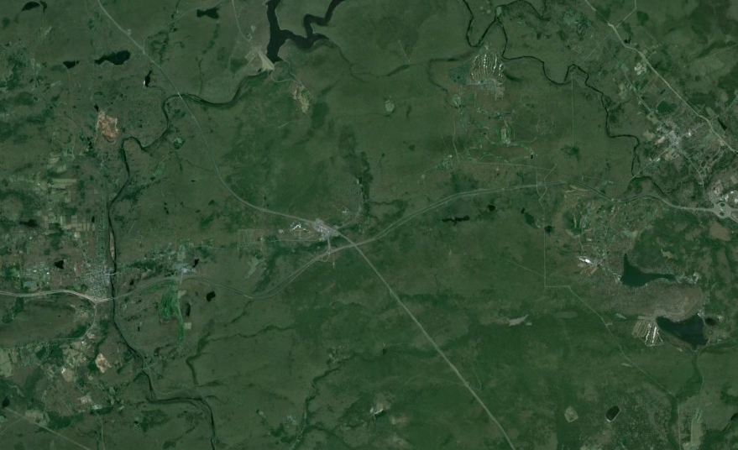
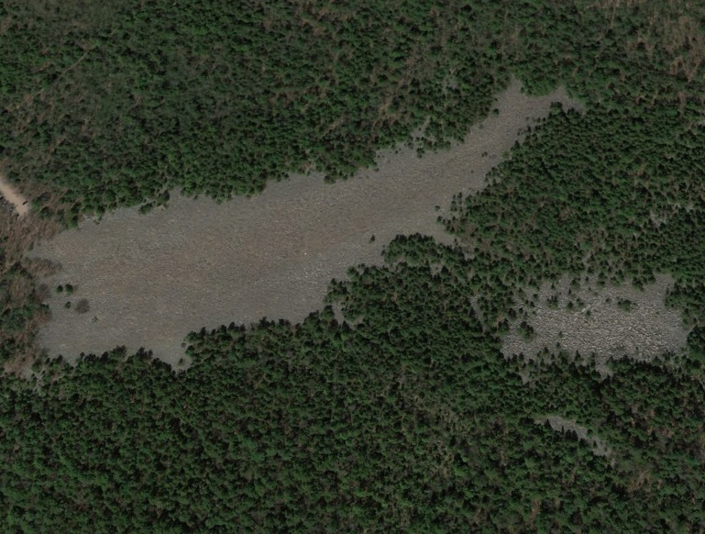
Last Glacial Maximum (Wisconsinan) Boundary
2km
LGM
550m

Slide 20
Notes:
ACCORDING TO PARK SIGNS 20 ka

Slide 21
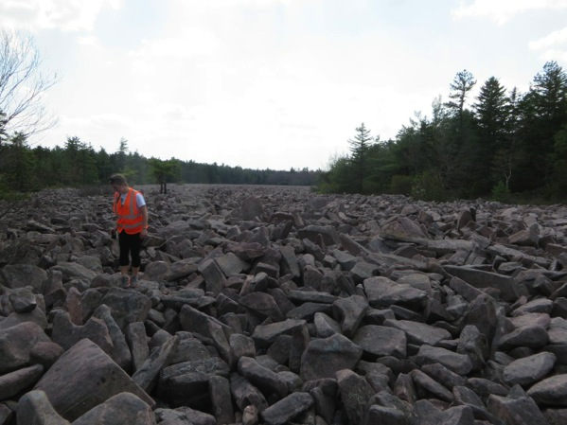
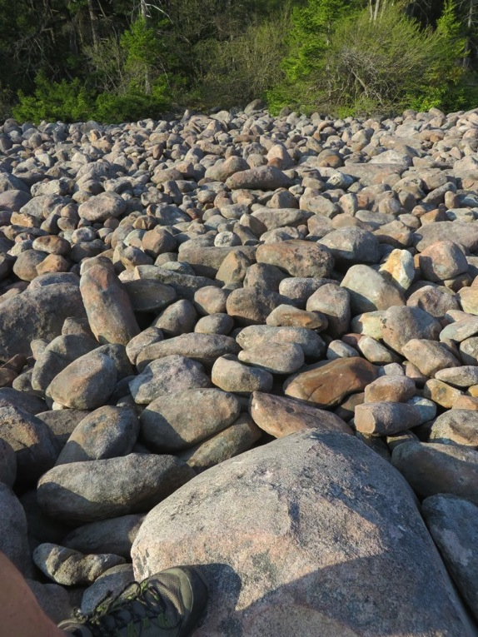
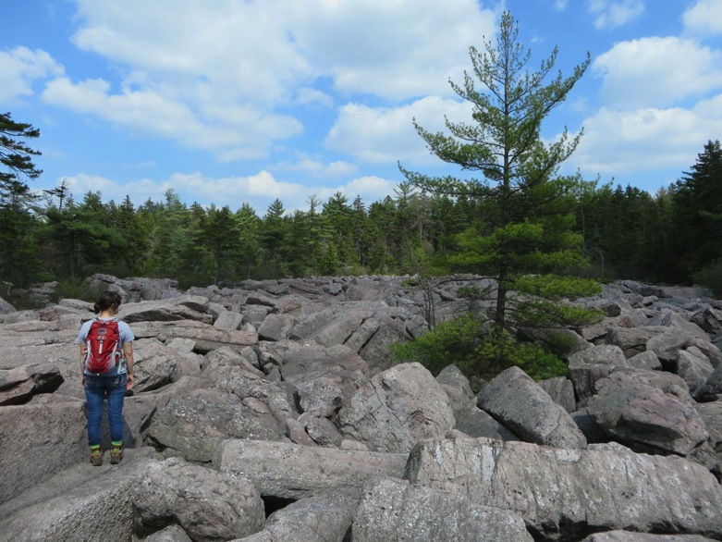
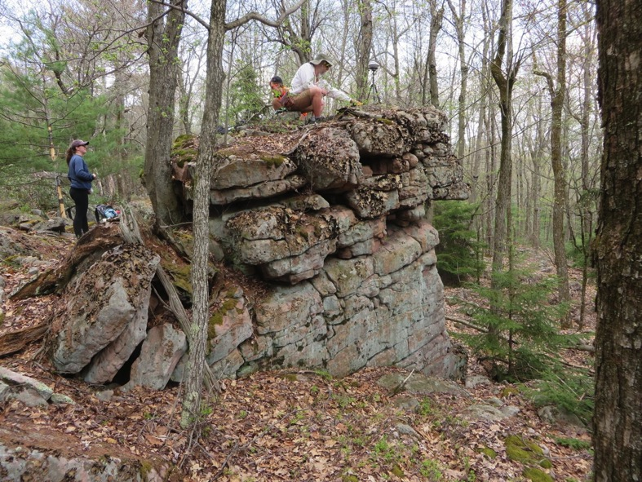
GUIDING QUESTIONS
How old is this thing really?!?
Spatial trends in ¹⁰Be?
Glean some idea of process?

Slide 22
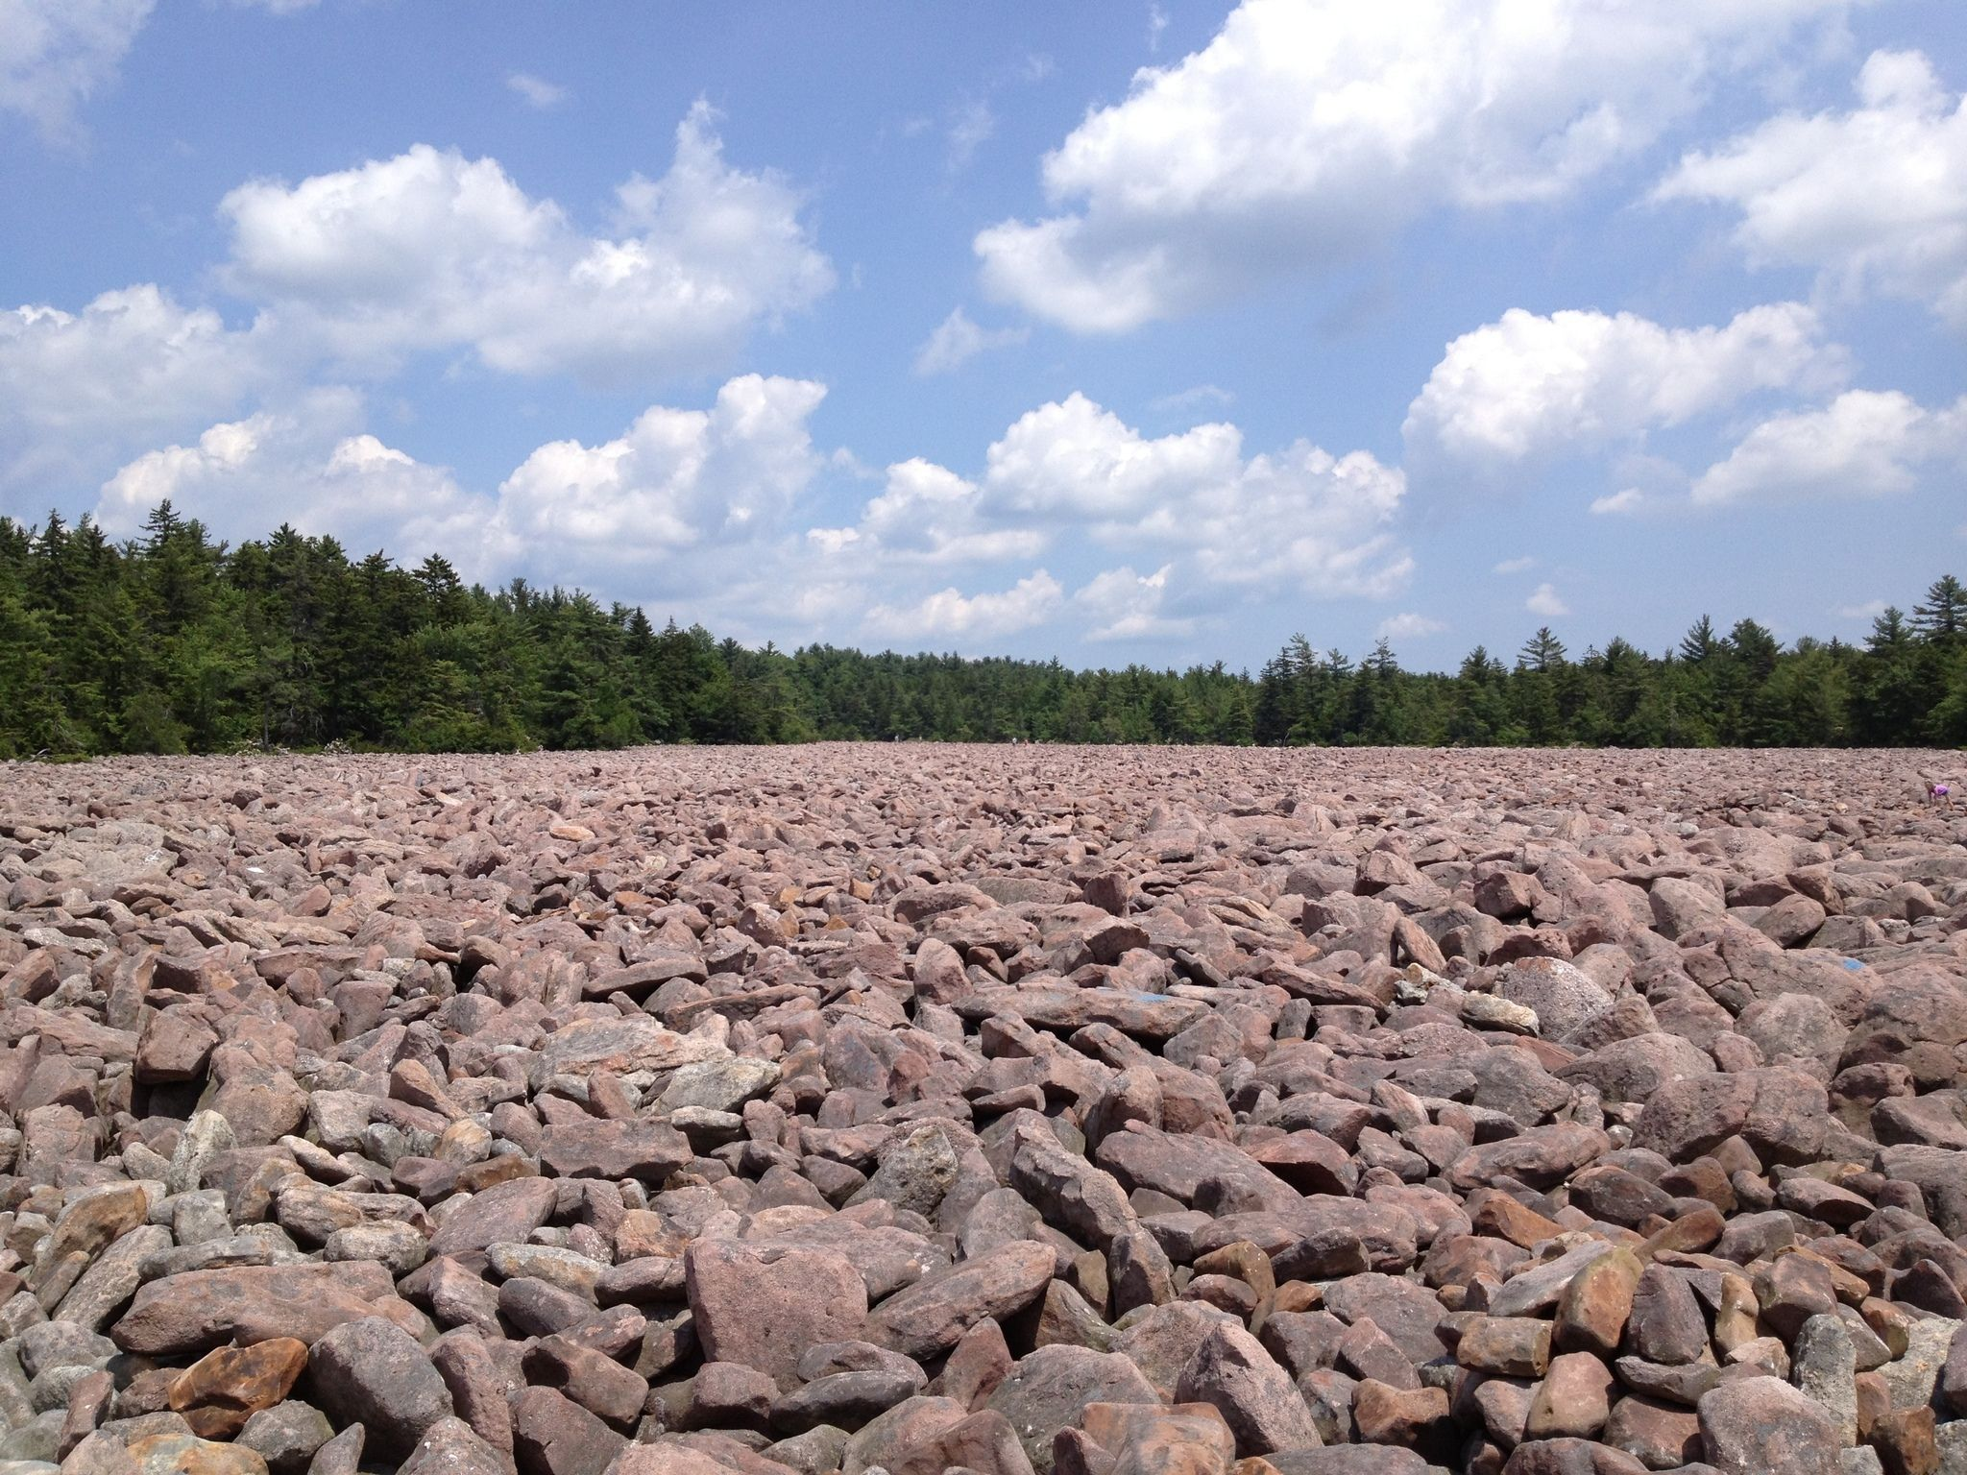
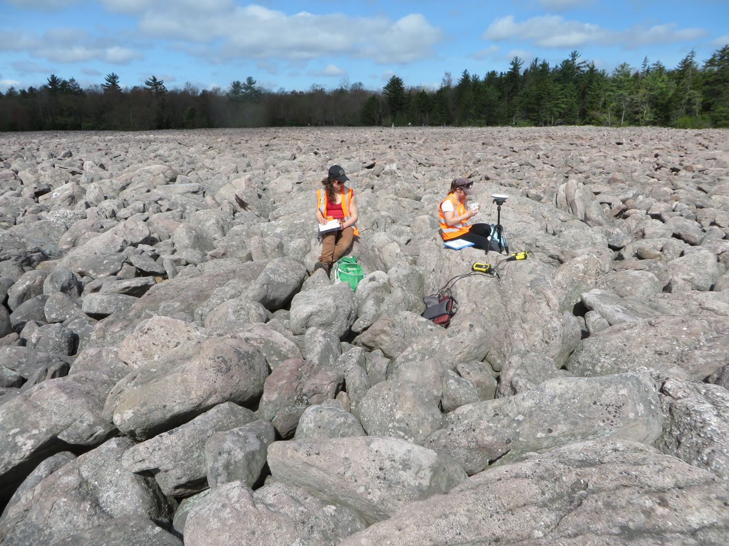
We sampled 52 boulders for in-situ ¹⁰Be analysis, and 20 for ²⁶Al

Slide 23
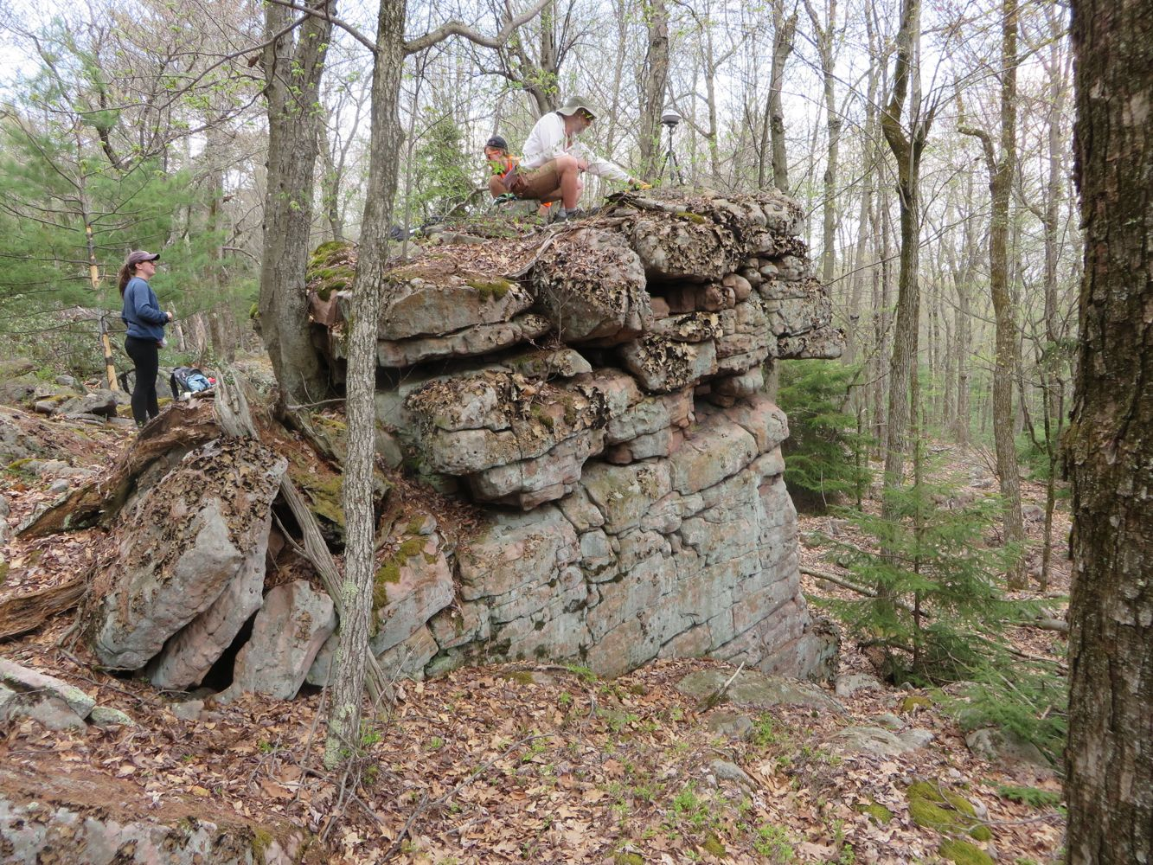
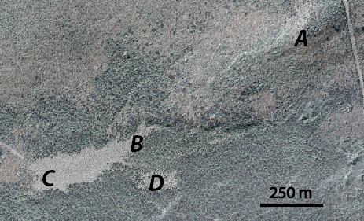
TORS (NE OF MAIN FIELD)

Slide 24
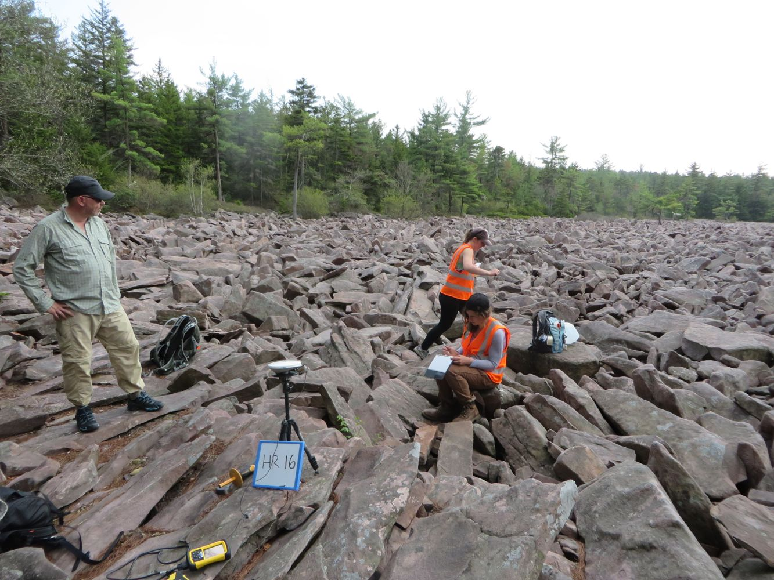
TOP OF FIELD (UPSLOPE)

Slide 25
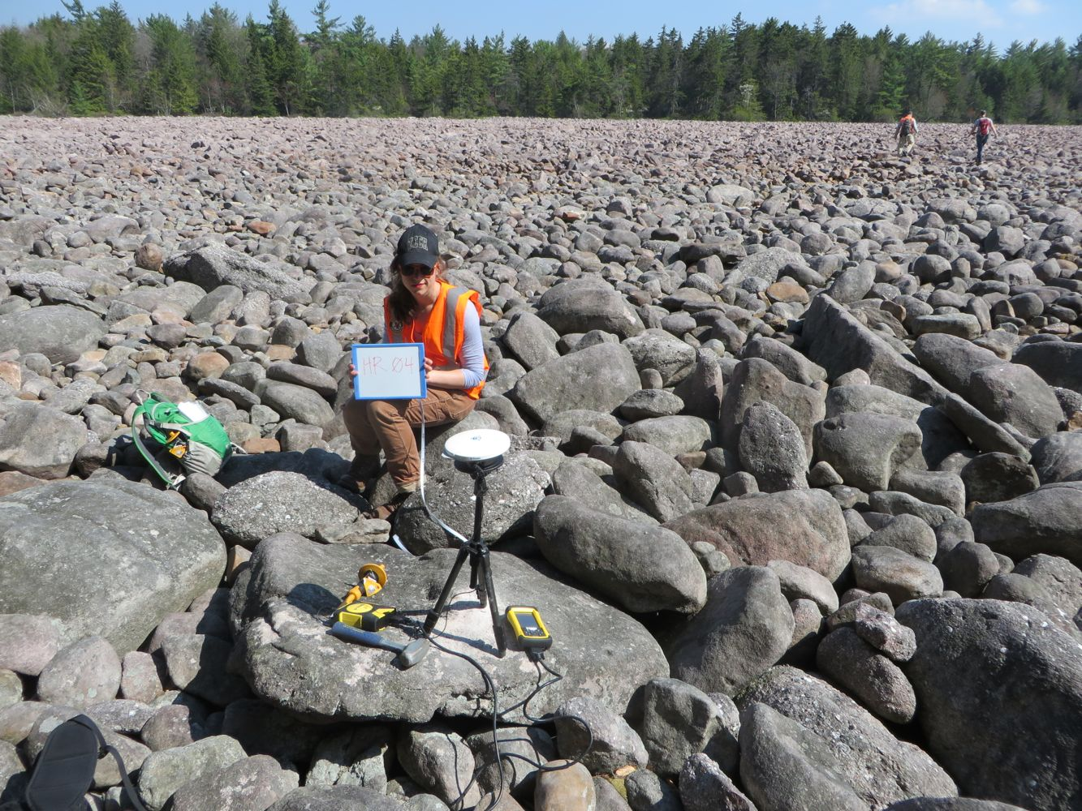
BOTTOM OF FIELD (DOWNSLOPE)

Slide 26
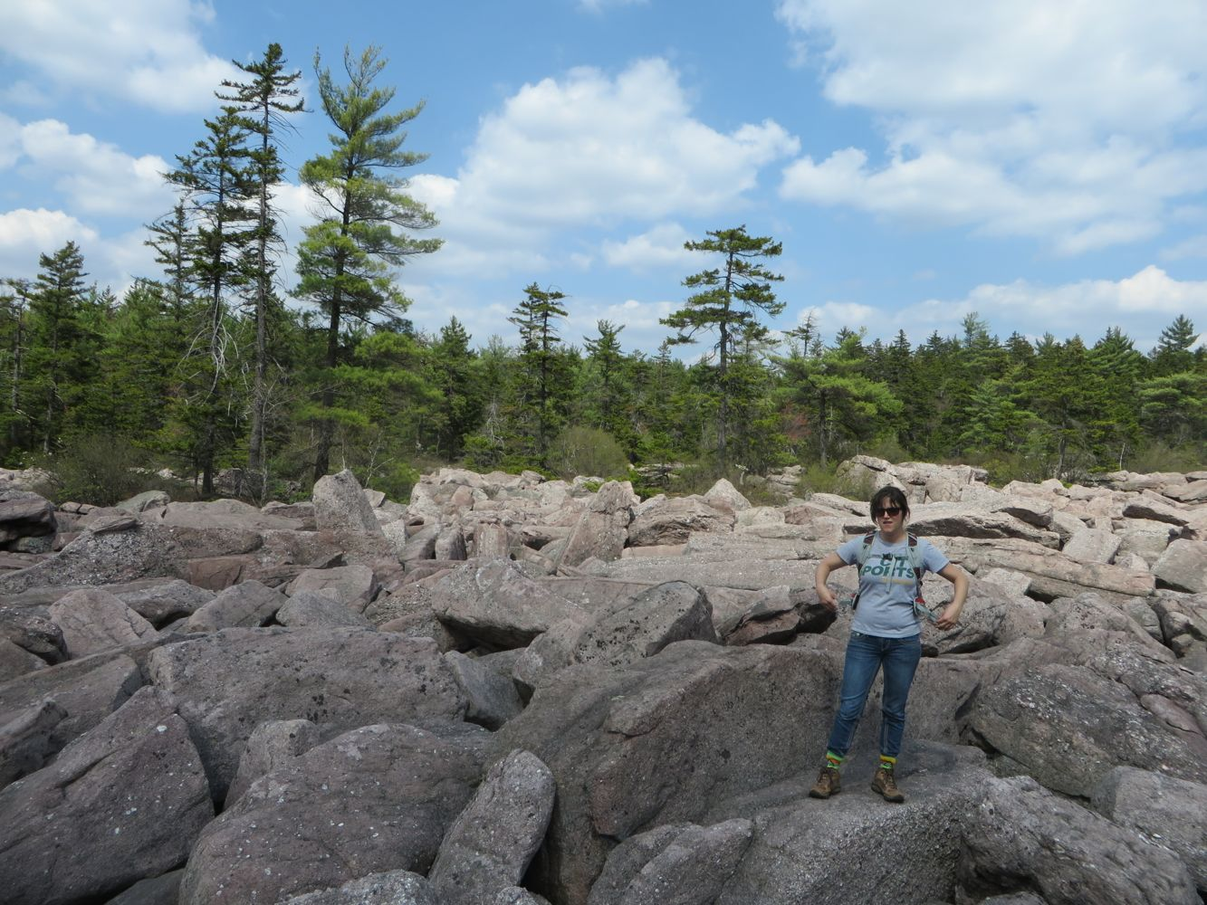
SUB-FIELD (SE OF MAIN FIELD)

Slide 27
Aerial View of Hickory Run

Slide 28
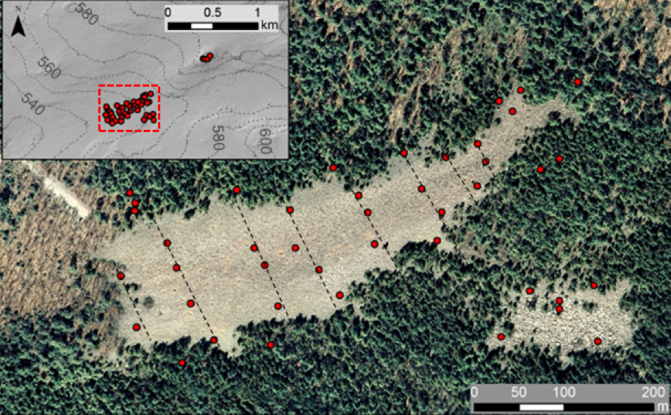
SAMPLING STRATEGY

Slide 29
Remember this!

Slide 30
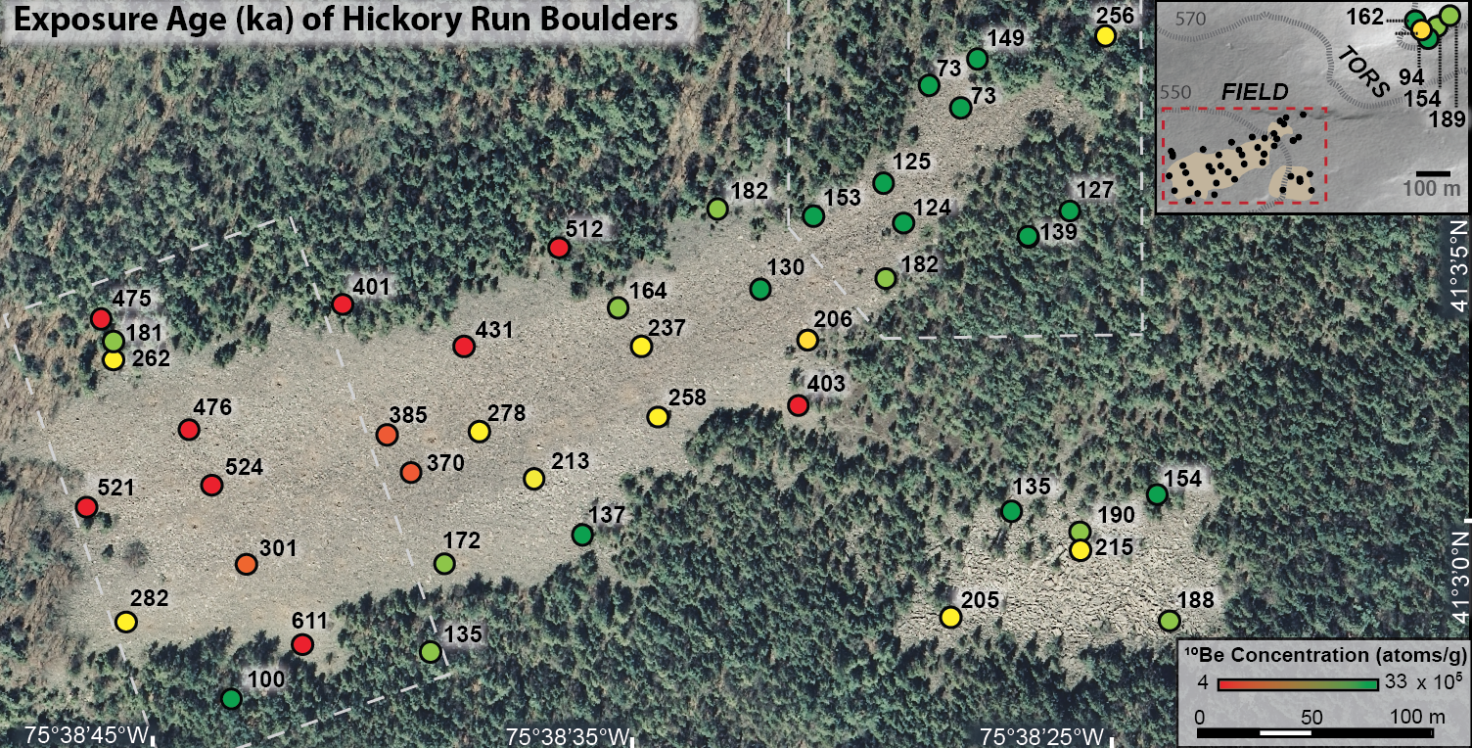
If I make many simplifying assumptions…
Minimum limiting ages of a half million years!
Notes:
No

Slide 31
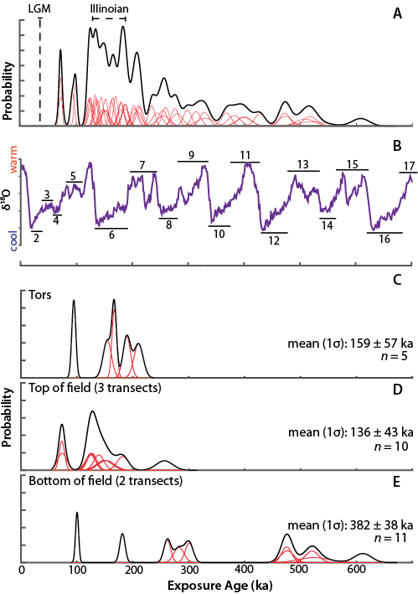
SPATIAL AND TEMPORAL TRENDS IN ¹⁰Be

Slide 32
Semivariogram
A second, perhaps more elegant, way to express spatial autocorrelation in boulder ages

Slide 33
Hickory Run boulders are dynamic. They flipping flip!

Slide 34
Two-isotope results: boulders are more or less indistinguishable from production ratio

Slide 35
WAIT WHAT
But the field was under ice at 130 ka? How can boulders be so old?!
Glacial mapping is wrong?
Cold-based, non-erosive ice?

Slide 36
HOLD UP
¹⁰Be increases downslope… why?
Boulders moved downslope
Frost-driven scarp retreat

Slide 37
Main Takeaways…
Periglacial boulder fields are ancient, dynamic, multigenerational features
No LGM ages; mode is MIS 6
Age of the ‘Illinoian’ in PA? Or cold-based (non-erosive) ice at 130 ka.

Slide 38
PART 2: YOUNG WOMANS CREEK
What are erosion rates like in a landscape adjusting to base level fall?

Slide 39
What exerts a stronger control on erosion: base level fall, or lithology?

Slide 40
Context: Miller et al. 2013 in Susquehanna River Basin (SRB)
Analyzed regional longitudinal profiles, compared them with previously measured cosmogenic erosion rates in the area
Detected wave of knickzones propagating upstream in response to past base level fall in the Miocene

Slide 41
Context: Miller et al. 2013 in Susquehanna River Basin (SRB)
Knickzones dictate erosion rates; higher erosion rates below knickzones regardless of lithology
Appear as sudden breaks on log slope/log area plots
We chose to intensively sample a watershed near Cooks Run (in purple)

Slide 42
Young Womans Creek Setting
Outside of glacial boundary
Gently folded Paleozoic sandstones
Supposed to be a lithologically ‘simple’, ‘uniform’ area
Notes:
230 km2 unglaciated watershed in the headwaters of the appalachian plateau province.

Slide 43
I took 17 fluvial sediment samples above and below stream junctions, across a range of subbasin slopes.

Slide 44
GIS/MATLAB ANALYSIS
2. extract and analyze channels
1. prepare elevation data
3. identify zones of incision

Slide 46
Young Womans Creek
Base level and lithology difficult to disentangle
Lithology exerts a control on erosion rate in small headwater catchments
‘Wave’ of incision stuck at top of watershed?
Knickzones propogate differently in nearby areas; drainage area dependence?

Slide 47
PART 3: GARNER RUN, SHALE HILLS CZO

Slide 48
PURPOSE OF GARNER RUN COSMO
Sandstone ridgelines common features
Does valley fill record history?
To measure ¹⁰Be concentrations in soil, rock, and fluvial sediment, and ²⁶Al in surface boulders and subsurface drill core samples.
To use fluvial sediments to estimate basin-wide erosion rate.
To estimate approximate residence time of regolith on Leading Ridge.

Slide 50
GARNER RUN SAMPLING STRATEGY
Notes:
4 types of samples. I collected 2 of these personally. JM will comment more on core data as she models, I present initial results?

Slide 51
amalgamated boulder transects

Slide 52
stream sediment collection
Notes:
Sieved 250-850um

Slide 53
REMEMBER THOSE DATING ASSUMPTIONS
No erosion after exposure
No inheritance at initial exposure
No intermittent shielding or complex exposure history (rolling, re-exposure, burial)
First, let’s talk in terms of concentration…
Notes:
In order to age.. No erosion, inheritance, no shielding, no complex history… ages are minimum total exposure ages. WE DON’T HAVE A CLUE

Slide 54
SOIL SAMPLES
Notes:
Large concentration on Tussey is counterintuitive

Slide 55
BOULDER TRANSECTS

Slide 56
STREAM SEDIMENTS

Slide 57
DRILL CORE WORK
Notes:
Not my main focus

Slide 58
IF WE MAKE A BUNCH OF ASSUMPTIONS THAT AREN’T NECESSARILY TRUE…
50,000 years?!
100,000 + years?!
Then ¹⁰Be concentrations represent effective exposure ages of ~50,000 years on LR and ~100,000+ on the valley floor
Notes:
In order to age.. No erosion, inheritance, no shielding, no complex history… ages are minimum total exposure ages. WE DON’T HAVE A CLUE

Slide 59
WHAT WE UNDERSTAND FROM GARNER RUN COSMO WORK
Garner run soils, stream seds, and rock have similar ¹⁰Be concentrations
Catchment erosion rate of ~7m/My
No LGM signal on ridgeline
This stuff has been kicking around for at least 100 ka!

Slide 60
Main takeaways:
Hickory Run is ancient despite LGM proximity
Garner Run and Hickory Run record 100,000+ years of exposure: preservation of landscapes through glacial cycles
No LGM signal anywhere?! Most dates 100-200 ka range
Erosion rates tend to be quite high (YWC) or low (HR, GR). Bimodal tendency…

Slide 61
Thanks!

Slide 62
Young Womans Creek Results
Erosion rates in trunks are representative of upstream
This plot is completely counterintuitive
Transition between ‘relict’ and ‘adjusted’ landscapes

